Slide 1
Supports for Remote Learners
Centre for Teaching and Learning
Queen’s University

Slide 2
This slide deck, compiled by Queen’s University’s Centre for Teaching and Learning, shares information and links about various campus supports for students and the role they play in enhancing your teaching and your students’ learning. Feel free to share selected information with your students and post the slides to your course website or within class presentations.

Slide 3
Campus Units
Four Directions Indigenous Student Centre
Student Academic Success Services (SASS)
Queen’s University International Centre (QUIC)
Student Wellness Services
Career Services
Experiential Learning Hub
Student Affairs – Support Services and Community Engagement
Queen’s Libraries
Please note—this is not a complete list of all student support organizations on campus! We’ve curated a short list to keep information overload to a minimum, but there are many additional organizations that are worth knowing about. The Division of Student Affairs and the AMS clubs listings are good follow-up sources.

Slide 4
Four Directions Indigenous Student Centre queensu.ca/fourdirections
Advising
Including financial, career, and academic.
Culturally relevant counselling and wellness programming.
Including individual and group counselling.
Tutoring
Cultural safety training
For campus partners and faculty
Cultural events and programs
Including beading, feasts, and fires.
Four Directions provides holistic support services for Indigenous students at Queen’s.

Slide 5
Student Academic Success Services (SASS) Website: sass.queensu.ca
Online resources on Academic Skills and Writing topics, including an Assignment Planner and resource about Working from home.
Workshops and Drop-in events.
Supports for students with English as an Additional Language, including appointments for academic English skills development.
Writing appointments and academic skills appointments currently held online and booked through an online booking system.
Student Academic Success Services (SASS) is the go-to for academic skills and writing support on campus that enhance students’ capacity to fulfill their learning goals and academic potential at Queen’s.

Slide 6
Queen’s University International Centre (QUIC) Website: quic.queensu.ca
Orientation resources and events for international students.
An International Student Guidebook.
International Student Advisors that provide transition guidance and information.
The English Conversation Program to assist students in developing spoken English.
Intercultural training for all students.
Information about adjusting to Canadian academics and about academic support.
The Queen’s University International Centre (QUIC) is a support service for all members of the Queen’s community and through its activities promotes an internationally informed and cross-culturally sensitive learning environment.

Slide 7
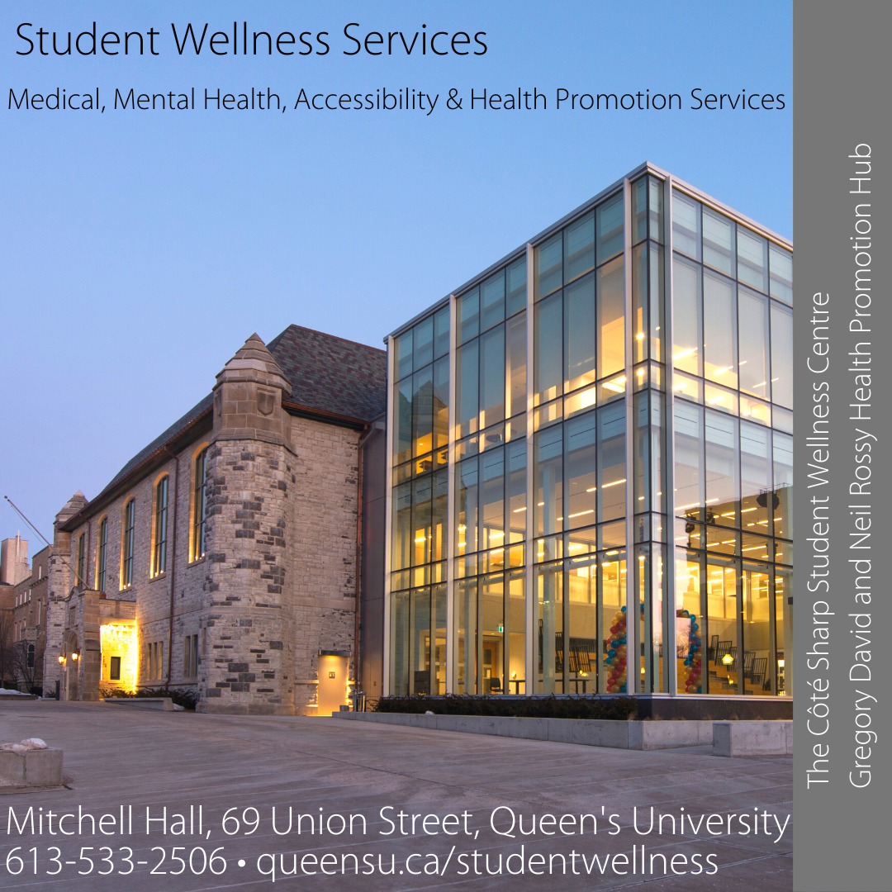
SWS services continue during COVID-19, visit our website for hours and updates. Same day appointments available.
Medical care appointments available with doctors, nurses and occupational therapists.
Mental health appointments, crisis support and specialized referrals
Professional and peer-led wellness groups, workshops and mental health trainings
Accommodations and supports for students with a disability provided by QSAS advisors
Healthy lifestyle and safer substance use appointments
Volunteer opportunities for students
https://www.queensu.ca/studentwellness/
Student Wellness Services works to provide a welcoming, confidential, and integrated service that is responsive to student health, wellness, and accessibility needs.

Slide 8
TAO’s online self-directed learning modules and resource library can be accessed by any student, staff or faculty.
Integrate TAO into your syllabus/course, for a unique wellness learning opportunity that can be personalized to meet the needs of your students. A specific program (with direct access code & tracking) can be created for your course, in collaboration with the SWS team. Contact healthed@queensu.ca

Slide 9
Career Services careers.queensu.ca
We can offer remote workshops to your class on a variety of career development topics through the Zoom platform. Read more about our offerings here: https://careers.queensu.ca/faculty-staff/career-help-your-students/request-career-workshop
Career Services offers remote support for students in the form of online workshops, drop-in advising, and counselling to answer questions related to major selection, career direction, job search & applications, and grad school – find out more at https://careers.queensu.ca/students
The Major Maps are a great resource to directs students towards to get them thinking about their degree selection, career options, and ways to build experience at Queen’s, along with the customizable blank MyMajorMap that students can use to make their own maps at https://careers.queensu.ca/students/wondering-about-career-options/major-maps
At Career Services, we help students explore all kinds of career questions. We work with currently-registered Queen's students (and recent grads) from first year through to PhD in any program.

Slide 10
Experiential Learning Hub queensu.ca/ experientiallearninghub
For students, we can offer remote workshops to your class with an experiential learning component
Setting Goals for Skills Development in EL
Professional Communications
Working Remotely
Reflection & Skill Articulation
For faculty, we offer consultations and tools to support the design and delivery of experiential learning
EL Faculty Toolkit
Supervising Students Remotely workshop
Contact el.hub@queensu.ca
The Experiential Learning Hub (EL Hub) is a “front door” to experiential learning at Queen's University. We offer consultations, workshops, and tools on experiential learning for both course instructors and students.

Slide 11
Your unit’s name, website and logo
Providing guidance and support to faculty around classroom behaviours, student concerns and non-academic policies
Early Alert program: CARE – online secure system used for supporting students in need (non-emergency)
Help with navigating the Non-Academic Misconduct System
Case management for Students at Risk
Green folder: Identifying and Responding to Students in Distress
Contact: supportservices@queensu.ca
Supporting faculty, staff and students, on and off-campus, by connecting them to available resources, assisting with student concerns and developing policies for better and safer student engagement.
Unit overseen by Assistant Dean Lindsay Winger, Student Affairs

Slide 12
Queen’s University Library library.queensu.ca
The Library stimulates excellence in research and scholarship through its collections, people, partnerships and services, and its physical and virtual environments.
Librarians will help undergraduate and graduate students develop research skills by:
Creating discipline-specific learning objects, tutorials, and guides based on information literacy needs that include finding, evaluating, interpreting, managing, and using information to answer questions and develop new knowledge.
Delivering skills-based class instruction, in person or remotely, to suit course assignments and learning outcomes.
Offering consultations for research help.
Contributing to the assessment of research skills through rubrics, (e.g. Journal Literature Search Strategy Rubric), quizzes, or assignments.

Slide 13
Queen’s University Library library.queensu.ca
We make teaching resources available by:
Providing course materials through our Course Reserves/eReserves service
Assisting instructors in adapting and/or building your own Open Education Resources
Assisting with creating accessible course materials for students with disabilities.
Identifying and purchasing information resources
Providing Research by Subject and Research by Course guides
Providing online tutorials (e.g. Sociology 122 Library Research Tutorial, Engineering Design and Practice)
Providing guides to Types of Information (e.g. Books Reviews, Government Information, Newspapers, Videos)

