Slide 1

Cytotoxic evaluation of the novel IGF1R CAR-T cell against solid tumors
Ryunosuke Ohno^{1,2}, Wataru Kawahara¹, Manaka Shinagawa¹, Shuji Mishima¹,
Yuta Maruyama¹, Aiko Hasegawa¹, Miyuki Tanaka¹, Koichi Hirabayashi¹, Yozo Nakazawa¹
1. Shinshu University, 2. Queen’s University

Slide 2

Disclosure of COI
Authors: Ryunosuke Ohno, Wataru Kawahara, Manaka Shinagawa, Shuji Mishima,
Yuta Maruyama, Aiko Hasegawa, Miyuki Tanaka, Koichi Hirabayashi, Yozo Nakazawa
Matters requiring disclosure of COI with regard to our presentation
during the past 3 years are as follows;
① Advisor： A-SEEDS Co., Ltd. (Y. Nakazawa)
② Stock ownership/capital gain： A-SEEDS Co., Ltd. (Y. Nakazawa)
③ Patent royalties：
④ Honoraria：
⑤ Writing fees：
⑥ Grants for commissioned/joint research： (Y. Nakazawa)
BrightPath Biotherapeutics Co., Ltd. / AGC Inc. / Daiichi Sankyo Co. Ltd.
Noile-Immune Biotech Inc. / TOASHIBA Corp. / BOURBON Corp. / NIPRO Corp.
⑦ Scholarship grants：
⑧ Endowed chair：
⑨ Gifts or other forms of compensation：

Slide 3
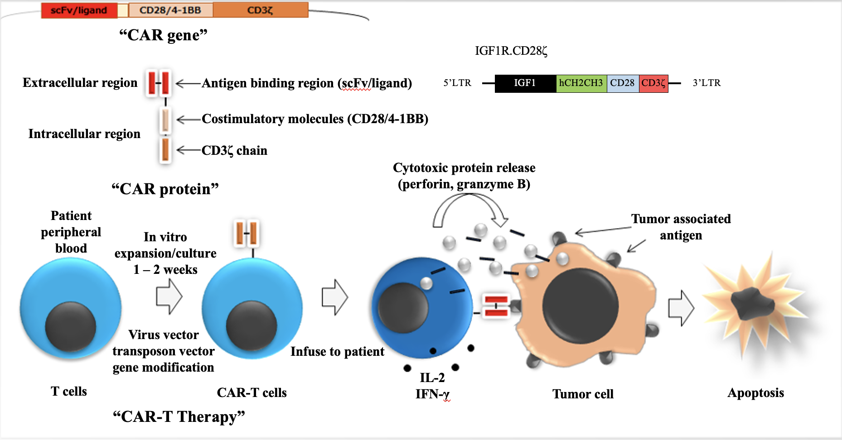
CAR-T Cell Therapy
CD-19 CAR-T cell against B cell tumor:
  2019: tisagenlecleucel approved
  2021: axicabtagene ciloleucel approved
  2021: lisocabtagene maraleucel approved
  2021: brexucabtagene autoleucel FDA approved
BCMA CAR-T cell against multiple myeloma:
  2021: idecabtagene vicleucel approved
  2022: ciltacabtageneautoleucel FDA approved
No approved CAR-T cell therapy against solid tumors

Slide 4
Target antigen design background
Insulin-like growth factor-1 receptor (IGF1R)
  Receptor tyrosine kinase that belongs to the insulin receptor family
  Associated with signaling pathways that regulate cell proliferation, differentiation, metabolism and survival
  Highly expressed in various carcinomas and expressed at low levels in healthy cells
  Associated with cancer progression and poor prognosis
IGF1R is an ideal target for cancer therapy
  None have been put into practical use
  A new modality is necessary
Simpson S, et al. Targ Oncol. 2017

Slide 5
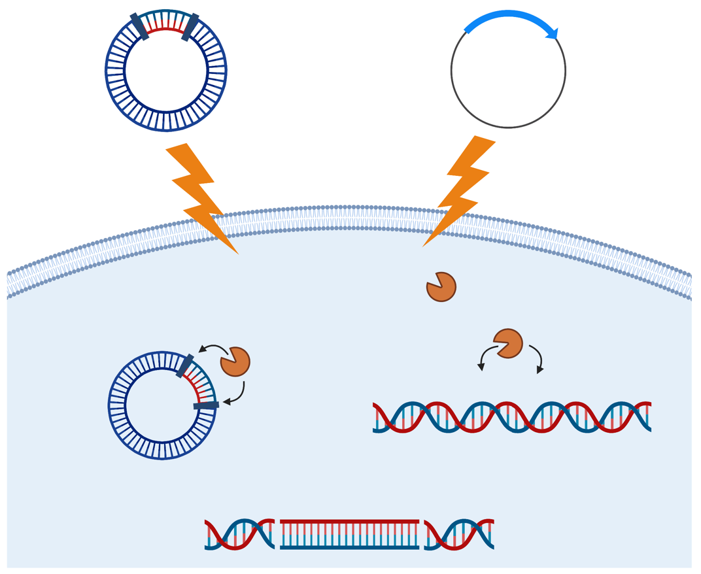
Non-viral genetically modified CAR-T cells
CAR transgene
plasmid
piggyBac transposase
plasmid
PiggyBac transposon based gene transfer
  Enables the expression and targeting of a specific antigen
  Nonviral integrating vector
  Enables the integration of the CAR gene into the T cell genome
  “Cut and paste” mechanism called transposition
Gene transfer by
electroporation
piggyBac
transposase
piggyBac
transposase

Slide 6
Optimization of the ligand-base CAR design technique
IGF1R CAR (1767bp)
We have developed a ligand-base CAR design technique rather than the conventional single chain antibody (scFV) based CAR-T cells
  Using the ligand (IGF-1) for the CAR antigen region resulted in unfavorable results
  Using the ligand precursor for the CAR antigen region preserved CAR expression, and hence eliciting cytotoxic effects against tumors expressing IGF1R
IGF-1 precursor
spacer
CD28
CD3zeta
SV40
poly A
CMV IE
promoter
5’ IR
3’ IR
pIRII-CAR.IGF1R.28.z
6117bp
AmpR

Slide 7
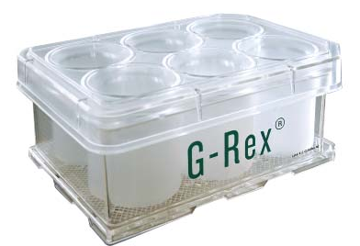
Manufacturing IGF1R CAR-T cells
Day 0
Day 14
Electroporation
Stimulation
Harvest
IR
CMV
Cell expansion using a container (G-Rex) with high gas permeability
pIRII-IGF1RCAR
IR
pIRII-IGF1R CAR
CMV
piggyBac
pCMV-piggyBac
Electroporation via utilizing 4D-NucleofectorTM
IL-7/15
IL-7/15
PBMNC
IGF1R CAR-T cells

Slide 8
CAR expression rate and cell count
A: CAR Expression (%)
B: CAR-T cell numbers
100
180
80
150
65.5%
120
60
T cell number (×10⁶ cells)
Percentage of CAR
90
40
60
20
30
0
0
0
3
7
14
（N＝5）
Days after transduction
（N＝4）

Slide 9
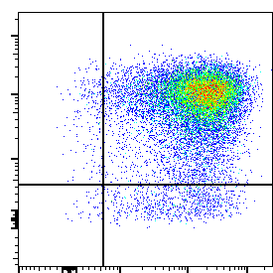
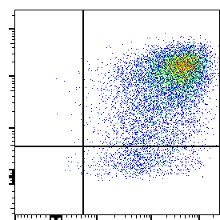
Manufactured CAR-T cell phenotype
A: Typical flow cytometry plot
B: CD4, CD8 memory phenotype
100
CD4+CAR+
CD8+CAR+
CD4
Central memory
Naïve
80
CD8
60
% of positive cells
CD62L
40
Effector memory
Effector
20
CD45RA
（N＝4）
0
Naïve
Effector
Naïve
Central memory
Effector
Effector memory
Central memory
Effector memory

Slide 10
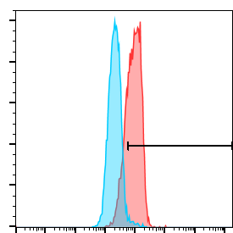
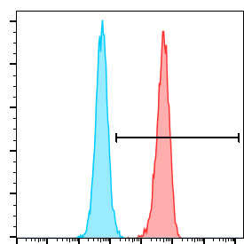
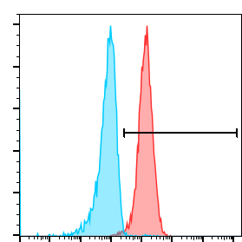
IGF1R expression on target
MX-1 (Breast cancer)
H1568
(Adenocarcinoma of the lung)
ARK-1 (Endometrial cancer)
72.9%
100%
98.8%
IGF1R

Slide 11
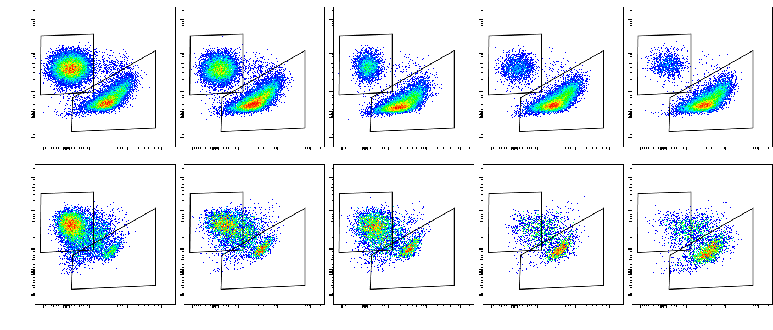
Result: Cytotoxic activity against MX-1
B: Tumor cell count
5
)
6
5
A: Typical flow cytometry plot
4
3
2
Tumor cell number (×10
1
1
4:1
2:1
1:1
1:2
1:4
0
（N＝5）
ATC
4:1
2:1
1:1
1:2
1:4
ATC
IGF1R
C: T-cell count
)
40
IGF1R
5
30
CD3
20
10
B7-H3
5
T cell number (×10
5
0
（N＝5）
4:1
2:1
1:1
1:2
1:4
ATC
IGF1R

Slide 12
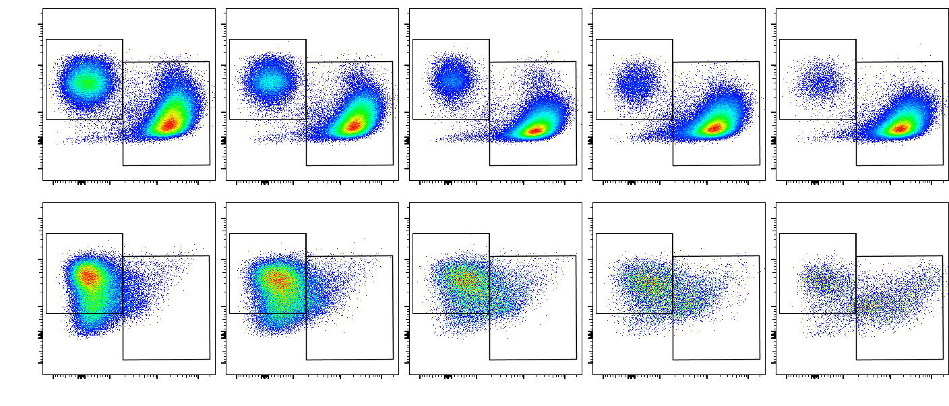
Result: Cytotoxic activity against H1568
B: Tumor cell count
5
)
15
A: Typical flow cytometry plot
12
9
Tumor cell number (×10
4:1
2:1
1:1
1:2
1:4
6
3
0
（N＝5）
ATC
4:1
2:1
1:1
1:2
1:4
ATC
IGF1R
C: T-cell count
IGF1R
)
12
CD3
6
9
6
B7-H3
3
3
T cell number (×10
0
（N＝5）
4:1
2:1
1:1
1:2
1:4
ATC
IGF1R

Slide 13
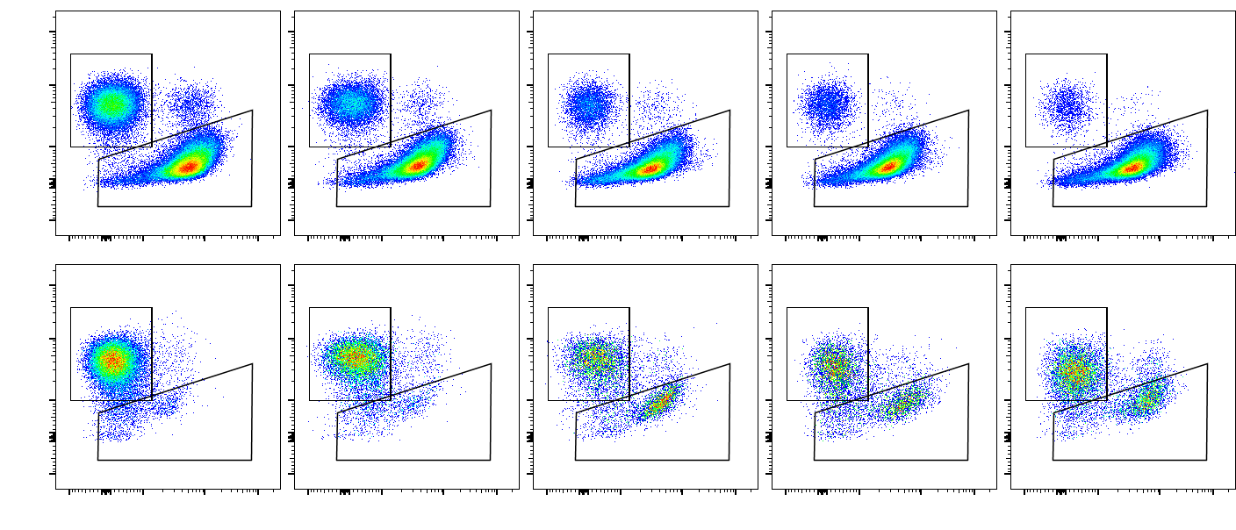
Result: Cytotoxic activity against ARK-1
B: Tumor cell count
5
)
8
7
A: Typical flow cytometry plot
6
5
Tumor cell number (×10
4
4:1
2:1
1:1
1:2
1:4
3
2
1
（N＝5）
ATC
0
4:1
2:1
1:1
1:2
1:4
ATC
IGF1R
C: T-cell count
IGF1R
)
8
CD3
5
6
4
2
B7-H3
1.5
T cell number (×10
1
0.5
0
（N＝5）
4:1
2:1
1:1
1:2
1:4
ATC
IGF1R

Slide 14
Cytokine release
IFN-γ
IL-2
800
9
600
6
400
3
200
0.2
50
IFN-γ (×10³ pg/ml/2×10⁵ cells)
IL-2 (pg/ml/2×10⁵ cells)
0.2
50
0
（N＝5）
0
（N＝5）
MX-1
H1568
ARK-1
MX-1
H1568
ARK-1
ATC
IGF1R
ATC
IGF1R

Slide 15
Summary & Conclusion
Successful establishment of the IGF1R-specific CAR-T cells using PiggyBac transposon method
Manufactured CAR-T cells showed a high average of 65.5% CAR expression and high levels of immature stem cell memory fraction
IGF1R CAR-T cells demonstrated specific anti-tumor activity against MX1, H1658, and ARK-1
Moving forward…
  Further improve the anti-tumor effects
  Evaluate the in vivo anti-tumor effects

