Slide 1


Information Session for Administrators:
Highlights of Renewed Collective Agreement between Queen’s University and PSAC Local 901 Unit 1 (2024-2027)
Michael Villeneuve, Director, Faculty Relations Office
Catarina Bridges, Senior Labour Relations Advisor, Faculty Relations Office
Lynnette Purda, Interim Dean, Smith School of Business
Chris DeLuca, Associate Dean, School of Graduate Studies
Sharon Regan, Acting Associate Dean (Research), Faculty of Arts and Science

Slide 2

Land Acknowledgement
Notes:
MV

Slide 3
Table of Contents
Overview
Outline of Amendments to Provisions
Article 7 (Correspondence and Information) - For Information Purposes Only
Article 5 (Union Representation & Activities)
Article 12 (Appointments)
Article 16 (Hours of Work)
Article 23 (Leaves)
Accommodation & Equity
Teaching Assistant Form
Changes to Wages & Benefits
Questions & Answers

Slide 4
1. Overview
The University and the Union first exchanged proposals on November 18th, 2024. The negotiated changes to the collective agreement were then ratified on April 24th, 2025.
A track changes version of the renewed collective agreement will be posted on the Faculty Relations website, along with a clean version, which will be posted shortly. This version will be the “official copy.”
Go to the tab
Select “Collective Agreements” in the drop-down menu
Click on the 2024-2027 Queen’s University – PSAC 901 Unit 1 Collective Agreements - *New
Disclaimer- This presentation is not intended as a substitute for the language of the Collective Agreement. Reliance should only be placed on the actual text of the "official copy" of the collective agreement.
Notes:
Michael V.

Slide 5
For Information Purposes Only
Article 7.03 & 7.04 - Correspondence and Information (Reporting)
The University will continue its obligation to provide two (2) Employee lists, three (3) times a year.
1st Key Change – The University is now required to provide the initial list five (5) Calendar Days prior to the beginning of each Academic Term. Previously, seven (7) Calendar Days
This list could include prospective Employees if their appointment commences in the Term for which the list is provided.
2nd Key Change – The inclusion of the “Preferred Name” category in both lists.
1st List | 2nd List
Now provided 5 days prior to the Start of Term | Provided within 21 calendar days of the Start of Term
Shall Contain: | Shall Contain:
Employee Name Preferred Name (New) Employee email address (if available) Faculty of Department | Employee ID, Name , Preferred name (New), Gender, Date of hire, Ending date, Faculty or department of work, Position title, Hourly wages where applicable, Monthly hours of work, Home address, Employee email address, Telephone numbers (if applicable) and whether the Employee is a temporary resident.
Notes:
Michael V.

Slide 6

Article 5 – Union Representation & Activities
Union Attendance at Employment Orientation Sessions - Article 5.07 b)
The Employer shall make every reasonable effort to invite the Union as soon as possible, but no less than one (1) week prior to all TA, TF and RA employment orientation sessions.
The Union is now entitled to up to 30 minutes to provide an overview of their role.
New Unpaid Leave of Absence - Article 5.08
The President or designate elected to the Local Union Executive shall be entitled to request an unpaid Leave of Absence from their Program of Study to a maximum of one (1) year. Such requests shall not be unreasonably denied. The President or designate shall remain a member of the Bargaining Unit.
Faculties/Departments must invite union representatives to employee orientation sessions as soon as possible, but no less than one week in advance.
Union President or designate is entitled to one (1) Unpaid Leave of Absence from their Program of Study.
Notes:
Michael V.

Slide 7
Article 12 - Appointments
Overview of Changes to Appointment Groups
Parties agreed only to amend criteria under Groups A, B and C
Group A* | Group B* | Group C* | Group D | Group E
Qualified graduate student | Qualified full-time graduate student | Qualified graduate student | Qualified graduate student | Qualified graduate student
For whom TAship is granted as part of the funding commitment | For whom there is no funding commitment (all unfunded years) | For whom TAship will not form part of the funding commitment | Previously held a TAship or TFship for the Employer. | Have not met the criteria as set out in 12.04 A, B, C, or D.
In the Department, Program or Faculty in which TAship is offered; or | In the Department, Program or Faculty in which TAship is offered | In the Department, Program or Faculty in which TAship is offered
In an interdisciplinary program without TA budget resources | In an interdisciplinary program without TA budget resources | In an interdisciplinary program without TA budget resources

Slide 8
Article 12 - Appointments
Continuation of Overview of Changes to Appointment Groups.
Groups A, B, and C are now expanded to all those qualified within the Faculty.
Group B is no longer limited to include only those in the first unfunded year; this group now includes all unfunded years.
Group B only includes graduate students registered with full-time status.
Notes:
Catarina B.

Slide 9
Articles 12 & 16 – Hours of Work
Removal of maximum hours for TAs and RAs in Article 12.02
New language in Article 16.02 as follows: “Normally, the maximum number of hours of work for any TA and RA , regardless of the number of TAships or Raships the Employee holds, is no more than an average of ten (10) hours per week. There will be no consequences for a TA who declines hours in excess of the normal maximum number of hours of work.”
The parties have agreed to some flexibility in the assignment of hours.
However, TAs and RAs reserve the right to decline hours above the normal maximum.
Notes:
Chris

Slide 10
Article 16 – Revised TA Appointment Process
Step 1
Five (5) days before the Academic Term, send Section A completed or an email communication with all of the fields in Section A of the Teaching Assistant Form (TAF).
Step 2
Within two (2) business days of the communication in Step 1, the TA is required to respond with the information required to complete the E-Contract.
Step 3
The Employment Supervisor will communicate or meet with the TA to jointly complete the TAF. The completed TAF will be signed off by both parties (TA and Employee Supervisor) and sent to all parties copied on the form no later than two (2) business days prior to the fifteenth of the month. TAF should be signed prior to the E-Contract.
Step 4
At the same time, advise the TA of the information required to create the E-Contract.
The finalized E-Contract will be signed by the TA no later than the fifteen (15th) of the month.
Notes:
Catarina B.

Slide 11
Article 16 – Revised TA Appointment Process Comparison
Old Process | New Process
By no later than the Tuesday prior to the Academic Term, the Employer will send Section A completed. At the same time, advise the TA of the information required to create the E-Contract. | Five (5) days before the Academic Term, send Section A completed or an email communication with all of the fields in Section A. At the same time, advise the TA of the information required to create the E-Contract.
No later than the Thursday prior to the Academic Term, the TA is required to respond with the information required to complete the E-Contract. | Within two (2) business days of receipt of the communication of Section A information, the TA is required to respond with the information required to complete the E-Contract.
If the TA provides the proper information in a timely fashion, the Employer will complete the E-Contract and send it to the TA by no later than the first Monday of the Academic Term. The TA shall sign the E-Contract immediately upon request. | The finalized E-Contract will be signed by the TA no later than the fifteen (15th) of the month. The TA shall sign the E-Contract immediately upon request.
No later than the second week of the Academic Term, the Supervisor and TA shall review Section B of the TAF. By the end of the second week of the Academic Term, the completed TAF shall be signed. The TA shall be provided a copy of the signed TAF. | The Employment Supervisor will communicate or meet with the TA to jointly complete the TAF. The completed TAF will be signed off by both parties (TA and Employee Supervisor) and sent to all parties copied on the form no later than two (2) business days prior to the fifteenth of the month. *TAF should be signed prior to the E-Contract.
Notes:
Catarina B.

Slide 12
Article 16 – Revised TA Appointment Process Timeline
TA provides the required information to complete E-Contract
TA shall sign the E-Contract immediately upon receipt. No later than the 15th of the month.
Grad Student Submits Course Preference
START OF ACADEMIC TERM
(September 1st, January 1st, May 1st)
Posting 22 Days Before
15 Days Before
5 Days Before
Within Two Business Days
Two Business Days Prior to the 15th of the Month
15th of the Month (Payroll Deadline)
Send TA copy of the TA form with Section A completed or communication with details. Inform the TA of the information required to create the E-Contract
The Employment Supervisor and TA shall review and complete the TA form. Prior to signing the E-Contract, the completed TAF should be signed
Notes:
Catarina B.

Slide 13

Article 16 – Hours of Work
Articles 16.07 f) and 16.08 d) Mid-Point Meeting (Applicable only to Teaching Assistants and Research Assistants)
At the request of the Employee or Employment Supervisor, the Employment Supervisor and the Employee shall meet at or around the mid-point of the TAship/RAship for the purpose of conducting a review of the Employee’s assigned activities.
The language has been revised as follows:
In the event that either the Employment Supervisor or the TA/RA agree that a reallocation of activities within the assigned hours is required, Section B of the TAF or RAF, as applicable, shall be revised accordingly. *A subsequent meeting is no longer required.
Notes:
Catarina B.
Previously, the Employee and the Employment Supervisor were required to hold a second and subsequent meeting if both parties felt that a reallocation of activities was required following the mid-point meeting.

Slide 14
Article 23 (Leaves)
Sick Leave – Article 23.22 has been revised to read as follows:
Employees shall be granted a minimum of twelve (12) and up to twenty (20) hours of paid sick leave per Academic Term. The number of hours to be paid to the Employee will be based on the number of hours of Scheduled Work that the Employee could not attend work as a result of their illness or injury
Taship hours | Sick leave hours
130+ | 20
120 | 19
110 | 17
100 | 15
90 | 14
80 or less | 12
Note- Sick leave will be prorated based on the number of hours in the appointment per a one-hundred-thirty (130) hour appointment.
Notes:
Michael V.

Slide 15
Article 23 (Leaves)
Gender-Affirming Care Leave *New Provision in Article 23.31
An employee who provides a certificate from a medical practitioner to Human Resources confirming that the employee requires a leave of absence in order to undergo procedure(s) related to Gender Affirming Care shall be granted up to an Academic Term of leave, or up to their remaining contract, whichever is least, without pay.
Bereavement Leave - Article 23.15 a) has been revised to read as follows:
An Employee shall be granted time off for a leave of absence with pay from one (1) to five (5) consecutive Business Days depending on circumstances to travel and/or attend to arrangements associated with the death of a member of the family, close relative, or Elder of the Employee or anyone close to the employee
Notes:
Sharon ☺

Slide 16
Accommodation & Equity
The collective agreement previously provided that all accommodation requests would be reported to Employee Wellness Services.
Employee Wellness Services facilitates accommodation requests related to disability; as such, Article 20.20 has been revised to read as follows:
All requests for accommodation shall be in accordance with the Workplace Accommodation Policy and Workplace Policy Procedure, as amended from time to time.
Notes:
Michael V.

Slide 17
Accommodation & Equity
Inclusion of reference to Employment Equity Policy
Article 25.01- In accordance with the University’s Employment Equity Policy, the Parties’ commitment to non-discrimination as contained in Article 20 of this Agreement, and to the principles of employment equity, the University and the Union recognize the responsibility and the need to promote equity in the employment of women, racialized persons, Indigenous peoples, persons with disabilities, 2SLGBTQIA+ persons and such other groups as may be designated by legislation
Notes:
Michael V.

Slide 18
Accommodation & Equity
Inclusion of LOA on Caste
The Parties jointly acknowledge the importance of ensuring the workplace is free of discrimination and harassment. Accordingly, the University recognizes that caste-based discrimination can be addressed through the University’s discrimination and harassment policies and procedures.
Notes:
Michael V.

Slide 19
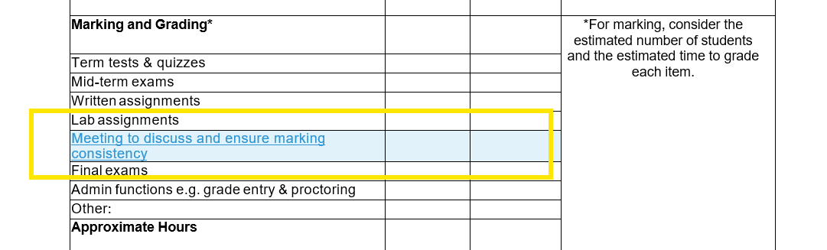
Teaching Assistant Form (TAF)
The parties agreed to two revisions to the TAF form. The first of which is shown below. The parties agreed to add the following category under the “Marking and Grading” heading
Notes:
Catarina B.

Slide 20
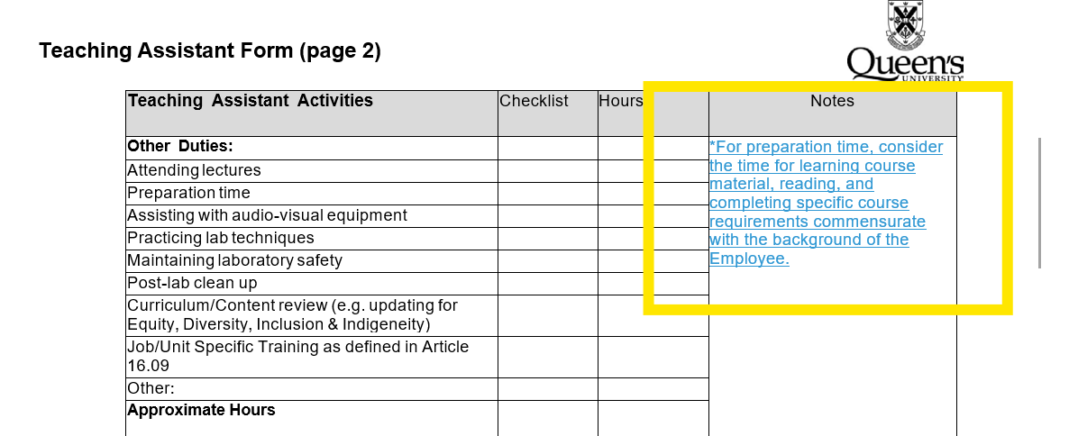
Teaching Assistant Form (TAF)
The parties also agreed to include the following note under the Teaching Assistant Activities heading
Notes:
Catarina B.

Slide 21
Wages: Teaching Assistants & Research Assistants
Position |  | Effective Date to April 30th, 2025 | May 1, 2025 to April 30, 2026 | May 1, 2026 to April 30, 2027
Teaching Assistant/ Research Assistant | Increase | 3% | 2.25% | 2.25%
 | Rate (Per Hour) | $42.37 | $48.90 | $50.00
 | 3% in-lieu of benefits | $1.27 | $1.47 | $1.50
 | 4% vacation pay | $1.69 | $1.96 | $2.00
 | Total | $45.33 | $52.33 | $53.50
This wage increase took effect as of the first day of the month that follows the date of ratification of this renewal Agreement (the "Effective Date") and will be implemented within the first three pay periods that follow the date of ratification. To receive these increases, Employees must be actively employed on the effective date and the date of ratification. Date of Ratification was April 24th, 2025.
Wage rates for TA's and RA's and Teaching Fellows include a market adjustment effective May 1st 2025.
Notes:
Michael

Slide 22
Wages: Teaching Fellows
Position |  | Effective Date to April 30th, 2025 | May 1, 2025 to April 30, 2026 | May 1, 2026 to April 30, 2027
Teaching Fellows | Increase | 3.00% | 2.25% | 2.25%
 | Rate (Per Hour) | $8,410 | $9,706 | $9,924
 | 3% in-lieu of benefits | $252 | $291 | $298
 | 4% vacation pay | $336 | $388 | $397
 | Total | $8,999 | $10,385 | $10,619
This wage increase took effect as of the first day of the month that follows the date of ratification of this renewal Agreement (the "Effective Date") and will be implemented within the first three pay periods that follow the date of ratification. To receive these increases, Employees must be actively employed on the effective date and the date of ratification. Date of Ratification was April 24th, 2025.
Wage rates for TA's and RA's and Teaching Fellows include a market adjustment effective May 1st 2025.
Notes:
Michael

Slide 23

Wages & Benefits Continued
LOA on Childcare
The University agrees to pay the Union a one-time lump sum payment in the amount of One Hundred and Ten Thousand Dollars ($110,000) to aid employees with costs associated with childcare.
The Union will be responsible for the administration of these funds, including establishing criteria for eligibility.
LOA – Lump Sum Ratification Bonus
The Employer agrees to provide all unique employees in the 2024-2025 Academic year, currently registered as a graduate student, with a one-time lump sum payment of two hundred and fifty dollars ($250) no later than the pay period following the date of ratification.
Notes:
Michael

Slide 24
LOA – “Employment Income Transparency”
The parties agree that where funding commitments include employment income, any employment income will be identified separately from other funding commitments. Any additional employment income (beyond employment granted as part of funding commitments) will not result in a reduction in non-employment sources of financial funding that the University provides to a graduate student.
The parties agree that this Letter of Agreement shall expire on April 30, 2027, at the
conclusion of the Term of the Collective Agreement and shall be subject to
renegotiation.
Notes:
Chris

Slide 25
LOA – “Employment Income Transparency”
Employment income should be separately identified from other funding commitments in the annual funding letter provided to students.
Note that any employment income over and above what was granted as part of funding will not result in a reduction in non-employment sources of financial funding.
Notes:
Chris

Slide 26
QUESTIONS?
Notes:
MV - all

Slide 27




