Slide 1


Information Session:
Highlights of Renewed Collective Agreement between Queen’s University and QUFA
(2022-2025)
May 3, 2023

Slide 2
Table of Contents
Overview
Adjuncts: What’s New?
Disputes, Grievances, Discipline, Arbitration, Safety & Security: What’s New?
Personnel Processes: What’s New?
Questions & Answers

Slide 3
I. Overview
A track changes version of the renewed collective agreement has been posted on the Faculty Relations website;
  Go to the Queen’s University Faculty Association (QUFA) tab
  Select “Collective Agreements” in the drop-down menu
  Click on the 2022-2025 Queen’s University – QUFA Collective Agreements - *New
  A clean version of the renewed collective agreement will be posted there soon. That is the “official copy” of the Collective Agreement, as per Article 4.3
  This presentation is a companion to the Power Point presented to Staffing Officers on March 29, 2023
  Today, we will focus on three areas of change.

Slide 4
I. Overview, Continued
What’s new:
  Adjuncts
  Disputes, Grievances, Discipline, Arbitration, Safety and Security, (i.e. Articles 19, 20. 21 and 22)
  Personnel Processes
  We will end the presentation with Q’s and A’s

Slide 5
II. Adjuncts: Term Adjuncts and Continuing Adjuncts
Reminder: Professional Expense Reimbursement also applies to Term Adjunct faculty members
Increase in PER to $350/year (Article 36.3.2) (Note: PER Update Memo was circulated by Faculty Relations on April 12, 2023)
Extension of PER carryforward to three years from two (Article 36.3.4)
Carryover for term adjuncts would apply when they are teaching courses in consecutive terms.
Provisions to ensure payment for Term Adjuncts for additional instructional, supervisory or administrative duties that extend beyond their contract end date, to be documented in contract/letter of appointment (Articles 42.4.4.4, Appendix Q)
Emphasis on additional. Work that was not contemplated when the original contract or letter of appointment was issued.
Notes:
Emphasis on Additional. Work that was not contemplated when the original contract or letter of appointment was issued. If Instructor A waits a week to grade papers that is not additional work. However if for some unforeseen reason there is additional work (maybe a teaching fellow was teaching a section of the same course and is unable to grade instructor teaching another section of the same course is not able to grade and Instructor A agrees to) is not able to grade and then that would be covered.

Slide 6
Adjuncts: Term Adjuncts and Continuing Adjuncts, continued
Compensation for Additional Duties (Article 42.3 & 42.4 and Appendix Q)
Reminder: workload standards do not apply to Term Adjuncts, but the Unit workload Standard does apply to Continuing Adjuncts (Article 37.1)
Appendix Q now covers Term Adjuncts and Continuing Adjuncts.
The objective was to address additional duties and to ensure that there isn’t pyramiding of entitlement for Continuing Adjuncts. Continuing Adjuncts shall receive the better of the consideration provided in the workload standard (Article 37), or compensation as per Appendix Q, but not both.

Slide 7
Adjuncts: Term Adjuncts and Continuing Adjuncts, continued
Article 15.5.4 was amended and applies to Term Adjuncts and Continuing Adjuncts:
    15.5.4 Members whose appointments do not include the full range of academic responsibilities set out in Article 15.1.1 may agree to perform administrative service responsibilities at the request of the Principal, Vice-Principal, Dean or Unit Head and shall be compensated as per Appendix Q. Refusal to accept administrative service responsibilities shall not prejudice the Member in respect of personnel processes.

Slide 8
Adjuncts: Term Adjuncts and Continuing Adjuncts, continued
Reminder: All stipends are deemed to include an allowance for course-related administrative duties. (42.4.1.7). But if a Term Adjunct is assigned Administrative Service and accepts, they are performing additional duties for which they must be compensated as per Appendix Q.
Term Adjuncts may agree to a request from a Unit head to perform additional duties including administrative service instructional or supervisory duties, such duties shall be appropriately compensated according to Article 42 and Appendix Q, and should not duplicate the allowance for course related administrative service. (Article 42.4.4.1 (b))
The categories of duties has been expanded in table A of Appendix Q

Slide 9
Adjuncts: Term Adjuncts and Continuing Adjuncts, continued
Annual reviews (Article 28.1.2) of the performance of Term Adjuncts are for the period of the Academic Year, defined in the Collective Agreement as July 1 through June 30th.
Corresponding notification timelines have changed to August 31, with the requirement to submit an Appointment Report by September 30th (Article 28.4.1)
Permitting acquisition of the right to SRoR by teaching one or more 0.5 credit course three times in three separate Academic Years over five consecutive Academic Years (Article 32.2.1). This gives the Member one extra year, if they need it, but if they satisfy the requirement in three years, they would acquire the right. They do not need to wait for five years.
Notes:
SROR now 5 years, get an extra year if you need it.
Includes Hotel

Slide 10
Adjuncts: Term Adjuncts and Continuing Adjuncts, continued
Allowance for one-half course (0.5 credit course) taught by a Postdoctoral Fellow to count toward SRoR for a Postdoc who also has a Term Adjunct appointment (Article 32.1.2)
One half credit course is the maximum irrespective of the number of degree credit courses or sections taught by such Postdoctoral Fellow.
Creation of modified appointments committees when the Term Adjunct applicant’s teaching crosses two or more Units (Articles 32.3.6.4 and 32.5.8.4); this clarification enables the chair to make the determination, and a memorandum of agreement will not be required
Notes:
SROR now 5 years, get an extra year if you need it.
Includes Hotel

Slide 11
Adjuncts: Term Adjuncts and Continuing Adjuncts
Other changes pertaining to Continuing Adjuncts include:
Annual course release for Continuing Adjuncts in receipt of multi-year external research funding as principal investigator (Article 32.6.5)
Expressly providing that the standard Continuing Adjuncts FTE is either 50% or 60%, where 60% recognizes a full load of service contributions (Article 42.3.3)
Pathway to Tenure for Continuing Adjuncts reduced from 12 to 10 years (Article 32.6.7)
Eligibility in the first year of the full responsibility appointment to apply for academic leave extended to a Continuing Adjunct promoted to full Professor (Article 33.1.2.3)
Addition of a Continuing Adjunct member to serve on the modified appointments committees for GRoR and Continuing Adjunct applications (Article 25.10.4.1 (b))

Slide 12
Article 19 – Grievance and Arbitration
III Disputes, Grievances, Discipline, Arbitration, Safety & Security
Addition of language that embeds and emphasizes “informal dispute resolution” as a precursor to formal grievances into the Article
19.1.2 A grievance is any dispute or difference, that has not been resolved informally as per Article 19.3, arising out of the application, interpretation, administration or alleged violation of the provisions of this Agreement, which is initiated in accordance with Article 19.4.
Deleted similar language from Article 41.6 (Department Heads provision, "Grievance Arising from Delegated Administrative Tasks) and placed it in 19.1 and 19.3

Slide 13
Article 19, continued
Either Party (QUFA or the University), or a Member, may seek informal resolution of a dispute or difference, including a dispute or difference arising from delegated administrative tasks carried out by a Department Head or a Library department head (Article 19.3.1)
  A renewed focus on Heads being involved in resolving disputes informally
  Example of "delegated administrative task" carried out by a Head would be decisions around office/lab space
If such a dispute or difference is not resolved, the Member or the Department Head or Library department head shall notify the Dean/University Librarian in writing. The Dean/University Librarian shall confirm or alter the decision within 10 days and shall advise the parties immediately (Article 19.3.2)
If the matter is resolved informally, the member involved in the dispute or difference may request to have the decision committed to writing (Article 19.3.4)

Slide 14
Article 19, continued
Updated Grievance Timelines:
  A Grievance may be filed within 20 working days of an event, transaction, decision, or the end of a set of circumstances (Article 19.4.1) [previously read “15”]
  A Step One meeting will be convened no later than 25 working days from the date of scheduling (Article 19.4.4) [previously read “40 working days”]

Slide 15
Article 20, Discipline
III Disputes, Grievances, Discipline, Arbitration, Safety & Security
A Member who is a respondent in an investigation is required to respond to the allegation by meeting with the investigator, if invited. Also new, confirmation of the Member’s right to review the investigators notes:
  20.3.4 As soon as practicable after commencing an investigation, the Provost and Vice-Principal (Academic), Dean, or delegate shall
  promptly and fully inform the Member in writing of the nature and substance of the allegation(s) and the scope of the investigation, including advising the Member of their right to seek advice from the Association, and inviting requiring the Member to respond to the allegation by meeting with the person(s) investigating the allegation. or by submission of materials, or both, as the Member sees fit. The Member will be permitted to review, for accuracy, the investigator’s notes of the responses given by the Member during their meeting(s). The Member may also submit materials for consideration by the investigator. If the Provost and Vice-Principal (Academic), Dean, or delegate invites the Member to meet to discuss the allegation, the invitation must be in writing and must allow the Member at least two(2) five (5) full working days to obtain advice or assistance from the Association;

Slide 16
Article 20, continued
A Unit Head no longer recommends the imposition of discipline to a Dean (but is involved in resolving disputes short of a grievance per 19.3) (Article 20.4.1)
In cases where the University has continued to pay the Member while the Member and/or the Association grieves a suspension without pay, the University shall receive credit for the amounts paid to the Member between the date of the grievance and the date of the settlement or arbitration award (Article 20.4.2 (a))
If a Member is dismissed and there is a settlement between the University and the Association, or an arbitration award in respect of the Member’s or the Association’s grievance, the University shall receive credit for the amounts paid to the Member between the date of the dismissal and the date of the settlement or arbitration award (Article 20.4.2 (b))

Slide 17
Article 20, continued
Any record of written reprimand or suspension with pay is subject to the sunset clause (i.e. shall be removed from the Member’s Official File after 48 months from the date of the imposition of the discipline)
  20.4.3 Any record of a written reprimand or suspension with pay shall be removed from a Member’s Official File after forty-eight (48) months from the date of the imposition of the discipline, written reprimand, provided that no subsequent discipline has been imposed within that period. After removal, such discipline cannot be offered in aggravation of penalty in a subsequent disciplinary proceeding. Where a written reprimand or suspension with pay is being grieved, notice of the grievance shall be attached to the record of discipline written reprimand in the Member’s Official File until the resolution of the grievance.

Slide 18
III. Disputes Grievances, Discipline, Arbitration, Safety and Security
Article 21: Harassment
Updated language to align with University policies and amended language whereby timelines for a grievance relation to discrimination, harassment and/or violence are automatically extended (Article 21.1.2):
  ...Where an issue is proceeding under the University’s policies and procedures regarding harassment, discrimination and/or violence, the timelines for a grievance and arbitration shall be automatically extended until those procedures have been completed.

Slide 19
Article 22: Safety and Security
Improved language regarding Member’s compliance with the Occupational Health and Safety Act (Article 22.1.1)
  The University and the Association agree to promote safe, secure and healthy working conditions and procedures. Members shall comply with the Occupational Health and Safety Act, R.S.O. 1990, c.0.1, as amended from time-to-time, and are encouraged to adopt and follow sound health, safety and security procedures in the performance of their work. and to encourage Members to adopt and follow sound health, safety and security procedures in the performance of their work.
Side note: Management right confirmed to mandate certain training obligations for Heads and other Members, as long as those rights are exercised in a fair and equitable manner consistent with the Article 8 (Management Rights clause)

Slide 20
Article 22: Safety and Security
Previous Article 22.1 (Emergency Suspension with Full Pay) has been removed from the CA. Management now has the right to rely on management rights to remove a faculty member from the classroom, subject to Article 8 (Management Rights clause). Previous language fettered management’s right by requiring “reasonable and probable grounds to believe that the failure to take action would result in clear risk of significant harm to a person associated with the University".

Slide 21
IV. Personnel Processes: What’s New?
Article 24 – Employment Equity
Article 25 – Appointments
Article 30 – Renewal, Tenure, Promotion (RTP)
Article 31 – RCAP
Articles 28 (Annual Performance Review); Appendix F (Term Adjunct Appointment Report; and Appendix V (MoA re: Return to Annual Performance Review and Merit)

Slide 22
IV. Personnel Processes: What’s New?
Article 24 – Employment Equity
Amendments include:
  Creation of new acronym, I-EDIAA, that is defined in Article 2 as “Indigenization – Equity, Diversity, Inclusion, Anti-Racism and Accessibility “
  Broadly infused principles of equity, diversity and inclusion into Article 24, the collective agreement generally, and in particular, hiring processes
  Article 24.1.6 (New)
    In any evaluative process, Members may include activities that advance I-EDIAA and such information will be considered in the evaluation
      see also changes to changes to Appendix F: Term Adjunct Appointment Report), specifically: “Members may include in any section below activities that advance I-EDIAA and such information will be considered in the evaluation”

Slide 23
Article 24 – Employment Equity, continued
  The principles are now expressly described in the provisions regarding appointment processes (24.1.4) and RTP/RCAP (Article 24.1.5)
  In particular, the Parties agreed that, in RTP/RCAP processes, criteria “shall not undervalue work which may be performed disproportionately by members of the equity-deserving groups”
  24.3 Appointment Processes
    The process that will be followed depends on whether it will be a typical, active search [24.3.1 (b)], or a Targeted Hire search [24.3.1 (a)]

Slide 24
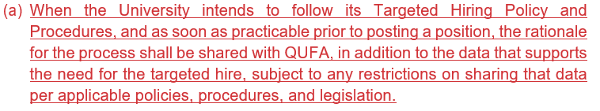
Article 24 – Employment Equity, Continued
TARGETED HIRE

Slide 25
Article 24 – Employment Equity, Continued
TYPICAL
(b) Advertisements and postings for appointments other than those for a targeted hiring process shall include the following statement: “The University invites applications from all qualified individuals. Queen's is strongly committed to employment equity, diversity, and inclusion in the workplace and encourages applications from Black, racialized/visible minority and Indigenous/Aboriginal people, women, persons with disabilities, and 2SLGBTQ+ persons”;

Slide 26
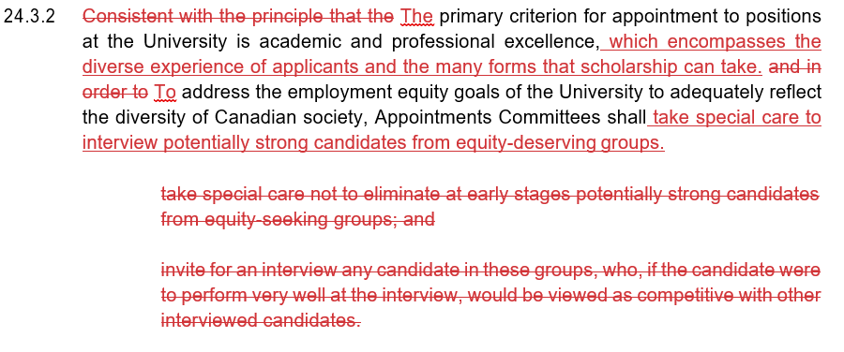
Article 24 – Employment Equity Continued

Slide 27
Article 24 – Employment Equity, continued
  The diverse experience of applicants, and the many forms that scholarship can take, have been incorporated into the concept of “academic and professional excellence”. And, we are all cautioned not to screen out the “potentially strong”
  If an Appointments Committee (Equity Rep) fails to adhere to the rules & practices that assure equity, data collection and submission of information to HREO, such non – compliance will be reported and the Unit identified as non-compliant (24.4.2)

Slide 28
Article 25 –Appointments
  Searches for Non-Term Adjunct appointments:
    When a search will be conducted in “an area of specialization” not represented on the Appointments Committee as defined in 25.5.1 (a), the committee may expand to include a Member with appropriate expertise. Said “expert Member” shall be a regular voting member of the committee, but shall only participate in deliberations for that specific appointment [(25.5.1 (e)]; an analogons provision has been added for the Library

Slide 29
Article 25 –Appointments , Continued
  25.7.1: “Exception to the appointments procedures may not be used to circumvent Article 24”
  An emergency appointment (an example of an exception) must not be for longer than one (1) year [25.7.1 (b)]
  New process in Library: appointment procedures for replacing a Librarian or Archivist for up to 12 months, will be handled by an “Abridged Appointments Committee” [25.7.2]

Slide 30
Article 25 –Appointments,Continued
  Term Adjunct Appointment Procedures
  Analogous to the change at Article 25.7.1, an exception to the posting requirements for Term Adjuncts may not be used to circumvent Article 24 (25.10.1.5]
  Unit Head now required to “consider the advice of the Term Adjuncts Appointment Committee” before deciding to waive posting of a Term Adjunct available appointment [25.20.1.5 (c)]
  More rules for Term Adjunct Appointments Committees see [25.10.2.3]
  Term Adjunct Appointments Committee must not undervalue work which is done predominantly by members of equity-deserving groups (25.10.2.7)

Slide 31
Article 30 – RTP
  [Note: there are analogous changes to Article 31, RCAP]
  RTP Committees
    Must follow a process consistent with the principles in Article 24
    Committee’s Equity Rep shall be Tenured
    When practicable, the Committee shall be reflective of differences in appointment type, rank and membership in equity-deserving groups [30.2.3]

Slide 32
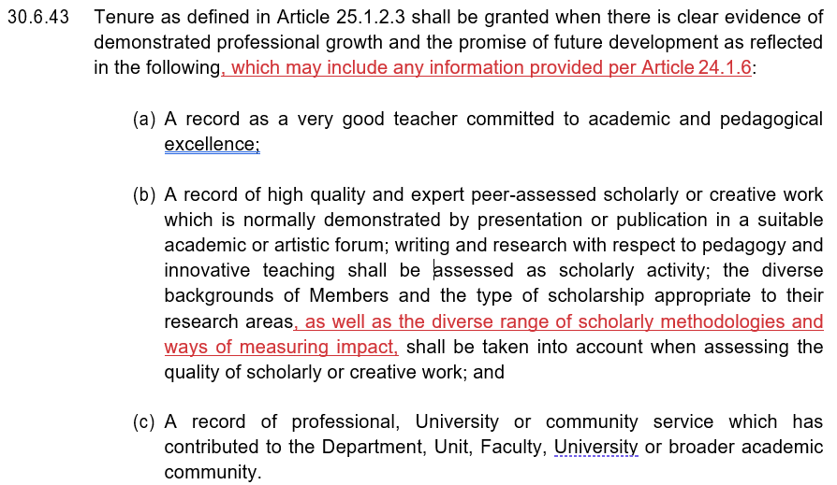
Article 30 – RTP, continued
    Tenure

Slide 33


Action | Previous Date | New Date
The notice is placed in For the Record | May 1 | May 1
The Unit Head provides notification | May 15 | May 15
The Member notifies the Unit Head | July 1 | June 1
The Unit Head arranges a meeting with the Member | July 15 | June 15
The Member provides a list of prospective referees to the Committee | July 31 | June 30
The Member provides materials to the Committee | August 15 | *August 1
The Unit Head requests reports from the referees | N/A | *August 15
New Timelines: RTP and RCAP

Slide 34
Article 28 Performance Review
Return to annual performance reviews and merit, and transition to a performance cycle that corresponds to the Academic Year (i.e. July 1 to June 30) commencing July 1, 2023. (Article 28.2.1). January 1, 2022 – June 30, 2023
There will be an 18-month transitional review period, i.e. Jan 1, 2022 – June 30, 2023; “Extra” additional merit points will be provided for the 18-month review.
Details of the agreement to return to annual performance review and merit – see new Appendix V
The University will provide training for heads on bias in faculty evaluation [28.1.1(c )]

Slide 35
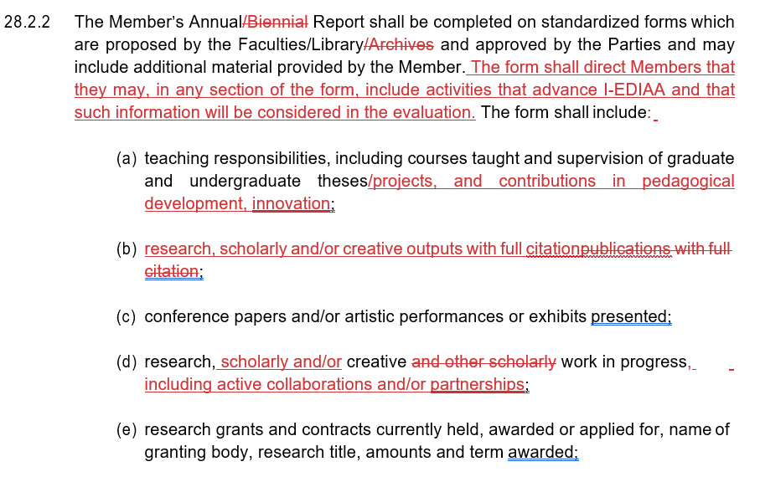
Article 28 Performance Review

Slide 36
Term Adjunct Appointment Report
Appendix F is a substantially revised form that is intended to conform to Article 28.5 of the CA
“Members many include in any section (on the form) activities that advance I-EDIAA and such information will be considered in the evaluation”
If the Term Adjunct Member performs administrative service responsibilities, and/or professional service, they may include details in their report.

Slide 37
QUESTIONS?

Slide 38




