Slide 1
Peopletools Update 8.62
Look and feel changes
February 23, 2026

Slide 2
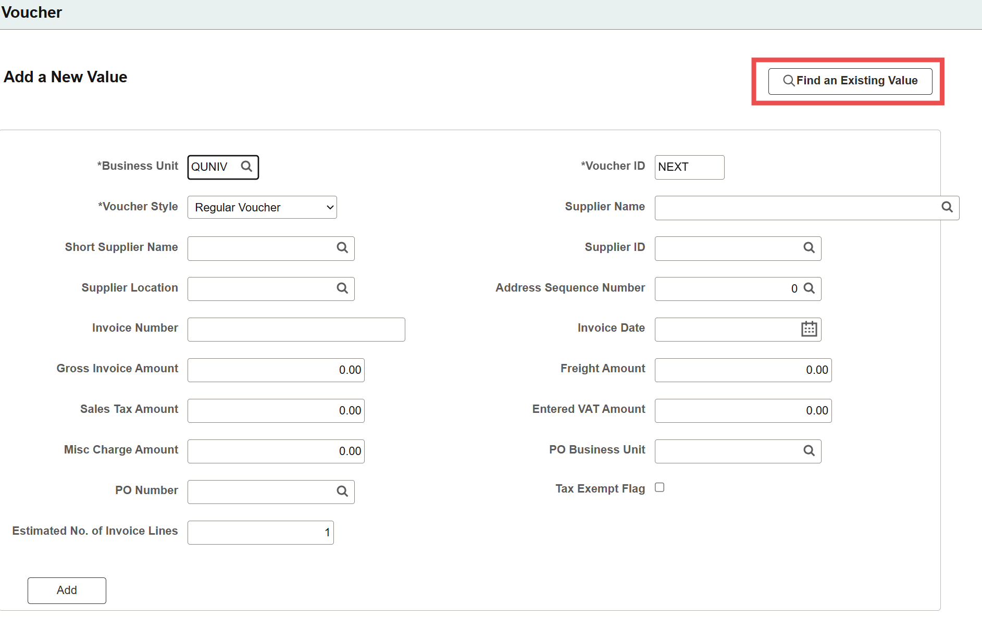
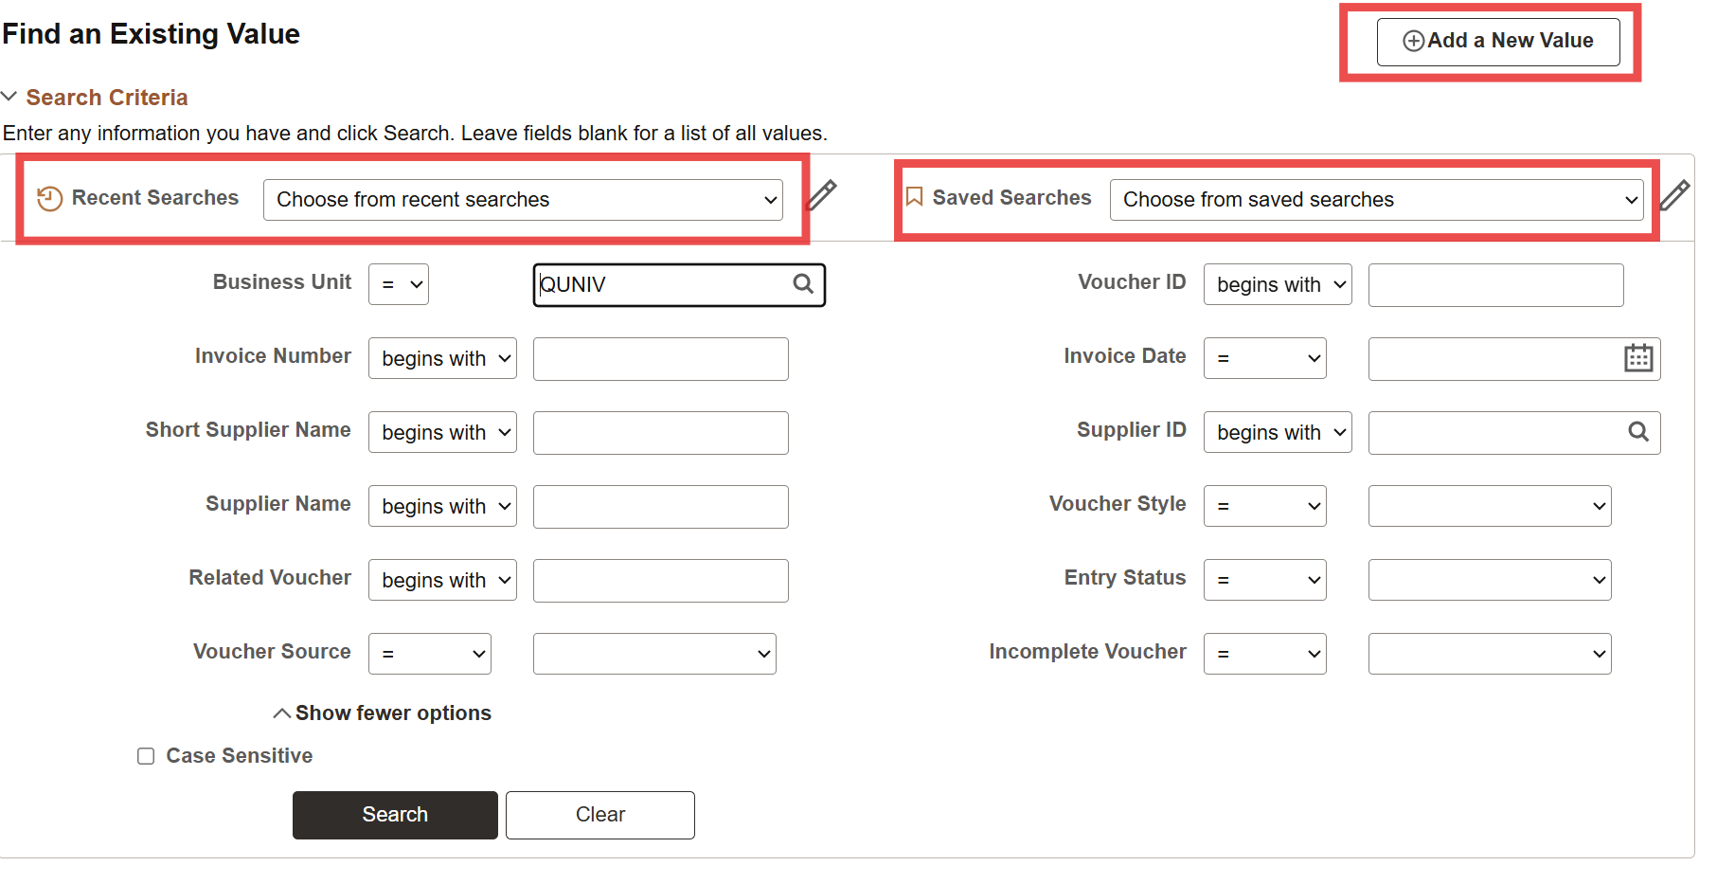
The search pages have a new look and feel. The “Find an Existing value” & “Add a new Value” tab has moved to the right.
Recent & Saved searches have been added, and the page layouts have changed

Slide 3
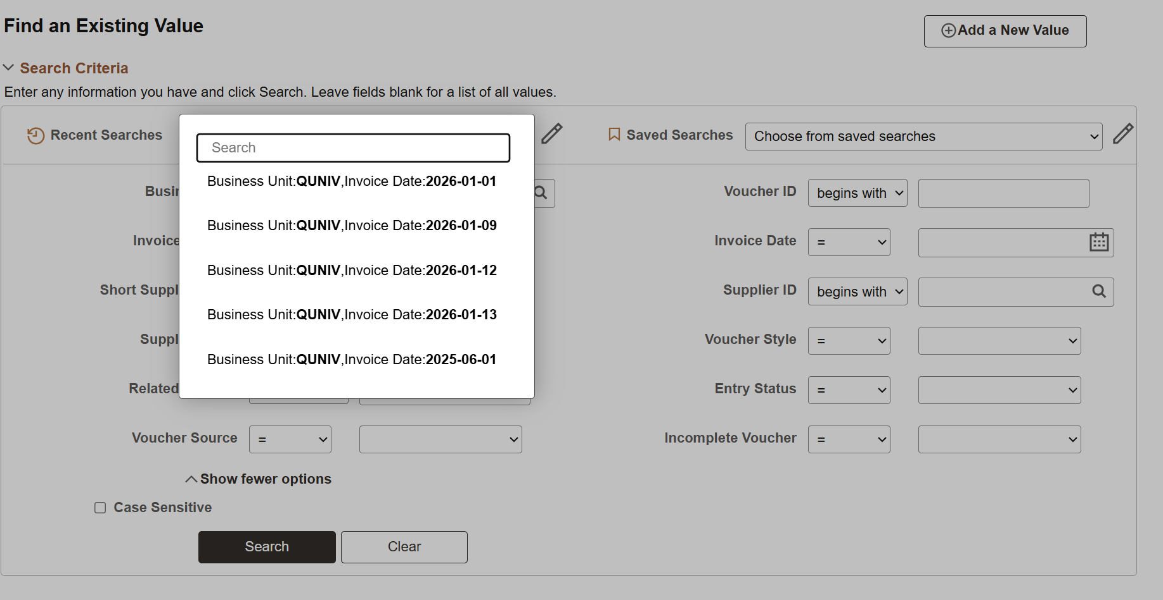
Recent searches can now be used to quickly find recently used searches.
Your last 10 searches will be displayed, with the 11th being replaced by a new search.

Slide 4
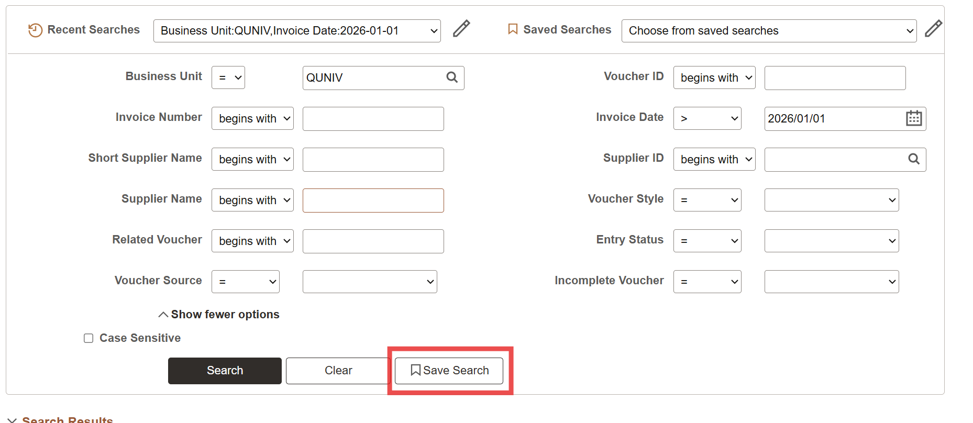
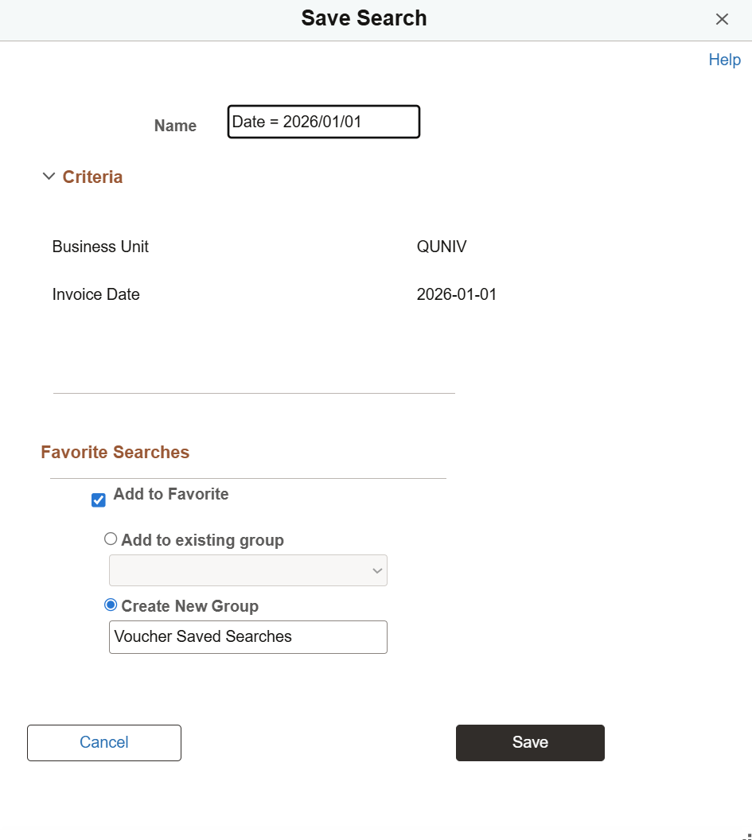
After searching specific criteria, the “Save Search” button will appear allowing you to save up to 10 frequently used searches for quick reference per search page.
Up to 20 saved searches can be added to your favorites by creating or adding to an existing group.

Slide 5
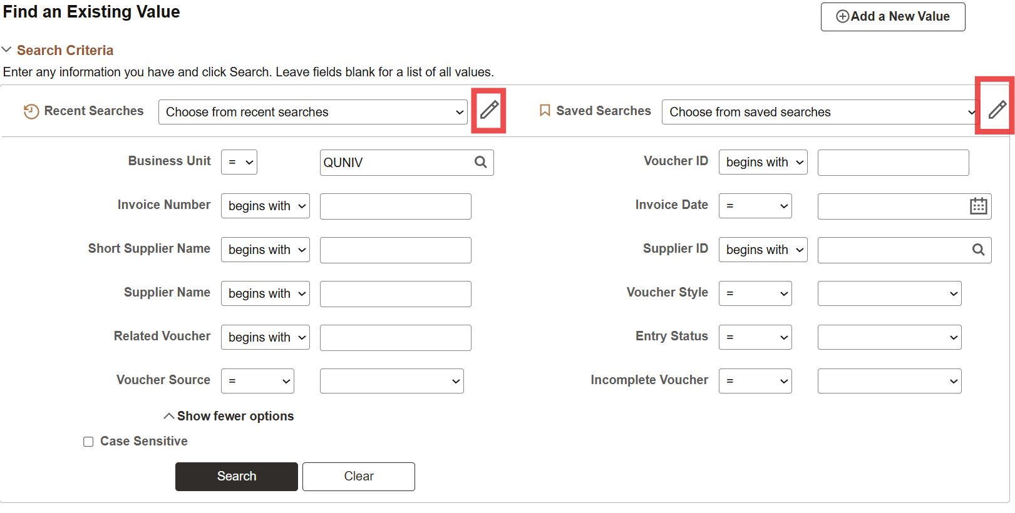
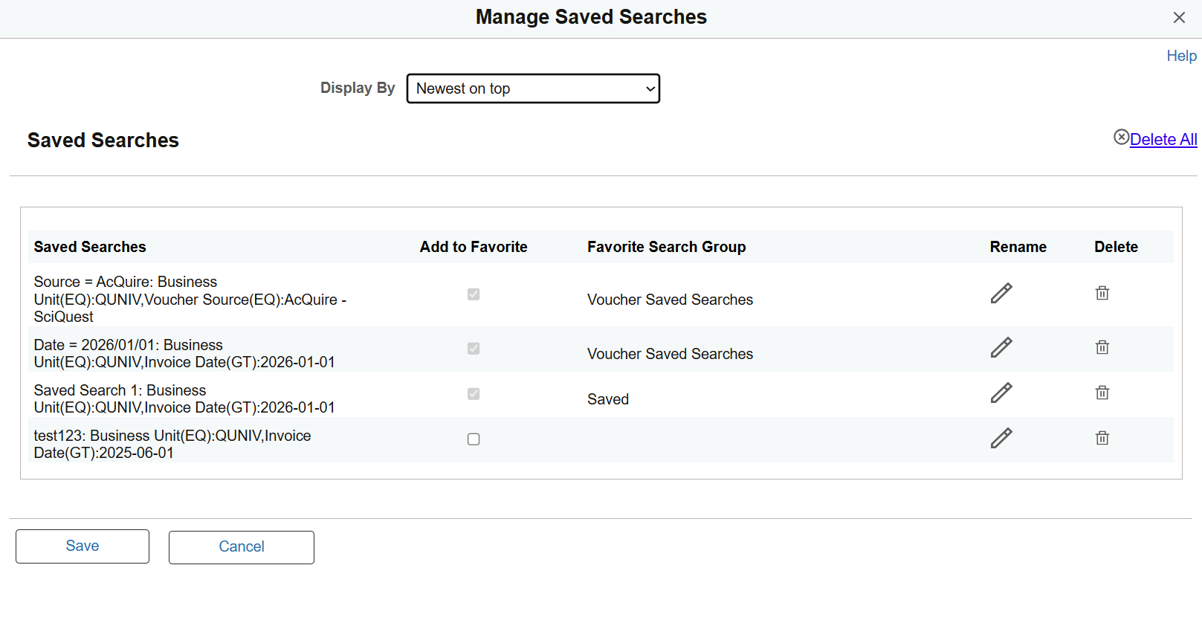
You can manage your saved searches using the pencil icon on the search page which will bring up a full list of your saved searches allowing you to add to a favorite group, rename, or delete the search.
For recent searches you can delete all or individual recent searches as needed.

Slide 6
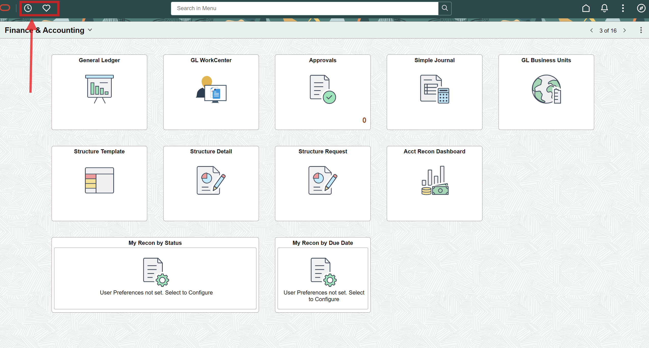
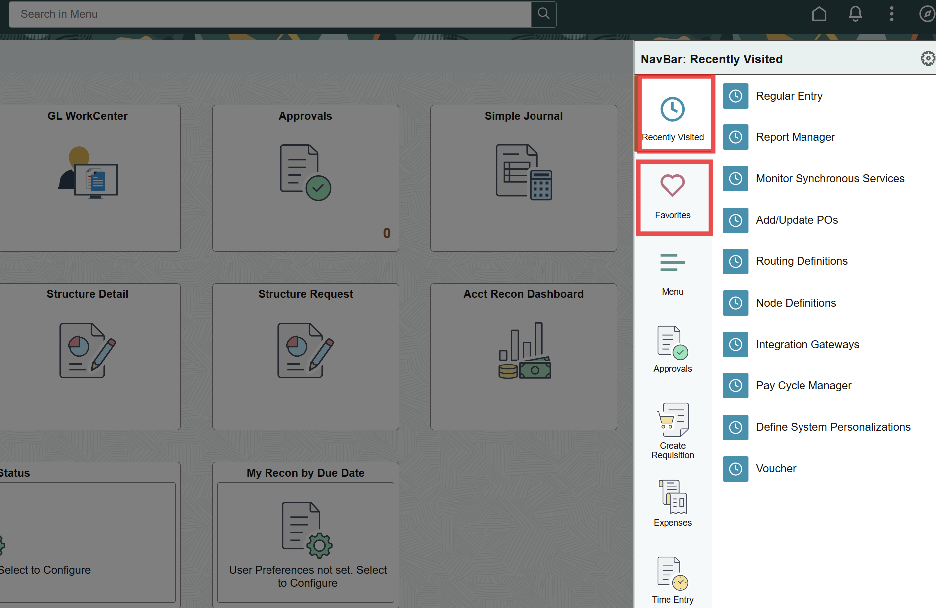
Two new buttons have been added to the top navigation bar to quickly access your favorites and recently visited pages. These button are also located in the navigation menu as they were before.

Slide 7
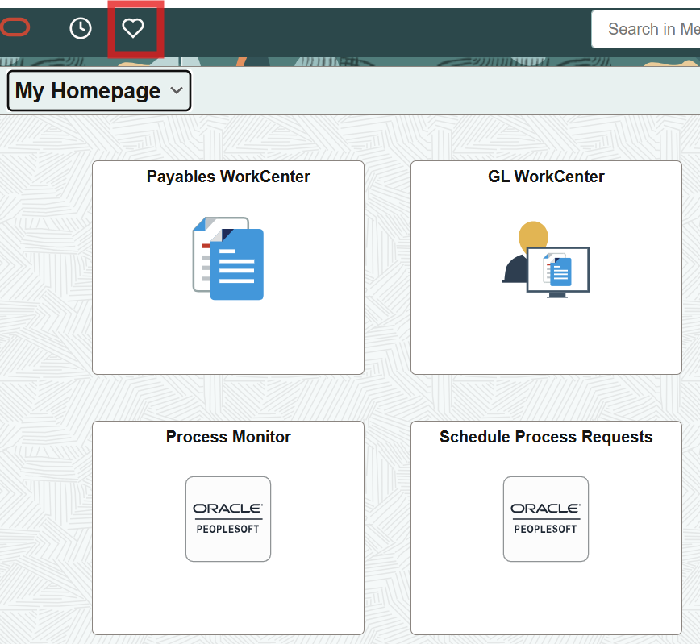
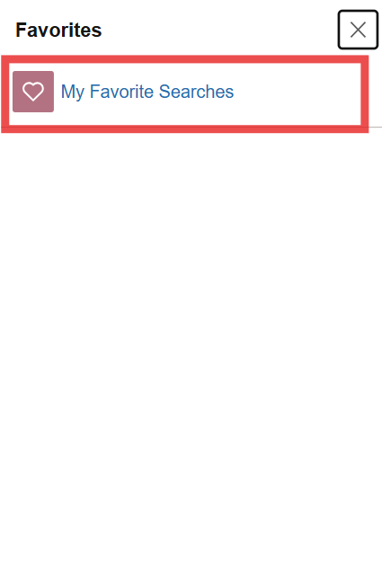
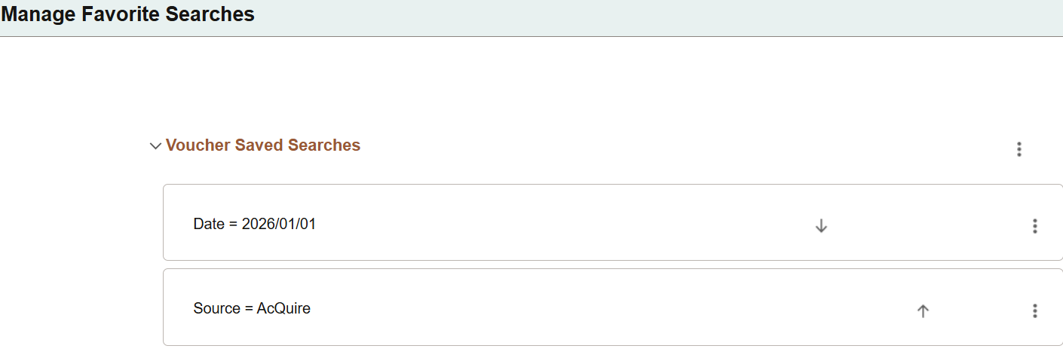
After adding a saved search to a favorite group, you can quickly run the search from the favorites navigation in the menu or using the icon on the top left.

Slide 8
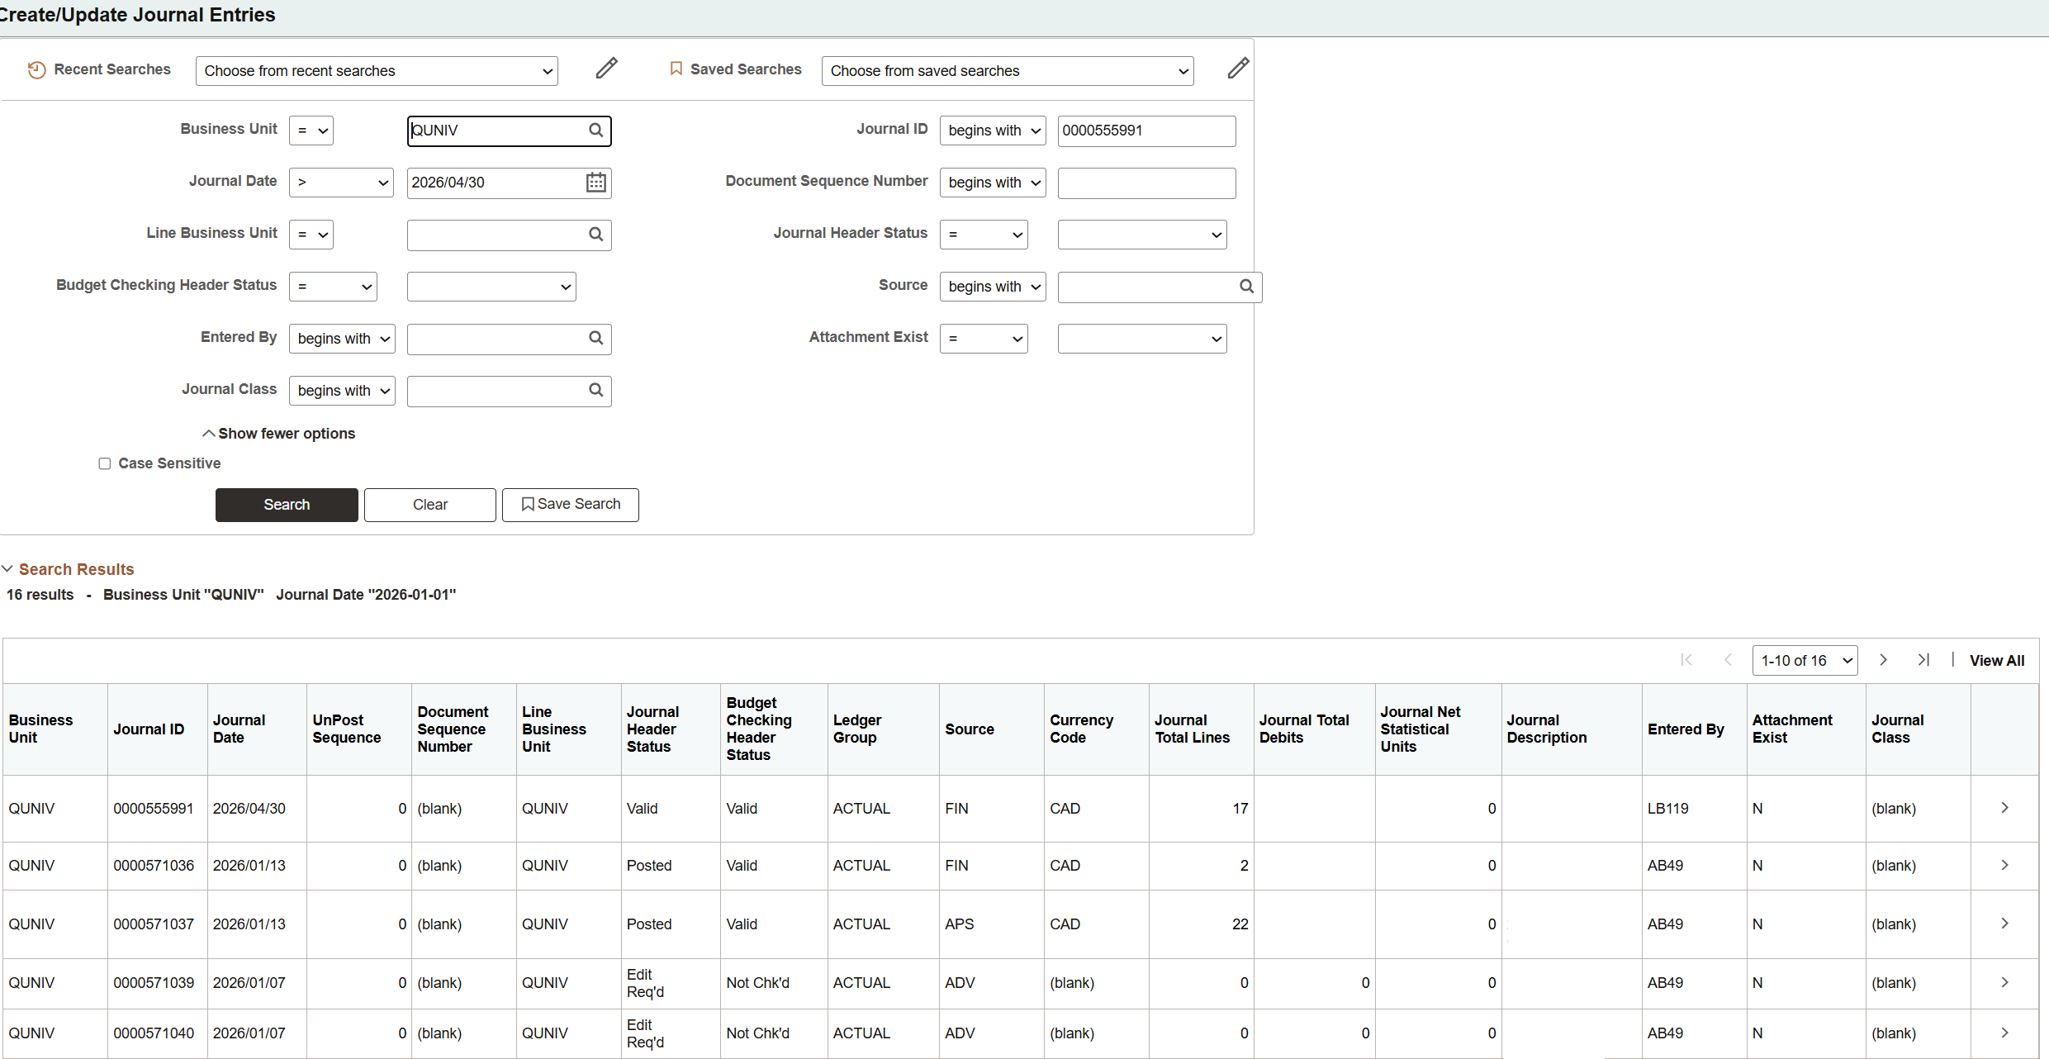
The search results when searching for journals/vouchers/receivables etc. no longer have a blue hyperlink look but they are still clickable links that will take you to the entry page and will function as they have in the past.

