Slide 1
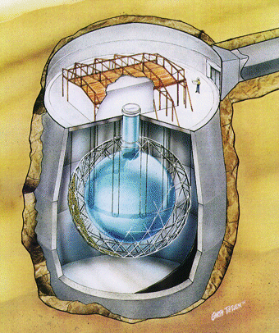
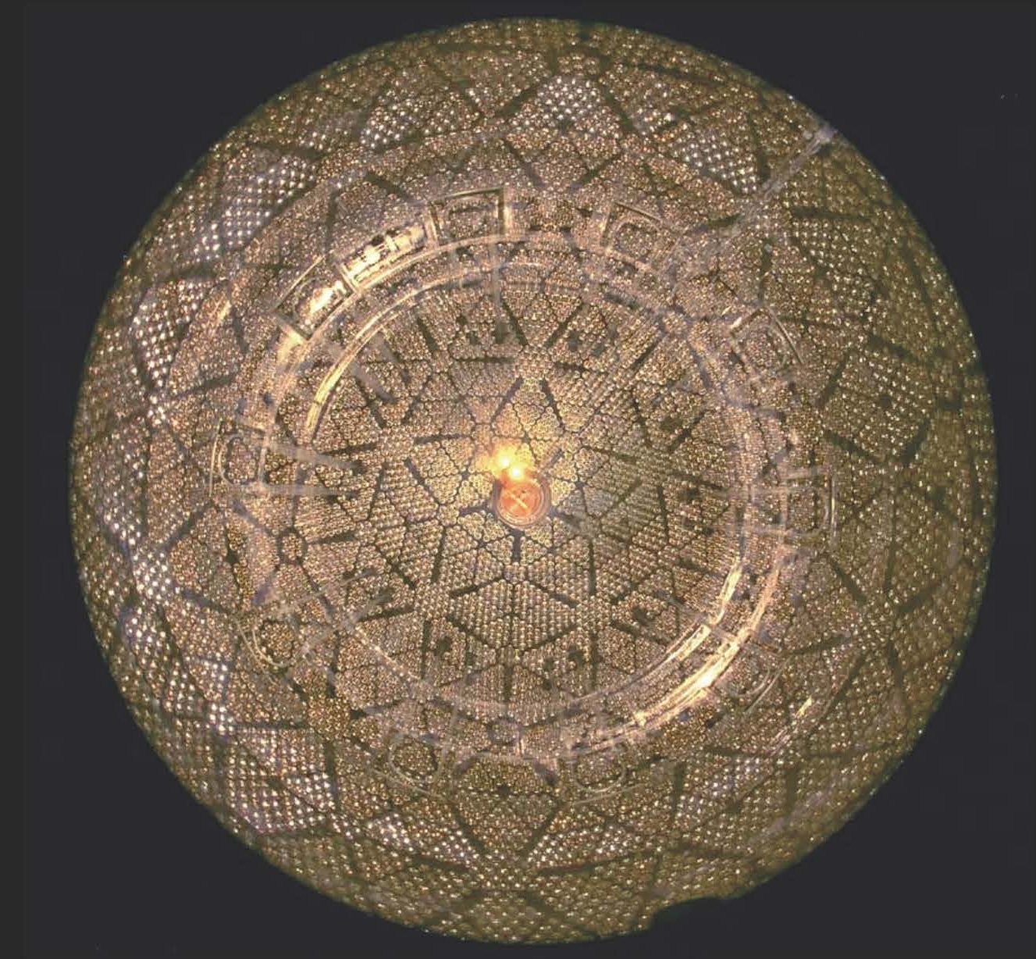
The Sudbury Neutrino Observatory: Observation of Flavor Change for Solar Neutrinos.
Art McDonald, Professor Emeritus
Queen’s University, Kingston, Ontario, Canada

Slide 2
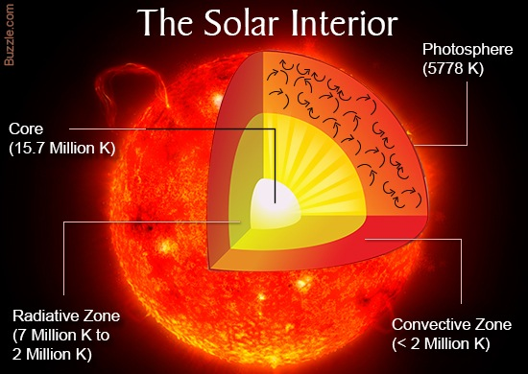
Neutrinos from the Sun
The middle of the sun is so hot that the centers of the atoms (nuclei)
fuse together, giving off lots of energy and neutrinos. The neutrinos penetrate easily through the dense material in the Sun and reach the earth.

Slide 3
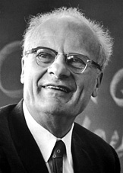
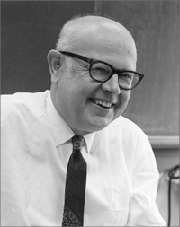
Understanding How the Sun Burns
Hans Bethe
Basic Theory 1939
Nobel Laureate 1967
Willy Fowler
Theory, Experiments 1950’s, 60’s
Nobel Laureate 1983
We stand on the Shoulders of Giants

Slide 4
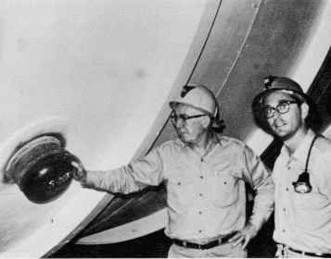
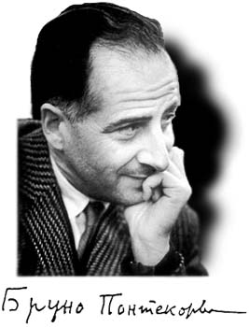
Pioneers of Solar Neutrino Physics: Davis, Bahcall, Pontecorvo & Gribov
1968: Gribov and Pontecorvo suggest flavor change (oscillation) of electron neutrinos to muon neutrinos as a possible reason.
1968: Davis’ Measurements with Chlorine-based detector show 3 times fewer than Bahcall’s calculations.
Ray Davis: Nobel Laureate 2002

Slide 5
SOLAR FUSION CHAIN
1984: Chen proposes heavy water to search for direct evidence of flavor transformation for neutrinos from ⁸B decay in the Sun.
Electron neutrinos and all active neutrinos are measured separately to show flavor change independent of solar model calculations.

Slide 6
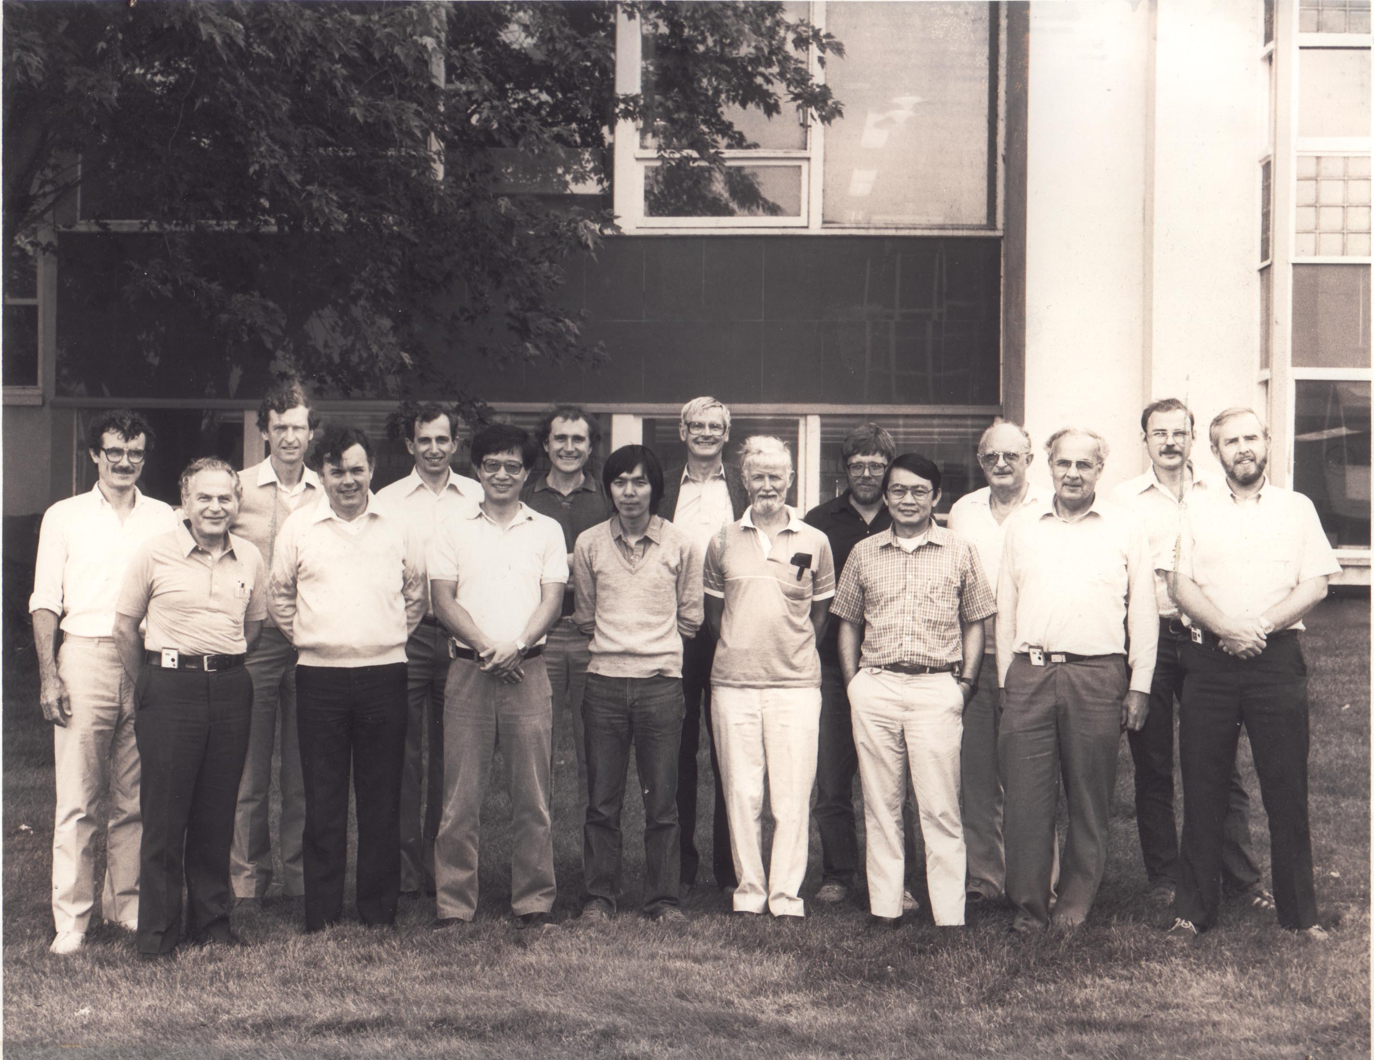
1985
Sinclair: UK
Spokespersons
McDonald
1987:US
1989:Director
1984
Ewan: Canada
1984
Chen: US
SNO Collaboration Meeting, Chalk River, 1986
PROPOSAL TO BUILD A NEUTRINO OBSERVATORY IN SUDBURY, CANADA
D. Sinclair, A.L. Carter, D. Kessler, E.D. Earle, P. Jagam, J.J. Simpson, R.C. Allen, H.H. Chen, P.J. Doe, E.D. Hallman, W.F. Davidson, A.B. McDonald, R.S. Storey, G.T. Ewan, H.‑B. Mak, B.C. Robertson Il Nuovo Cimento C9, 308 (1986)

Slide 7
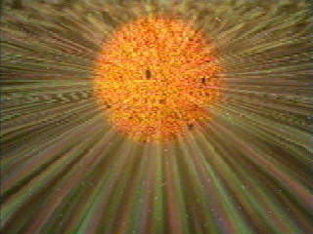
How does SNO detect neutrinos from the Sun?
Billions of them stream out every second from the nuclear
reactions powering the Sun and strike our detector. Once
an hour they make a burst of light that we can detect.

Slide 8
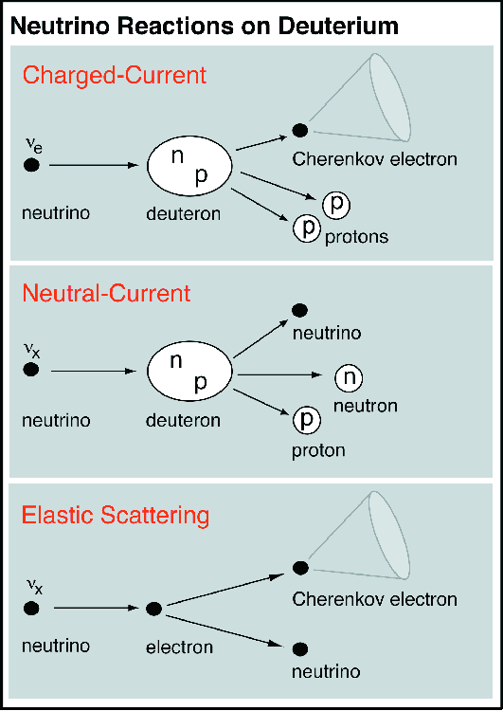
Unique Signatures in SNO (D₂O)
(1 in 6400 molecules in ordinary water are D₂O. We used >99.75% D₂O)
Electron Neutrinos (CC)
ν_{e}+d → e⁻+p+p
E_{thresh} = 1.4 MeV
Equal Sensitivity All Types (NC)
ν_{x}+d → ν_{x}+n+p
E_{thresh} = 2.2 MeV
3 ways to
detect neutrons
Comparing these two reactions tells if electron neutrinos have changed their type.
Radioactivity must be carefully controlled because gamma rays can also break apart deuterium and produce a free neutron.
Elastic Scattering from Electrons
ν_{x}+e⁻ → ν_{x}+e⁻
ν_{x}, but enhanced for ν_{e} x 6
10 times lower count rate
Points away from the Sun

Slide 9
3 neutron (NC) detection
methods (systematically different)
Phase I (D₂O)
Nov. 99 - May 01
Phase II (salt)
July 01 - Sep. 03
Phase III (³He)
Nov. 04-Dec. 06
n captures on
²H(n, γ)³H
Effc. ~14.4%
NC and CC separation by energy, radial, and directional distributions
2 tonnes of NaCl
n captures on
³⁵Cl(n, γ)³⁶Cl
Effc. ~40%
NC and CC separation by event isotropy
400 m of proportional counters
³He(n, p)³H
Effc. ~ 30% capture
Measure NC rate with entirely seperate detection system.
³⁵Cl+n
5 cm
8.6 MeV
²H+n
6.25 MeV
n
³H
p
³He
³H
n + ³He → p + ³H
³⁶Cl

Slide 10
Sudbury Neutrino Observatory (SNO)
Neutrinos are very difficult to detect so our detector had to be very big with low radioactivity, deep underground.
NEUTRINO
1000 tonnes of heavy water: D₂O
$ 300 million on
Loan for $1.00
34 m
or
~ Ten
Stories
High!
2 km below the ground
9500 light sensors
12 m Diameter Acrylic Container
Ultra-pure
Water: H₂O.
Urylon Liner and
Radon Seal

Slide 11
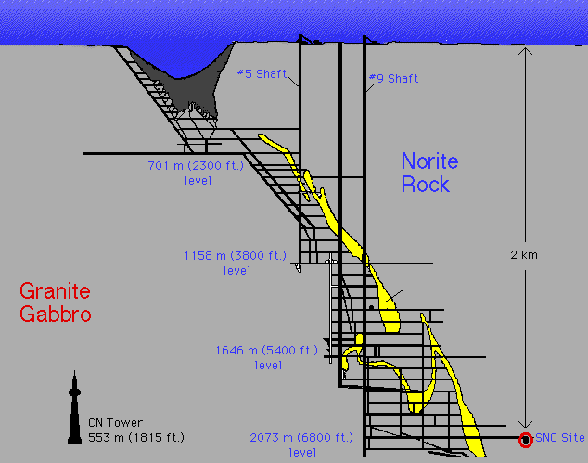
To study Neutrinos with little radioactive background, we went 2 km underground
to reduce cosmic rays and built an ultra-clean detector: SNO
VALE’S
CREIGHTON
MINE NEAR
SUDBURY,
ONTARIO
Nickel ore

Slide 12
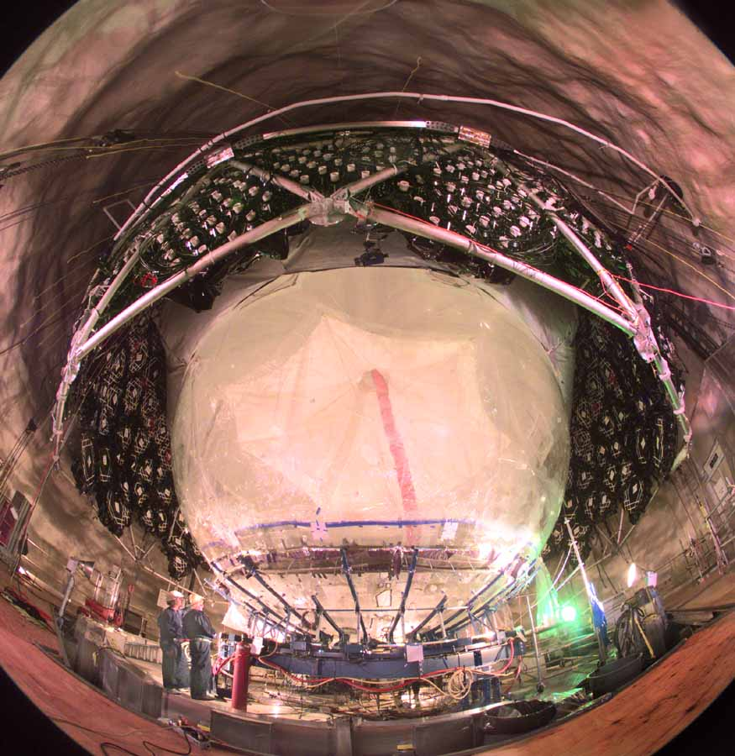
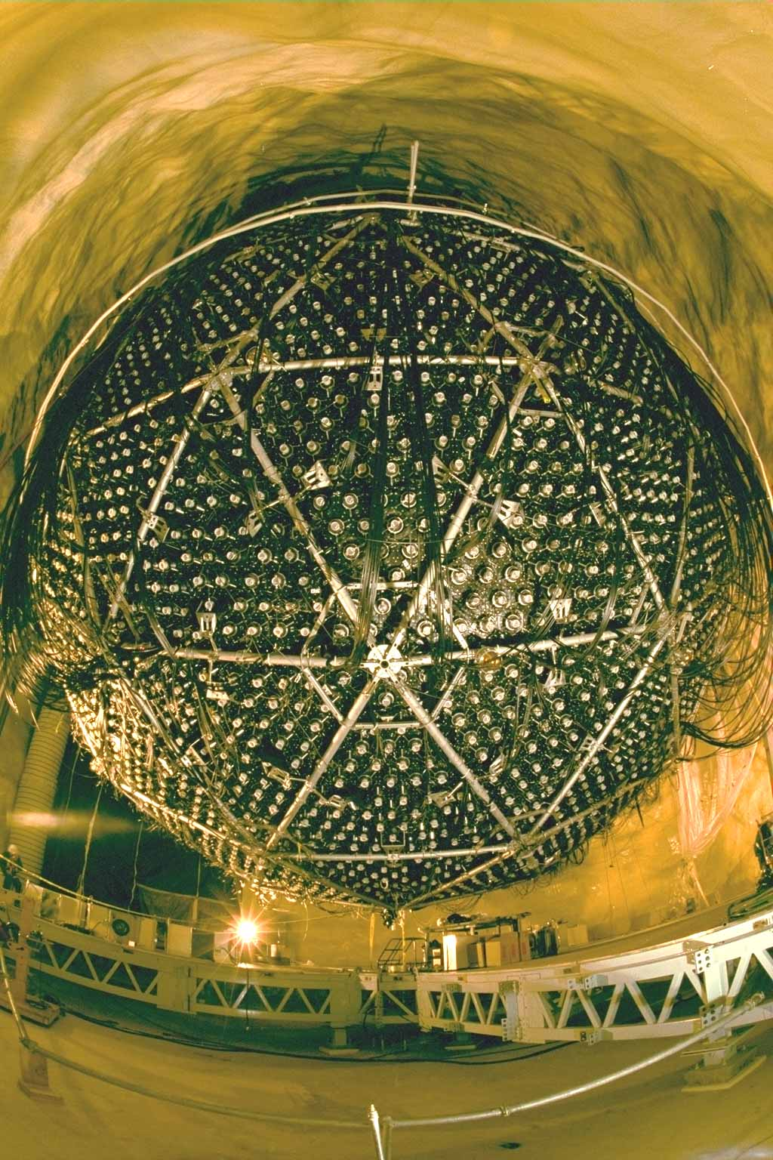
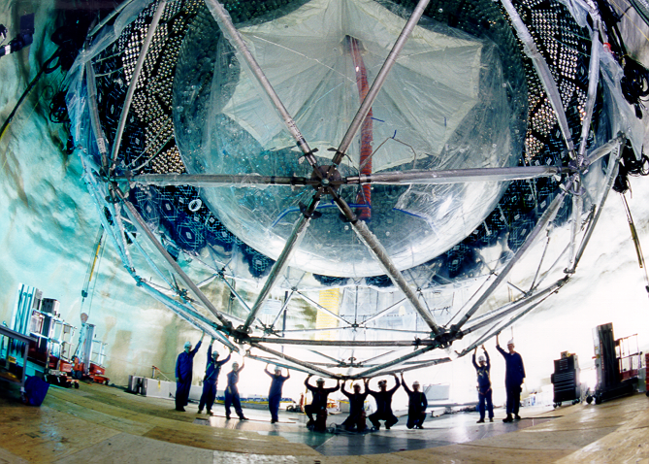
SNO: One million pieces transported down in the
3 m x 3 m x 4 m mine cage and re-assembled under
ultra-clean conditions. Every worker takes a shower
and wears clean, lint-free clothing.
70,000 showers during the course of the SNO project

Slide 13
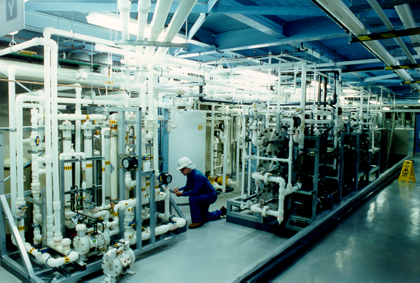
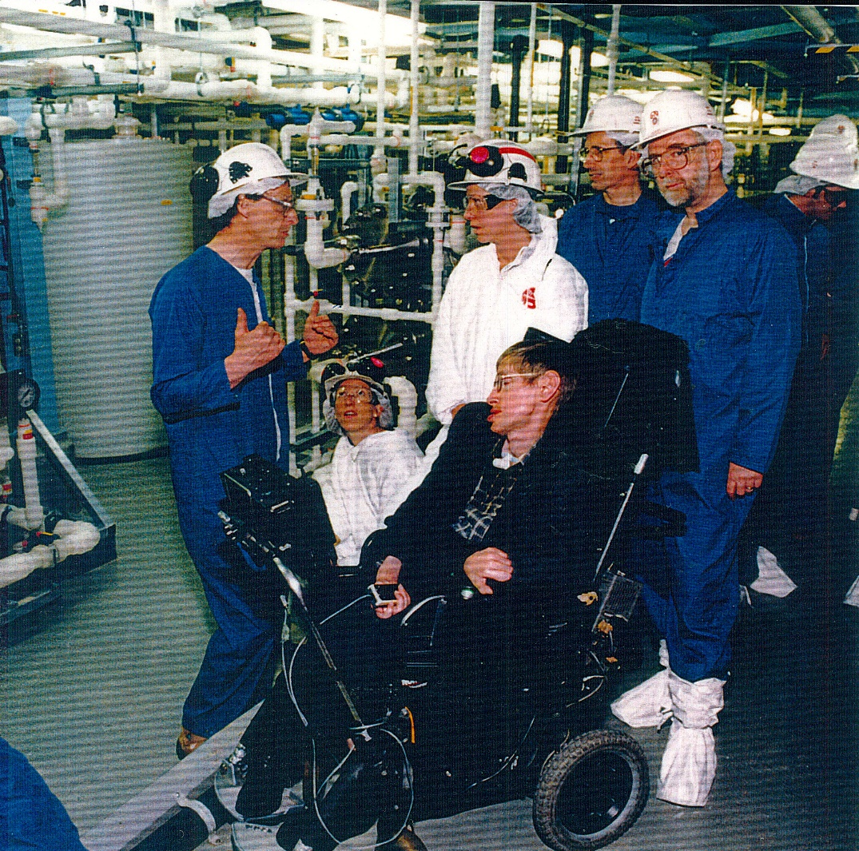
Water systems were developed to provide low radioactivity water and heavy water: 1 billion times better than tap water. Less than one radioactive decay per day per ton of water!!
Steven Hawking’s Visit
Posed some special
Challenges – INCO
Designed a special
Rail car for him.
(Stainless steel with
Lots of nickel, of course)

Slide 14
WE OBSERVED NEUTRINOS FROM THE SUN
WITH ALMOST NO RADIOACTIVE BACKGROUND
SUMMED DATA
After Calibration:
ELECTRON
NEUTRINOS
AT EARTH ARE
ONLY 1/3
OF ALL
NEUTRINOS
ELECTRON NEUTRINOS
ALL NEUTRINO TYPES
Electron kinetic energy (MeV)
Data from Pure Heavy Water Phase in 2002

Slide 15
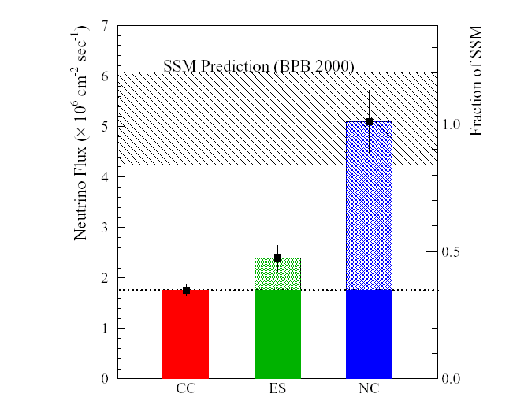
Excellent
Agreement
With the
Solar Model
Calculations
SOLAR
MODEL
SNO USED HEAVY WATER TO MEASURE TWO SEPARATE THINGS
LESS THAN ONE
CHANCE IN 10 MILLION
FOR “NO CHANGE IN
NEUTRINO TYPE”
ELECTRON
NEUTRINOS
ALL NEUTRINO
TYPES
A CLEAR DEMONSTRATION NEUTRINOS CHANGE THEIR TYPE:
2/3 OF THE ELECTRON NEUTRINOS HAVE CHANGED TO MU, TAU
NEUTRINOS ON THE WAY FROM THE SOLAR CORE TO EARTH. THIS REQUIRES THAT THEY HAVE A FINITE MASS.

Slide 16
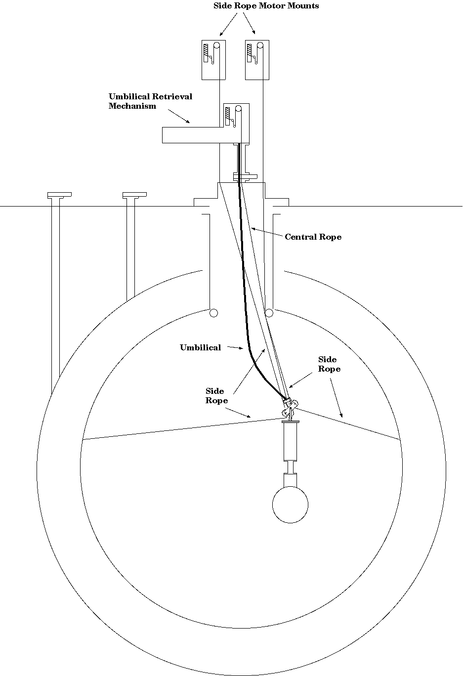
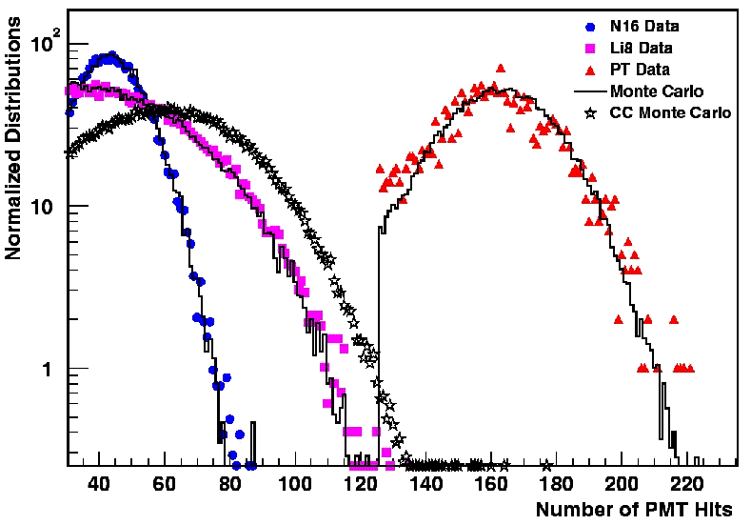
SNO Energy Calibrations
6.13 MeV
19.8 MeV
Detailed Detector Mapping with LaserBall, ¹⁶N, ²⁵²Cf, ²³⁸U, ²³²Th
β’s from ⁸Li
γ’s from ¹⁶N and t(p,γ)⁴He
²⁵²Cf neutrons
Radioactivity: Rn and encapsulated U and Th

Slide 17
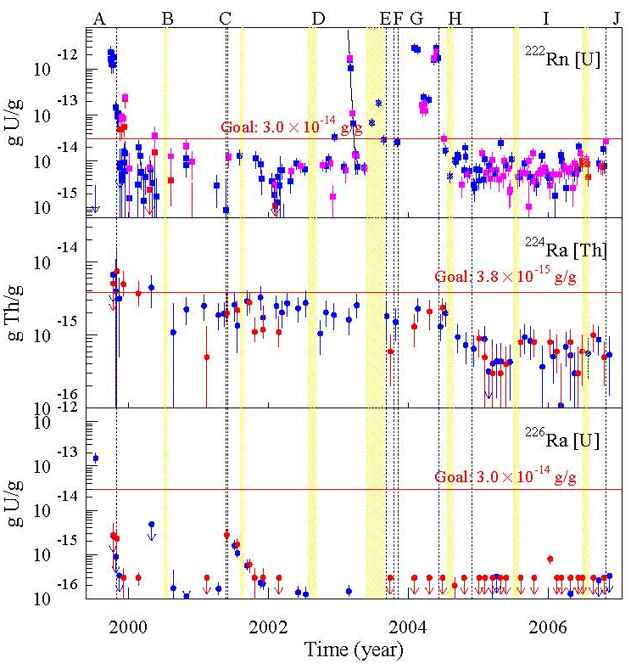
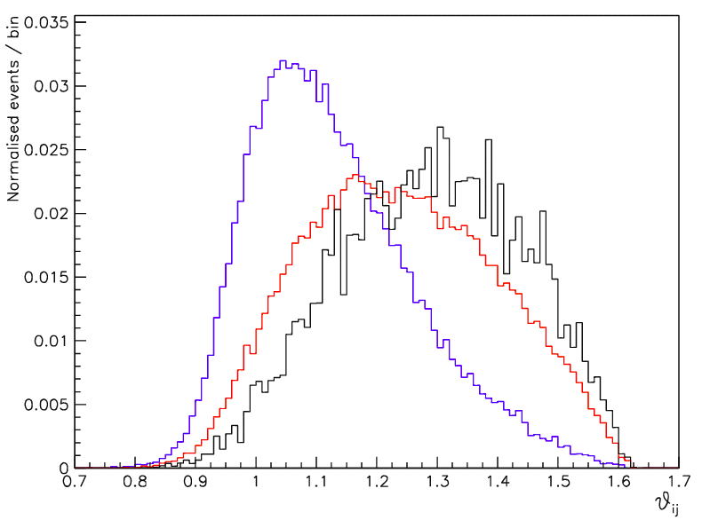
Measuring U/Th Content
Ex-situ
Ion exchange (²²⁴Ra, ²²⁶Ra)
Membrane Degassing (²²²Rn)
count daughter product decays
In-situ
Low energy data analysis
Separate U and Th Chains
Using Event isotropy
U Chain
Th Chain
Numbers of background neutrons from gamma rays breaking apart deuterium are measured to be 3 times smaller than the signal. Uncertainty from this is less than 10% of the neutrino measurement.
Isotropy

Slide 18
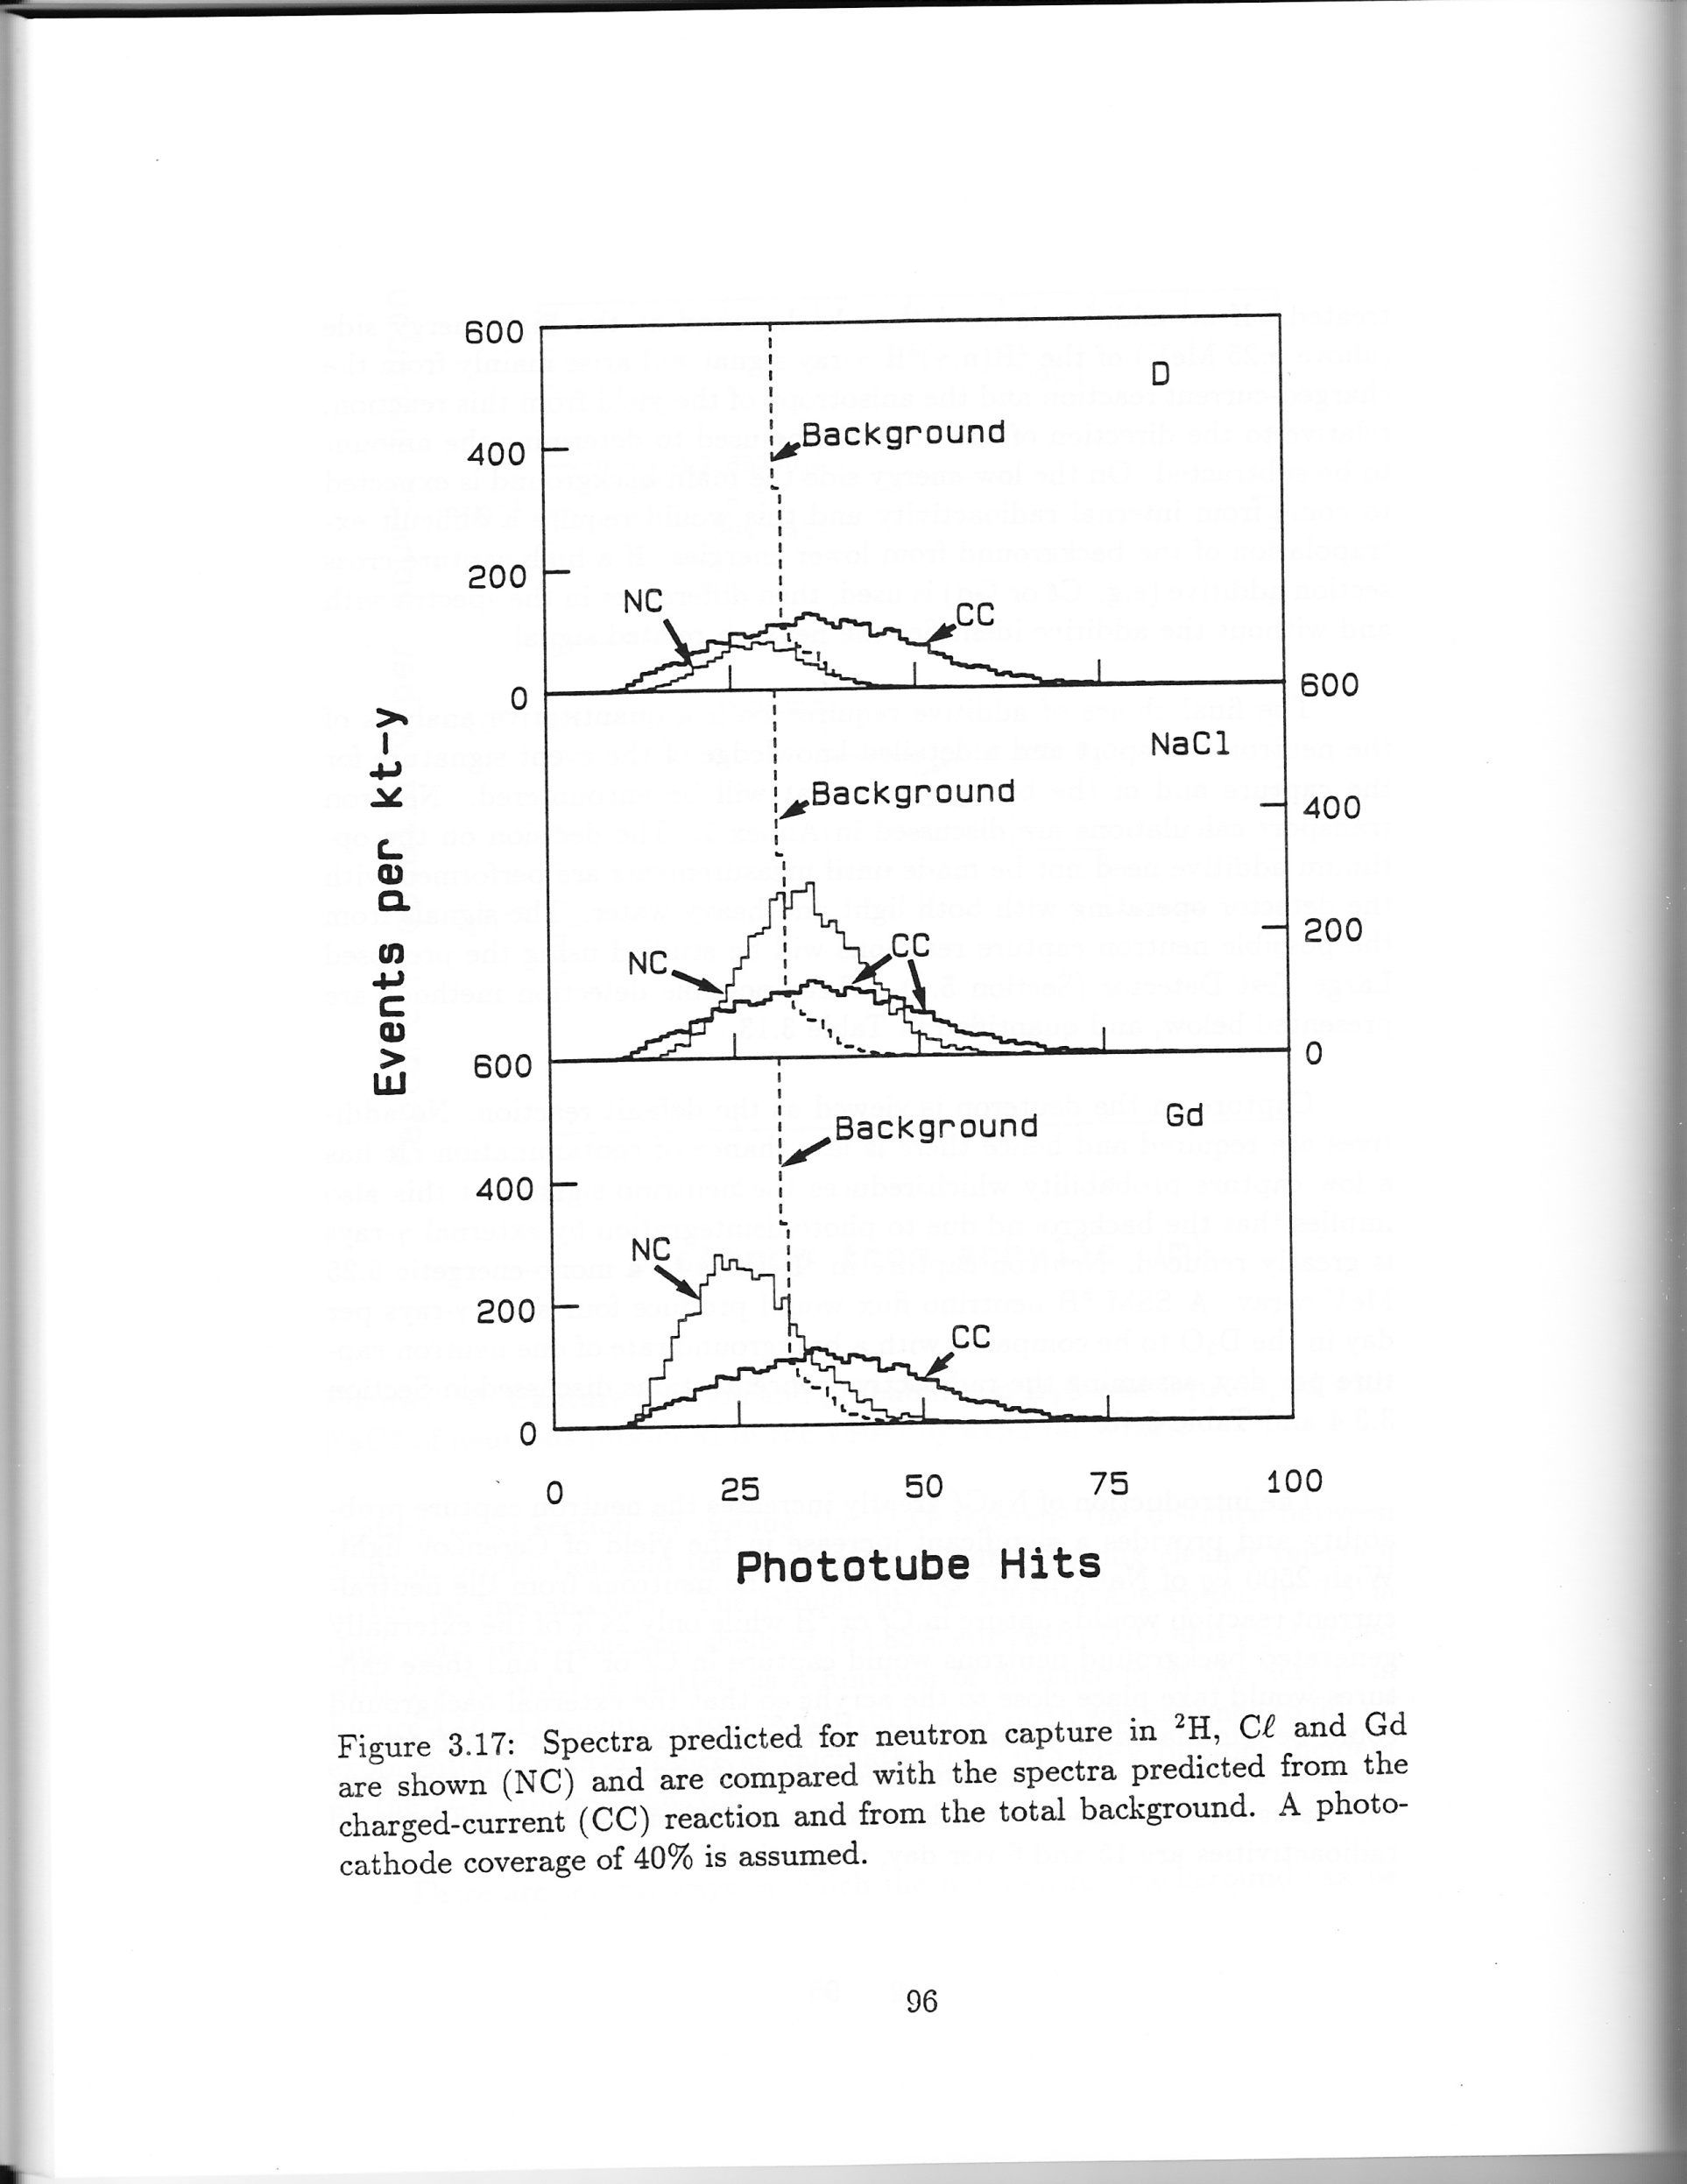
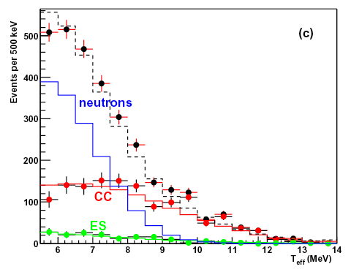
As measured 1999-2003
D₂O
As simulated in 1987
D₂O
NaCl

Slide 19
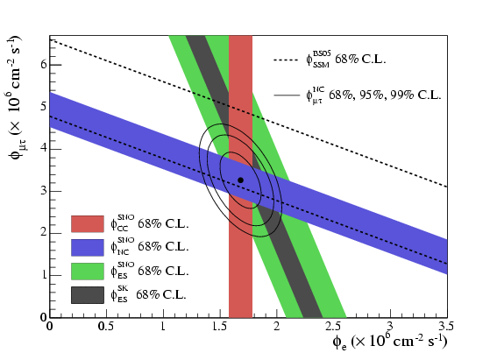
SNO Results for Salt Phase
Flavor change
determined by > 7 σ.
New physics beyond
The Standard Model of
Elementary Particles!
ν_{μ ,}
ν_{τ}
The Total Flux of Active
Neutrinos is measured
independently (NC) and agrees
well with solar model
Calculations:
5.82 +- 1.3 (Bahcall et al),
5.31 +- 0.6 (Turck-Chieze et al)
Electron neutrinos
Electron Neutrinos are only 1/3 of Total

Slide 20
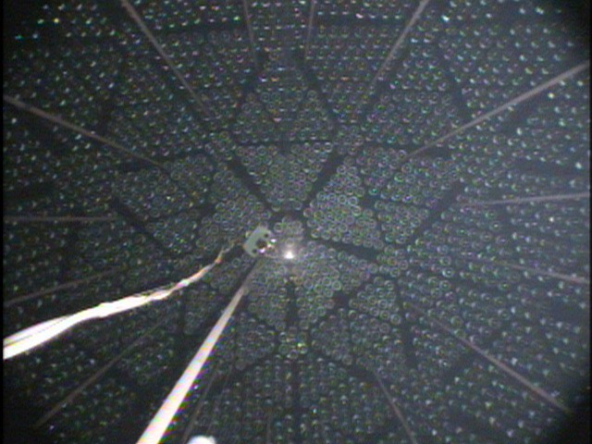
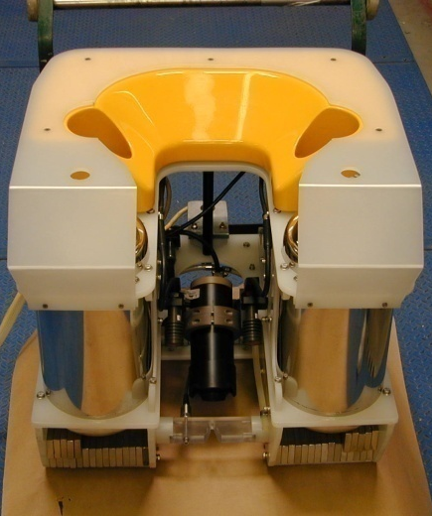
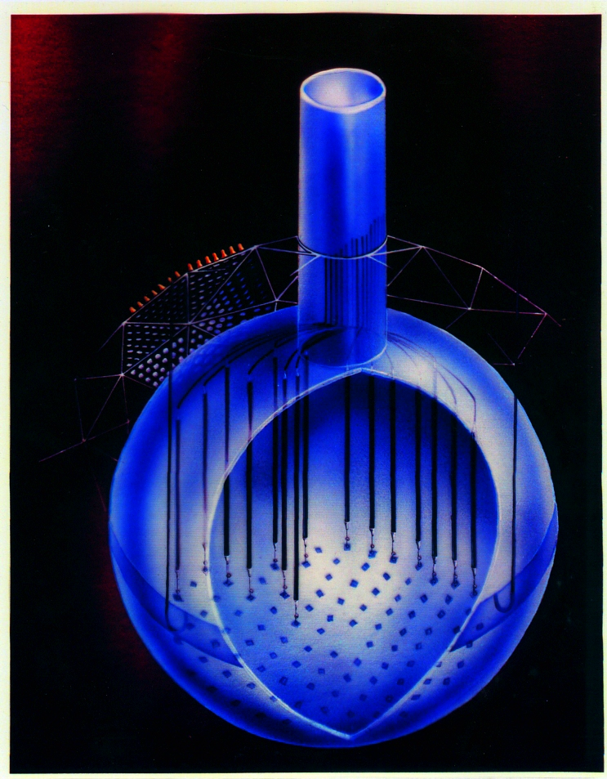
Phase 3: 400 m of Ultra Low Background Neutron Counters installed in the heavy water by a remotely controlled submarine
Light
Sensors
The Neutron Counters were a great success (after a lot of hard work by Hamish Robertson and his team).
Neutron
Detectors
The original
Submarine …
Yellow, of course!
The yellow paint was
much too radioactive.
Well, maybe not!

Slide 21
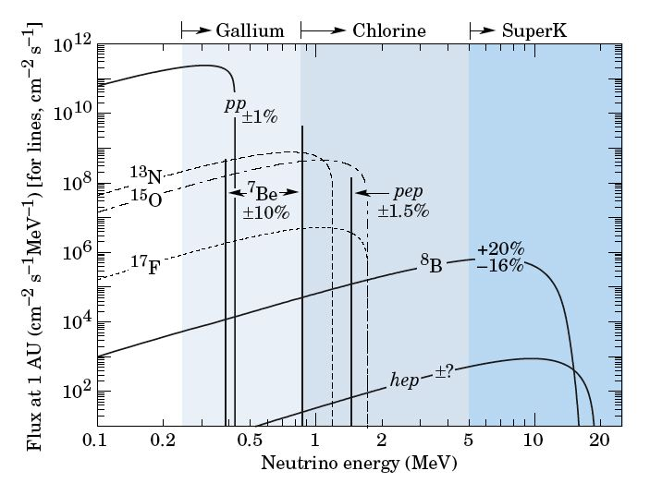
Including other solar neutrino measurements
1989 on
1992 on
1968 on
2001 on
Kamiokande
, SNO
Bahcall et al.

Slide 22
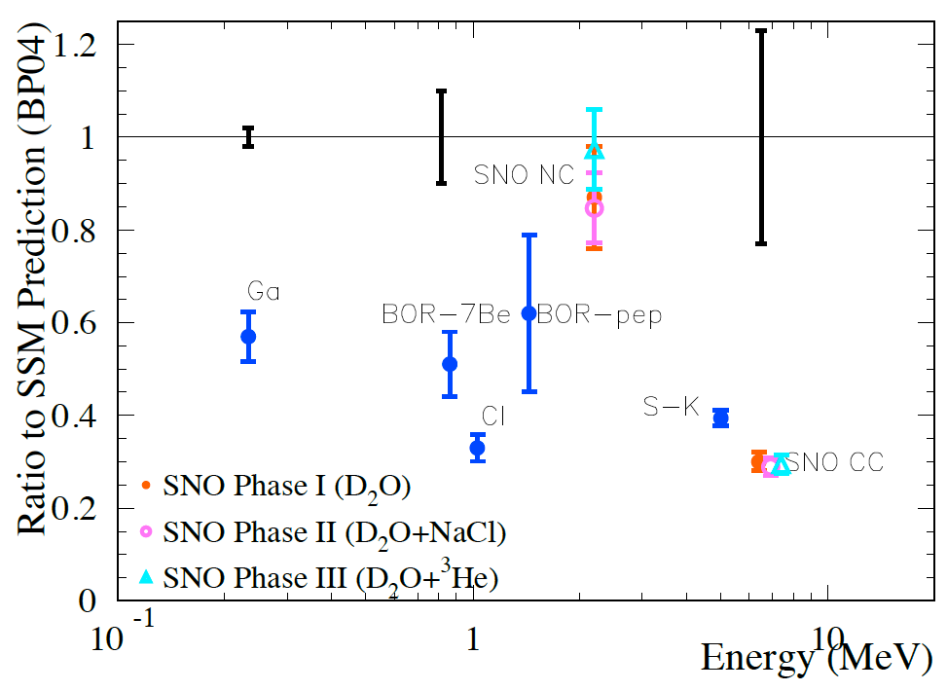
Solar Neutrino Problem
Year 2000 Experimental sensitivity: primarily or exclusively electron neutrinos
^{Theory}
pp ν
⁸B ν
⁷Be, ⁸B ν

Slide 23

Solar Neutrino Problem
Resolved
all ν_{x}
^{Theory}
ν_{e}only

Slide 24
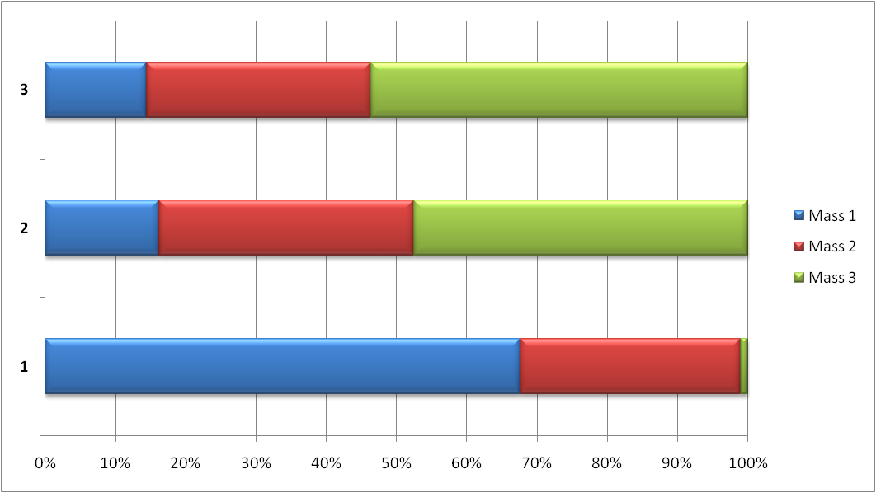
NEUTRINO OSCILLATIONS AND NEUTRINO MASS
Neutrino Flavors (Electron, Muon, Tau) can be expressed as combinations of Masses (1,2,3)
Tau
Neutrino
Muon
Neutrino
Quantum mechanics states
Electron
Neutrino
The mass fractions change as the neutrino travels
After traveling there is a finite probability to be detected as a different flavor type
Created in a unique Flavor State

Slide 25
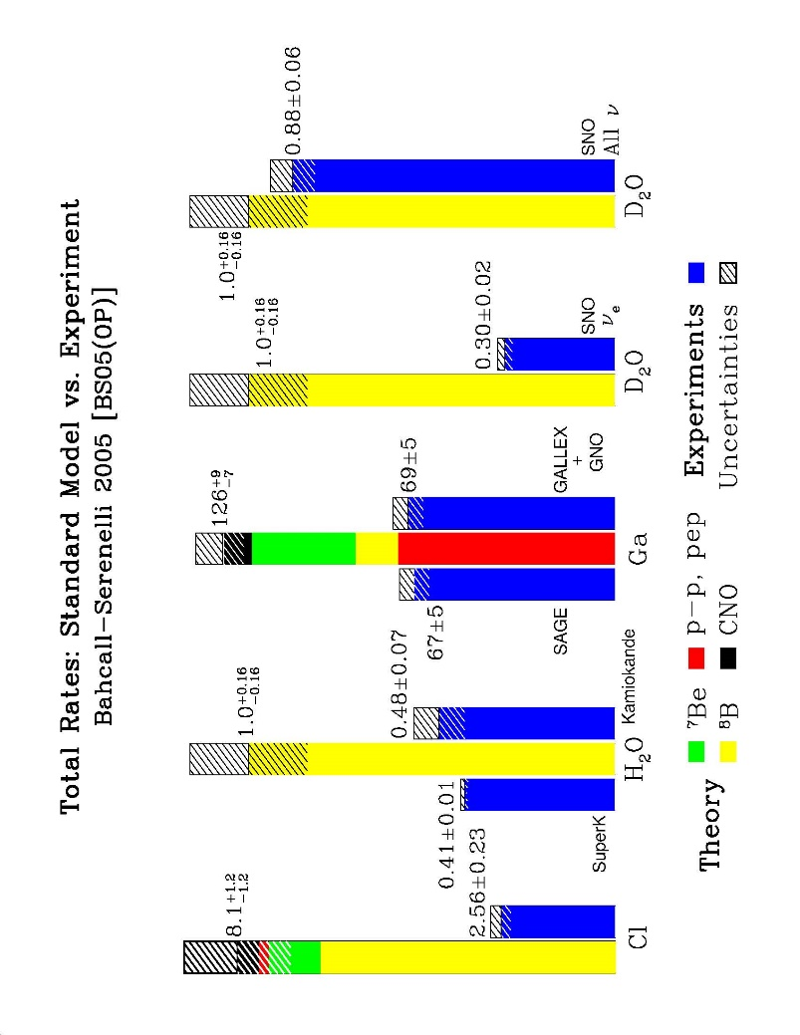
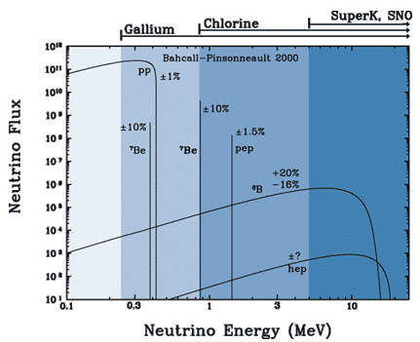
Combining SNO with other solar measurements
Solar Fluxes: Bahcall et al
Experiment vs Solar Models
The analysis concludes that the electron neutrinos are converted to a pure Mass 2 state by interaction with the dense electrons in the sun via the Mikheyev-Smirnov-Wolfenstein (MSW) effect. This interaction determines that Mass 2 is greater than Mass 1 as well as determining Δm₁₂² and the mixing parameter θ₁₂

Slide 26
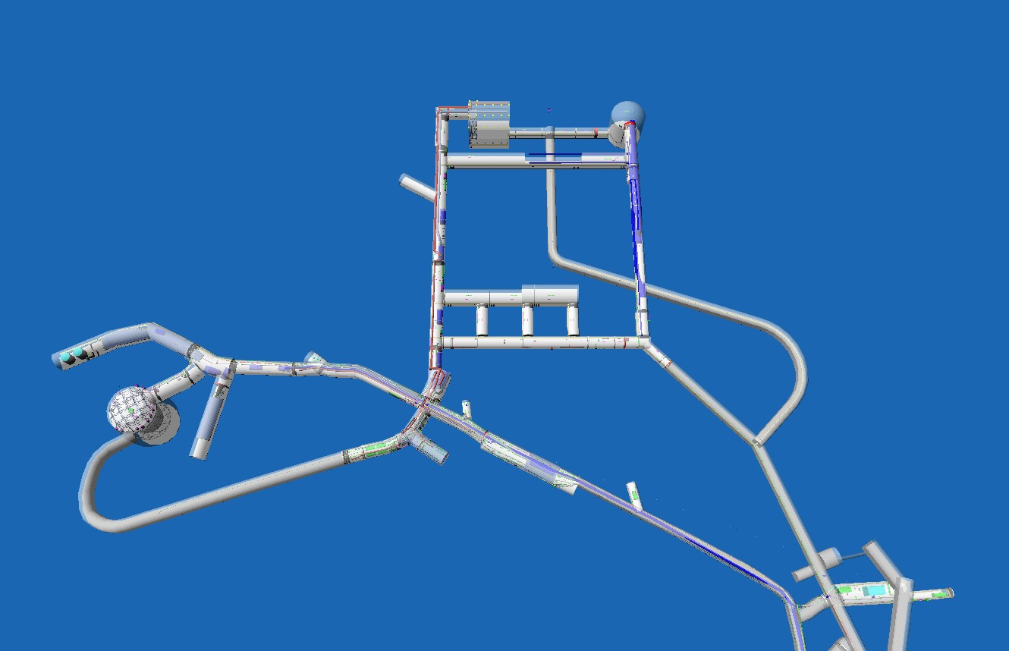
The Future: SNOLAB
DEAP/CLEAN 3600 kg Ar,
MiniCLEAN 500 kg Ar, Ne:
Dark Matter
New large scale project.
Cube Hall
60 to 800 times lower
μ fluxes than
Gran Sasso, Kamioka.
HALO
SuperNovae
Phase II
Cryopit
Now:PICO-2L,
DAMIC:Dark Matter
Now: PICO-60: Dark Matter
2016: SuperCDMS Dark Matter
New Area
SNO+: Double Beta, solar,geoneutrinos
Low Background counting facility
Ladder Labs
Utility
Area
SNO Cavern
Personnel facilities
All Lab Air: Class < 2000

Slide 27
Experiments at SNOLAB
NEUTRINOS:
- SNO+: An experiment is in construction (called SNO+) to replace the heavy water with an organic liquid (Linear Alkyl Benzene:LAB) loaded with over 2 tons of Tellurium-organic compound.
Tellurium is an ideal element to observe “neutrino-less double beta decay” a very rare radioactive process that will test whether neutrinos are their own anti-particles and if so, could tell us the absolute mass of all neutrino types. This is relevant to theories where neutrinos have a strong role in the conversion of anti-matter to matter in the early Universe. SNO+ will be among the most sensitive international experiments for neutrino-less double beta decay. SNO+ will also provide a sensitive measurement of neutrinos from the Earth, lower energy neutrinos from the Sun and from Supernovae.
- HALO: A Supernova detector using Lead and the SNO 3He detectors to emphasize electron neutrino detection for a galactic supernova.
DARK MATTER: A number of different techniques are being employed to detect Dark Matter particles left from the Big Bang:
  - DEAP and MiniClean (Liquid Argon), PICO (bubble detection in materials containing fluorine), DAMIC (Highly Pixelated solid state detectors) and SuperCDMS relocating to SNOLAB (Solid State Bolometers)

Slide 28
The Sudbury Neutrino Observatory
Funding Agencies, Other Support for SNO
CANADA:
• NSERC
• NRC
• Industry Canada
• Northern Ontario Heritage Fund Corp.
• INCO
• AECL
• Ontario Power Generation
• Nortel
USA:
• US Department of Energy
UK:
• Particle Physics and Astronomy Research
Council
Institutions:
Canada
University of Alberta (since 2005)
Chalk River Labs (until 1992)
Carleton University
University of Guelph
Laurentian University
NRC (until 1992)
Queen’s University
University of British Columbia
TRIUMF Laboratory
USA
Brookhaven National Lab
Princeton University (until 1992)
University of Texas at Austin (2002- 2008)
Los Alamos National Lab
Lawrence Berkeley National Lab
University of Pennsylvania
University of Washington
UC Irvine (until 1989)
Louisiana State University (since 2005)
MIT (since 2005)
UK
Oxford
Portugal
LIP Lisbon
(since 2005)

Slide 29
262 SNO Physics Paper Authors: Adam Cox, Aksel L. Hallin, Alain Bellerive, Alan Smith, Alan Poon, Alexander Wright, Allan Myers, Alysia Marino, André Krüger, André Roberge, Andre Krumins, Andrew Ferraris, Andrew Hime, Anett Schülke, Anthony Noble, Araz Hamian, Arthur McDonald, Aubra Anthony, Azriel Goldschmidt, Barry Robertson, Bassam Aharmim, Bei Cai, Benjamin Monreal, Bernard Nickel, Berta Beltran, Bhaskar Sur, Blair Jamieson, Brandon Wall, Brent VanDevender, Brian Morissette, Bruce Cleveland, Bryan Fulsom, Bryce Moffat, Carsten Krauss, Catherine Mifflin, Charles Currat, Charles Duba, Charlotte Sims, Christian Nally, Christian Ouellet, Christine Kraus, Christopher Kyba, Christopher Howard, Christopher Jillings, Christopher Tunnell, Christopher Waltham, Clarence Virtue, Colin Okada, Darren Grant, David Anglin, David Sinclair, David Waller, David Wark, Davis Earle, Diane Reitzner, Dimpal Chauhan, Doug Hallman,D ouglas Cowen, Douglas McDonald, Duncan Hepburn, Ed Frank, Edward Clifford, Michael Dragowsky, Emmanuel Bonvin, Eric Norman, Erik Saettler, Etienne Rollin, Eugene Guillian, Eugene Beier, Fabrice Fleurot, Feng Zhang, Ferenc Dalnoki-Veress, Fraser Duncan, Gabriel D. Orebi Gann, Geoffrey Miller, George Doucas, George Ewan, Gerhard Bühler, Gersende Prior, Gordana Tešić, Gordon,McGregor, Gregory Harper, Guy Jonkmans, Gwen Milton, Hadi Fergani, Hamish Robertson, Hans Bichsel, Hans Mes, Hardy Seifert, Hay Boon Mak, Heidi Munn, Helen M. O'Keeffe, Hendrick Labranche, Henry Lee, Hok Seum Wan Chan Tseung, Huaizhang Deng, Hugh Evans, Hui-Siong Ng, Ian Lawson, Ilan Levine, Ira Blevis,Jacques Farine, James Cameron, James Hall, James Loach, James Leslie, Jaret Heise, Jason Detwiler, Jason Hewett, Jason Pun, Jason Goon, Jeanne Wilson, Jeffrey Secrest, Jeremy Lyon, Jerry Wilhelmy, Jessica Dunmore, Jian-Xiong Wang, Jimmy Law, Jocelyn Monroe, John Amsbaugh, John Boger, John Orrell, John Simpson, John Wilkerson, Jon Hykawy, Jose Maneira, Joseph Formaggio, Joseph Banar, Joseph Germani, Joshua Klein, Juergen Wendland, Kai Zuber, Kara Keeter, Kareem Kazkaz, Karsten Heeger, Katherine Frame, Kathryn Schaffer, Keith Rielage, Kennneth McFarlane, Kevin Graham, Kevin Lesko, Kevin McBryde, Khalil Boudjemline, Klaus Kirch, Laura Kormos, Laura Stonehill, Laurel Sinclair, Louise Heelan, Malcolm Fowler, Manuel Anaya, Marc Bergevin, Marcus Thomson, Maria Isaac, Marie DiMarco, Mark Boulay, Mark Chen, Mark Howe, Mark Kos, Mark Neubauer, Martin Moorhead, Masa Omori, Melin Huang, Melissa Jerkins, Michael Bowler, Michael Browne, Michael Lay, Michael Lowry, Michael Miller, Michael Thorman, Michal Shatkay, Mike Schwendener, Miles Smith, Minfang Yeh, Miriam Diamond, Mitchell Newcomer, Monica Dunford, Morley O'Neill, Mort Bercovitch, Myung Chol Chon, Naeem Ahmed, Nathaniel Tagg, Neil McCauley, Nicholas Jelley, Nicholas West, Nikolai Starinsky, Nikolai Tolich, Noah Oblath, Noel Gagnon, Nuno Barros, Olivier Simard, Patrick Tsang, Paul Keener, Peter Wittich, Peter Doe, Peter Watson, Peter Skensved, Peter Thornewell, Philip Harvey, Pierre Luc Drouin, Pillalamarr Jagam, Ranpal Dosanjh, Reda Tafirout, Reena Meijer Drees, Reyco Henning, Richard Allen, Richard Ford, Richard Helmer, Richard Hemingway, Richard Kouzes, Richard Hahn, Richard Lange, Richard Ott, Richard Taplin, Richard Van Berg, Richard Van de Water, Rizwan Haq, Robert Black, Robert Boardman, Robert Stokstad, Robert Heaton, Robert Komar, Robin Ollerhead, Rushdy Ahmad, Ryan MacLellan, Ryan Martin, Ryuta Hazama, Salvador Gil, Sarah Rosendahl, Scott Oser, Sean McGee, Shahnoor Habib, Sherry Majerus, Simon Peeters, Stanley Seibert, Steffon Luoma, Steven Elliott, Steven Bille, Steven Brice, Teresa Spreitzer, Thomas Andersen, Thomas J. Radcliffe, Thomas J. Bowles, Thomas Kutter, Thomas Sonley, Thomas Steiger, Timothy Van Wechel, Tom Burritt, Tudor Costin, Tyron Tsui, Vadim Rusu, Vladimir Novikov, Walter Davidson, William Frati, William Handler, William Heintzelman, William Locke, William McLatchie, Xin Chen, Xin Dai, Yaroslav Tserkovnyak, Yasuo Takeuchi, Yekaterina Opachich, Yuen-Dat Chan And 11 who have passed away: Herbert Chen, John C. Barton, John Cowan, Andre Hamer, Clifford Hargrove, Barry C. Knox, Jan Wouters, Peter Trent, Robert Storey, Keith Rowley and Neil Tanner

