Slide 1
What Is the Brain?
An Intro to Brain Reach

Slide 2


What is science?
What is a SCIENTIST?
Notes:
Now discuss who you are, a scientist and ask them what they think scientists do. Brainstorm on this and use this to start explaining your role as a scientist. Tell them that during the entire year they will be BrainReach Investigators and they will be learning science with you.
Distribute a folder to each student as well as a cardboard paper. Have them write their name on both (in large caps!!). Explain that they will have to take this folder out every time you come and that you will have hand outs for them to store in this folder.
Icon by Eucalyp on flaticon.com

Slide 3
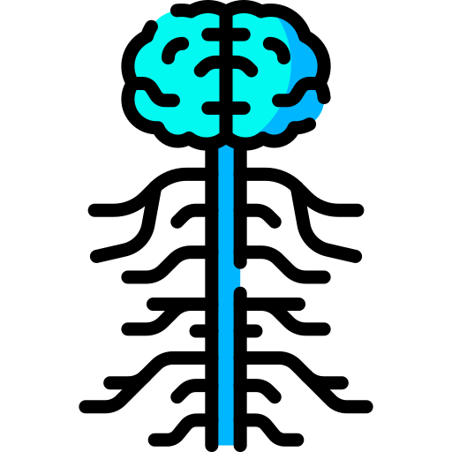
What is a
neuroscientist?
Notes:
Now specify that you are a neuroscientist, you study the brain!
Icon by Freepik on flaticon.com

Slide 4
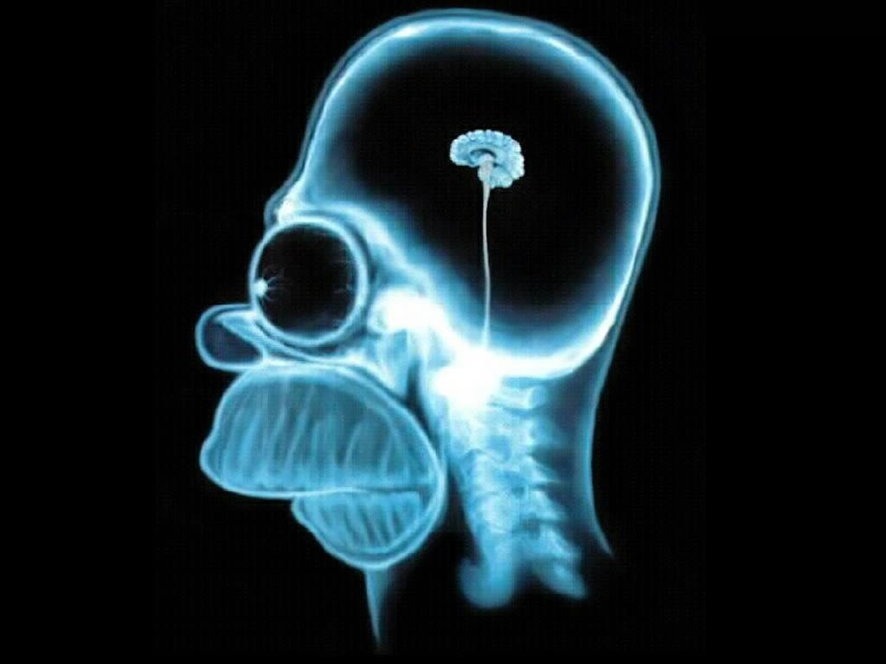
Notes:
Start by asking the students if they think this is an accurate representation of the brain, then proceed to the real brain picture.
Original image source unknown (published on many Internet sites)

Slide 5

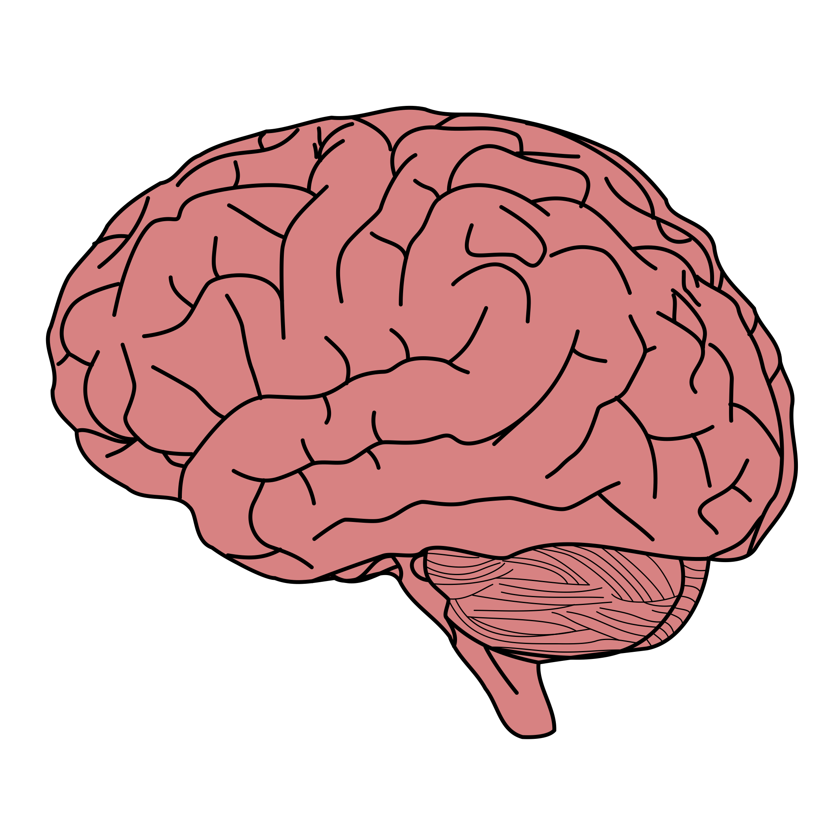
The Brain
Think!
What do you know about the brain?
Notes:
Ask them what they know about the brain or what they may have heard or seen in movies and on TV. Use this time to brainstorm with them and see what they know about it or what they are interested in (i.e. are there many questions on dreams, memory etc).
If they mention info that is false, i.e. we use 10% of our brain….at this point you can start going into more details and correct any misconceptions.

Slide 6
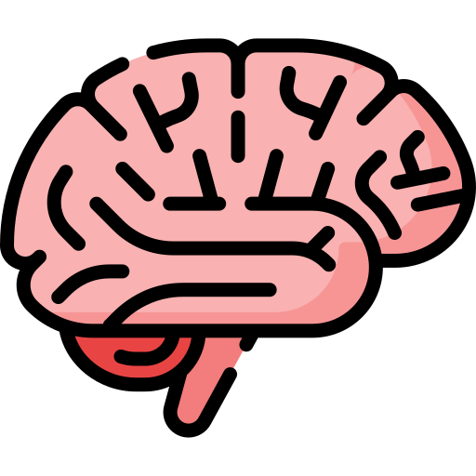
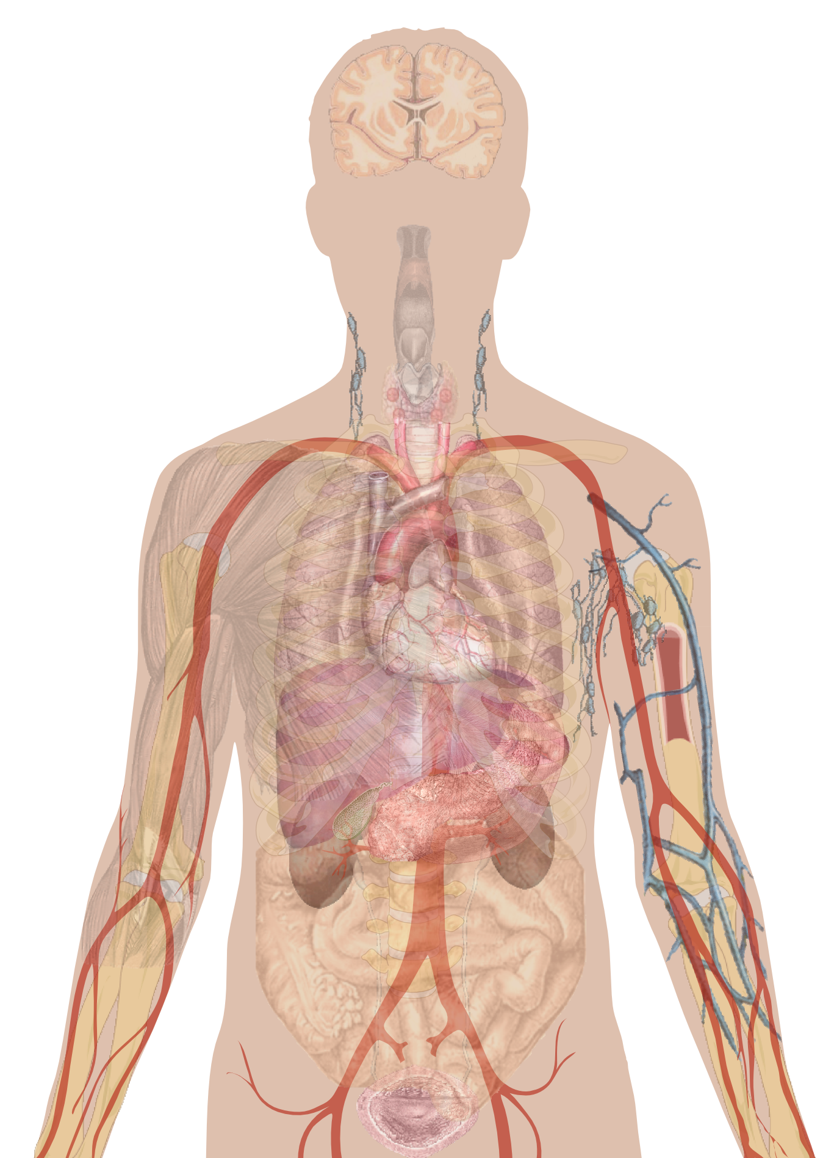




The Brain Is an Organ
Let’s look at the human body!
Notes:
Don’t spend too much time on this slide (i.e. do not describe in detail the functions of all the other organs)…this is where the Question folder comes in handy….whenever there are too many questions that are broad, ask the student(s) to write it down and put it in the question folder. Simply write a brief response and hand it back to them next class. This way their question got answered and you were still able to teach!!
Start from the bigger picture: the human body as a whole.
Ask the kids to name major organs and explain where the organs are located and their major functions.
Heart: Pump: helps circulate blood carrying nutrients and oxygen around the body.
Lung: Breathing: helps us get the oxygen needed for our organs to get energy and function
Liver: helps with metabolism and stores “food”
Kidney: filter: cleans our blood from waste
Skin: protects our body from foreign elements
Brain: processing centre: thinking, moving, ….
This is the organ that we will focus on and discover together!
Human body image By Mikael Häggström - All used images are in public domain., CC0, https://commons.wikimedia.org/w/index.php?curid=15298838
Organ images by Freepik on flaticon.com

Slide 7
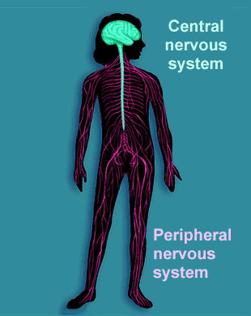
The Nervous System
Think!
How does your brain communicate?
Notes:
We know now that the brain is the main processing center (like a computer). But it does not have Wifi!!! Ask the students, how to you think the brain communicates with rest of the body? Brainstorm ideas. Ask them: what is our brain connected to? (you can point to your back if they are having trouble!). They might say “vertebral column” clarify that this protects something very important in the center of it…our spinal cord!! Our nervous system is like a highway for cars. Some information leaves the brain to travel down our spinal cord (in vertebral column) and reaches our fingertips or toes by passing through our nerves. Other information starts at out fingertips and toes, travels through our nerves to our spinal cord and back to the brain. Our brain and spinal cord are known as the central nervous system and our nerves (found in all our limbs and body) are part of peripheral nervous system.

Slide 8
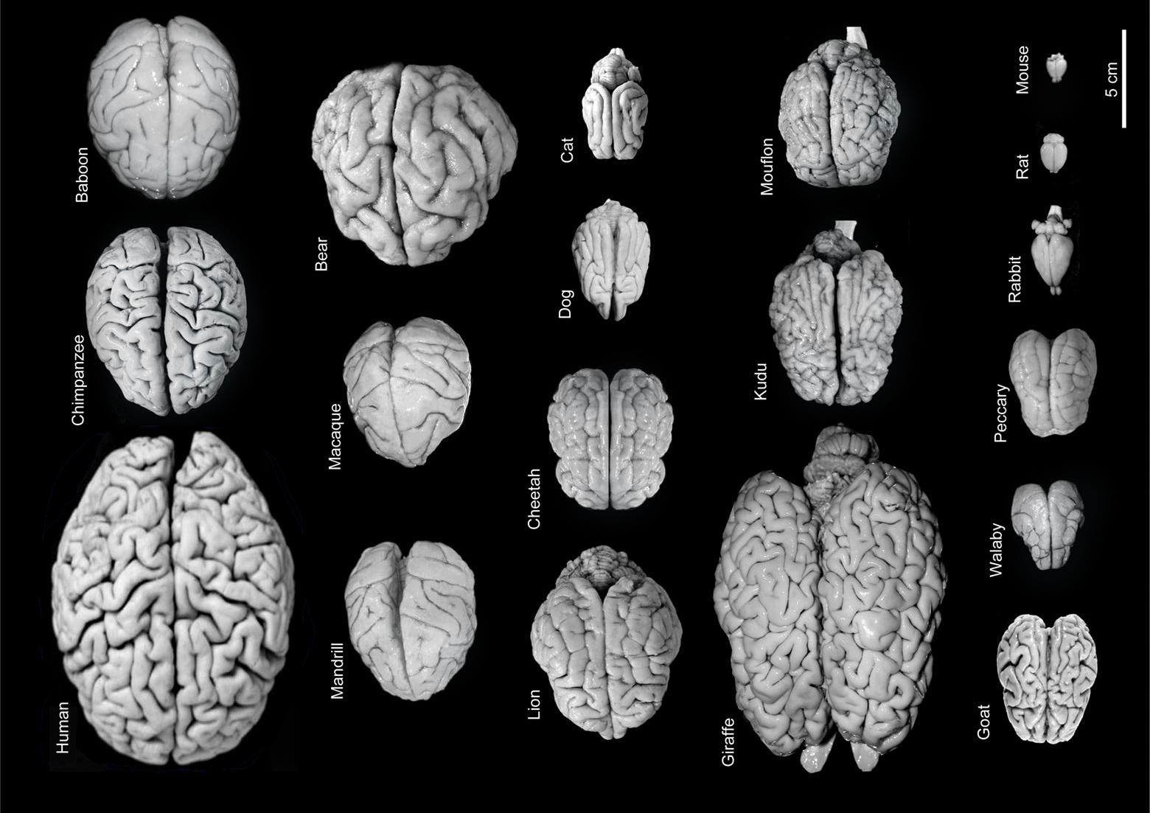
Why does your brain have folds?
Challenge: Try to put your brain in your pocket…
Notes:
In this picture you see different brains. What are the similarities? What are the differences?
Why do many of them have folds?

Slide 9
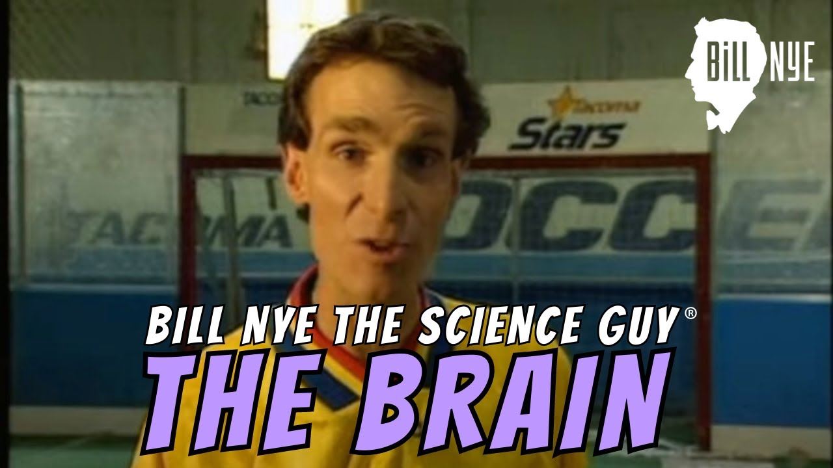
Why does your brain have folds?
Let’s watch!
Notes:
Note: Make sure this works ahead of time. We will post this video file for you, so you can also play the video in windows media player if needed..
This is a Bill Nye video discussing the folds of the brain.
If you are giving the presentation in French, mute the video and discuss it as you are showing the video.
Here is the YouTube link for the video, as it might not load in the PowerPoint:
https://www.youtube.com/watch?v=Camj8085Te0

Slide 10
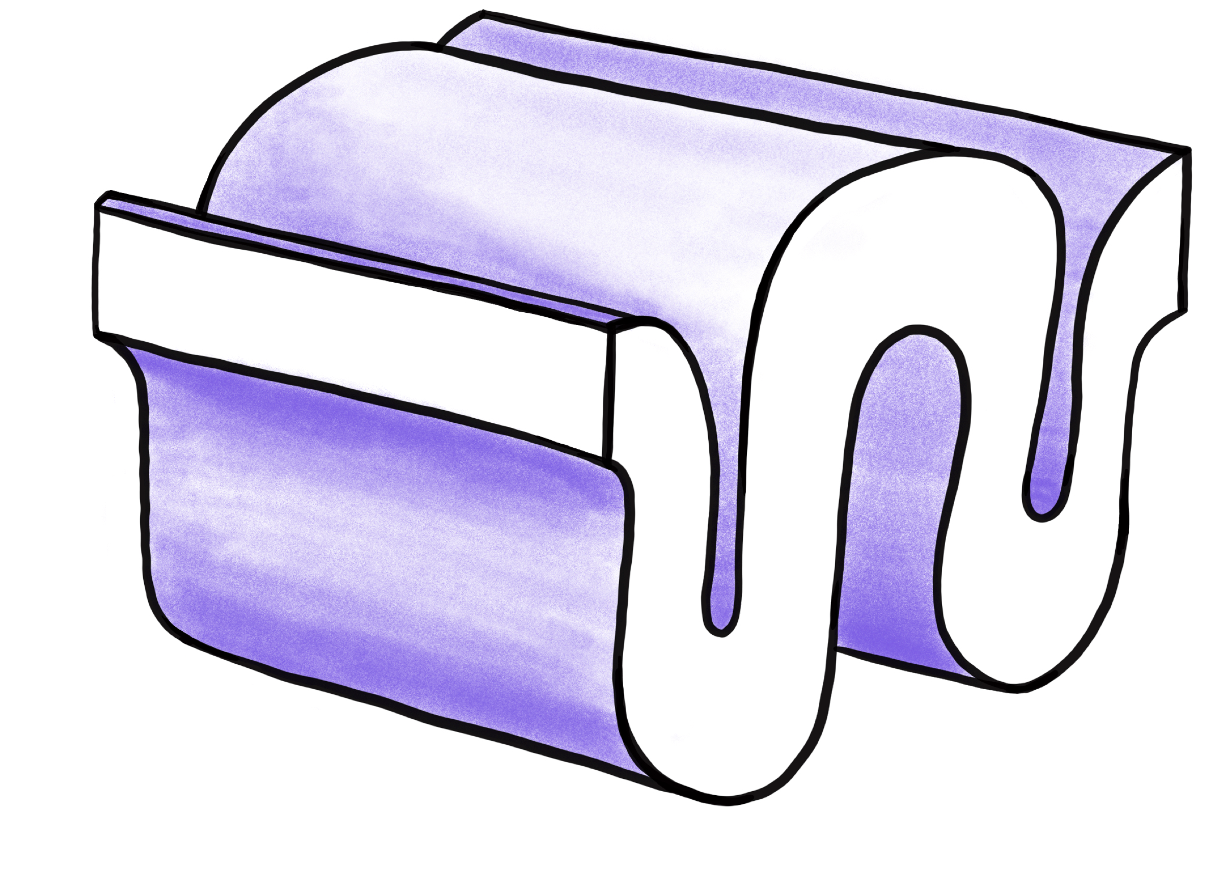
Brain Anatomy
Gyri
Cortex
Sulci
Cerebellum
Brainstem
Notes:
Hand out the brain models, but don’t let them start taking them apart yet. First go over the main structures: the cortex, cerebellum and brain stem. Show them a sulcus and a gyrus on this diagram.
Helpful Websites:
http://thebrain.mcgill.ca/
(the above website is also in French)
http://www.brainpop.fr/sante/lecorpshumain/cerveau/
http://fr.brainexplorer.org/brain_atlas/Brainatlas_index.shtml

Slide 11
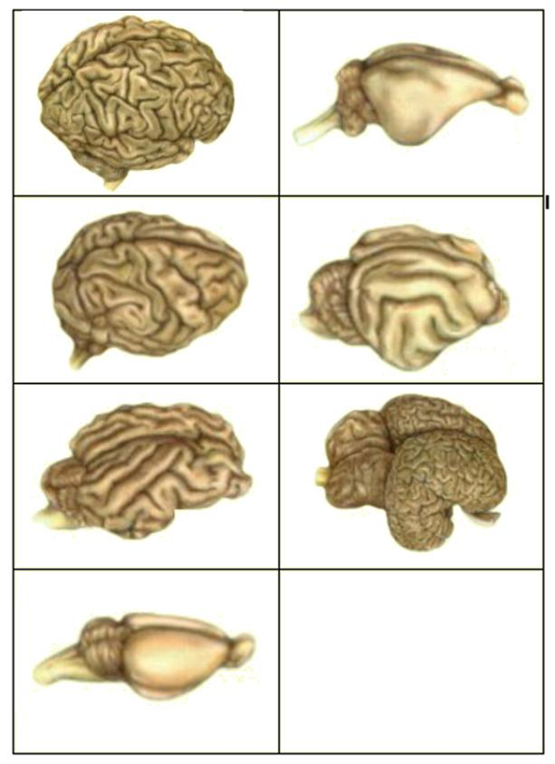
Activity!
Match the brain to the animal:
Human
Rat
Sheep
Rabbit
Dolphin
Chimpanzee
Cat
1
2
3
4
5
6
7
Notes:
ACTIVITY!! This entire activity should last about 15-20 min
MATERIALS FOR ACTIVITY: Laminated matching cards (be sure to collect these at the end of class, we will reuse them), activity worksheet
Have them get into groups. Each group gets a set of laminated matching cards. The goal of the activity is to match each brain to the correct animal. Let them know that all the brains are intentionally equally sized, if not it would be too easy for them!! Give them about 5 min to complete this task and then go over the answers with them. Remind them what we just talked about. Brains became wrinklier as species evolved and that more wrinkles often means more “intelligence.” If they need another hint, look at the direction of the brainstem.
You can give them the answers to this activity by going to the next slide, or you could point to each brain and have the class vote on which one they think it is.

Slide 12
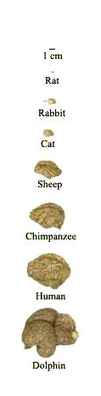
ACTUAL SIZE
Activity!
1
1 cm
Rat
Match the brain to the animal:
Human
Rat
Sheep
Rabbit
Dolphin
Chimpanzee
Cat
6
Rabbit
5
Cat
2
Sheep
4
Chimpanzee
3
Human
7
Dolphin
Notes:
Here we see that they are in fact different in size. Here are the answers to the activity. The more complex an animal’s brain is, the more folds there are. => You can hand out the “brain matching activity answer sheet.” They will keep it in their folder.
http://thebrain.mcgill.ca/flash/i/i_05/i_05_cr/i_05_cr_her/i_05_cr_her.html
Ever since the first mammals appeared more than 200 million years ago, the cerebral cortex has assumed greater and greater importance compared with the brain's other, older structures. Because these structures had proven their effectiveness for meeting certain fundamental needs, there was no reason for them to disappear. Instead, evolution favoured a process of building expansions and additions, rather than rebuilding everything from the bottom up. This expansion of the surface of the neocortex (also known as the isocortex) is more apparent in predatory mammals than in herbivorous ones. Catching prey may be difficult, but a successful hunt provides a far more nutritious meal than any plant. To hunt successfully requires a highly evolved sensorimotor system. Mammals with a large neocortex thus have an advantage, because that is where the sensory and motor regions are located. Scientists have also observed that the size of the neocortex has increased tremendously in primates, from the smallest monkeys, such as lemurs, on to the great apes and human beings. Many scientists believe that this growth in the primates’ neocortex reflects the growing complexity of their social lives. Indeed, the ability to predict the behaviour of other individuals within a group seems to have conferred a large evolutionary advantage. Thus evolution would have favoured the growth of certain parts of the cortex that are responsible for social skills such as language, because they improved this ability.
Another point on which everyone agrees is that the increase in the folds of the cortex has been a major factor in the evolution of the brain. These folds, by enabling a larger cortical surface area to fit inside the cranial vault, allow for a better organization of complex behaviours.

Slide 13
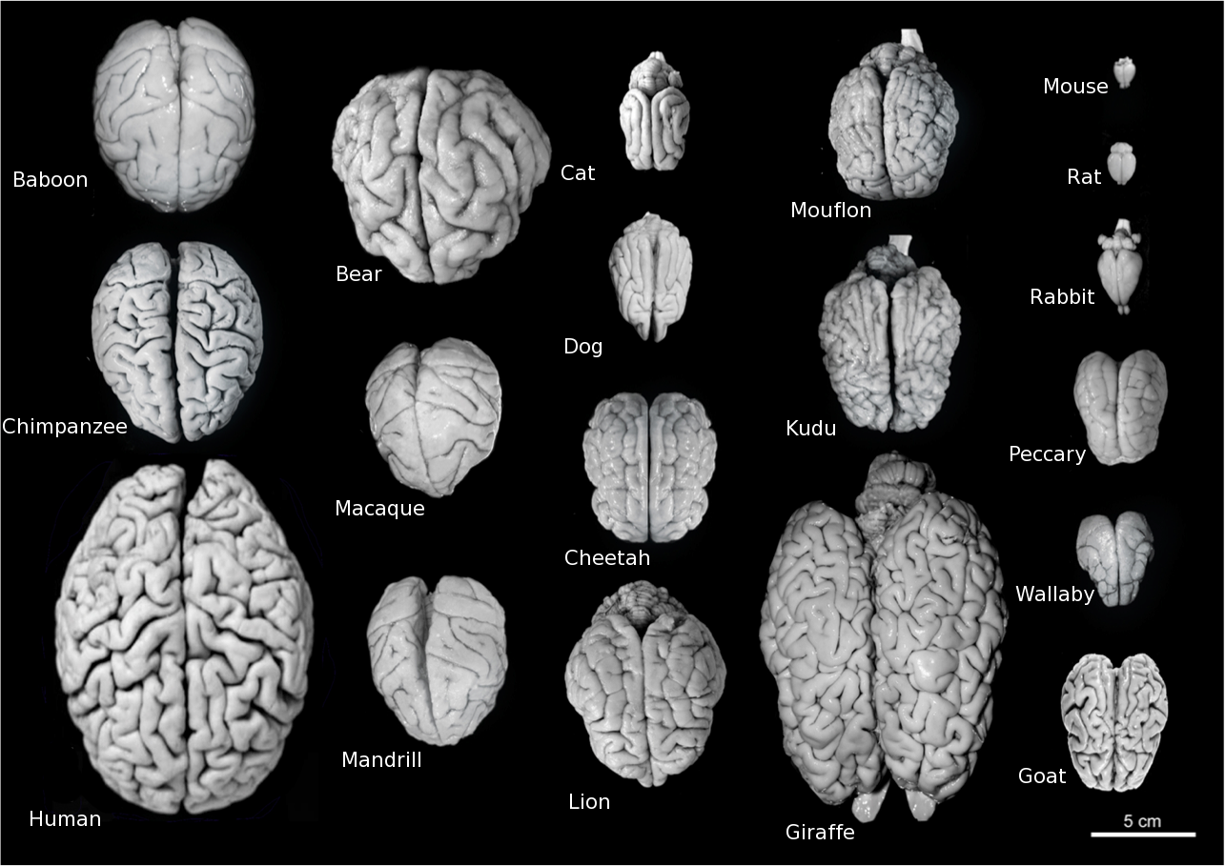
Here are some more animal brains:
Notes:
If you have time….you can show this slide that they have already seen, but this time it has the animal names on it.
Here is the picture used a few slides before with the names of the animals. You can use it to sum up the concepts.
FYI for presenters:
Mandrill – Old World monkey, closely related to baboon
Mouflon – Wild sheep
Kudu – subspecies of antelope
Wallaby – macropod, looks like a small kangaroo
Peccary – medium sized animal with resemblance to a pig

Slide 14
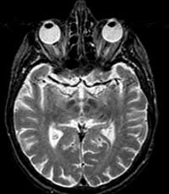
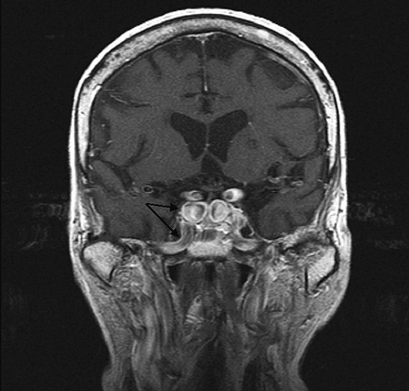
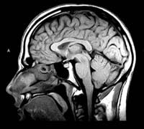
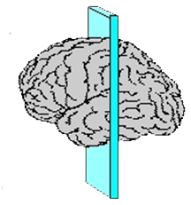
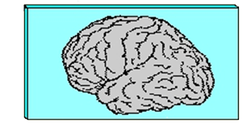
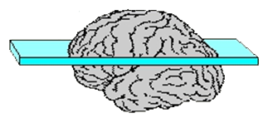
How do we see INSIDE the brain?
Horizontal
Coronal
Saggital
Notes:
Explain that scientists can visualize the brain, and what’s inside it, but using various imaging techniques (if there are questions, you can talk about the various types of imaging, depending on class interest).
In this example, we can use MRI to scan the brain in different planes – go through the planes with the students.

Slide 15
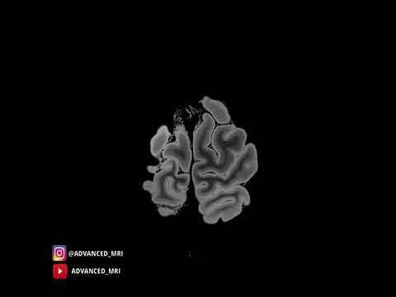
Notes:
This is a high resolution scan of brain (0:30): https://www.youtube.com/shorts/V_JOdlaDn6M
(make sure you orient them to what they are seeing. That you are starting from the top and moving through the brain).
Here are some other videos you can watch, depending on 1) the amount of time you have left & 2) how advanced the students are:
A children's Guide to MRI (2:30): https://www.youtube.com/watch?v=b073SYKrvP4
How does an MRI machine work (3:10): https://www.youtube.com/watch?v=nFkBhUYynUw
This video is more advanced. I would only show if the students are older or more advanced (say 6th grade) or specifically show interest. You could also clip out 30 seconds of it, and give a simpler explanation.

Slide 16
Summary
Neuroscience is the study of the nervous system
It includes the brain, spinal cord, and peripheral nervous system
The brain has folds and is made up of parts
Notes:
Prompt:
What do the brain and spinal cord make up? (Central nervous system)
What are some of the brain’s parts? Do you remember what the folds are called? (Cortex, cerebellum, brainstem; gyri, sulci)

Slide 17
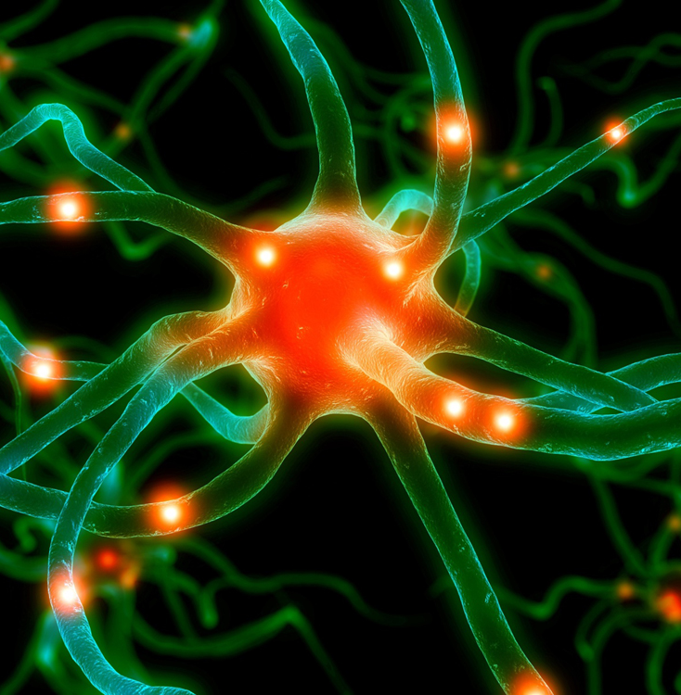
Summary
Different animal species have different brains
We can look at the brain in 3 planes with MRI
Notes:
Prompts:
What are some of the differences in animals’ brains? (Size, folds)
What are the 3 planes? (Horizontal, saggital, coronal)
Does anyone remember what MRI stands for?

Slide 18
Questions?

