Slide 1
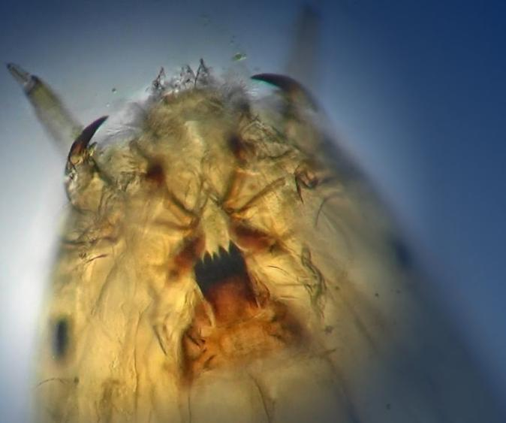
Using chironomid sedimentary assemblages to infer long-term changes in the deepwater oxygen conditions of Peninsula Lake, ON
Adam Jeziorski, Dara Corrigan, Clare Nelligan,
Andrew M. Paterson, and John P. Smol
PALS 2019
Notes:
25 mins (~40 slides) on deepwater oxygen conditions in Peninsula Lake, ON

Slide 2
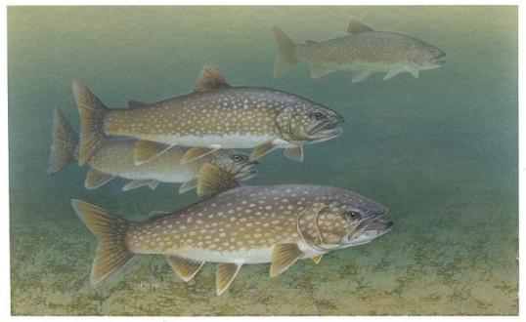
Lake Trout and Deepwater Oxygen
Lake Trout (Salvelinus namaycush) are a cold water fish, vulnerable to a wide variety of environmental stressors
Lake Trout lakes are a rare and valuable resource with 20-25% of global supply located in ON (~2200)
Many southern Lake Trout populations live within narrow temperature and oxygen boundaries in the hypolimnia of stratified lakes
Climate warming a “threat multiplier”
Concern Lake Trout habitat may be impacted by reduced ice cover and increased strength of lake stratification

Slide 3
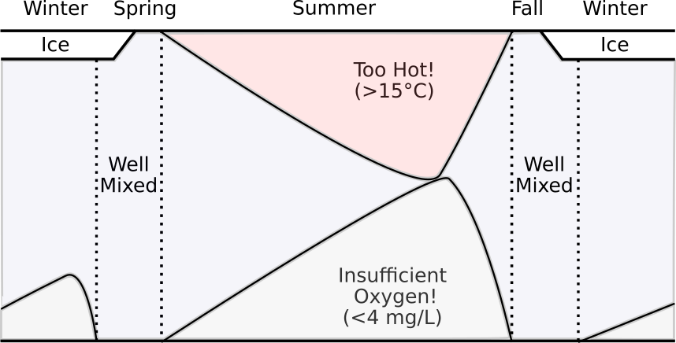
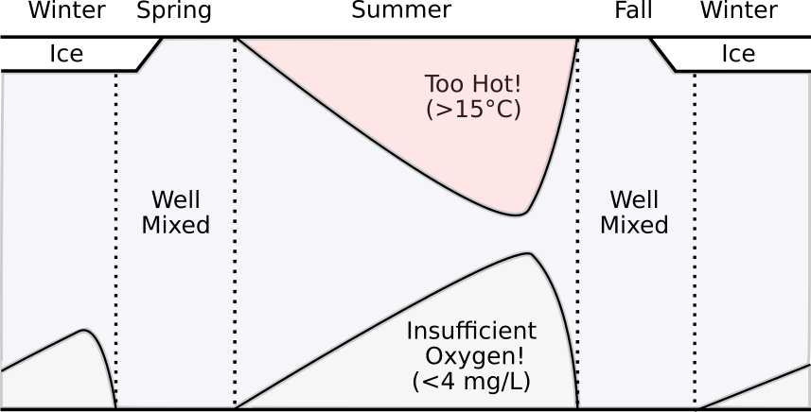
Lake Trout Habitat “Squeeze”
Provincial Criterion for Volume-weighted Hypolimnetic O₂ > 7 mg/L
(Evans et al. 2007)
Notes:
(Figure modified from Guzzo and Blanchfield 2016)
Interested in examining long-term changes in VWHO, use chironomids as a paleoindicator

Slide 4
Peninsula Lake
Located on the Precambrian Shield in south-central ON
Stocked with Lake Trout to support recreational fishing
Since European settlement, the catchment has experienced varied environmental stressors:
Forest clearance
Water level management
Land-use changes related to cottage and resort development
Peninsula Lake Characteristics
Location | 45° 20′ N 79° 06′ W
Surface Area | 8.4 km²
Drainage Area | 62.4 km²
% Watershed Forested | 47.0
% Watershed Developed | 7.7
Maximum Depth | 37 m
pH | 7.2
Total Phosphorus | 9.4 μg/L
Dissolved Organic Carbon | 4 mg/L
Lake Trout Status | P-G-T

Slide 5
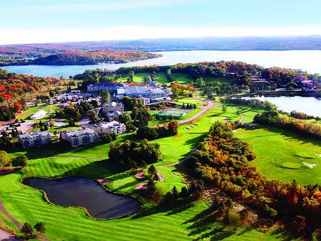
Peninsula Lake
Deerhurst Resort
Established 1896, first major resort on the northern lakes of Muskoka
Today it spans 800+ acres and can host 1000 guests
Prior to the 1970s the resort pumped its raw sewage directly into the lake
Peninsula Lake Timeline
1868 | First Pioneers
1870 | Road
1886 | Railway
1870-1890 | Development of Local Industries
1896 | Deerhurst Resort
Late 1800s – Early 1900s | Significant Timber Harvesting
1972 | Sewage Treatment
2010 | G8 Summit

Slide 6
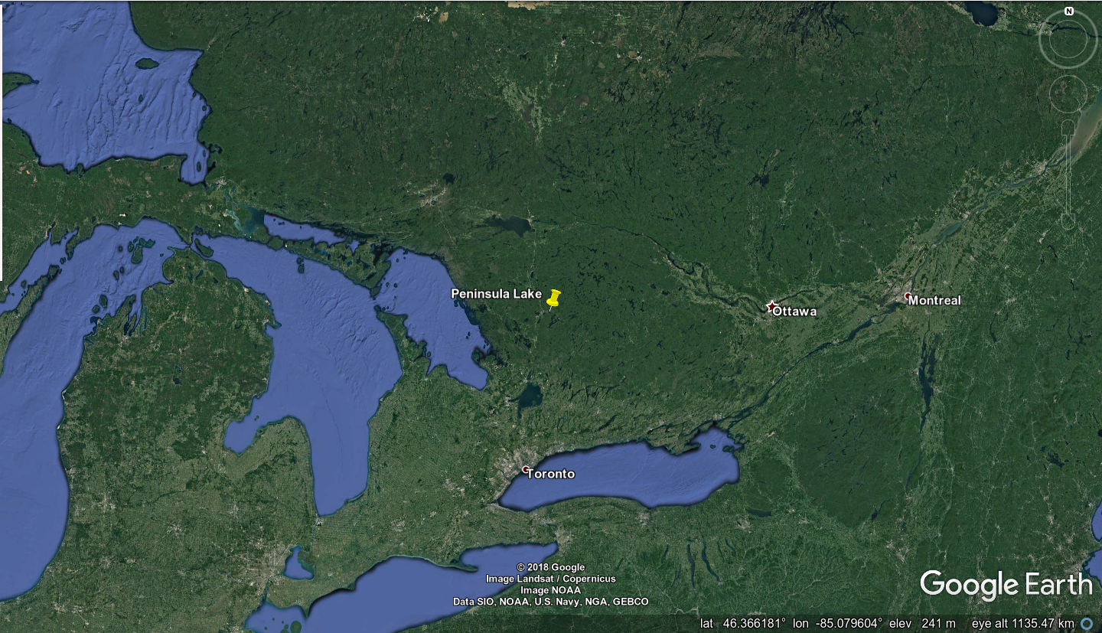
Peninsula Lake

Slide 7
Peninsula Lake

Slide 8
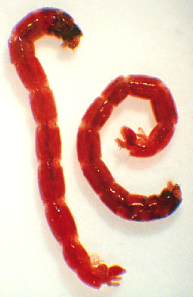
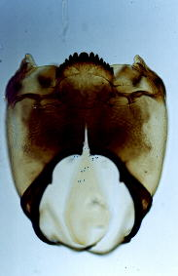
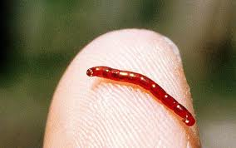
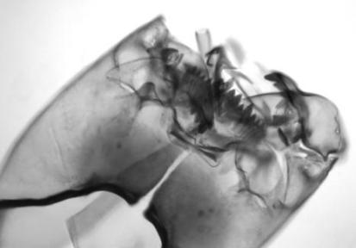
Chironomids
Chironomidae (non-biting midges) are a widespread insect family
Larval head capsules preserve well in lake sediments (identifiable to genus/species level)
Reliable ecological indicators due to rapid life cycle, active dispersal, and sensitivity to variety of environmental variables
Sedimentary chironomid assemblages have been used to study:
Climate (temperature)
Eutrophication and oxygen depletion (volume-weighted hypolimnetic oxygen; VWHO)

Slide 9
Diatoms
Diatoms (Class: Bacillariophyceae) are a major algal group
Siliceous cell walls preserve well in lake sediments
Most widely used ecological indicators
Sedimentary diatom assemblages have been used to study:
pH
salinity
nutrient concentrations (e.g. TP)

Slide 10
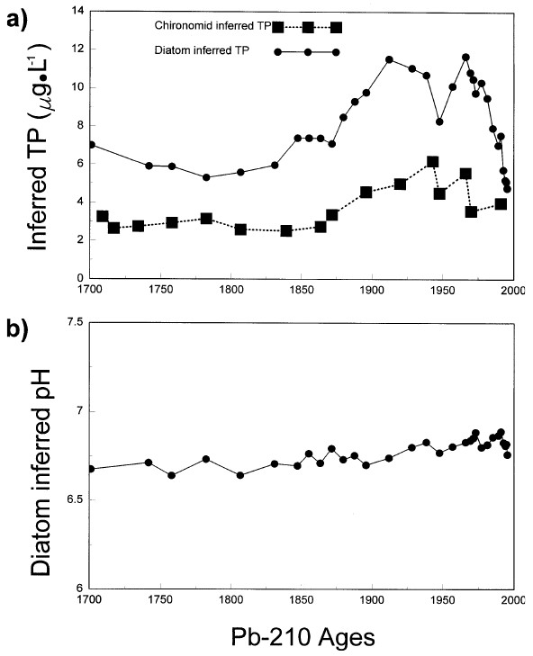
Previous Paleolimnological Work
Diatom and chironomid analysis conducted in mid-1990s (Clerk et al. 2000)
Pre-settlement assemblages indicate oligotrophic conditions, oxygen-rich hypolimnion
Increasing eutrophication and hypoxia through the 1970s (nutrient additions from land clearance and sewage disposal)
Recovery in nutrient levels, lagged by rising deepwater oxygen concentrations
(Clerk et al. 2000)

Slide 11
Previous Paleolimnological Work
(Clerk et al. 2000)
Notes:
Red line indicates 1972 or year of sewage control , so due to low head capsule density the 1995 core was only able to produce at most 2 data points to show the chironomid recovery
Red lines indicate founding of resort and start of sewage treatment

Slide 12
Peninsula Lake Revisited
Management interest in continued recovery of Peninsula Lake
Potential influence of regional climate warming
Implications for Lake Trout habitat
In 2014, a new sediment core (28cm) collected from western basin (34m depth)
Analyzed for:
²¹⁰Pb dating
VRS-inferred chlorophyll a
Chironomid assemblages
Chironomid-inferred VWHO
Diatom assemblages

Slide 13
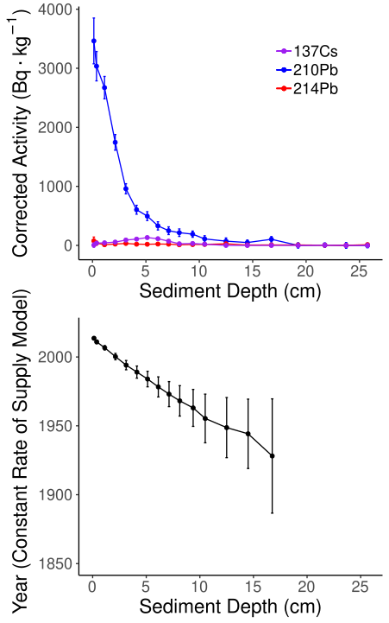
²¹⁰Pb Chronology
2014 core length = 27cm
Sectioned at varying resolution 0.25cm (0-10), 0.5cm (10-15), 1.0 cm (15-28)
CRS basal date at 16.75cm (corresponding to mid-1920s)

Slide 14
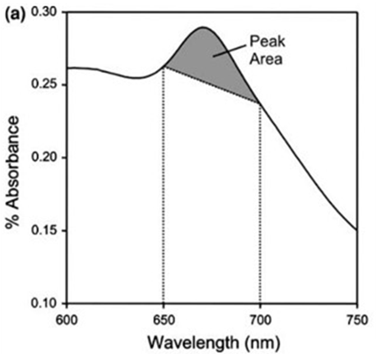
VRS-inferred chlorophyll a
Visible Range Spectroscopy (VRS)
Infer [chlorophyll a] (including its isomers and main diagenetic products) in the sediment matrix (Michelutti et al. 2010)
Absorbance peak/reflection trough between 650-700 nm
Allows trends in primary production to be inferred
Increase above baseline began early 20th century, has intensified from mid 20th century to present
~1970
~1927

Slide 15
Chironomid Assemblages
Profundal Taxa
Littoral Taxa
Notes:
Similar to Clerk et al. some merging of intervals required at the top to get adequate chironomid counts
No zones identified in CONISS analysis
Red lines indicate founding of resort and start of sewage treatment
Following initial settlement, general decline in profundal taxa, trend has reversed in samples dating after the 1995 core
Roberto: struck by the differences compared to the Clerk assemblages (e.g. Protanypus found only in recent interval, no major decline in Heterotrissocladius - does the sediment core extend past 1850 AD?), recent declines in Heterotrissocladius, Parakiefferiella nigra w/ increases in Sergentia and Chironomus that are not reflected in VWHO inferences probably due to increases in Micropsectra, and the recent changes in littoral taxa which don't have an impact on VWHO inferences but look like a climate warming signal.

Slide 16
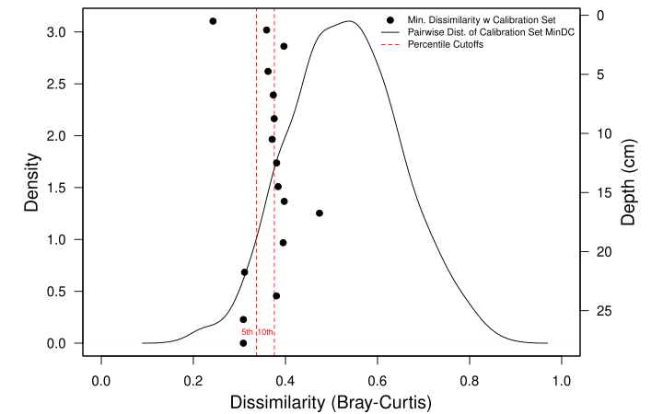
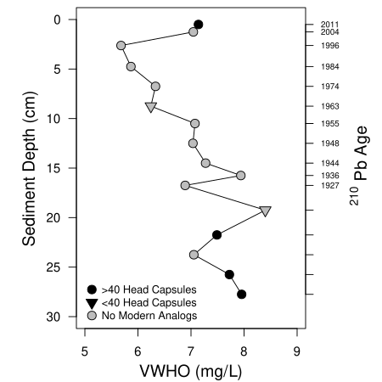
Peninsula VWHO
Volume-Weighted Hypolimnetic Oxygen inferred using the Quinlan and Smol (2001;2010) midge calibration set
Relatively poor modern analogs within the calibration set (few samples with <5% dissimilarity)
However, marked decline in inferred-VWHO over 20th century with sharp recovery in most recent sediments
Notes:
Downcore assemblages are generally 60% similar to assemblages in the training set (looks like that is the case for all downcore intervals except one). So although classified as "poor analogs", they aren't horrible.

Slide 17
Peninsula Diatoms
~1985-Present
~1935 - ~1985
Late 1800s - ~1935
Prior to ~1935 diatom assemblages dominated by D. stelligera
Between 1935-1985 D. stelligera decreased in abundance while Aulacoseira ambigua, A. subarctica, and Asterionella formosa increased (indicative of increasing nutrient concentrations)
Notes:
Time periods identified with CONISS analysis of diatom assemblages
Onset of nutrient enrichment during the 1930s, spring-TP measures from 1990-2016 range from 6-14ug/L but no directional trend
Note from Clare: Stratigraphy is simplified to present taxa (or species complex) where the relative abundance is >5%. I simplified all the diatom stratigraphies in my thesis in this way as I was looking at trends across 8 cores. Anyways, someone may ask about the slight increase in Stephs at the top of the core (particularly since you mention nutrient recovery). You can say that Stephs (medius and minutulus) were found in low rel abundances throughout the entire core and the small increase (by a few %) isn't a clear sign of nutrient enrichment. I copied in the text where I discuss this in my thesis below.

Slide 18
Peninsula Diatoms
~1985-Present
~1935 - ~1985
Late 1800s - ~1935
In the most recent sediments A. ambigua and A. subarctica have decreased to trace abundances, while D. stelligera has recovered somewhat and increases in A. formosa have continued
Recovery in nutrient conditions concurrent with changes associated with climate warming/increased thermal stability
Notes:
Time periods identified with CONISS analysis of diatom assemblages

Slide 19
Conclusions
Over the past 20 years, Peninsula Lake has continued its recovery from nutrient enrichment and hypolimnetic oxygen depletion
However, improvements have been accompanied by ongoing increases in primary production (perhaps in response to climate warming and a longer stratification period), the recovery is not a restoration to pre-impact conditions
Improvements in Lake Trout habitat related to deepwater oxygen may be offset by rising temperatures

Slide 20
References
Clerk S, Hall R, Quinlan R, Smol JP (2000) Quantitative inferences of past hypolimnetic anoxia and nutrient levels from a Canadian Precambrian Shield lake. Journal of Paleolimnology 23:319-336
Michelutti N, Blais JM, Cumming BF, Paterson AM, Rühland K, Wolfe AP, Smol JP (2010) Do spectrally inferred determinations of chlorophyll a reflect trends in lake trophic status? Journal of Paleolimnology 43:208-217
Quinlan R, Smol JP (2001) Chironomid-based inference models for estimating end-of-summer hypolimnetic oxygen from south-central Ontario shield lakes. Freshwater Biology 46:1529-1551
Quinlan R, Smol JP (2010) Use of Chaoborus subfossil mandibles in models for inferring past hypolimnetic oxygen. Journal of Paleolimnology 44:43-50

Slide 21
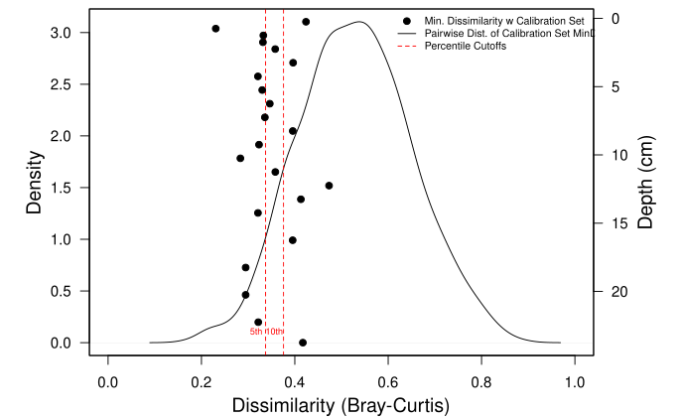
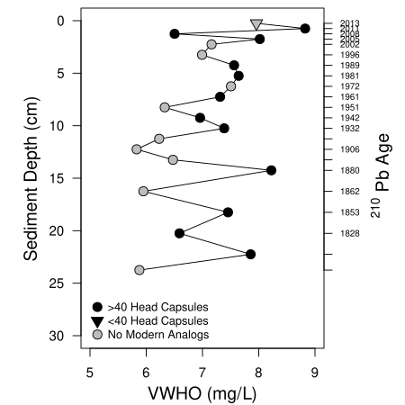
Harp Lake VWHO

Slide 22
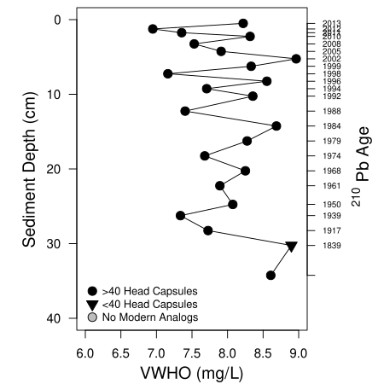
Red Chalk Main VWHO

