Slide 1
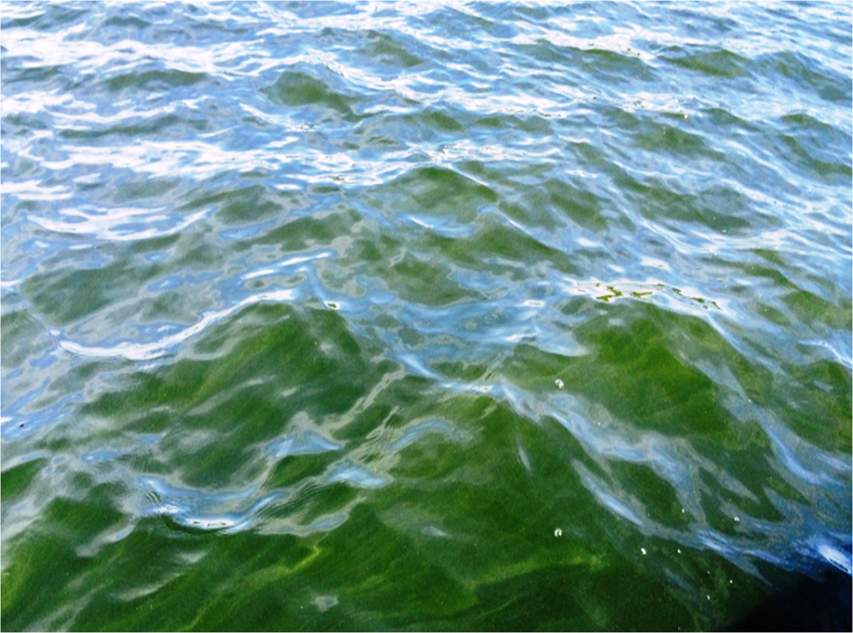
Reconstructing water quality trends in a eutrophic Ontario Lake Trout lake with blue-green algal blooms
Clare Nelligan, Adam Jeziorski, Brigitte Simmatis, Kathleen M. Rühland, Andrew M. Paterson, Victor Castro and John P. Smol
(Muskrat Lake, Sept 2015)

Slide 2
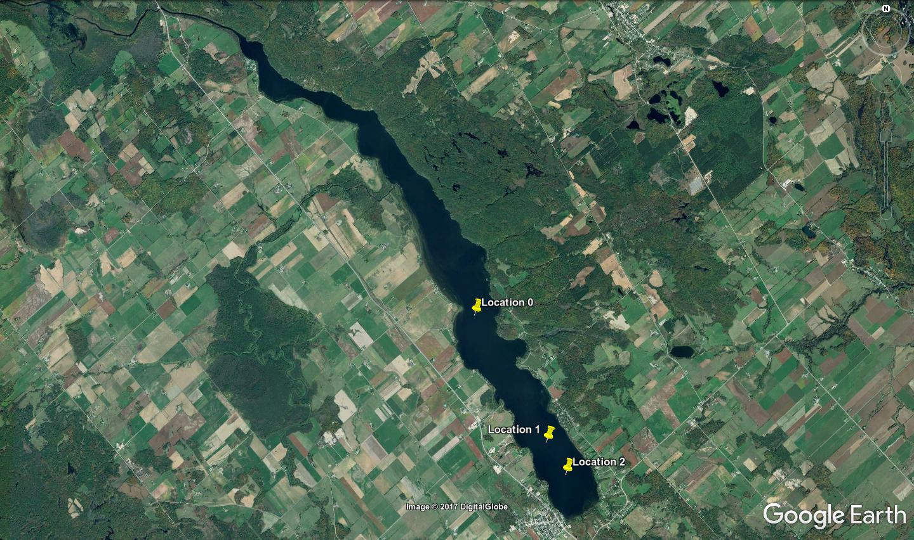
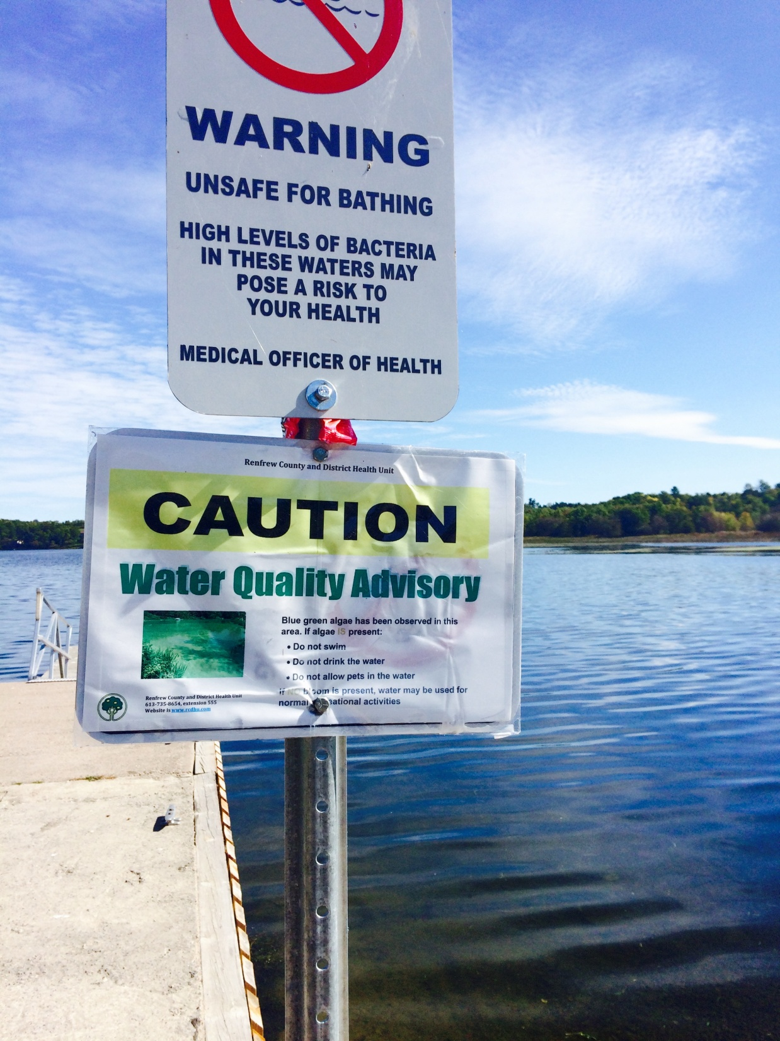
Muskrat Lake
Sept 2015

Slide 3
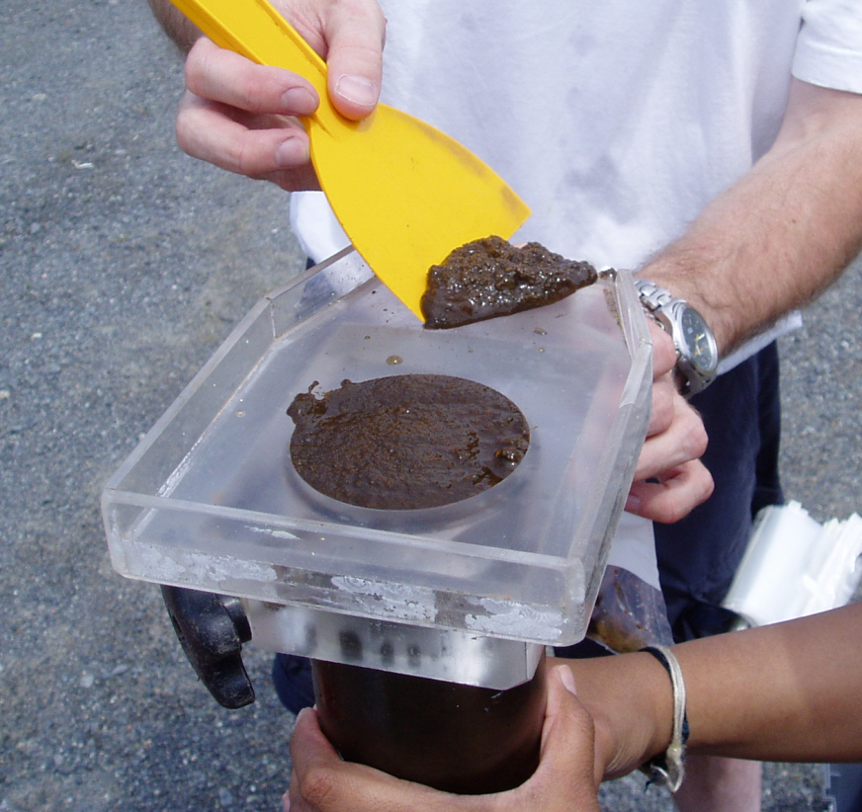
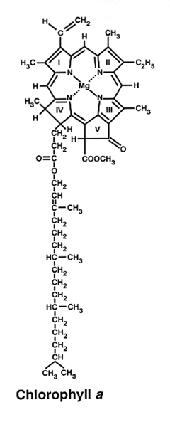
Chlorophyll a
Diatoms
Diatoms
siliceous algae; nutrient status, lake mixing
Chironomids
larval midges; deep-water oxygen
Chlorophyll-a
VRS-inferred; whole lake primary production
(Slide: Liz Favot)

Slide 4
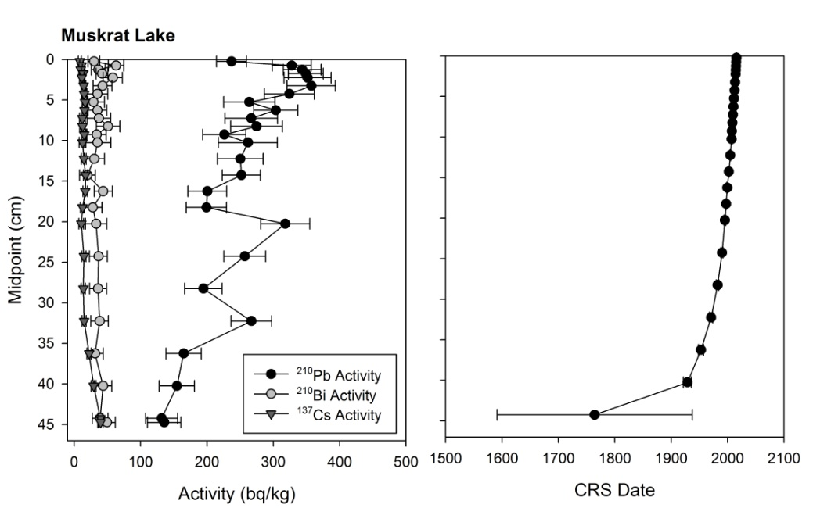
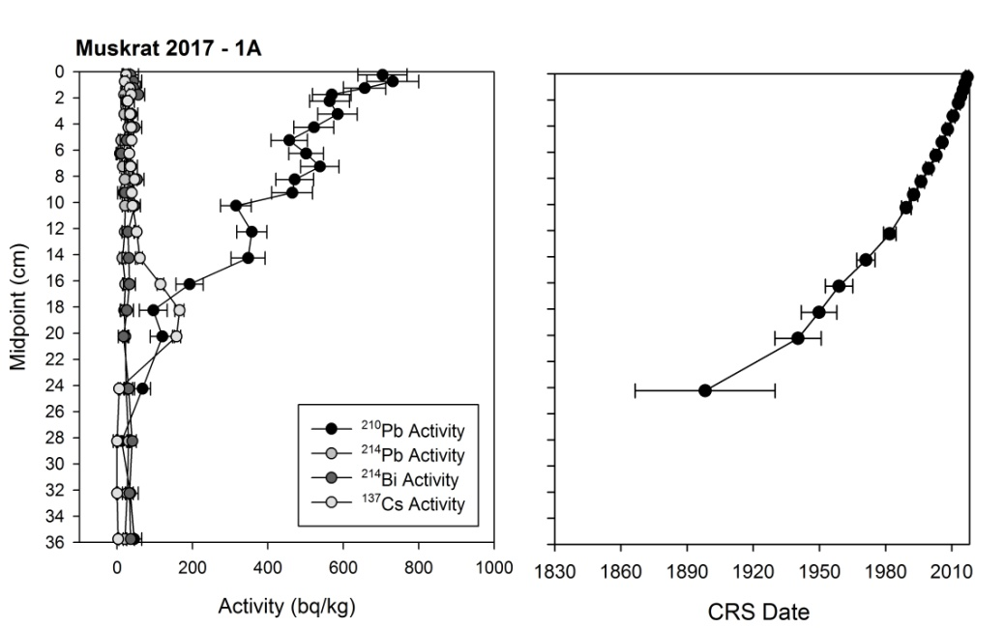
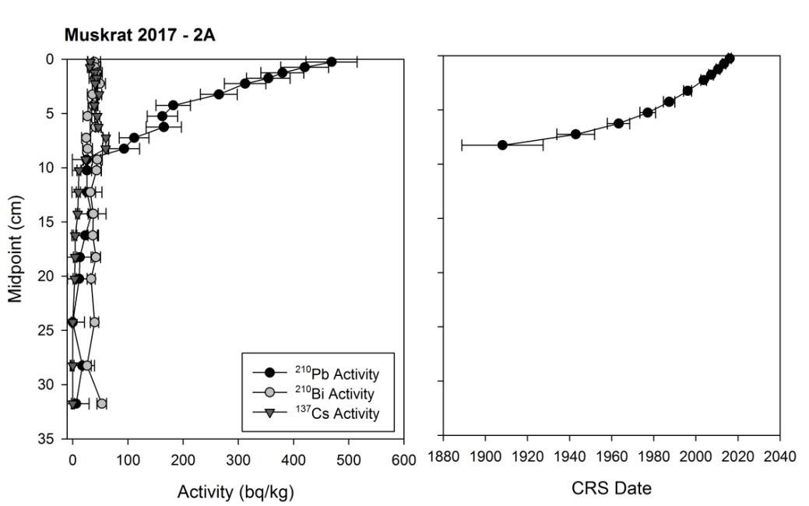
Sediment cores collected in 1983 and 2015 and 2016
Sediment cores collected in 1983 and 2015 and 2016
1983 Core

Slide 5
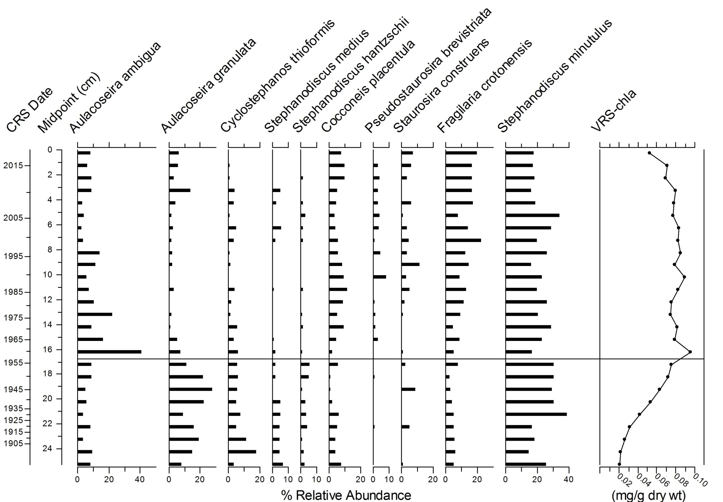
Diatom taxa associated with mesotrophic and/or eutrophic conditions occur throughout the sedimentary record
1958
Notes:
All dominant taxa indicative of meso to eutrophic conditions. Taxa with higher nutrient optima occur in higher relative abundances before ~1950 (S. hantzchii, C. thioformis, A. granulata) – may indicate a SLIGHT decrease in TP (still meso to eutrophic after 1950s). Peak in A. ambigua at ~1950 ... Not sure what that means (lines up with timing of agriculture increase).

Slide 6
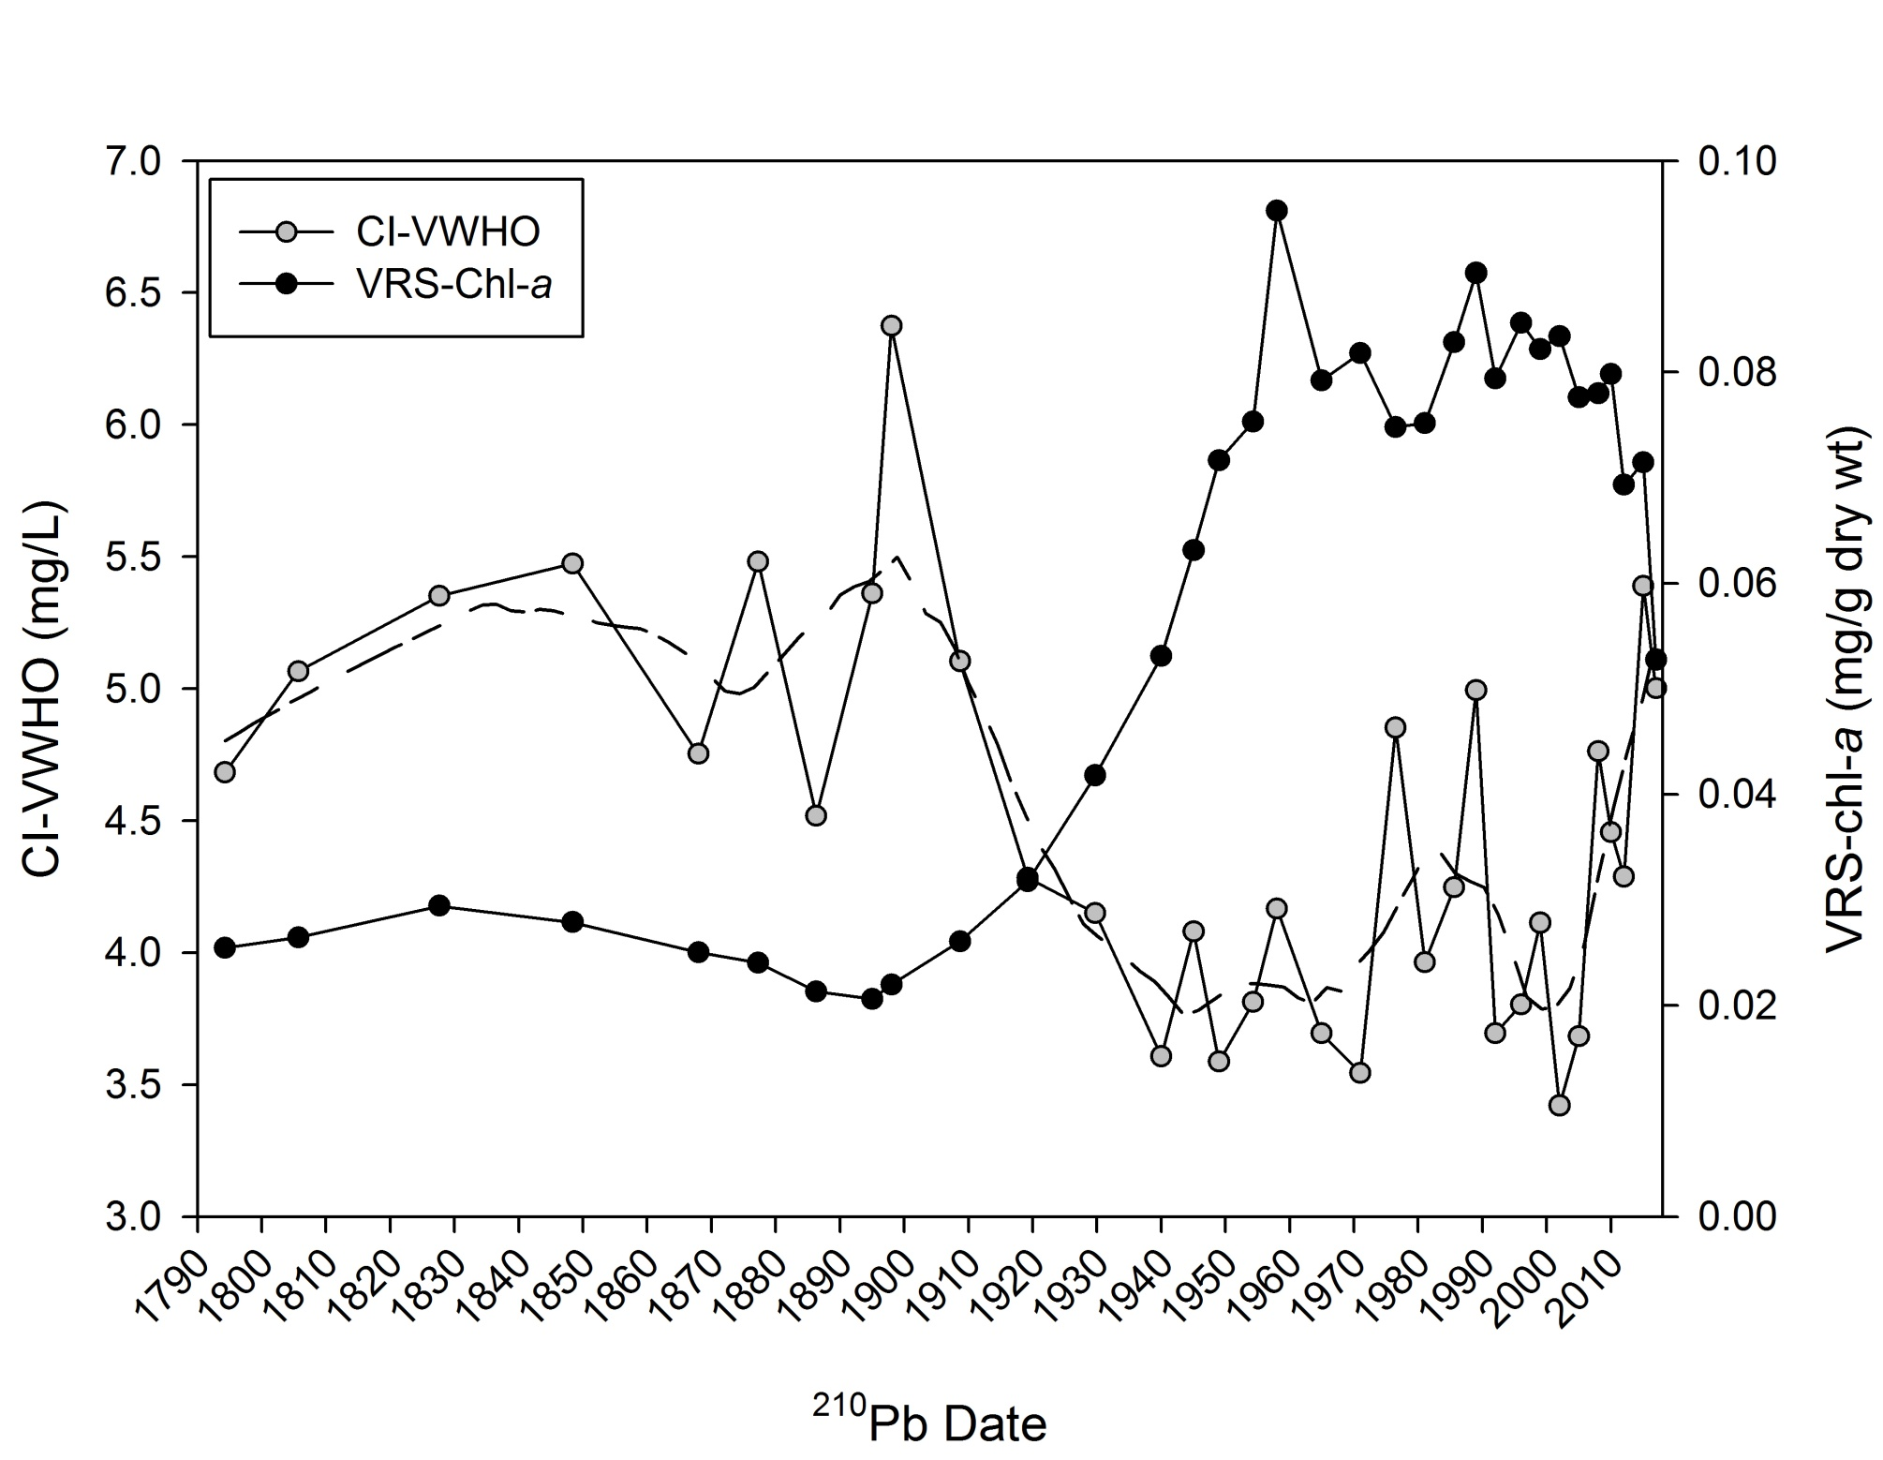
Increase in primary production and decrease in VWHO started after late-1800s (before the intensification of agriculture)

Slide 7
Preliminary Conclusions
Diatom data suggest Muskrat Lake was likely meso or eutrophic since the late-1800s
Deterioration of water quality likely began during the late-1800s, prior to the intensification of agriculture
Increases in periphytic diatom taxa (that can live on sand, silt, stones or plants) may suggest a change in littoral habitat availability after the 1960s
enhanced shoreline erosion and/or macrophyte production

Slide 8
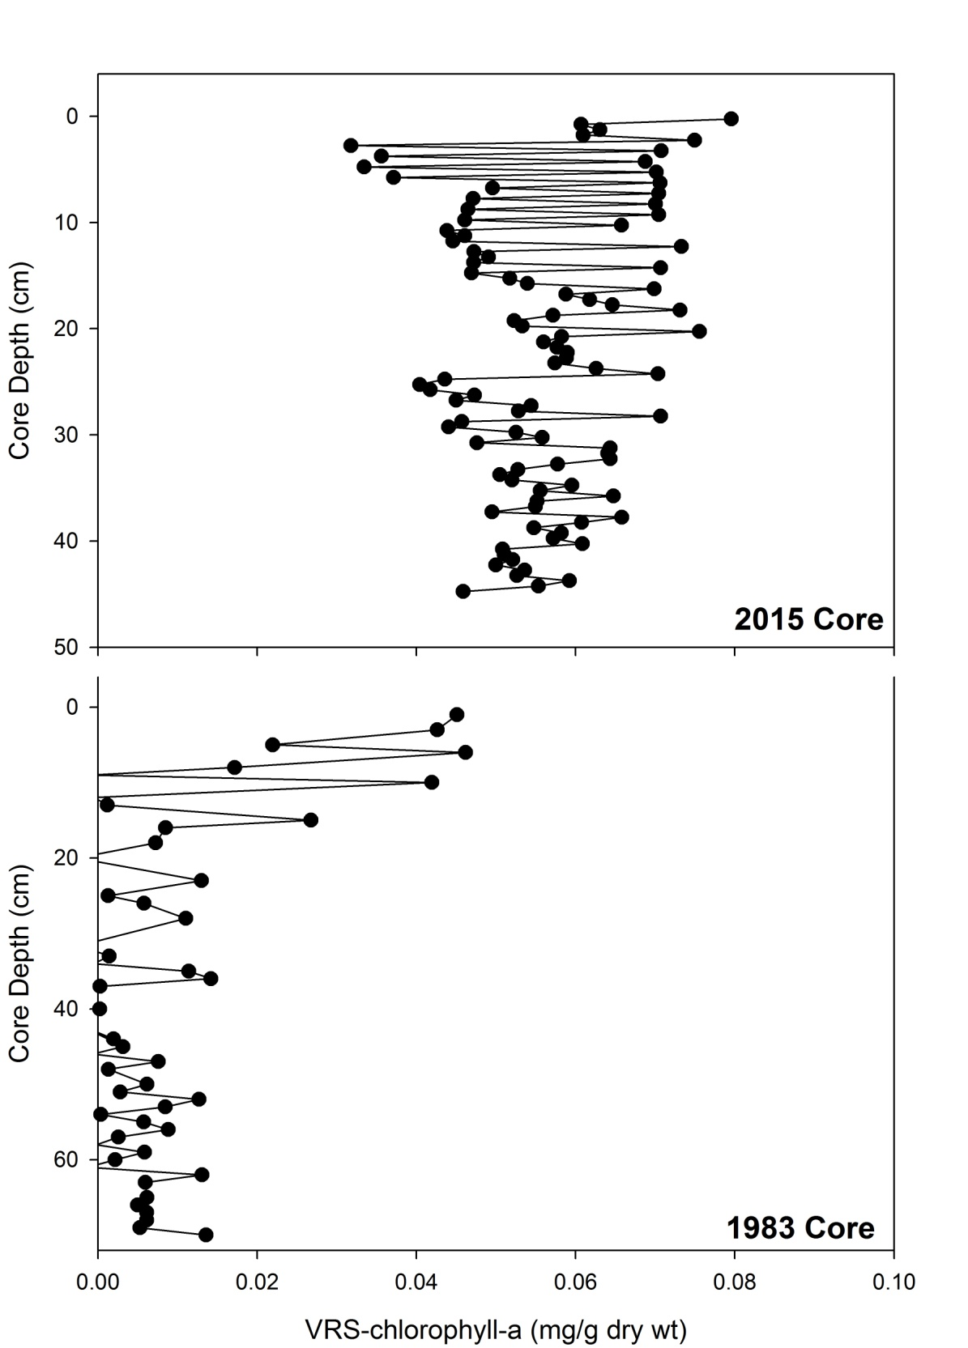
2015
Large variability in VRS-chla in 2015 and 1983 cores taken from deepest area of the lake
Potentially tracking bloom events or inter-annual primary production?
1983
~1960

Slide 9
