Slide 1
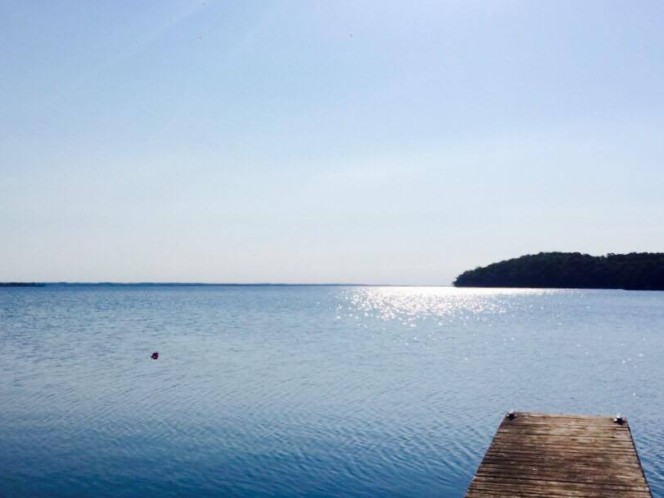


Water-quality trends in
Canadian Lake Trout lakes
Clare Nelligan, Adam Jeziorski, Kathleen M. Rühland, Andrew M. Paterson, and John P. Smol

Slide 2
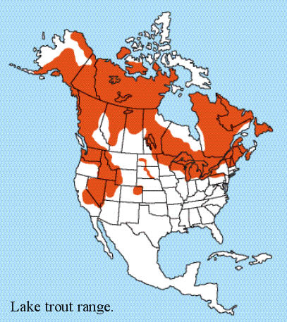
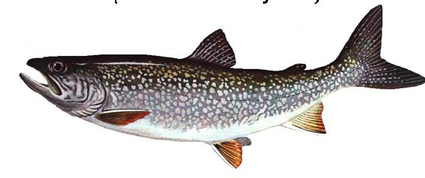
Lake Trout in Canada
Widely distributed cold-water taxon
Large bodied (30-80 cm in length) & late maturing (5-10 yrs)
Valuable natural resource that is important to Canada’s recreational fisheries
Ontario
(OMNRF 2006)
(Photo http://www.hookhack.com/html/fom020113_laketrout.html)
Notes:
-Rare and valuable resource – 1% of Ontario lakes (20-25% of worlds lake trout lake)
Confined to specific environmental conditions ( particularly for oxygen and temperature)
Making them a good ecological indicator for lake health and associated with cold, deep lakes
-Considered a relict of the last major glaciation event, evolving in multiple refugia and dispersed across their range when the glacial ice sheets melted
In the early 19th century, lake trout were important to the commercial fisheries of the Great Lakes
By the mid 1900s- it was evident that these stocked were being over exploited
Today, lake trout is important to the provinces recreational fisheries ( a sector that contributes billions to the provincial economy)- with lake trout being the preferred fish among anglers

Slide 3
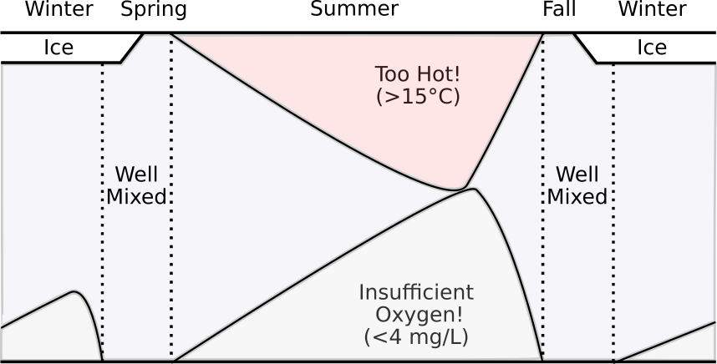
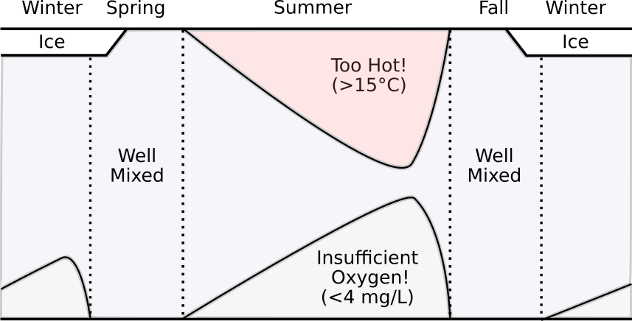

Lake Trout Habitat “Squeeze”
Provincial Standard for Volume-weighted Hypolimnetic O₂ > 7 mg/L
(Evans et al. 2007)
(Figure modified from Guzzo and Blanchfield 2016)

Slide 4
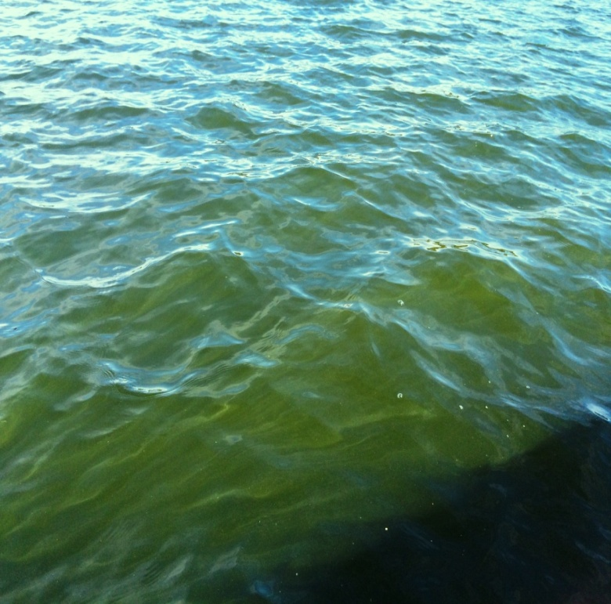
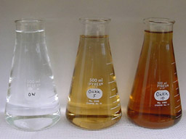
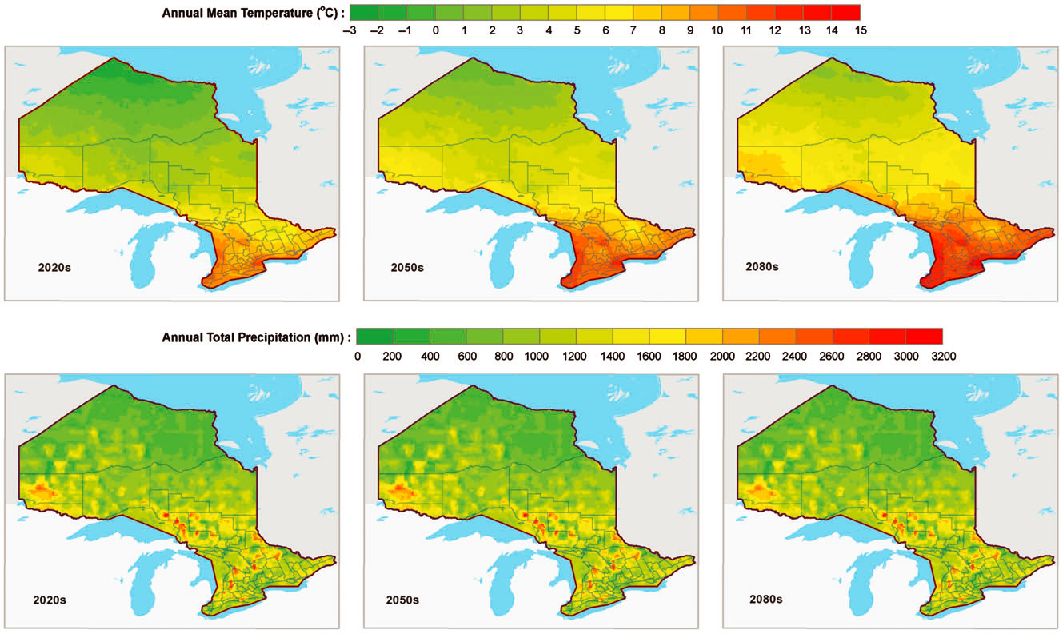
Nutrients (TP)
Dissolved Organic Carbon (DOC)
Climate Warming
(Stratification, Mixing, Ice Cover)
(Figure: Wang et al. 2014)
Notes:
Variables that influence hypolimnetic DO

Slide 5
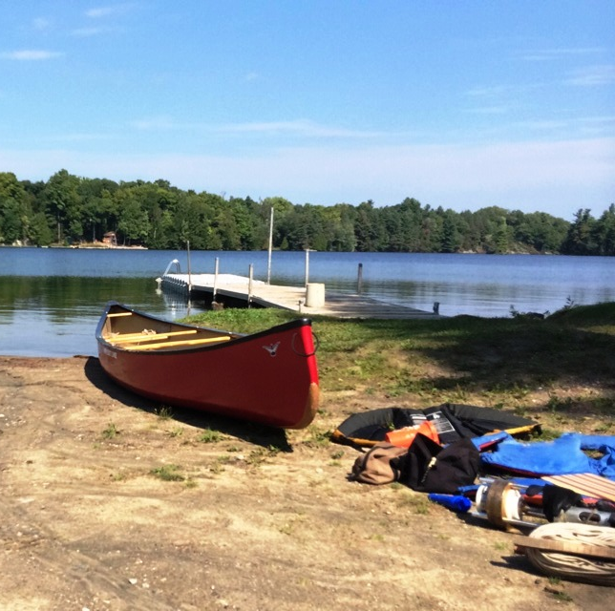
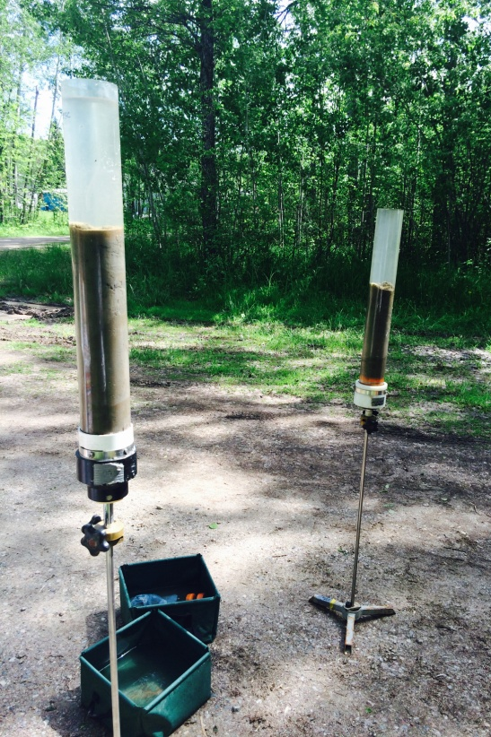
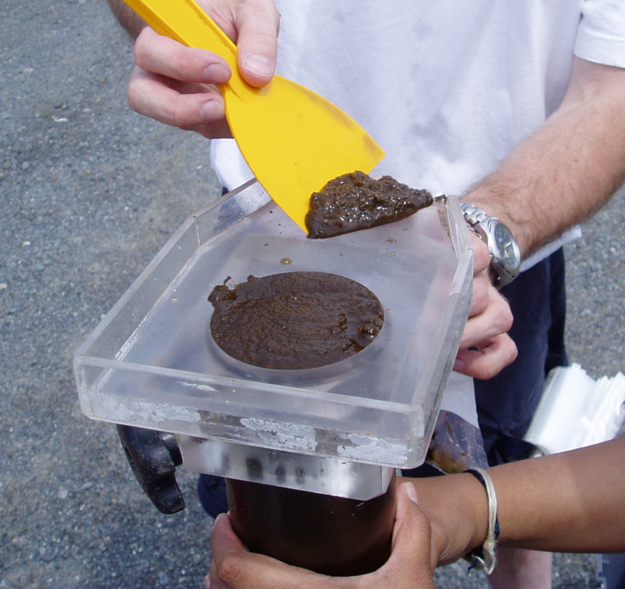
Objectives:
To characterize long-term trends in hypolimnetic oxygen in lakes that support Lake Trout
Identify environmental stressors (e.g., nutrients, warming, etc.) that may be driving oxygen dynamics in these lakes
Chironomids:
To reconstruct end-of-summer volume-weighted hypolimnetic [O₂] (VWHO)
Diatoms:
To reconstruct [TP] and other environmental drivers
Sedimentary Inferred Chlorophyll-a:
To track trends in whole-lake primary production

Slide 6
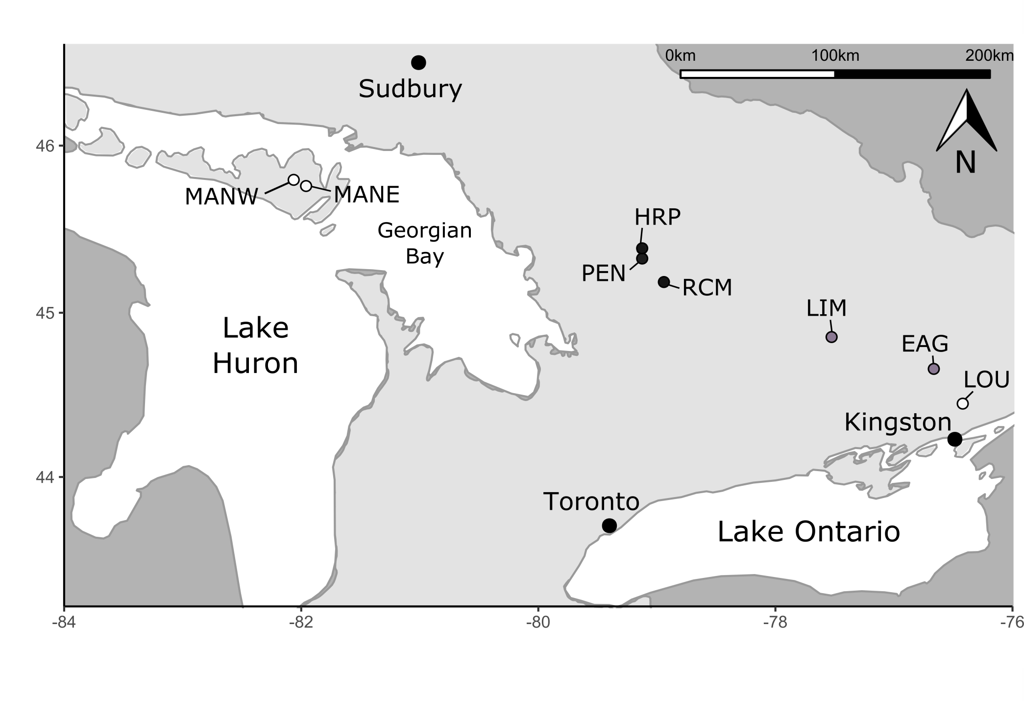
Lakes were selected based on the availability of long-term monitoring data, or because they satisfied one of the following criteria:
Impacted by shoreline development or agriculture
Experienced changes in their [DO] profiles
Identified as below the provincial standard for [DO] in a Lake Trout lake
Of prior management interest
Ecoregion:
Shield Lakes
Transition Lakes
Off-Shield Lakes

Slide 7
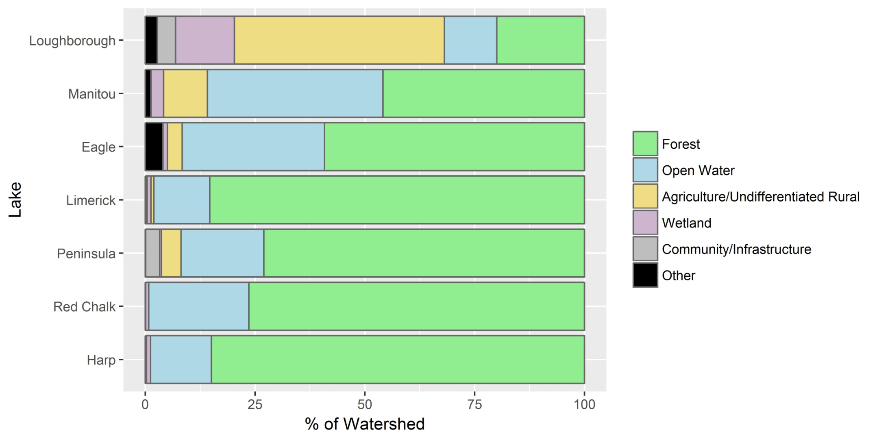
Off-Shield
Transition
Shield
Notes:
May TP data average for years with available water chemistry between 2000 and present. Peninsula is July TP. Limerick TP data driven by high TP (20-30 ug/L) during May and July of 2006.
Harp and Red Chalk have lowest TP – other lakes are generally oligotrophic but occasionally cross into the mesotrophic range

Slide 8
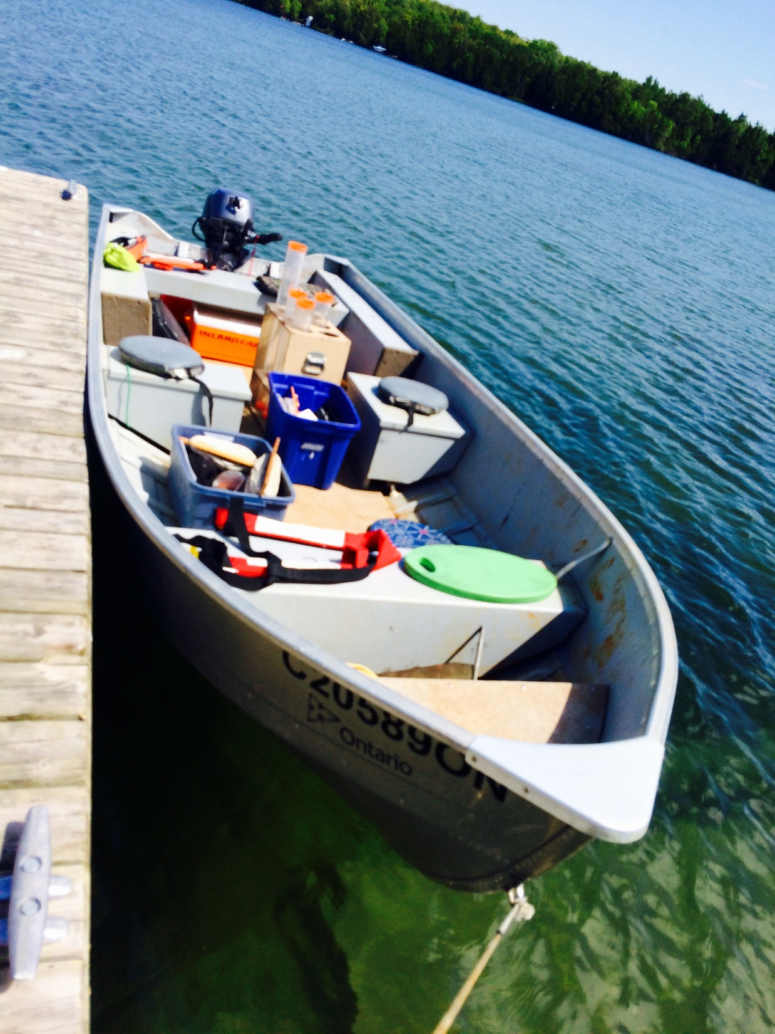
Methods
Gravity cores were collected from the study lakes between 2013 and 2016
Cores were ²¹⁰Pb dated and analyzed for diatoms, chironomids, and spectrally-inferred chlorophyll-a
TP was reconstructed using the Hall and Smol (1996) and Reavie and Smol (2001) diatom transfer functions
Chironomid-inferred VWHO was determined using the Quinlan and Smol (2001, 2010) model
Paleo-reconstructions were standardized to Z scores and analyzed from ~1900-present

Slide 9
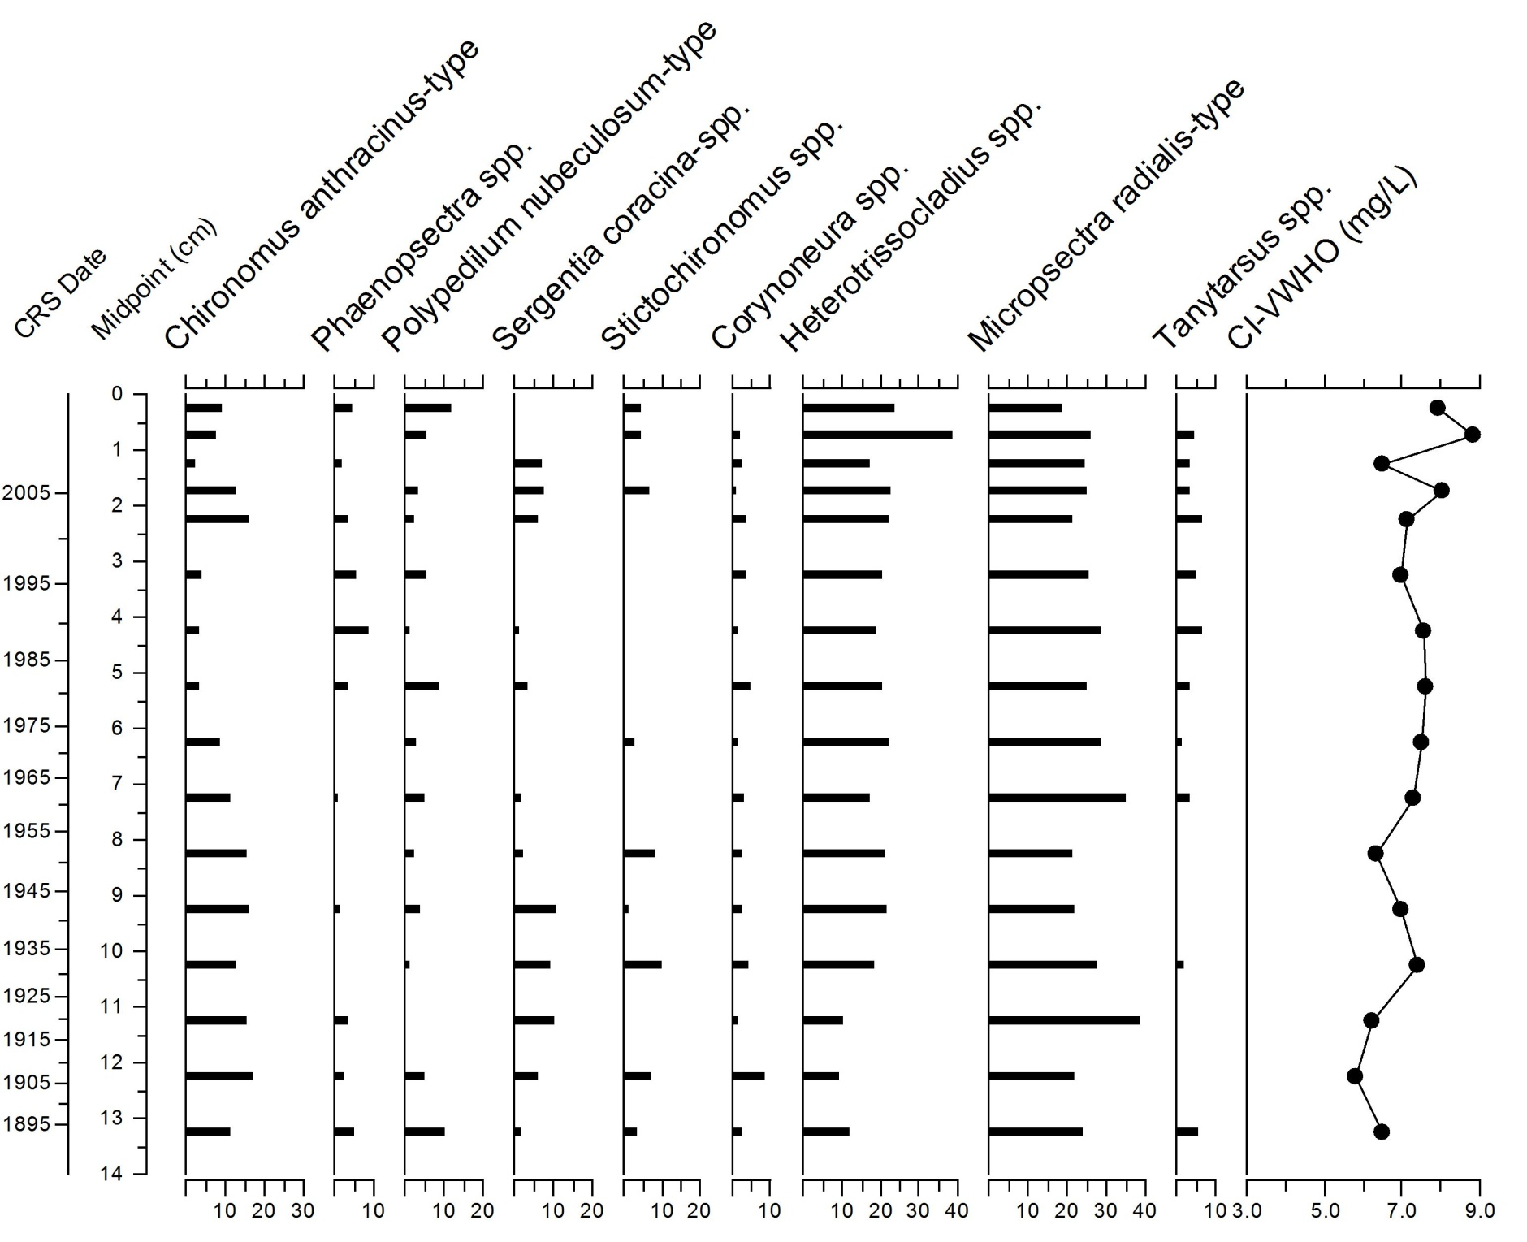
Chironomid Assemblage Data
Harp Lake
% Relative Abundance
Notes:
Tracking changes in Micropsectra and heterotrissoclasius – increase in CI-VWHO also likely due to decrease in Chironomus (Phaenopsectra not included in the model)

Slide 10
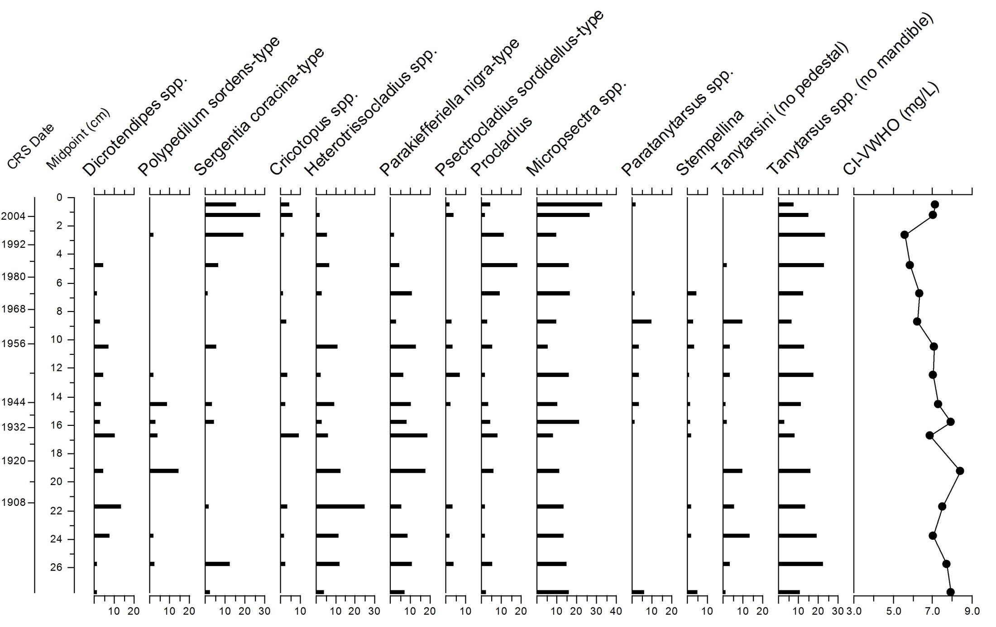
Chironomid Assemblage Data
Peninsula Lake
% Relative Abundance
Notes:
Tracking changes in Micropsectra and heterotrissoclasius (changes in CI-VWHO in both Harp and Pen largely driven by profundals)

Slide 11
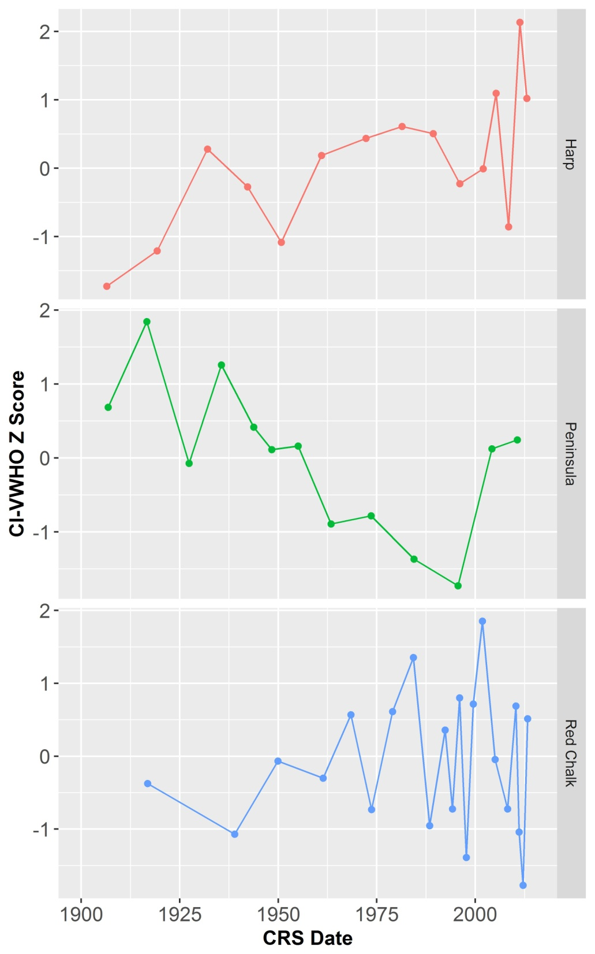
Chironomid-inferred VWHO
Shield Lakes
Harp Lake
Peninsula Lake
CI-VWHO Z Score
*
CI-VWHO Z Score
*
Τ = 0.52, p = 0.006
Τ = -0.436, p = 0.04
*
Note: “h ”denote intervals with < 50 chironomid head capsules

Slide 12
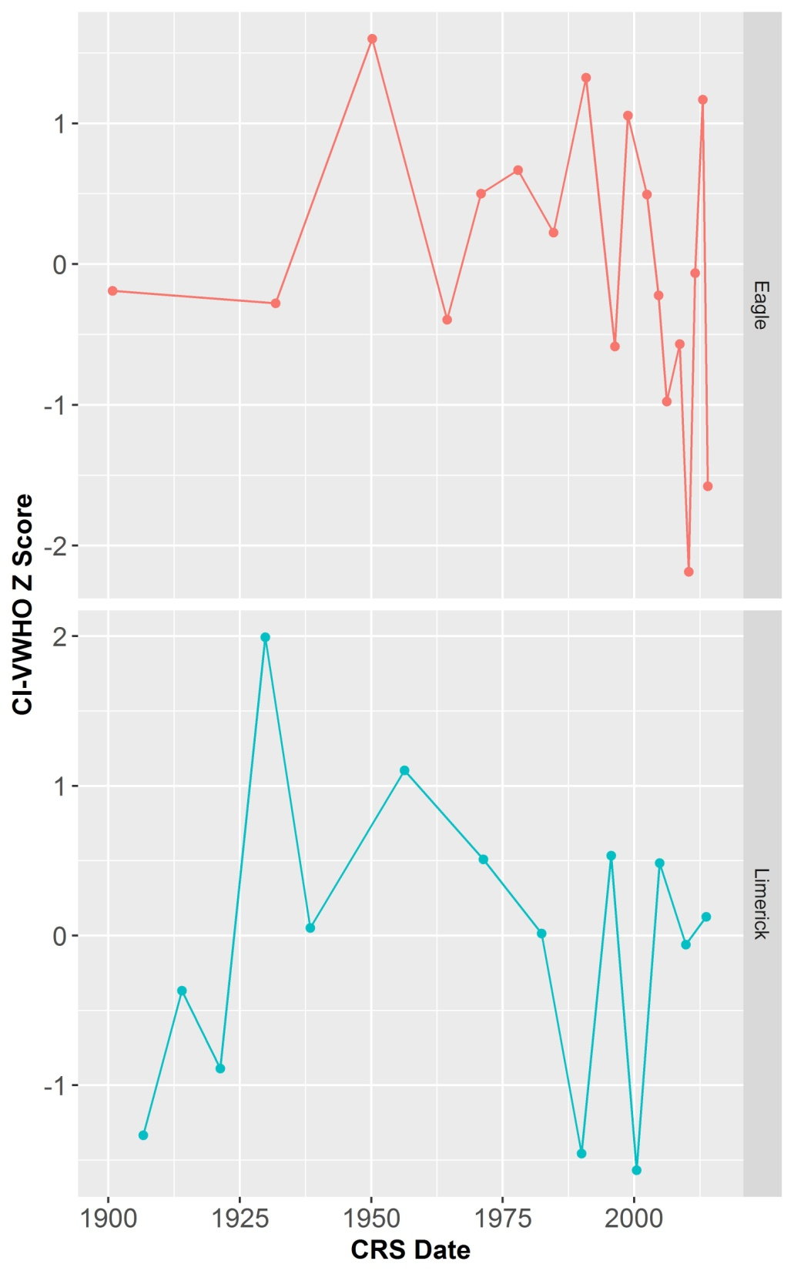
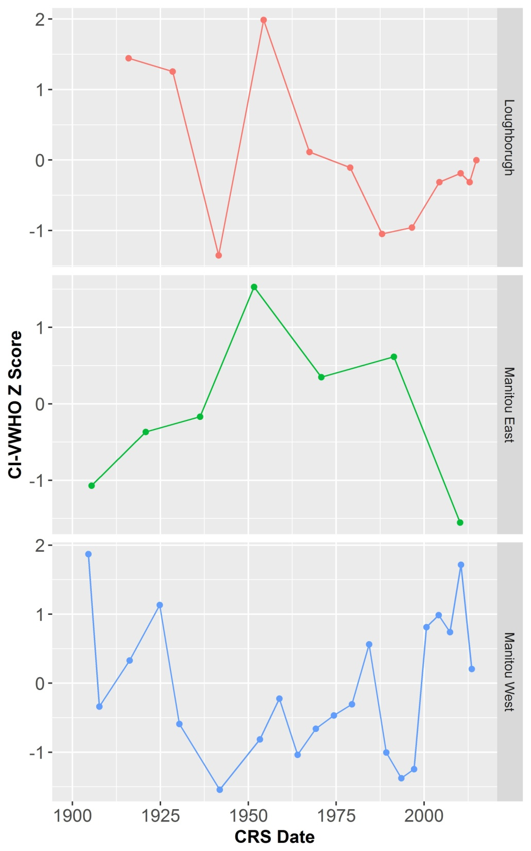
Chironomid-inferred VWHO
Shield Lakes Transition Lakes Off-Shield Lakes
Harp Lake
Eagle Lake
Loughborough Lake
*
*
CI-VWHO Z Score
Lake Manitou (E)
*
CI-VWHO Z Score
CI-VWHO Z Score
Peninsula Lake
Red Chalk Lake
*
Lake Manitou (W)
*
*
*
Limerick Lake
Overall, CI-VWHO trends were lake-specific
*
Note: “h ”denote intervals with < 50 chironomid head capsules
Notes:
Trends across the other lakes were more variable and/or not monotonic
Also many of the lakes exhibited slight increases in recent sediments

Slide 13
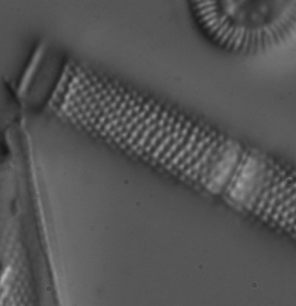
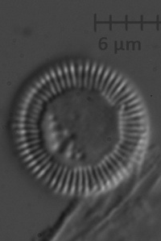
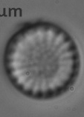
Summary of Diatom Assemblage Trends
Shield Lakes
Transition Lakes
Off-Shield Lakes
Gradual/subtle changes in diatom assemblages consistent with enhanced stability
Pronounced shifts consistent with enhanced stability
Decrease in mesotrophic taxa
Diatom assemblage shift consistent with enhanced stability in Lake Manitou
Increase in mesotrophic taxa in off-Shield lakes
Enhanced Stability
+
Nutrient Recovery
Enhanced Stability
+
Nutrient Loading
Gradual change in thermal stability
Notes:
Shield Lakes: changes generally gradual and subtle (in Red Chalk and recently in Pen). Most prominent change in Pen diatom assemblages reflect earlier water quality degradation and very recent (and subtle) increase in small cyclotelloid taxa and decrease in Aulacoseira
Transition: decrease in mesotrophic taxa in Eagle (slight decrease in Limerick – less apparent)
Off-Shield: increase in mesotrophic taxa in both off-shield lakes. Loughborough increase in lightly silicified S. minutulus – maybe a response to warming (?) in addition to increasing nutrients

Slide 14
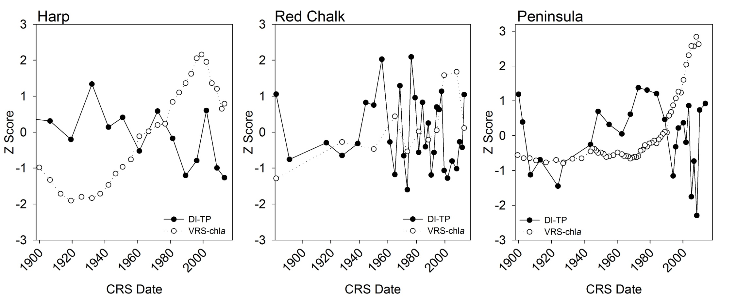
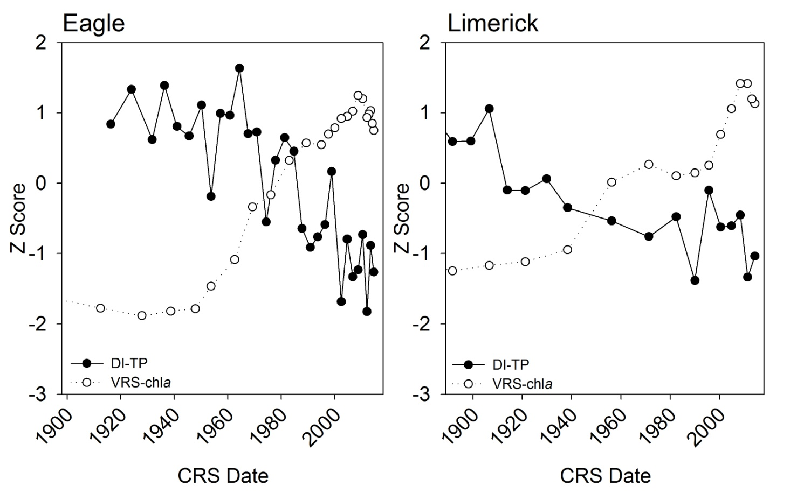
VRS-chlorophyll-a and diatom-inferred TP (DI-TP)
Shield Lakes
DI-TP
VRS-chla
Transition Lakes
Increasing sedimentary-inferred chlorophyll-a observed alongside stable or decreasing DI-TP
Notes:
No significant trend in TP in Shield lakes, but increasing significant trend for chla in Shield lakes
Significant decreasing trend in TP in Eagle and Limerick, and increasing chla trend

Slide 15
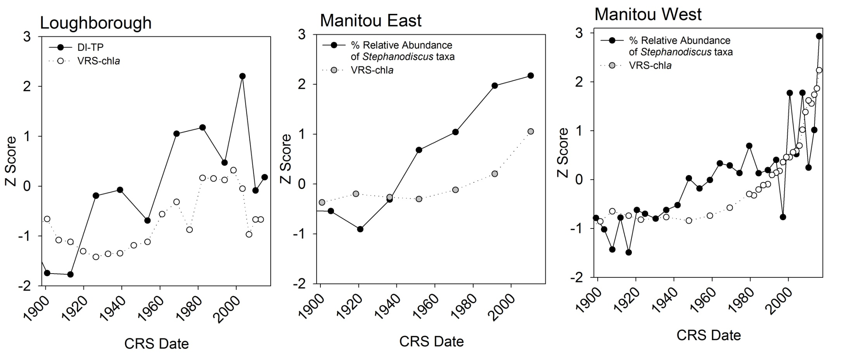
VRS-chlorophyll-a and diatom-inferred TP (DI-TP)
Off- Shield Lakes
DI-TP
VRS-chla
In lakes located off-Shield, both sedimentary chlorophyll-a and DI-TP (or the % relative abundance of mesotrophic Stephanodiscus taxa) have increased

Slide 16
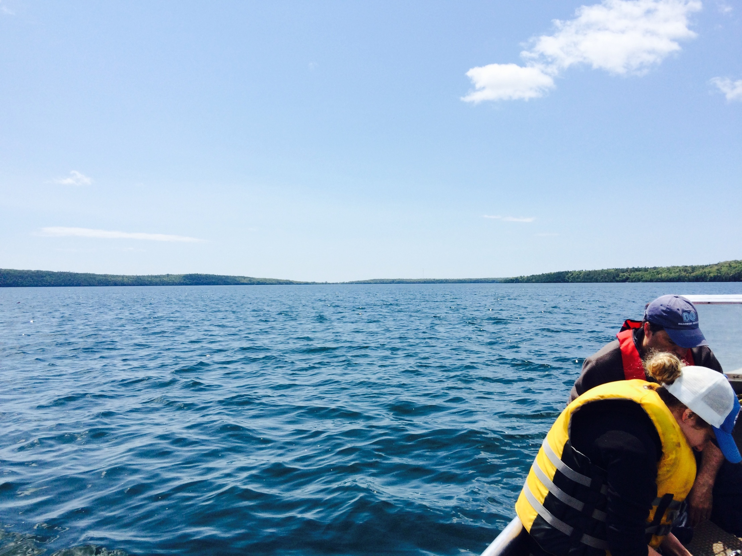
Conclusions
VWHO trends appear to be lake-specific and subtle
However, trends in environmental variables that can influence oxygen were generally coherent across lakes and/or regions. For instance:
Most lakes record diatom assemblage shifts consistent with changes in lake thermal properties
Nutrients have increased in off-Shield lakes
Sedimentary-inferred chlorophyll-a have increased across all lakes (independent of nutrients in Shield and Transition lakes)
This may suggest that changes in environmental variables that can influence VWHO are not yet of a great enough magnitude to influence oxygen dynamics in many of these systems
These data also suggest that off-Shield lakes may be more sensitive to water quality degradation from nutrient loading

Slide 17




Thank you for listening!
Summary:
VWHO trends appear to be lake-specific and subtle
Trends in environmental variables that can influence oxygen were generally coherent across lakes and/or regions
This may suggest that changes in environmental variables that can influence VWHO are not yet of a great enough magnitude to influence oxygen dynamics in many of these systems
These data also suggest that off-Shield lakes may be more sensitive to water quality degradation from nutrient loading
Acknowledgments: Liz Favot, Branaavan Sivarajah, Ron Ingram, Hillary Austin-Quinn, Jenny Moe, the Blue Jay Creek Hatchery staff, and PEARL

Slide 18
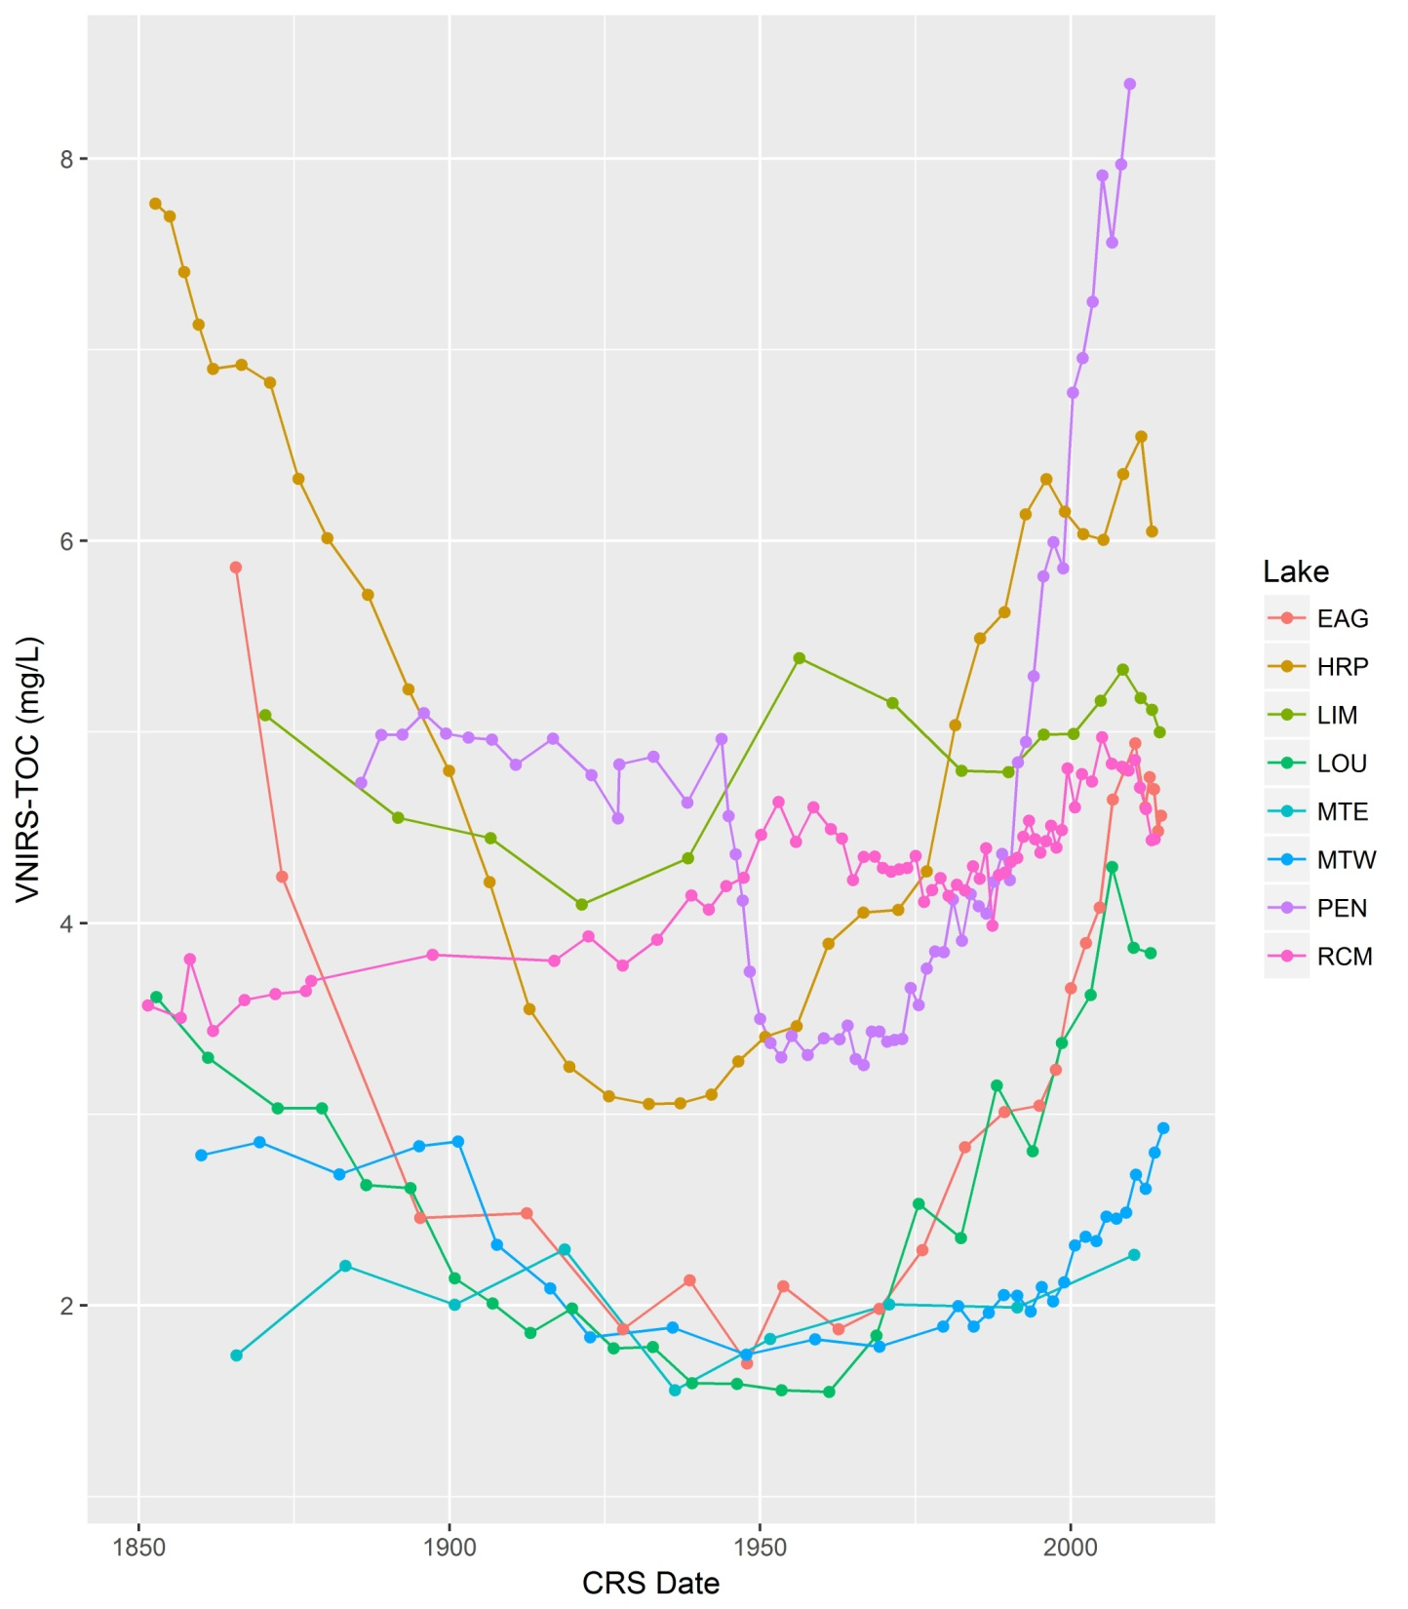
Total Organic Carbon (TOC)

Slide 19
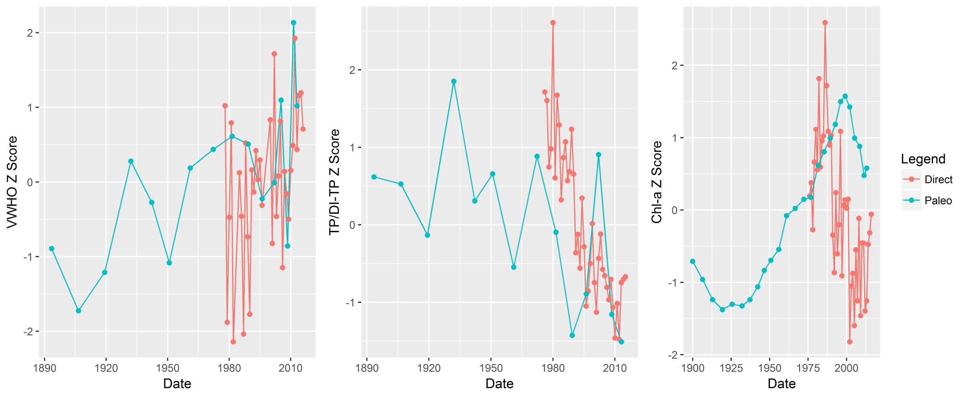
How do paleo-inferred trends compare with direct monitoring data ?
Harp Lake
Trends are generally consistent between direct monitoring data and paleo-reconstructions (potentially a slight lag in the paleo chla data)

Slide 20
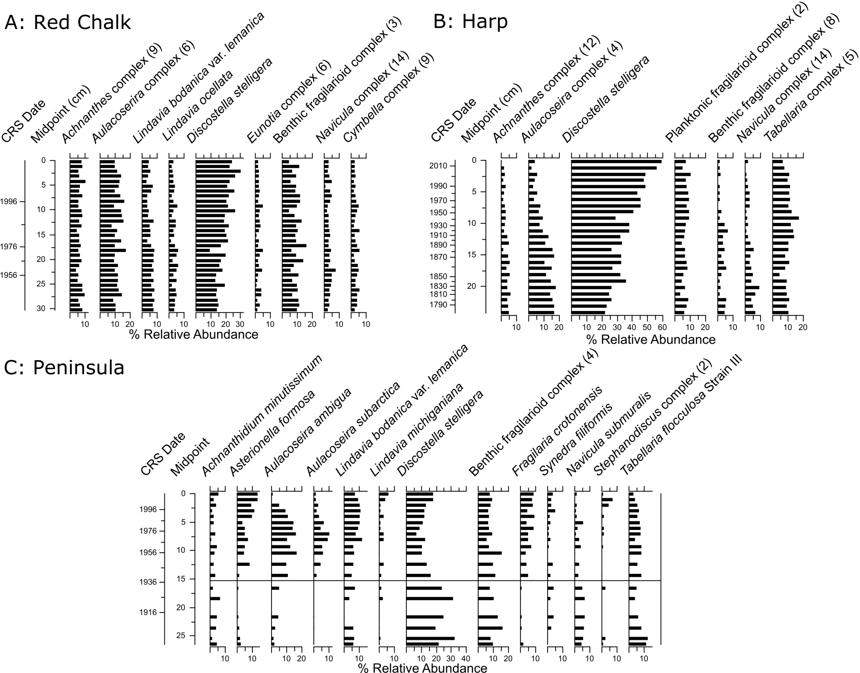
Shield Lakes
Subtle changes
Gradual increase in D. stelligera
Gradual increase in D. stelligera and decrease in Aulacoseira taxa
Historical degradation in water quality from initial settlement and development (Clerk et al. 2000)
Recent (and subtle) increase in D. stelligera and decrease in Aulacoseira taxa

Slide 21
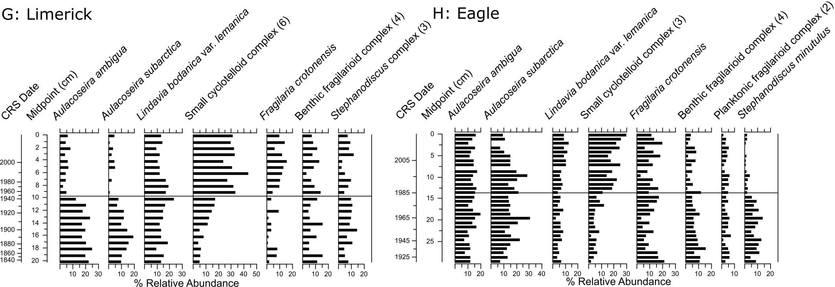
Boundary/Transition Lakes
Increase in small cyclotelloid taxa and decrease in Aulacoseira taxa that occur at different times in the paleo record
Decrease in Stephanodiscus taxa in Eagle Lake

Slide 22
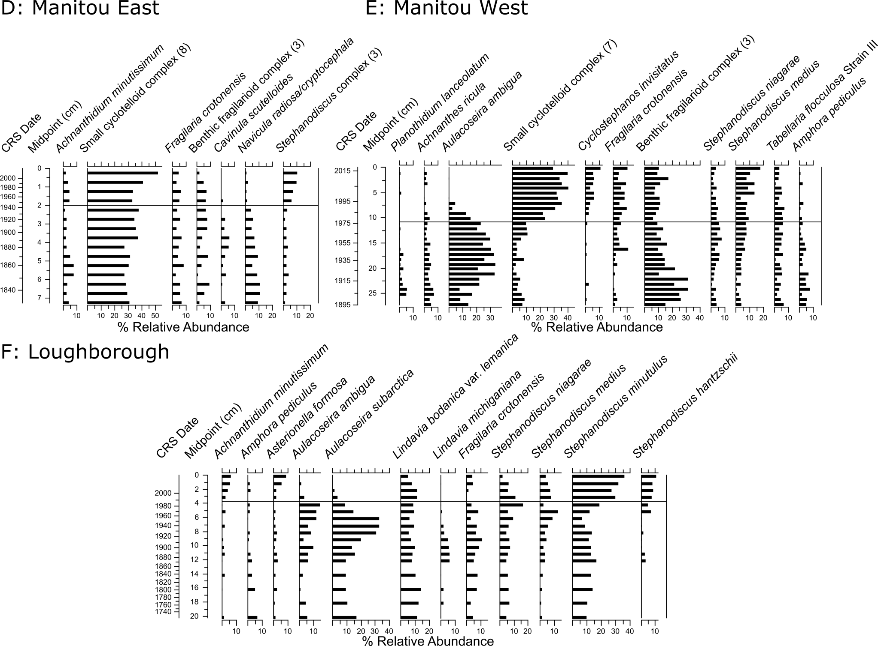
Off-Shield Lakes
Increase in Stephanodiscus taxa and small cyclotelloid taxa
Increase in Stephanodiscus taxa
Increase in small cyclotelloid taxa and decrease in A. ambigua and benthic fragilarioids
Diatom assemblages dominated by mesotrophic taxa that increase after ~1980
Decrease in A. subarctica and increase in small, lightly silicified S. minutulus (may be associated with warming)

