Slide 1
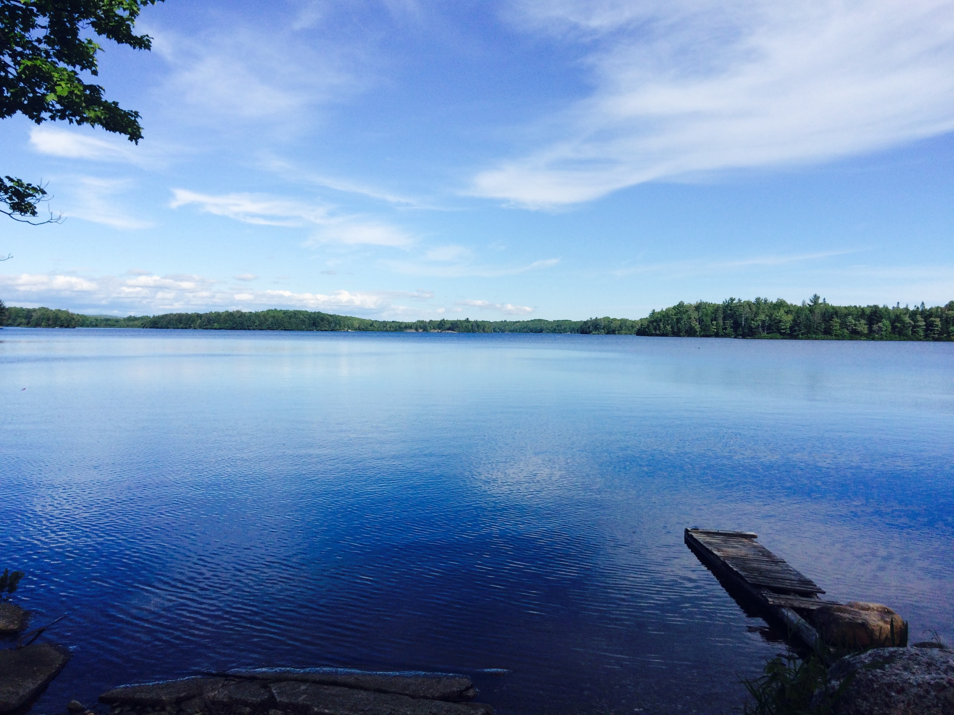


Lake Trout habitat trends: Insights from ~40 years of monitoring
Clare Nelligan, Adam Jeziorski, Kathleen Rühland, Andrew Paterson and John Smol
SCL/CCFFR 2019

Slide 2
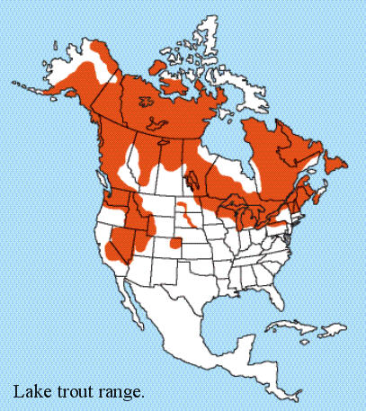
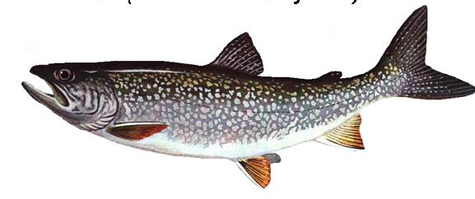
Lake Trout
Widely distributed cold-water taxon
Found in cold, deep, well-oxygenated lakes (Martin and Olver 1976)
Valuable natural resource that is important to Ontario’s recreational fisheries (OMNRF 2014)
Specific habitat requirements for temperatures and dissolved oxygen (DO; Gibson and Fry 1953)
Ontario
(OMNRF 2006)
(Photo http://www.hookhack.com/html/fom020113_laketrout.html)
Notes:
Lake Trout are a widely distributed coldwater taxon
Lake Trout re-colonized in-land lakes across North America during the last glacial retreat (reviewed in Wilson and Mandrak 2004), and as you can seen they are distributed across Canada and parts of the northern united states. Generally, Lake trout are found in cold-deep, well-oxygenated lakes that are common of the Canadian shield.
In Ontario, they are a valuable natural resource
– 1% of Ontario’s 250 000 lakes support a lake trout population (and this 1 % represents 20-25% of all lake trout lakes in the world)
They are a popular sport fish. In the early 19th century, lake trout were important to the commercial fisheries of the Great Lakes. By the mid 1900s- it was evident that these stocked were being over exploited
Today, lake trout is important to the provinces recreational fisheries ( a sector that contributes billions to the provincial economy)- with lake trout being the preferred fish among anglers
Lake Trout also have specific habitat requirements for temperature and dissolved oxygen
Making them a good ecological indicator for lake health whereby protecting lake trout habitat also indirectly protects habitat for other coldwater fish species (like brook trout)

Slide 3
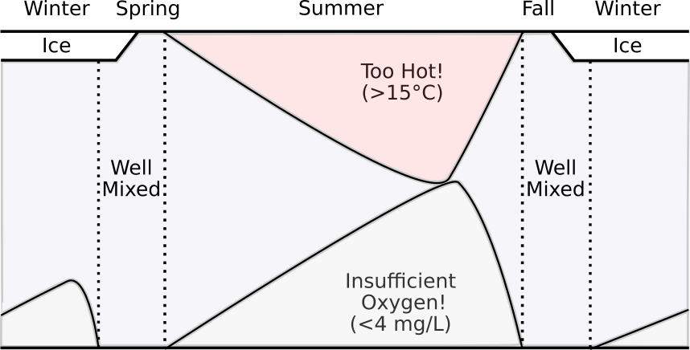
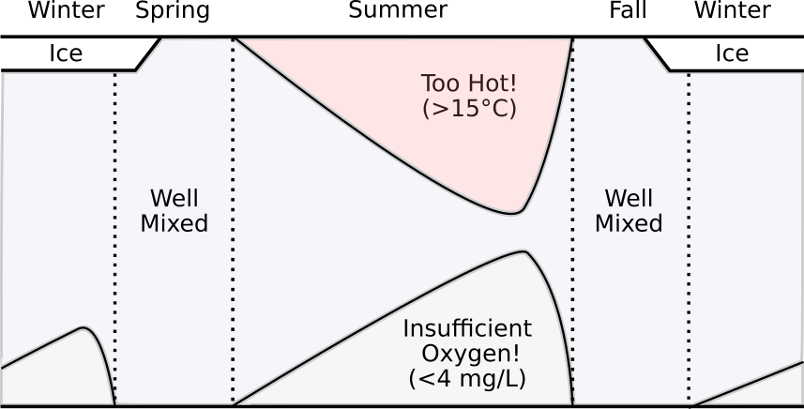
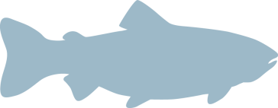
Lake Trout Habitat “Squeeze”
(Figure modified from Guzzo and Blanchfield 2016)
Usable Habitat: < 15 °C, > 4 mg/L DO (Evans et al. 1991)
Optimal Habitat: < 10 °C, > 6 mg/L DO (Evans et al. 1991)
Lethal limits: > 23.5 °C, < 3 mg/L DO (Gibson and Fry 1953, Evans 2007)
Notes:
Looking at how habitat for lake trout changes over the open water period, habitat is most reduced at the end of summer – before stratification breaksdown in the fall
The concern is that warmer epilimnetic waters and longer and stronger stratification may further compress the habitat available to lake trout and other coldwater fish within the water column – this is often referred to as the temperature-oxygen squeeze
My thesis is aimed at better understanding the oxygen dynamics in lake trout lakes

Slide 4
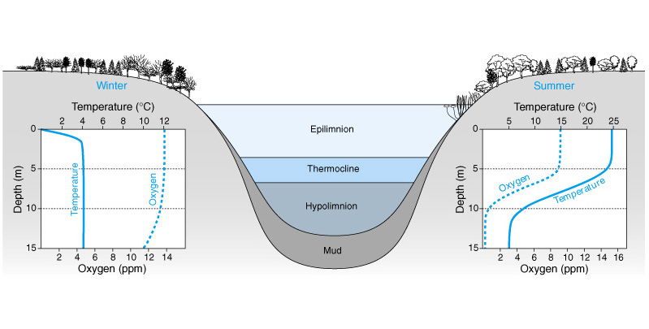
Volume-weighted hypolimnetic oxygen
Provincial criterion for end-of-summer volume-weighted hypolimnetic oxygen (VWHO) > 7 mg/L (Evans 2007)
Incorporates the influence of both hypolimnetic VOLUME and DO CONCENTRATION
VWHO =
∑ (Oxygen x Volume of Water at each 1 m strata)
Total Volume of Hypolimnion
(Photo: https://cdn.cloud1.cemah.net/wp-content/uploads/sites/63/2018/04/CLMP-2018-DOTemp.pdf)
Notes:
Based on Evans findings the provincial criterion of end-of-summer VWHO in a lake that supports lake trout is set t 7 mg/L – set to protect recruitment and the survival of juveniles
Why VWHO? – there are many metrics that can be used to quantify anoxia – why do we look at VWHO?
- because this metric is weighted by volume – it can be compared among lakes iwth different bathymetries
- however, because VWHO can respond to changes in both hypolimnetic volume and hypolimnetic DO is it important to understand what influences both components

Slide 5
Shoreline Development Management in Ontario
The Lakeshore Capacity Assessment
  Municipalities are encouraged to restrict development within 300 m of the shoreline if:
    *End-of-summer VWHO is sampled between August 15th and September 15th (OMOE et al. 2010)
  The lake has a TP concentration of 50% over modeled baseline,
or if end-of-summer VWHO is < 7 mg/L
In most Ontario Lake Trout lakes, limited long-term data limits our ability to understand if (and how) VWHO conditions have changed
Notes:
In ontario, lake trout habitat is primarily managed through using a tool called the Lakeshore Capacity assessment
In this guide, municipalies are encouraged to restrict development within 300 m of the shoreline if the lake has a TP concentration of 50% over the modelled baseline or if end-of-summer VWHO is less than 7 mg/L – the guide recommends that end-of-summer VWHO should be sampled between Aug 15th and Sept 15th
However in most Ontaro lake Trout lakes, limited long-term data really limited our ability to understand if (and how) vwho condition have changed over time

Slide 6
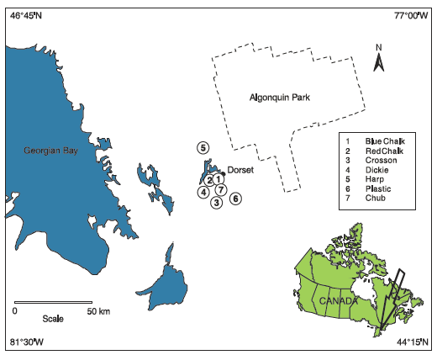
Dorset A Lakes
Lakes sampled bi-weekly since the late-1970s
Water chemistry
Temperature-oxygen profile
Small (< 100 ha), mostly headwater lakes
Two of the lakes, Harp and Red Chalk, support Lake Trout populations
(Molot and Dillon 2008, CJFAS)
Notes:
Six lakes (Blue Chalk, Chub, Crosson, Harp, Plastic, and Red Chalk) in the Muskoka-Haliburton region of Ontario, Canada, were selected for this study (Figure 1). These lakes have been monitored intensively by the Dorset Environmental Science Centre since the late-1970s. The six study lakes are small (surface area < 100 ha), headwater lakes (all except Red Chalk Lake which is directly downstream of Blue Chalk Lake), that are located within the Precambrian Shield. Red Chalk Lake has two distinct depositional basins separated by a shallow sill (Red Chalk Main and Red Chalk East) that were analyzed separately. The lakes vary in morphometry, water chemistry, and amounts of shoreline development (Table 1).
Harp Lake and Red Chalk Main Lake both have Lake Trout populations (OMNRF 2006), and current end-of-summer VWHO concentrations are below the provincial water quality objective of 7 mg∙L⁻¹ (aimed to protect recruitment and the survival of juvenile Lake Trout; Evans 2007). Harp is a “put-grow-take” recreational fishery (OMNRF 2006) – these are designated lake trout lakes that are actively stocked and managed to direct fishing pressure away from undisturbed sites
Although the other study lakes do not support Lake Trout populations, the availability of rare long-term monitoring data spanning ~ 40 years allows for the examination of hypolimnetic oxygen trends across four additional dimictic lakes in the region.

Slide 7
Research Questions
In the two Dorset A lakes that support Lake Trout:
How has oxythermal habitat and end-of-summer VWHO changed over the past 40 years?
Is September 15th still a good date to assess end-of-summer VWHO?
In the other dimictic Dorset A lakes:
How has VWHO changed over the past 40 years (i.e., are trends common to all lakes)?
And if so, what component of the VWHO calculation (concentration and/or volume) contributed to VWHO trends?

Slide 8
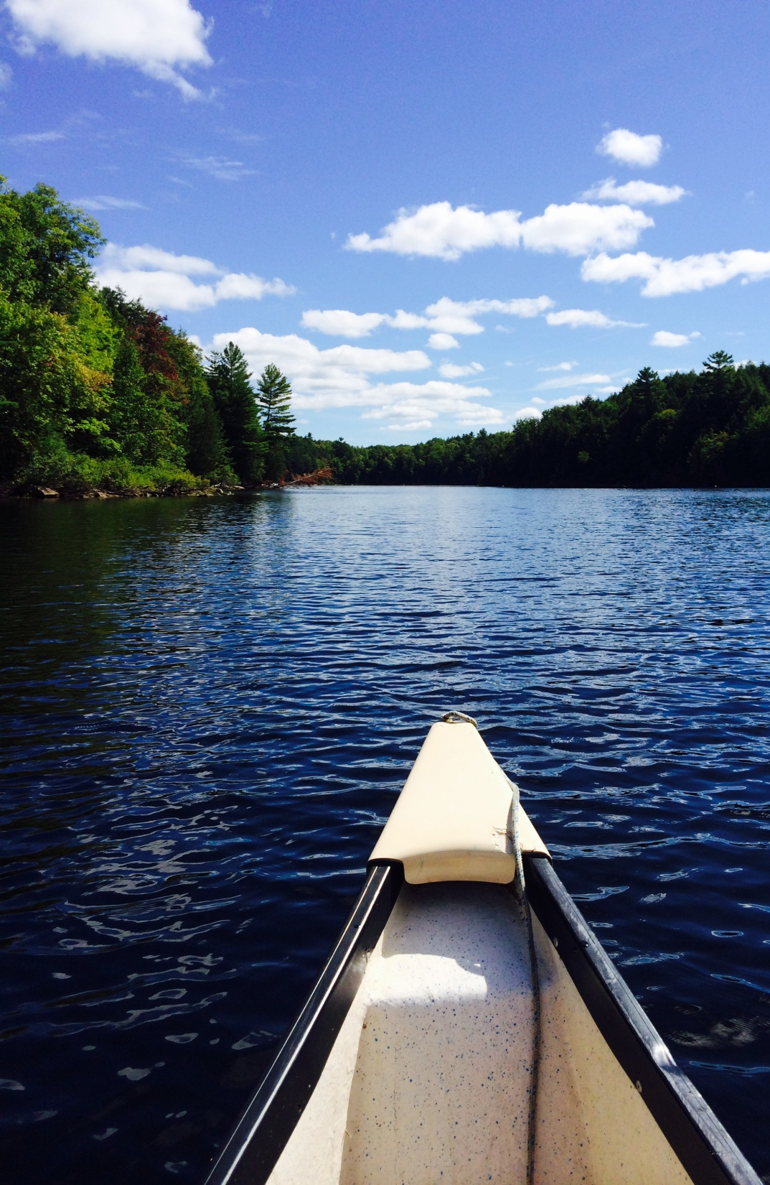
Methods
The volume of optimal habitat was determined using:
Deepest point in the water column where temperatures were ≥ 10 °C
Shallowest point in the water column where the DO concentration was ≤ 6 mg/L
Habitat volumes were expressed as proportions to allow comparisons to be made between the two lakes

Slide 9
Methods
For all dimictic lakes:
Thermocline depth
Hypolimnetic Volume
Mean hypolimnetic DO concentration
VWHO
were calculated and values were standardized to September 15th
Mann-Kendall trend tests were performed to detect monotonic changes in each variable

Slide 10
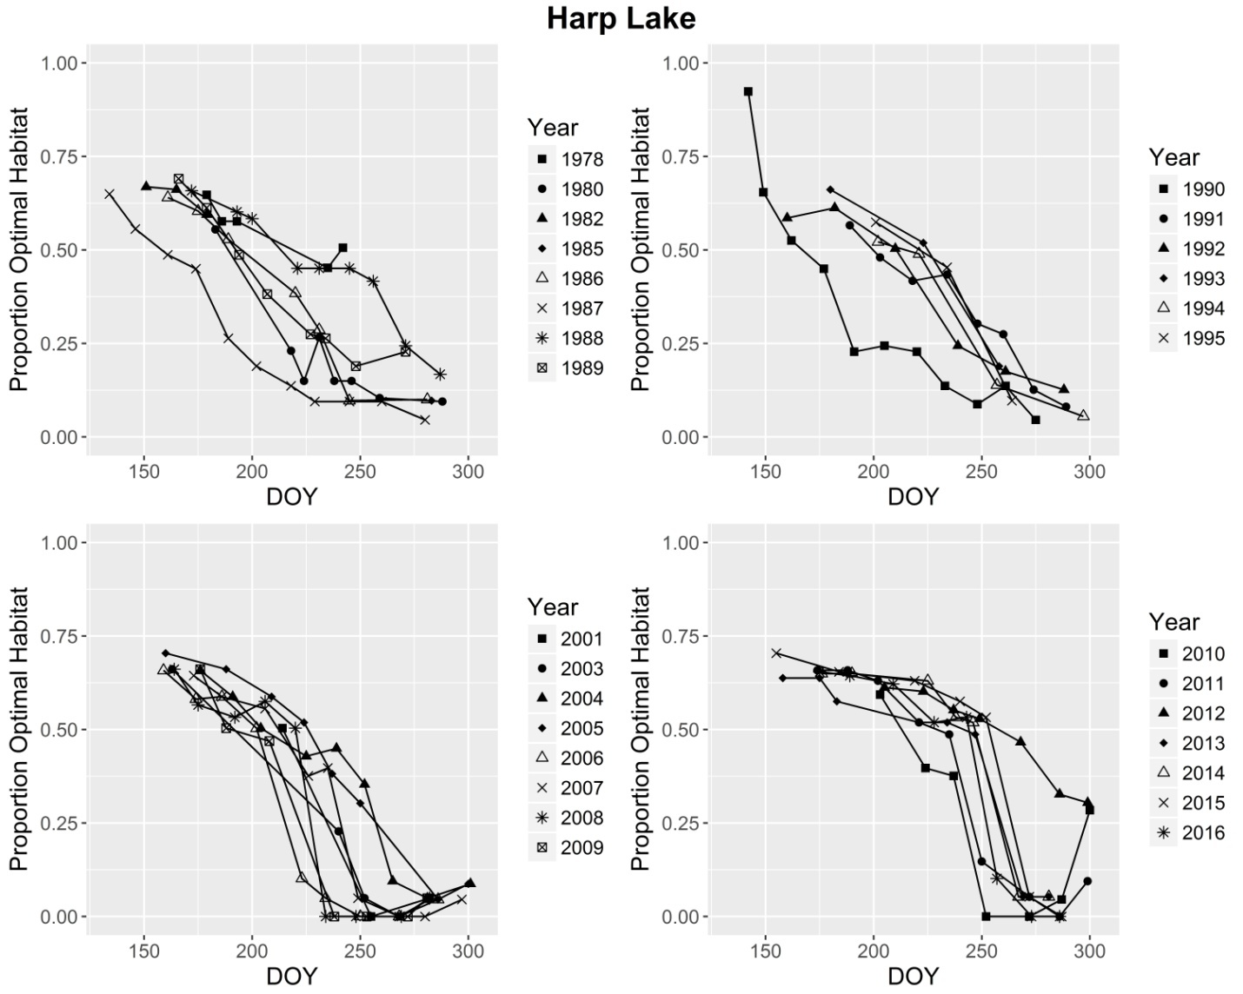
1978-1989
1990-1995
150
200
250
300
150
200
250
300
2001-2009
2010-2016
150
200
250
300
150
200
250
300
Day of Year (DOY) Guide: 250: September 7th, 259: September 15th, 300: October 27th
Notes:
10 isotherm and 6 oxycline oftenn present persisted into October
Harp – prop optimal habitat gradually decreased from late-spring to early fall , between 2000 and 2010 reuction occurred more abruptlu
Optimal habitat was completely absent by end of summer in 2001, 2003, 2006 -2011 (this did not previously occur in harp Lake)

Slide 11
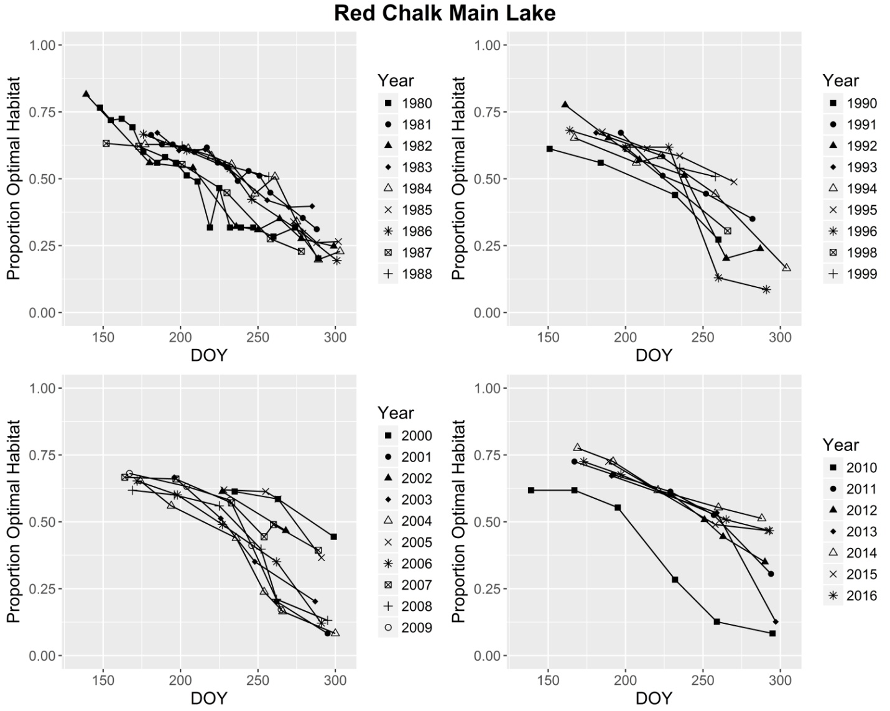
1980-1988
1990-1999
150
200
250
300
150
200
250
300
2000-2009
2010-2016
150
200
250
300
150
200
250
300
Day of Year (DOY) Guide: 250: September 7th, 259: September 15th, 300: October 27th
Notes:
More optimal habitat in Red Chalk compared to harp
Change to an abrupt decrese is less aparent in red Chalk compared to Harp

Slide 12
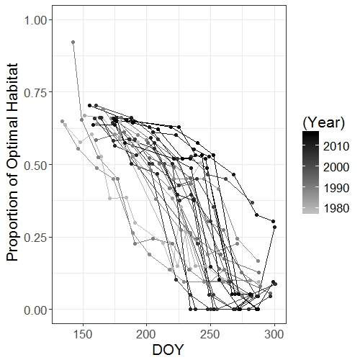
Harp Lake
Year
Day of Year

Slide 13
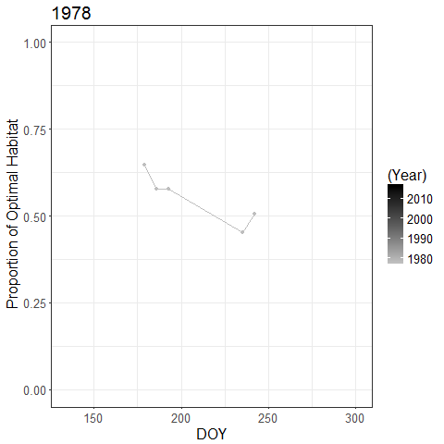
Harp Lake
Harp Lake
Year
Year
High proportions of optimal Lake Trout habitat are present for longer into the year before decreasing to seasonal minimum
Day of Year
Notes:
The line marks september 15th – you can see how sampling at that point would give you an over estimate of the seaosnal habitat minimum

Slide 14
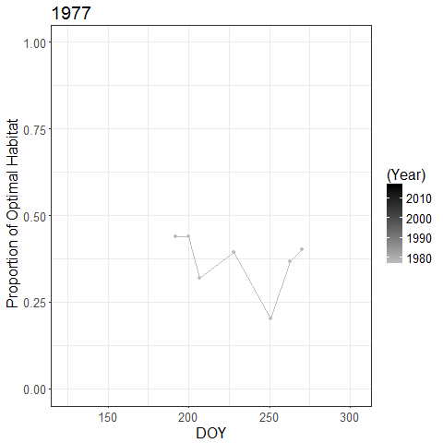
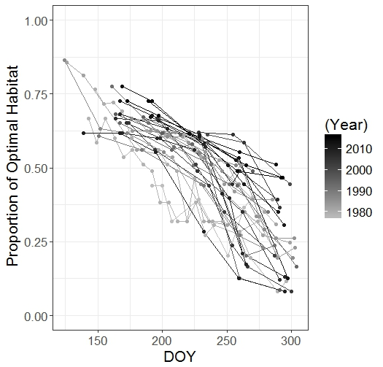
Red Chalk Lake
Red Chalk Lake
Year
Year
Day of Year

Slide 15
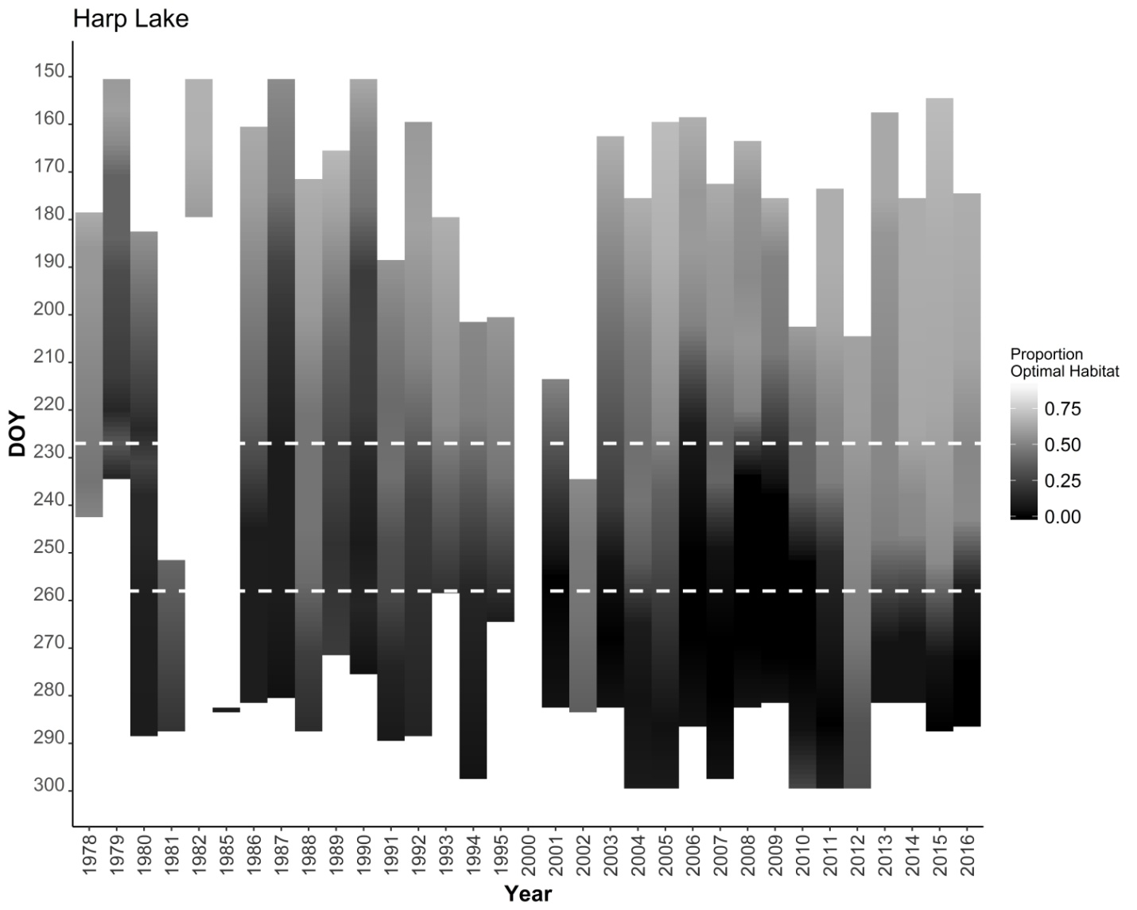
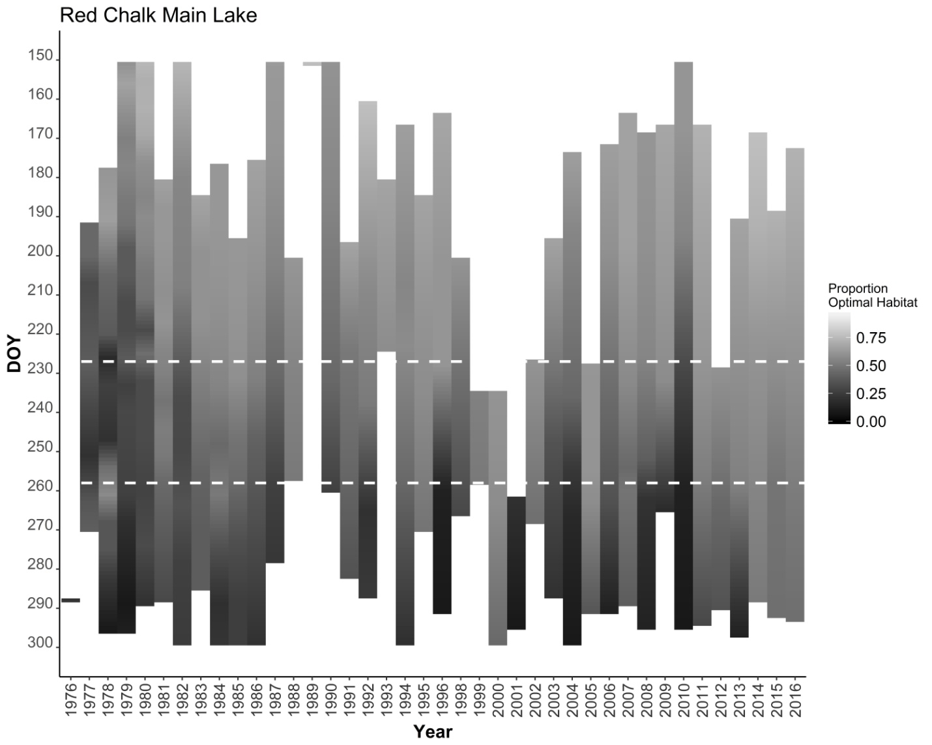
HARP: The lowest proportion of optimal habitat (“worst-case” conditions for Lake Trout) consistently occurred after September 15th since 2010
RED CHALK: “worst-case” condition generally occurred after September 15th throughout the entire monitoring period
Notes:
These plots present the data in a differnet way. DOY is plotted on the y axis and year is plotted on the x axis. The dotted white lines are August 15th and September 15th. The darkest part of each bar represents the habitat minimum that eyar. You can see this often took place within the dotted lines. Durng the early 2000s this minima was reach earlier, however now you can see that it is being reach outside the dotted lines.
Red Chalk has more habitat than Harp – with typically the minima reached after Sept15th over the entire record.

Slide 16
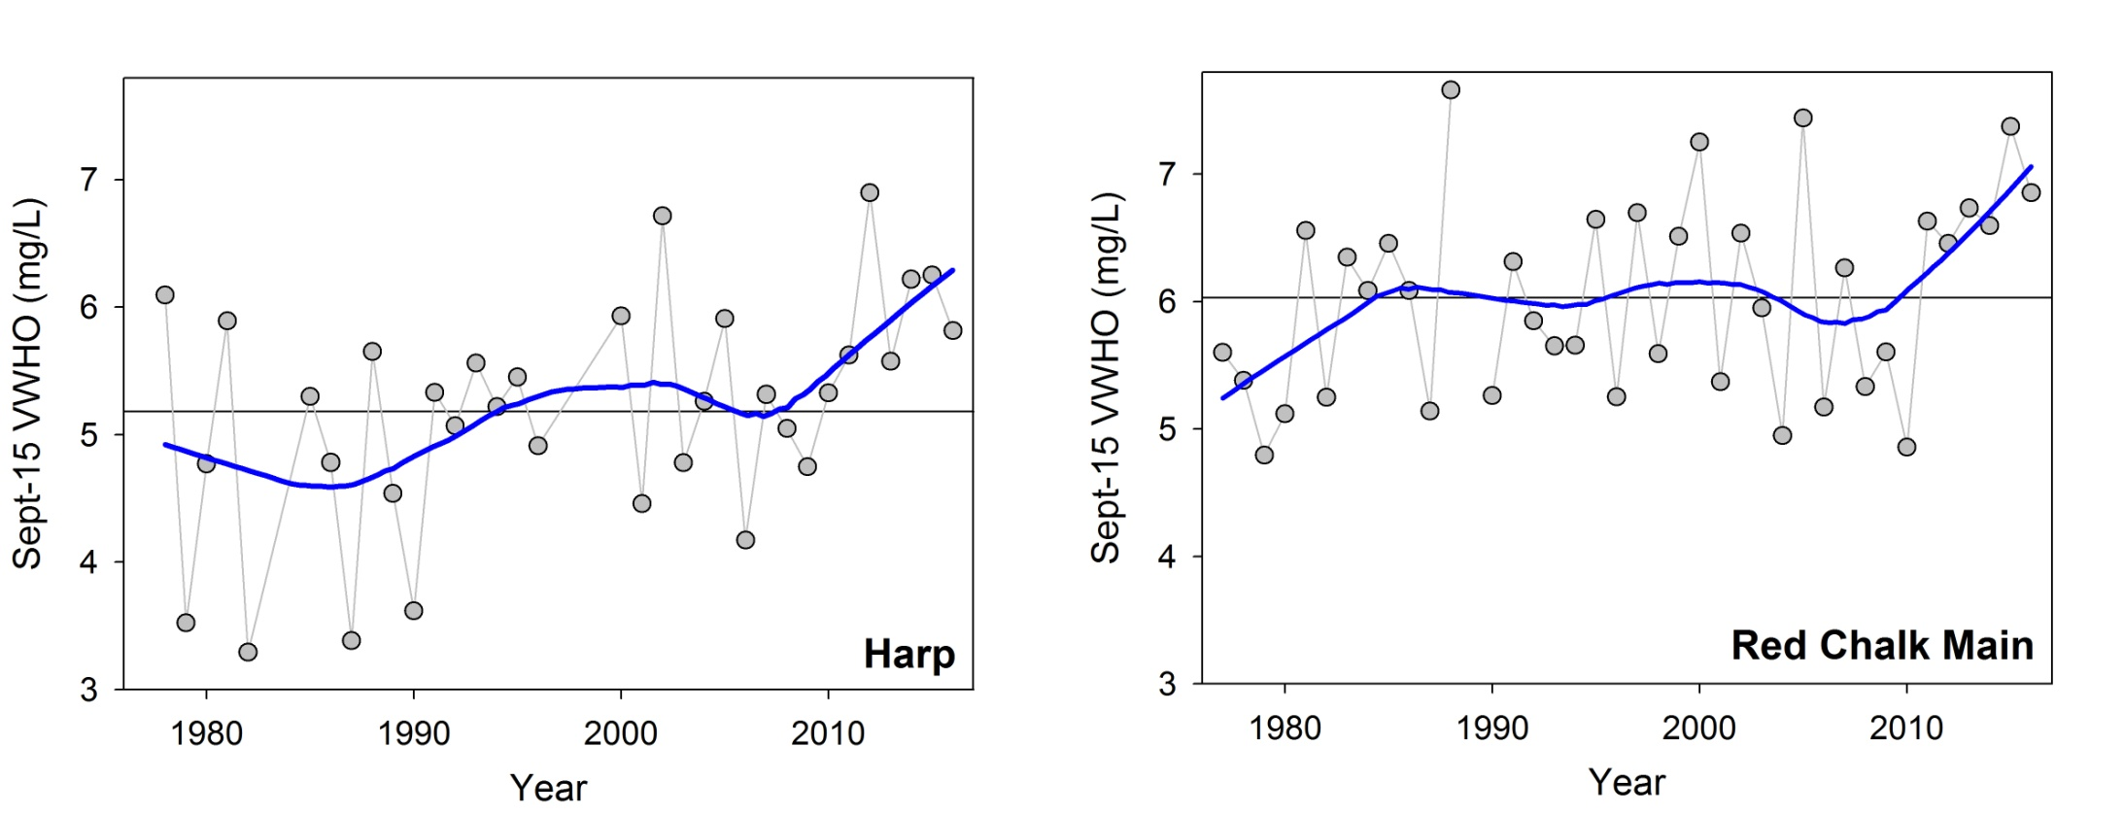
Volume-weighted hypolimnetic oxygen
Are changes in VWHO driven by changes in hypolimnetic VOLUME or hypolimnetic DO CONCENTRATION, or both?

Slide 17
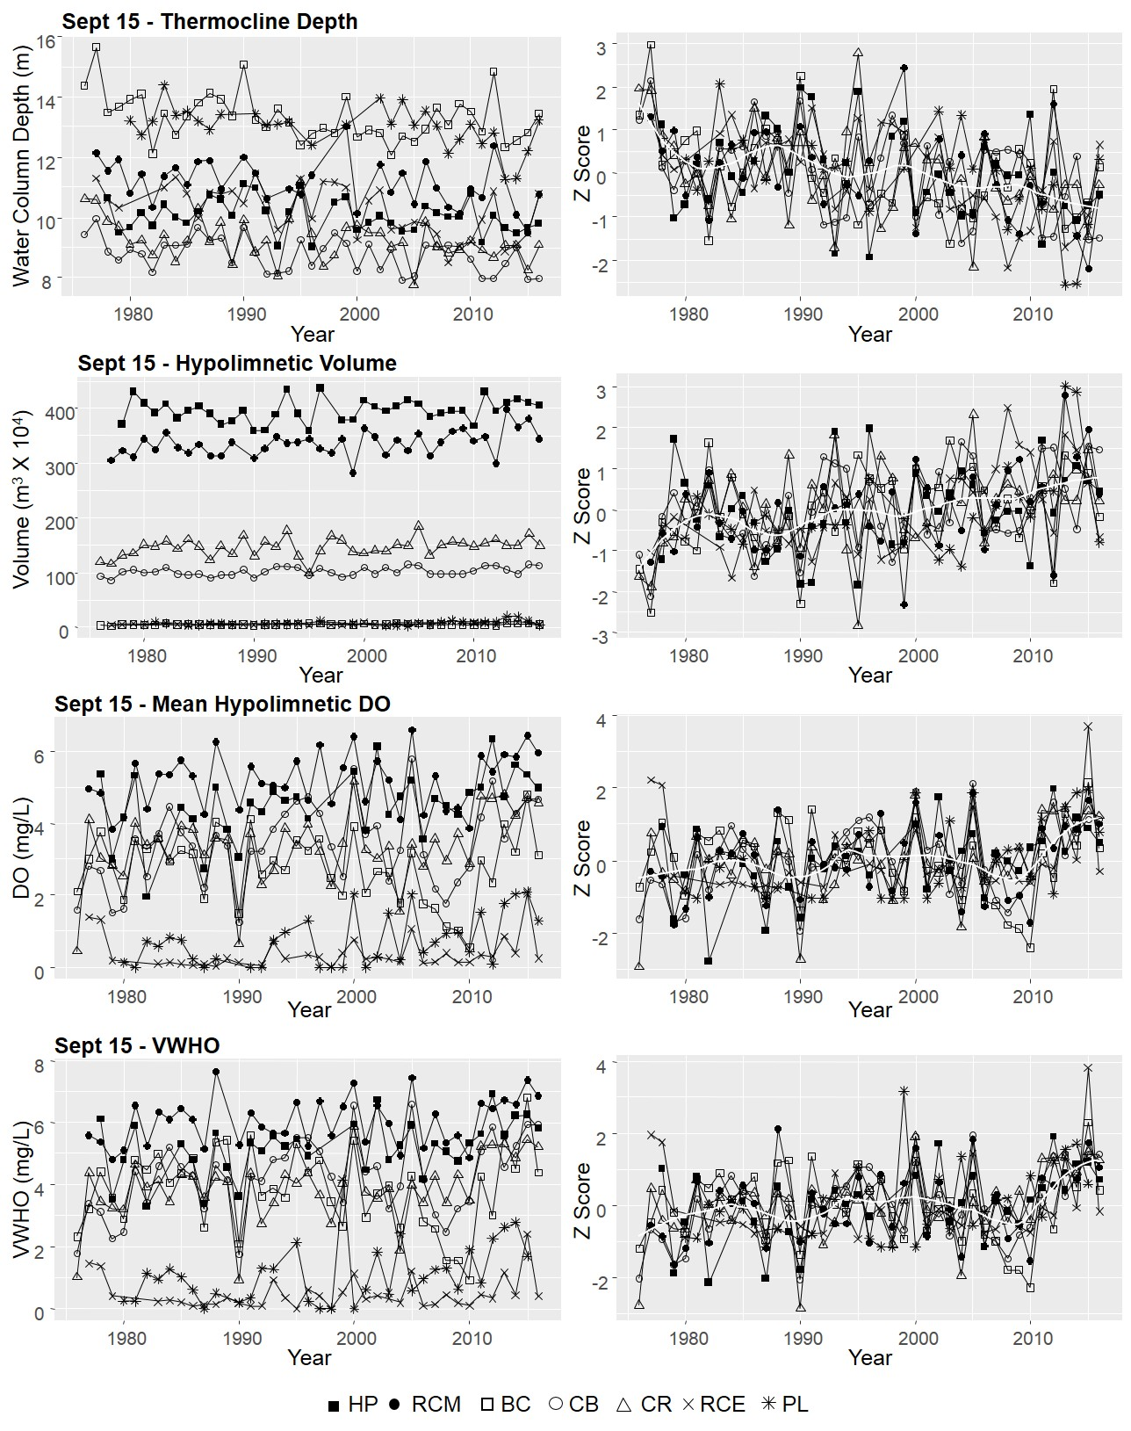
Notes:
Standradized thermocline depth and hypolimnetic volume – range in both parametrs
- Not informative for comparing trends betwen lakes – data was z scores – seen decrease in thermocline depth and a corresponding increase in hypolimentic volume

Slide 18
Significant breakpoint detected at 2010
Notes:
Increase in mean hypo DO and VWHO post 2010

Slide 19
Mann-Kendall Trend Tests
 | Sept-15 VWHO | Sept-15 Mean hypolimnetic [DO] | Sept-15 Hypolimnetic Volume | Sept-15 Thermocline Depth
Blue Chalk | T = -0.049, p = 0.66 | T = -0.14, p = 0.20 | T = 0.30, p = 0.0059 | T = -0.29 p = 0.0083
Chub | T = 0.28, p = 0.01 | T = 0.25, p = 0.024 | T = 0.30, p = 0.0059 | T = -0.30, p = 0.0063
Crosson | T = 0.24, p = 0.027 | T = 0.21, p = 0.060 | T = 0.26, p = 0.018 | T = -0.28, p = 0.0095
Harp | Τ = 0.29, p = 0.016 | T = 0.31, p = 0.010 | T = 0.15, p = 0.18 | T = -0.16, p = 0.17
Plastic | T = 0.32, p = 0.0083 | T = 0.35, p = 0.0041 | T = 0.29, p = 0.028 | T = -0.36, p = 0.006
Red Chalk (E) | T = 0.098, p = 0.40 | T = 0.20, p = 0.094 | T = 0.39, p = 0.00078 | T = -0.41, p = 0.00039
Red Chalk (M) | T = 0.22, p = 0.047 | T = 0.19, p = 0.10 | T = 0.33, p = 0.0032 | T = -0.33, p = 0.0029
Positive trends detected in both hypolimnetic volume and mean hypolimnetic [DO]
Notes:
Often trends were detected in both in volume and mean DO – the only two lakes that did not have signficant man kendall trend test in VWHO was RCE and BC

Slide 20
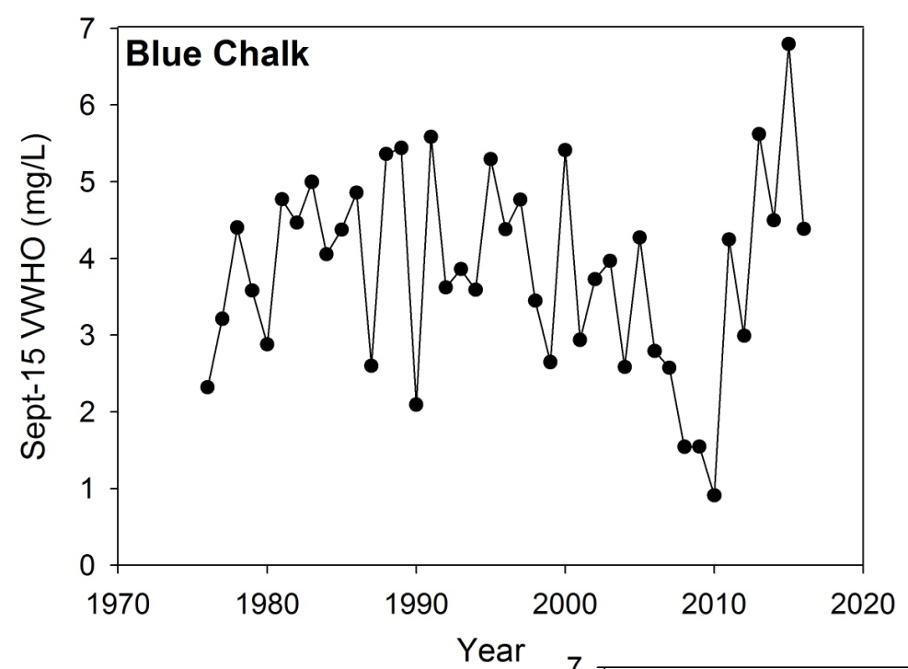

Mann-Kendall Trend Tests
 | Sept-15 VWHO | Sept-15 Mean hypolimnetic [DO] | Sept-15 Hypolimnetic Volume | Sept-15 Thermocline Depth
Blue Chalk | T = -0.049, p = 0.66 | T = -0.14, p = 0.20 | T = 0.30, p = 0.0059 | T = -0.29 p = 0.0083
Chub | T = 0.28, p = 0.01 | T = 0.25, p = 0.024 | T = 0.30, p = 0.0059 | T = -0.30, p = 0.0063
Crosson | T = 0.24, p = 0.027 | T = 0.21, p = 0.060 | T = 0.26, p = 0.018 | T = -0.28, p = 0.0095
Harp | Τ = 0.29, p = 0.016 | T = 0.31, p = 0.010 | T = 0.15, p = 0.18 | T = -0.16, p = 0.17
Plastic | T = 0.32, p = 0.0083 | T = 0.35, p = 0.0041 | T = 0.29, p = 0.028 | T = -0.36, p = 0.006
Red Chalk (E) | T = 0.098, p = 0.40 | T = 0.20, p = 0.094 | T = 0.39, p = 0.00078 | T = -0.41, p = 0.00039
Red Chalk (M) | T = 0.22, p = 0.047 | T = 0.19, p = 0.10 | T = 0.33, p = 0.0032 | T = -0.33, p = 0.0029
Increases post-2010 still observed in both Blue Chalk and the east basin of Red Chalk
Positive trends detected in both hypolimnetic volume and mean hypolimnetic [DO]
Notes:
Often trends were detected in both in volume and mean DO – the only two lakes that did not have signficant man kendall trend test in VWHO was RCE and BC

Slide 21
Conclusions
In the two Dorset A lakes that support Lake Trout:
How has oxythermal habitat and end-of-summer VWHO changed over the past 40 years?
The proportion of optimal oxythermal habitat and Sept-15 VWHO increased post-2010
Is September 15th still a good date to assess end-of-summer VWHO?
Although high proportions of optimal habitat persisted for longer into the year, the seasonal habitat minimum often occurred after Sept-15
In the other dimictic Dorset A lakes:
How has VWHO changed over the past 40 years (i.e., are trends common to all lakes)? Are trends driven by changes in hypolimnetic oxygen concentration or volume?
Increases in VWHO post-2010 were observed at all sites and were driven by increases in hypolimnetic oxygen concentration, hypolimnetic volume, or both variables
Notes:
KMR- I would use past tense on first point to be clear - It can still be recent and persistent. … maybe the word persistent isn’t quite correct here.

Slide 22




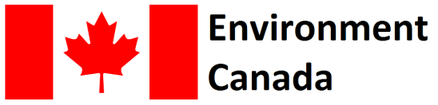
Thank You for Listening!
Key Literature
Evans DO, Casselman JM, Wilox CC. 1991. Effects of exploitation, loss of nursery habitat, and stocking on the dynamics and productivity of Lake Trout populations in Ontario lakes. Ontario Ministry of Natural Resources p. 103.
Evans DO. 2007. Effects of hypoxia on scope-for-activity and power capacity of Lake Trout (Salvelinus namaycush). Can J Fish Aquat Sci. 64:345–361.
Guzzo MM., Blanchfield PJ. 2016. Climate change alters the quantity and phenology of habitat for Lake Trout (Salvelinus namaycush) in small Boreal Shield lakes. Can J Fish Aquat Sci. 74:871-884.
[OMOE] Ontario Ministry of the Environment, Ontario Ministry of Natural Resources, and Ontario Ministry of Municipal Affairs and Housing. 2010. Lakeshore Capacity Assessment Handbook: Protecting Water Quality in Inland Lakes. Ontario. p. 106.
Notes:
KMR- I would use past tense on first point to be clear - It can still be recent and persistent. … maybe the word persistent isn’t quite correct here.

Slide 23
 | Blue Chalk | Chub | Crosson | Harp | Plastic | Red Chalk East | Red Chalk Main
Latitude | 45° 11' 55.47" N | 45° 12' 50.77" N | 45° 5' 1.75" N | 45° 22' 45.70" N | 45° 10' 48.55" N | 45° 11' 25.00" N | 45° 11' 24.93" N
Longitude | 78°56' 26.30" W | 78° 58' 56.78" W | 79° 2' 5.57" W | 79° 7' 57.40" W | 78° 49' 23.64" W | 78° 56' 26.00" W | 78° 56' 51.33" W
Lake Area (ha) | 52.4 | 34.4 | 56.7 | 71.4 | 32.1 | 13.1 | 44.1
Z_{mean} (m) | 8.5 | 8.9 | 9.2 | 13.3 | 7.9 | 5.7 | 16.7
Z_{max} (m) | 23 | 27 | 25 | 37.5 | 16.3 | 19 | 38
Lake Volume (m³ x 10⁴) | 446.8 | 304.2 | 521.6 | 950.8 | 252.4 | 74.8 | 735.2
Watershed Area (km²) | 1.583 | 3.06 | 5.79 | 5.42 | 1.28 | 5.89
Mean Residence Time (days) | 1610 | 701 | 548 | 1131 | 1204 | 912 | 912
DOC Range (mg∙L⁻¹) | 1.63 - 2.50 | 4.25 - 6.07 | 3.76 - 5.53 | 3.50 - 5.66 | 1.81 - 2.99 | 2.55 - 3.95 | 2.29 - 4.40
TP Range (μg∙L⁻¹) | 5.17 - 8.00 | 7.33 - 12.57 | 7.38 - 12.52 | 5.02 - 9.02 | 3.54 - 8.15 | 5.18 - 8.58 | 3.95 - 5.94
pH Range | 6.44 - 6.92 | 5.48 - 6.05 | 5.33 - 5.98 | 6.14 - 6.62 | 5.51 - 6.04 | 6.27 - 6.66 | 6.12 - 6.60
Number of cottages/ dwellings | 15 | 25 | 0 | 90 | 0 | 10
Notes:
Lakes are generally oligptropgi (chub and crosson have the highest TP), slightly acidc, range in development,
Harp and red chalk – two deepest lakes – largest lake volumes

Slide 24
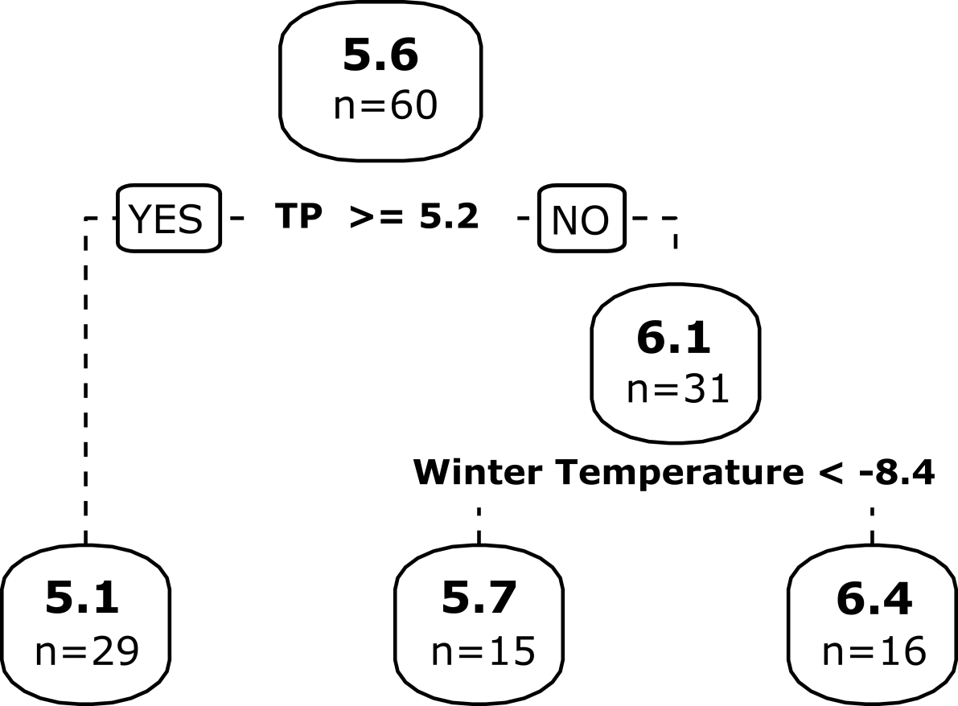
Regression Tree Analysis
VWHO Tree
TP (r = -0.49), DOC (r= -0.39), and average winter temperature (r= 0.31) were the most correlated with VWHO
Lowest VWHO was observed when TP >= 5.2 μg/L
Highest VWHO was observed when TP < 5.2 μg/L and when winter temperatures were warmer than -8.4 °C
R² = 0.33 , root node error = 0.82
Volume Tree: R² = 0.73, included DOC , [DO] Tree: R² = 0.22, included TP
Notes:
Variation in VWHO was best explained by TP and average winter temperature

Slide 25
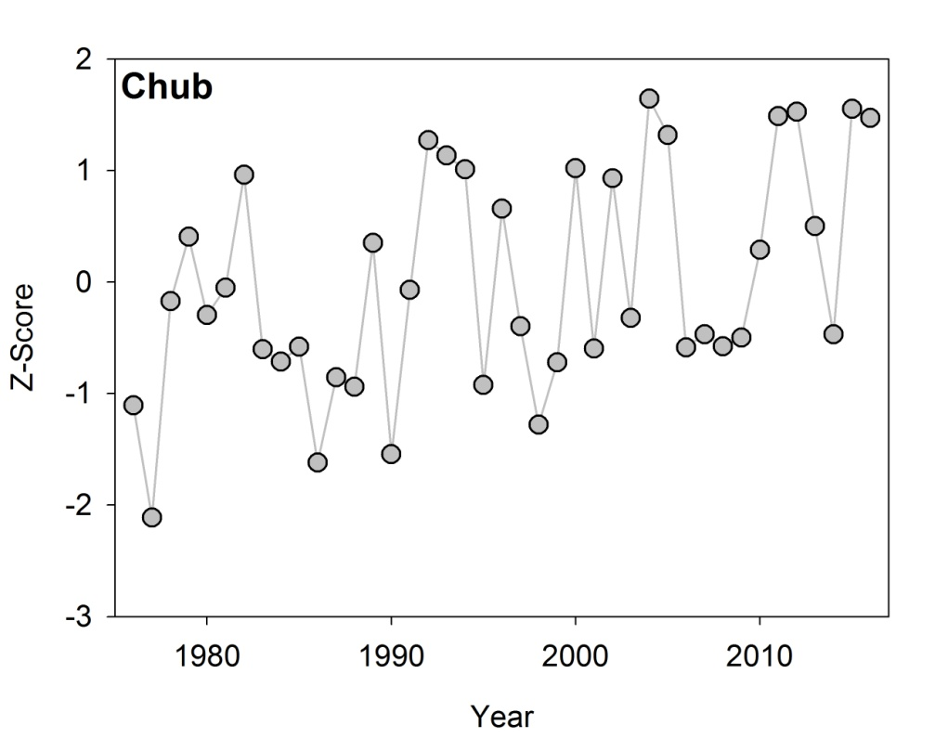
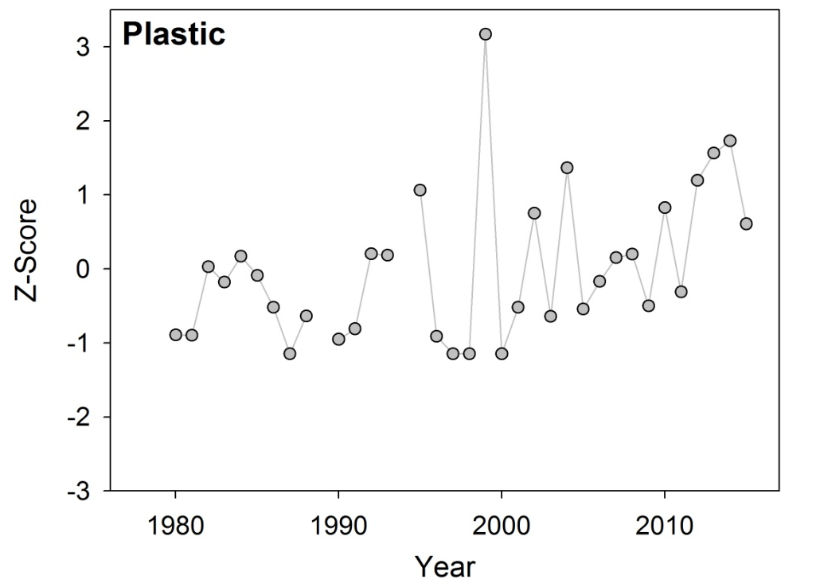
Coherency Analysis
 | Sept-15 VWHO | Sept-15 Mean hypolimnetic [DO] | Sept-15 Hypolimnetic Volume | Sept-15 Thermocline Depth
r_{i} | 0.58 (p < 0.01) | 0.54 (p < 0.01) | 0.35 (p < 0.01) | 0.40 (p < 0.01)
Notes | Excluding Plastic | Excluding Plastic | Excluding Chub | Excluding Chub
Higher temporal coherence for oxygen trends compared to volume trends
shallowest lake (16.3 m)
highest DOC concentration
Notes:
First step in the coherency analysis is to create a homogeneous subset of lakes – essential try to find the lakes that are changing the same before asking how much the same are they – this was done using a brien’s test which analyses the structure of the between lake correlation matrix. For a group of lake sto be considered homogenous – the matrix must have equal correlations, no interactions, ad equal mean correlations. If these criteria were not satisfied, the lake with the lowest mean correlation for dropped and the test was repeated. For the grouping of lakes to be considered synchronous, the gran mean of each correlation matrix needed to be signficantly different from 0. which excluded plastic from the VWHO and mean DO analysis and sub from the hypolimnion vlume and thermocline depth anlsys
The measure of synchrony was represnted by ri (intraclass correlation coefficent) that represents the mean Pearson correlation coefficient between lakes
Plastic still incraeses post 2010 like the other sites – and chub volume also still increases (most variable record)

