Slide 1
Lake Trout Strategic Project
Meeting 1
April 24th 2014

Slide 2
Agenda
Project Objectives
Summary of what we promised
Timeline and Milestones
Short, medium and long-term
Communication Strategy
Budget Items
Progress of the paleo group
Other Business

Slide 3
Project Objective
“To develop new predictive tools for forecasting the impact of climate change and other anthropogenic activities on hypolimnetic dissolved oxygen concentrations in Lake Trout lakes of Ontario”

Slide 4
Project Overview
Theme 1: Understanding the past
Theme 2: Modeling the present
Theme 3: Forecasting the future
Develop and calibrate models on a common set of study lakes
Apply models to lakes of significant interest to supporting organizations
New toolset for lake and resource managers
Notes:
The project combines three distinct yet complementary techniques that will accurately hindcast, measure and predict past, present, and future hypolimnetic [DO] in the study lakes as a function of multiple drivers including lakewater chemistry, algal blooms and physical structure of the lake (e.g., length of ice cover, extent of thermal stratification). In the summer of 2014, sediment coring will begin in northern bays of the Lake of the Woods, and biological and chemical indicators preserved in the sediments (i.e. paleolimnological approaches) will be examined to develop and refine tools for hindcasting deepwater [DO]. This work will build on recent published findings from Poplar Bay in northern Lake of the Woods, where paleolimnological investigations have found that the onset of substantial warming during the late-1970s triggered marked biological changes among algal and invertebrate communities. The tools and models developed through these analyses will provide managers with a scientifically-defensible approach for managing lake trout habitat in a multiple-stressor world, provide guidance on mitigation strategies, and enable sustainable management.

Slide 5
Theme 1 – Paleolimnology
Provide lake managers with detailed paleolimnological reconstructions of hypolimnetic [DO], TP, lake production, DOC, and climate variables for the strategically selected study lakes.
The paleoenvironmental data will be used by the project’s modelers to validate broad-scale environmental drivers of historic [DO].
The relationships between [DO] and its drivers in the paleo data sets will be compared to those from both empirical and computational lake models.

Slide 6
Theme 2 – Empirical Model
New model developed using 1999-2010 data before generating results to compare with recent paleolimnological data and the dynamic 1D model.
Empirical model rebuilt to include lake [DOC] as an independent variable in addition to TP.
Predictions of end-of-summer [DO] profiles will be transformed into volume-weighted hypolimnetic DO and compared with paleo reconstructions and dynamic model predictions from recent years.
Revised model will be applied to several inland lakes at high risk of cyanobacteria blooms

Slide 7
Theme 3 – Dynamic Model
A 1D (vertical) model will be developed to simulate physics and biogeochemistry over timescales relevant to future climate change.
Model predictions will be validated against historical lakewater observations (“A” lakes) and paleolimnological data.
The technology developed will be transferred to Environment Canada who have already embedded the 1D hydrodynamic submodel within their Canadian Land Surface Scheme, General and Regional Climate Models (GCMs) and Numerical Weather Prediction models.

Slide 8
Theme 3 – Dynamic Model
We will couple the 1D hydrodynamic Environment Canada model to the biogeochemistry algorithms from DYRESM-WQ and develop the coupled model for a Canadian setting that incorporates ice cover and is fully coupled to the Environment Canada weather and climate prediction models.
We will develop an empirical sediment oxygen demand (SOD) model, for the new dynamic 1D model, from the paleolimnological data time-history of organic matter accumulation in the sediments and reconstructed [DO].

Slide 9
Theme 3 – Dynamic Model
The dynamic model simulations will be calibrated and validated against the 35 year DESC “A” lake data set. The simulated data will be of higher space-time resolution than the “A” lake data, and so will be used to aid development of the empirical model.
The dynamic model will be coupled to Environment Canada GCM hindcasts to simulate broad-scale modeled trends during past climatologies (e.g., pre-industrial ~1850 AD) and the results will be compared to the paleoenvironmental data .

Slide 10
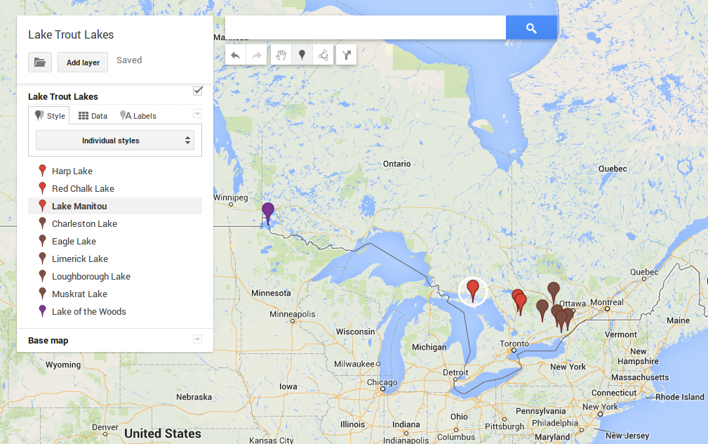
Study Lakes
Notes:
Our focus is upon a set of lakes (including Lake of the Woods) with naturally-reproducing lake trout populations, long-term oxygen data, and fall into at least one of the following categories: there is significant shoreline development pressure or agriculture in the watershed; there have been long-term changes in measured hypolimnetic dissolved oxygen (DO) concentration; they are near or below the provincial guideline of 7 ppm for end-of-summer mean volume-weighted hypolimnetic [DO]; and/or they are of current management concern for water quality or have experienced recent algal blooms.

Slide 11
Timeline/Milestones (Short term)
Milestone | Description | Start | Finish
1. Recruit graduate students and PDF | Theme1 PDF and PhD1; Theme2 MSc; Theme3 PhD2 | 2013-Oct-15 | 2013-Dec-16
2. Project orientation and data collection | Study of field sites, long-term datasets and existing models, learn and develop methodologies | 2014-Jan-01 | 2014-Jul-01
3. Workshop 1 | Initial workshop/data sharing meeting | 2014-Apr-01 | 2014-Apr-01
4. Field Season 1 | Collection of sediment cores from the study lakes located in Eastern and Central Ontario (PDF, PhD1) | 2014-Apr-01 | 2014-Sep-01
5. Coupling of 1D models | Couple 1D physical and biogeochemical models (PhD2) | 2014-Apr-01 | 2015-Jul-01
6. Sediment Analysis | Analyze in Field Season 1 sediments for invert remains, spectral signatures, radioisotopes (PDF), diatoms (PhD1). | 2014-Jul-01 | 2016-Jan-01
7. Test original empirical model | Test original empirical model for predicting end-of-summer oxygen profiles with current data (MSc) | 2014-Jul-01 | 2014-Oct-01

Slide 12
Timeline/Milestones (Medium term)
Milestone | Description | Start | Finish
8. Transfer paleo data | Transfer of paleo data to modelling groups as analyses of individual sediment cores are completed (PDF, PhD1) | 2014-Sep-01 | 2015-Oct-01
9. Workshop 2 | Workshop/data sharing meeting at Queen’s all PI’s and partners | 2014-Oct-01 | 2014-Oct-01
10. Revision of empirical model | MSc will revise empirical model using 1999-2010 data including DOC as an independent variable | 2014-Oct-01 | 2015-Apr-01
11. Development of SOD model and validation of 1D model | PhD2 wil develop carbon based predictive SOD model from paleo cores and validate models against long-term DESC data sets. | 2014-Oct-01 | 2015-Oct-01
12. Workshop 3 | Workshop/data sharing meeting at one of the research or partner hubs; all PI’s and partners. | 2015-Apr-01 | 2015-Apr-01
13. Field Season 2 | Collection of sediment cores from Lake of the Woods and Lake Manitou (PDF, PhD 1) | 2015-Apr-01 | 2015-Sep-01

Slide 13
Timeline/Milestones (Medium term)
Milestone | Description | Start | Finish
14. Validation of revised empirical model | MSc will validate and compare the revised empirical model with the long-term observational data, paleo reconstructions and 1D dynamic model | 2015-Apr-01 | 2015-Oct-01
15. Application of revised empirical model | MSc will apply the revised empirical model to several inland lakes at risk of cyanobacteria blooms | 2015-Jul-01 | 2015-Oct-01
16. Validation of dynamic models | Validation of the dynamic models against long-term observation datasets and paleo reconstructions (TP, DO, DOC), (PhD2, PDF, PhD1) | 2015-Jul-01 | 2016-Apr-01
17. Workshop 4 | Workshop/data sharing meeting at one of the research or partner hubs; all PI’s and partners. | 2015-Oct-01 | 2015-Oct-01
18. Workshop 5 | Workshop/data sharing meeting at one of the research or partner hubs; all PI’s and partners. | 2016-Apr-01 | 2016-Apr-01

Slide 14
Timeline/Milestones (Long term)
Milestone | Description | Start | Finish
19. Application of dynamic models | Apply models to predict future [DO] in lake trout lakes under climate change scenarios (PhD2) | 2016-Apr-01 | 2016-Dec-31
20. Paleolimnological synthesis | Synthesize paleolimnological information (chironomids, diatoms, radioisotopes) to examine relationship among [DO], algal blooms, nutrient, climate, and/or other environmental factors. | 2016-Jul-01 | 2016-Dec-31
21. Workshop 6 | Final workshop/data sharing meeting; user sector workshop. | 2016-Oct-01 | 2016-Oct-01

Slide 15
Communication Strategy
PI’s, Government, LotW/FOCA
Website (papers, presentations, etc.)
Avoid detail fatigue in partners

Slide 16
Budget Items

Slide 17
Theme 1 Progress (Paleo)
Sediments:
Harp Lake
Red Chalk Lake
Charleston Lake
Eagle Lake
Limerick Lake
Loughborough Lake
Muskrat Lake
Lake Manitou
Lake of the Woods
Collected August 2013
Will be collected summer 2014
Will be collected fall 2014/ summer 2015

Slide 18
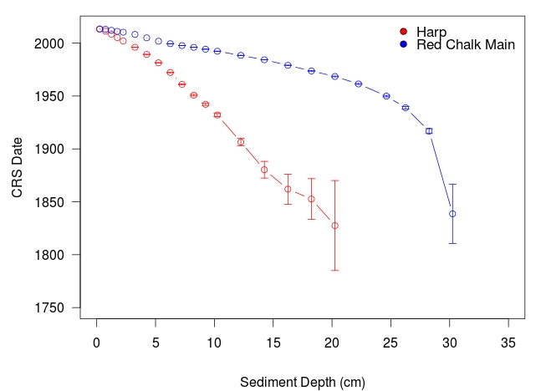
Theme 1 Progress (Paleo)
Harp and Red Chalk sediment cores both dated (RC
~Half of Harp chironomid counts complete
Clare starts May 1st and will begin diatom analysis immediately

