Slide 1
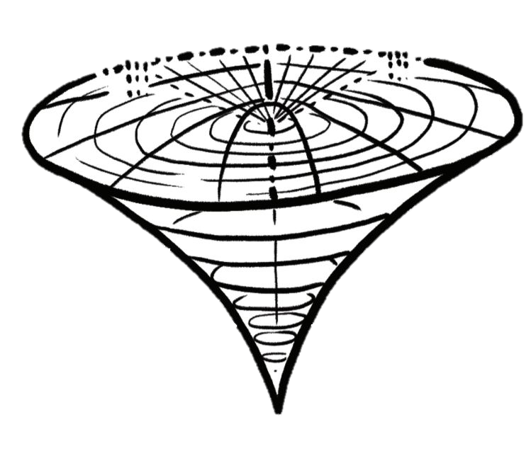
Sexual Configurations Theory
A New Way of Understanding Gender/Sex & Sexuality
For Educators & Students in Courses Related to Feminist/Queer Studies and/or Human Sexuality
By: Sari van Anders, Jason Burns, Katya Kredl, and Daniel Shuchat
For questions, contact Dr. Sari van Anders sva5@queensu.ca

Slide 2
There are many ways of conceptualizing sexual orientation:
0
1
2
3
4
5
6
Straight
Bisexual
Gay/Lesbian
Exclusively heterosexual
Equally heterosexual and homosexual
Exclusively homosexual
Some people use typology, classifying it using broad categories.
Some people think of it as a continuum (like the Kinsey scale), a spectrum, or a grid. Some people make categories from these continua.
However, most of these methods focus on one aspect of sexual orientation: partner gender/sex.

Slide 3
Sex, Gender/Sex, & Gender (note: people can define these in ways that make sense to them, too!)
Sex
bodily, evolved
Gender/Sex
people, aspects, identities
Gender
sociocultural, learned
female, male, sex-diverse
gender sex diverse, women, men
masculine, feminine, gender-diverse
voice
body frames
legal identity
recognition
interactions
laws
skin texture
genitals
felt identity
norms
clothes
communities
We use the word gender/sex to represent whole people or identities where sex and gender cannot be easily disentangled. Some identity words like transgender or butch could be used to describe sex, gender/sex or gender.

Slide 4
Sexual Configurations Theory (SCT)
Gay
Slut
Lesbian
Asexual
In SCT, partnered sexuality can be broken down into multiple parameters including:
partner number sexuality
gender/sex sexuality
SCT also creates space for other aspects of sexuality using sexual parameter_{n}, including those that do exist, have existed, may not yet be voiced, or might come.
Straight
Gender/Sex
Partner Number
Single by choice
Partnered Sexuality
Queer
Poly
Bi
Player
Sexual Parameter_{n}
Kink
(van Anders, 2015)

Slide 5
Nurturance & Eroticism
Nurturance and eroticism are an additional parameter of sexuality; they are interwoven into partner number and gender/sex sexuality.
A relationship or connection with a partner can be nurturant, erotic, or both.
An individual can have relationships and connections that are coincident (e.g., nurturant and erotic) or branched (e.g., nurturant and non-erotic).
Nurturance warm, loving, support
Connection
Intimacy
Commitment
Closeness
Wanting
Liking
Heart rate
Orgasm
Eroticism tantalizing, arousing, genital pleasure
(van Anders, 2015)

Slide 6
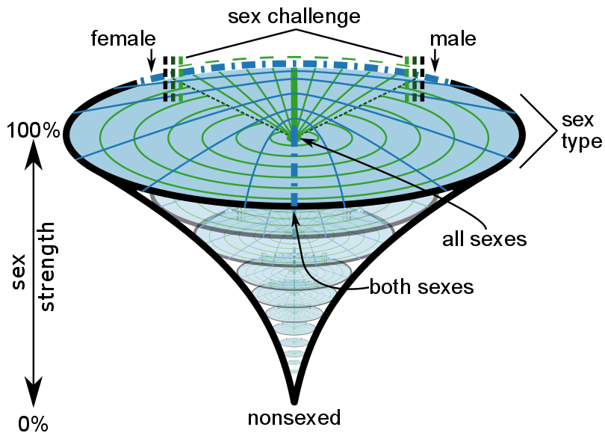
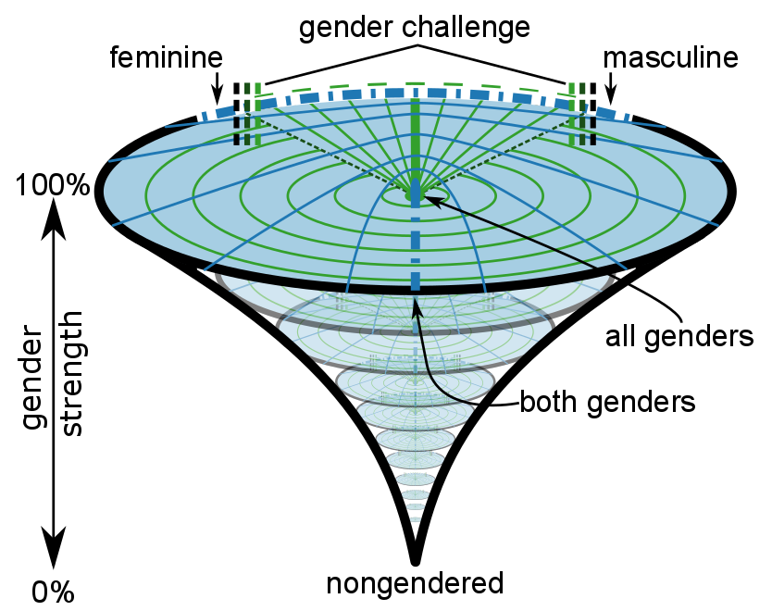
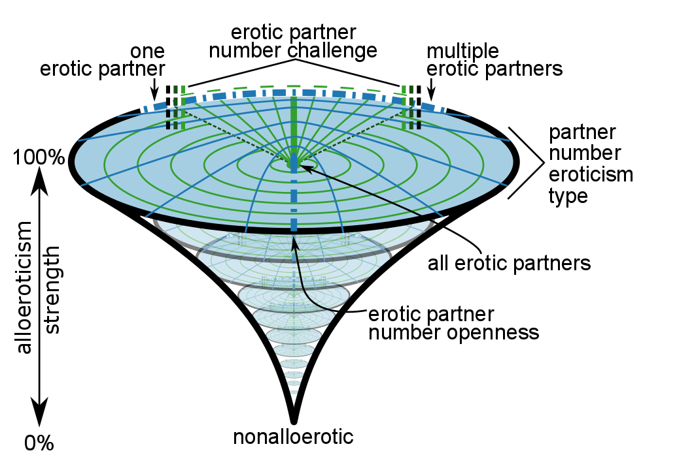
Not One, But Many
People can map their location onto each sexual parameter using a special SCT diagram.
People can mark their locations with a dot, many dots, outlined areas, blobs, or however makes sense to best represent themselves. They can write text on it too.
And, people can locate their statuses/behaviours and/or orientations.
(van Anders, 2015)

Slide 7
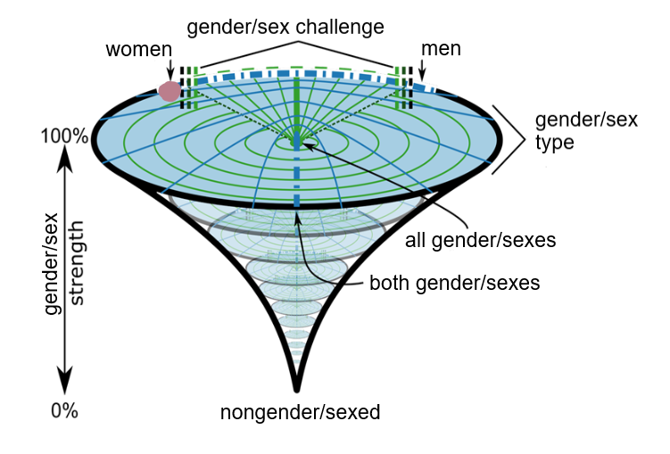
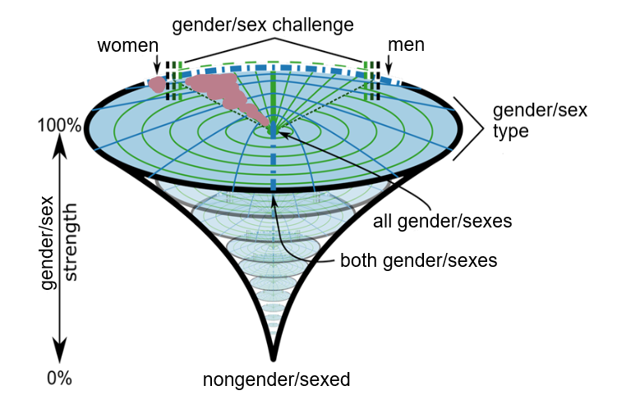
The outside ring represents the binary
I’m attracted to women, so I’m going to put a dot on women.
I’m also attracted to women, but I’m interested in women who have characteristics people associate more with men, like being muscular. I’m going to shade the challenge area beside woman to reflect that.
The dotted line shows the challenge area. Inside this area represents people who consciously and/or are seen to challenge traditional ideas or norms.
(van Anders, 2015)

Slide 8
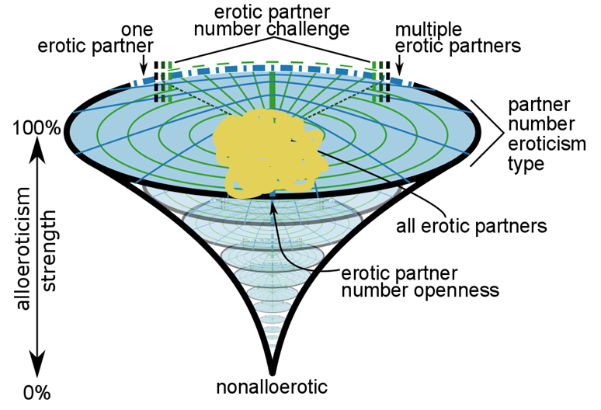
The closer to the middle you get, the less specific it becomes.
I’m happy with any number of erotic partners so I’ll shade in a wide area to represent that.
I’m open to any number of nurturant partners, and currently I have one. I’ll put a dot at “one” and write status, to represent my current partner. I’ll shade a larger area and write orientation to represent generally what interests me.
(van Anders, 2015)

Slide 9
How important each aspect is to you is represented by the strength bar.
My partner’s sex doesn’t matter to me, so I’ll put sex at 0%.
Some people’s diagrams coincide across gender, sex, and sexuality; for other people the strength and/or area branches.
Gender is important to me - I like to date masculine nonbinary people. I’ll shade in an area close to masculine and put the strength at 90%.
(van Anders, 2015)

Slide 10
gender/sex nurturance
I prefer to have nurturant relationships with women or nonbinary people.
People’s diagrams can also coincide or branch depending on relationship type.
gender/sex eroticism
I’m asexual and don’t tend to experience sexual attraction. I enjoy the erotic aspects of my relationship with my current partner, so I’ll represent her on this diagram.
(van Anders, 2015)

Slide 11
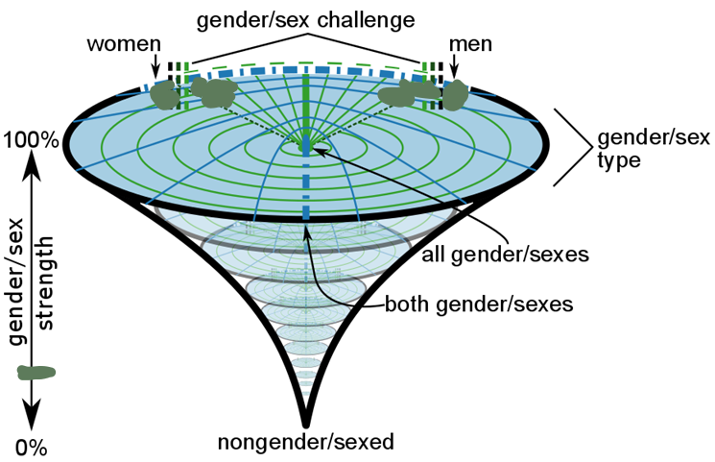
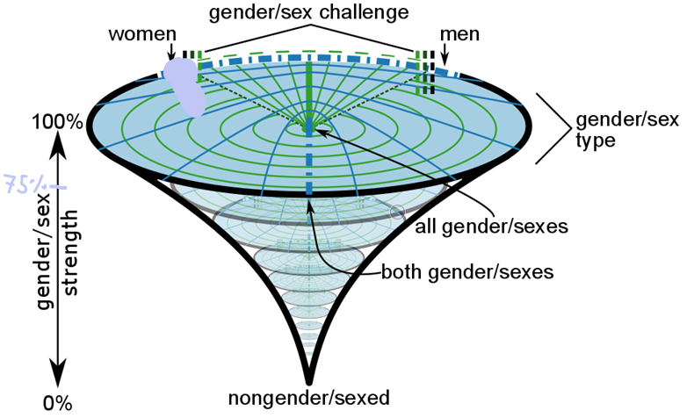
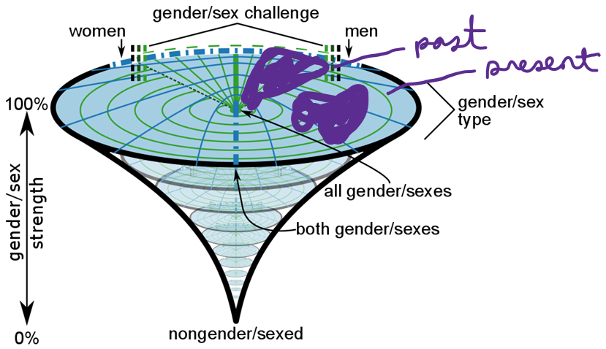
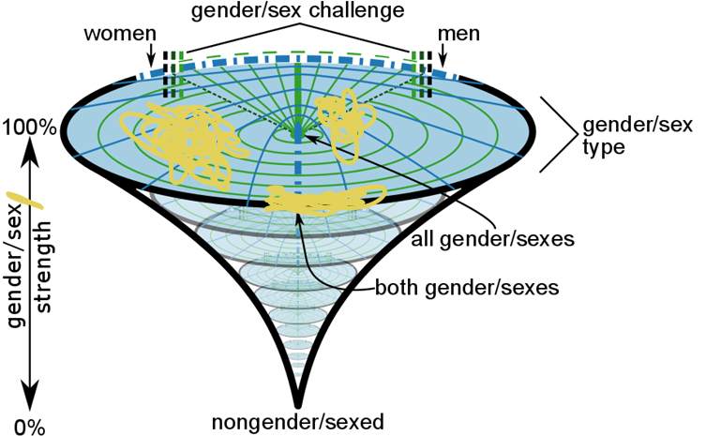
There is no right or wrong way to use SCT - however you use it is the right way!
(van Anders, 2015)

Slide 12
For more information, go to:
Original SCT Theory Paper
van Anders, S.M. Beyond Sexual Orientation: Integrating Gender/Sex and Diverse Sexualities via Sexual Configurations Theory. Archives of Sexual Behavior, 44, 1177–1213 (2015). link
See our lab website for more including:
Videos
A zine (with translations!)
Empirical articles
A workbook
And more!

