Slide 1
REFLECTIVE APPROACH TO THE PRACTICE OF LAW
PAPER PrESENTED AT THE INTERNATIONAL RP SYMPOSIUM AT QUEENS UNIVERSITY, CANADA ON 24TH JUNE 2026
BY PRofessor Olaide Gbadamosi, SAN
Faculty of Law,
Ifetedo Campus
Nigeria

Slide 2
OUTLINE OF PAPER
OUTLINE OF PAPER
ABSTRACT
1. INTRODUCTION
2. MEANING OF REFLECTION IN LEGAL PRACTICE
3. IMPORTANCE OF A REFLECTIVE APPROACH
4. CORE ELEMENTS OF REFLECTIVE LEGAL PRACTICE
5 BENEFITS OF REFLECTION IN LEARNING
6. REFLECTION IN PROFESSIONAL LEGAL PRACTICE
7. PRACTICAL METHODS FOR DEVELOPING REFLECTIVE PRACTICE
8. ILLUSTRATIVE EXAMPLE
9. CORE BENEFITS OF REFLECTIVE PRACTICE IN LAW
10. INTEGRATING REFLECTION INTO DAILY WORKFLOW
GIBBS’ REFLECTIVE CYCLE DESCRIBES THIS SIMPLE AND STRAIGHTFORWARD SIX-STEP PROCESS:
11 KEY CHALLENGES IN REFLECTIVE PRACTICE
12. OVERCOMING BARRIERS TO REFLECTION
13. CONCLUSION

Slide 3
ReflectiON IN LEGAL practice
Reflection entails critically examining legal decisions, strategies, and outcomes; questioning underlying assumptions and biases; learning from both successes and failures; and integrating such learning into future conduct.
Through reflection, lawyers are able to evaluate their decisions, identify strengths and weaknesses, and improve future performance. In legal practice, reflection involves:
Learning from successes and failures;
Considering the ethical implications of professional conduct; and
Applying lessons learned to future legal engagements.
Reflective practice encourages lawyers to become active learners rather than passive performers of professional duties. It enables legal practitioners to transform experience into knowledge and knowledge into improved professional judgment.

Slide 4
Importance of Reflective Practice in Legal Education
A reflective lawyer is more likely to demonstrate competence through continuous learning, ethical sensitivity in recognizing moral dilemmas, improved strategic thinking, and a client-centered orientation that appreciates the human dimension of legal problems
The legal profession increasingly recognizes that effective legal education must extend beyond the acquisition of substantive legal knowledge.
Reflective practice contributes to legal education by:
Enhancing critical thinking and analytical skills;
Promoting deeper learning and understanding;
Encouraging ethical awareness and professional responsibility;
Developing emotional intelligence and resilience;
Facilitating self-directed learning; and
Preparing students for the realities of legal practice.
Reflective learning also enables students to connect legal theory with practical experience, thereby bridging the traditional divide between law-in-books and law-in-action.

Slide 5
Benefits of reflection in learning
Fostering metacognition, providing the opportunity to consider the process of one's own learning,
Enabling individuals to critically evaluate various aspects of their experiences.
Reflection nurtures critical thinking, enhances professional skills, and promotes deeper learning by encouraging students to draw meaning from their experiences.
Enhanced Professional Competence
Reflection enables lawyers to identify weaknesses, improve skills, and develop more effective legal strategies.
Improved Legal Reasoning
Better Client Representation
Ethical Awareness
Professional Resilience and Well-being
Lifelong Learning

Slide 6
REFLECTIVE APPROACH TO THE PRACTICE OF LAW
A reflective approach to the practice of law involves the deliberate and structured examination of one’s professional experiences before, during, and after legal engagements. It shifts the lawyer from merely performing legal tasks to actively learning from practice, thereby enhancing competence, ethical awareness, and overall effectiveness.
A reflective lawyer:
(i) Critically evaluates their decisions, strategies, and assumptionS
(ii) Considers the broader impact of legal actions on clients, society, and justiciii) Learns from past cases and experiences rather than repeating patterns unexamined.
(iv) Balances technical competence with ethical judgment
Modern legal practice requires more than knowledge of legal rules
Lawyers must demonstrate:
Ethical sensitivity
Critical thinking
Adaptability
Lifelong learning
Reflective practice promotes continuous professional growth.

Slide 7
Traditional view of law: application of legal rules to disputes
Contemporary legal practice is increasingly complex.
Lawyers face:
Ethical dilemmas
Technological changes
Diverse client needs
Complex social realities
Reflective practice enhances professional effectiveness and accountability.

Slide 8
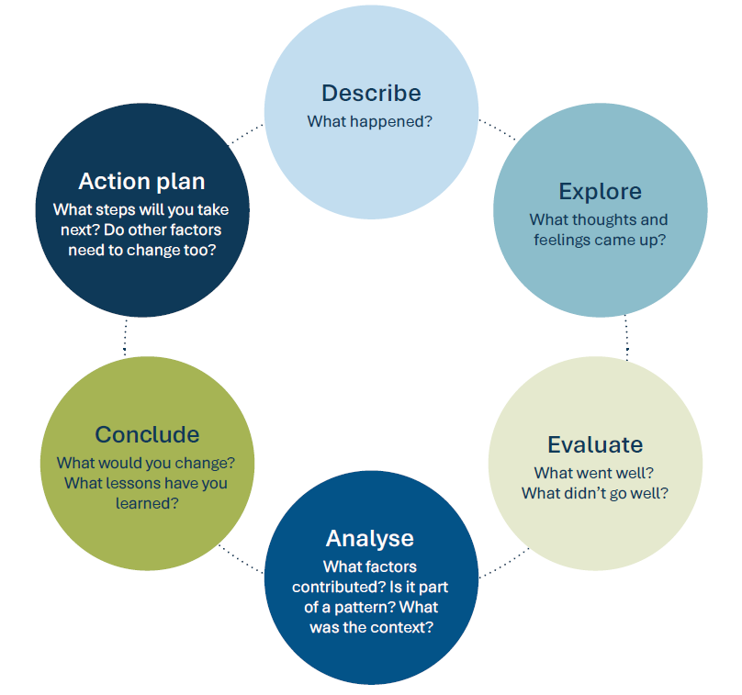
GGIBBS 6 STEP APPROACH TO reflective practice
^{[1]} https://www.simplypsychology.org/gibbs-reflective-cycle.html. accessed 3 May 2026.

Slide 9
Key Challenges in Reflective Practice
* Time Constraints
* Fear of Vulnerability and Criticism
* Insufficient Skills and Training
* Rigid Organizational Environments
* Superficial Engagement
* Heavy workloads and demanding schedules often leave little time for reflection.
* Superficial Reflection

Slide 10
Overcoming Barriers to Reflection
* Use Structured Frameworks
* Peer Mentorship and Coaching
* Create Supportive Environments
* Integrate Technology and reflection into daily professional routines;
Encouraging mentorship and peer-support systems;
Creating supportive institutional environments;
Utilizing technology-based reflective tools and journals
Incorporating reflective practice into Continuing Professional Development programmes.

Slide 11
Practical Methods for Developing Reflective Practice
Reflective practice can be cultivated through several practical methods, including:
Reflective Journaling
Case Reviews
Mentorship and Coaching
Peer Discussions
Continuing Professional Development

Slide 12
Recommendations
Faculties of Law should integrate reflective learning exercises into teaching and assessment methods.
Law firms and legal departments should institutionalize post-case reviews and reflective discussions.
Legal institutions should create environments that encourage self-assessment, ethical reflection, and continuous learning.
Future of legal education and legal practice lies in producing reflective practitioners who possess not only legal knowledge and technical expertise but also the self-awareness, adaptability, and ethical commitment necessary to advance justice and uphold the rule of law.

Slide 13
Conclusion
Incorporating a reflective approach into the practice of law transforms routine legal work into an active process of learning and improvement
A reflective approach transforms legal practice into a dynamic and evolving discipline, improving legal reasoning, ethical judgment, and service delivery to clients and society, consistent with judicial expectations of diligence and professionalism from counsel.
Advancing a reflective approach to the practice of law transforms legal work from a mechanical application of rules into a thoughtful, self-aware, and ethically grounded discipline. It requires lawyers to move beyond routine by engaging in a "dialogue of thinking and doing," where they continuously analyze how and why they perform their duties to improve future performance.

