Slide 1
Navigating the Complexity of Polycrisis as Legal Educators: Reflective Practice as a Transformative Process
Alexandra McEwan & Luke Price
College of Law, School of Business and Law
Central Queensland University
June 2026

Slide 2
Acknowledgement of Country.
We acknowledge Traditional Owners
and Custodians and pay respect to the Elders of all First Nations Peoples of Australia.

Slide 3
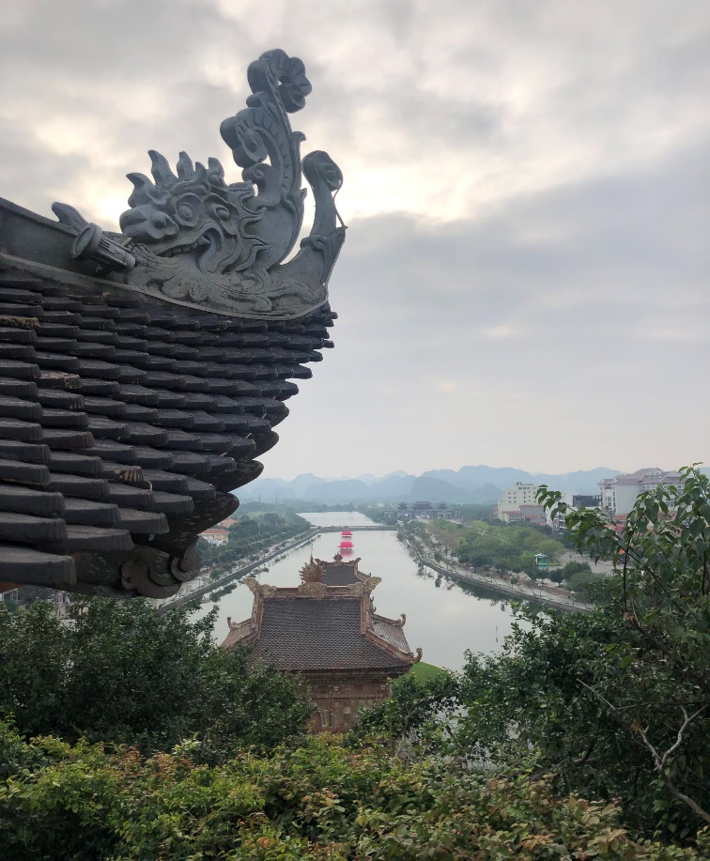
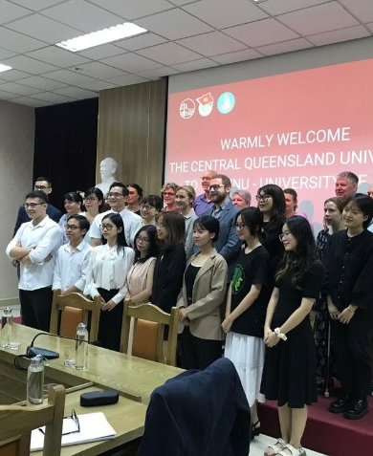

Catalyst for Reflection
Photo 1: Alexandra McEwan; Photo 2: Mira Moore; Photo 3: The Red Shanked Douc Langur (Pygathrix nemaeus) Quang Nguyen Vinh / Pexels

Slide 4
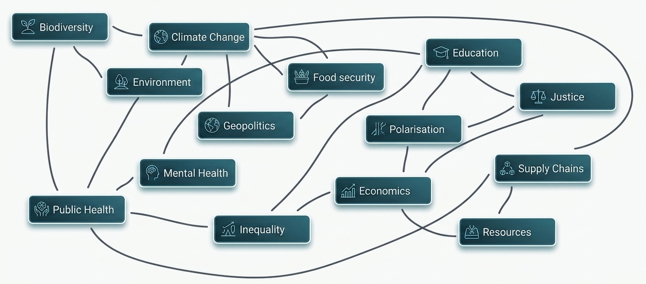
Dimensions of Polycrisis

Slide 5
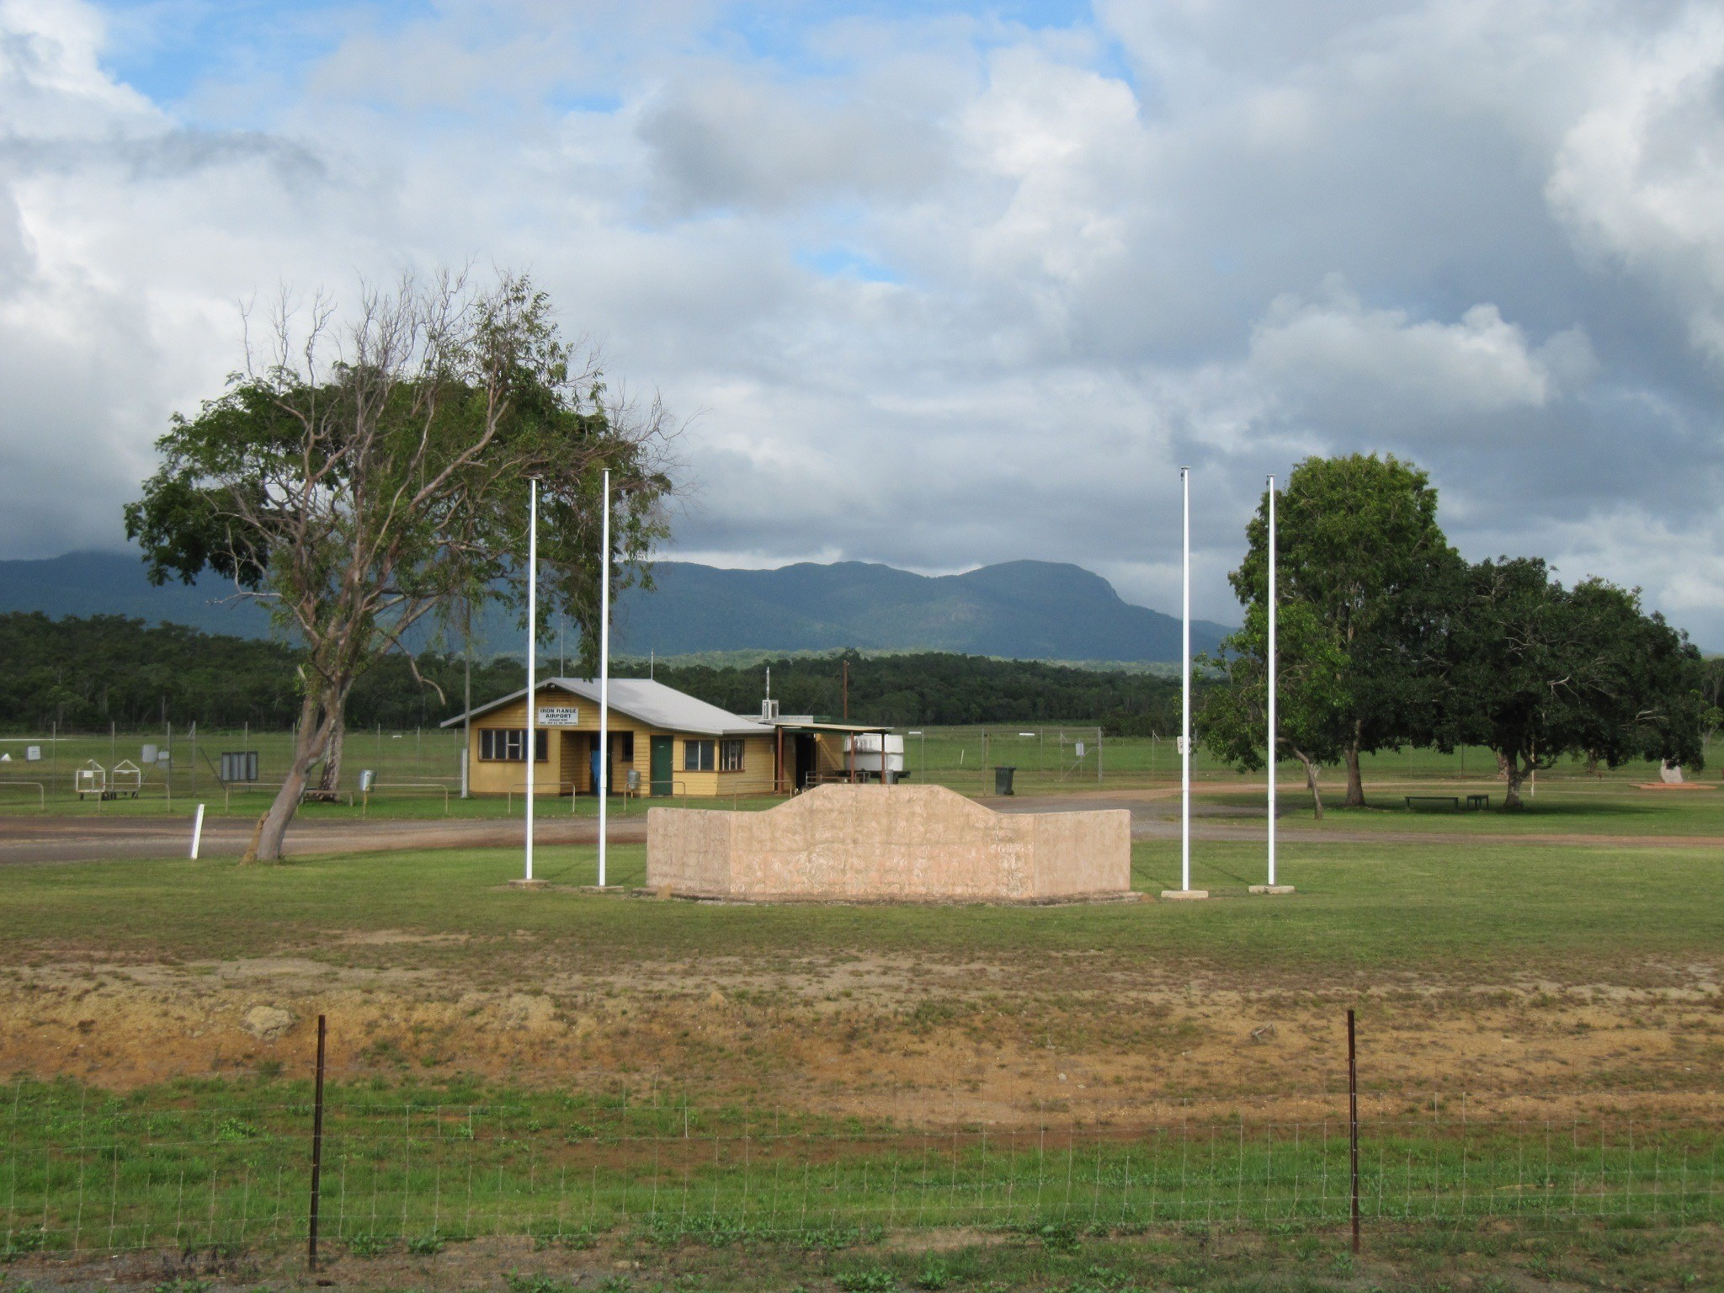
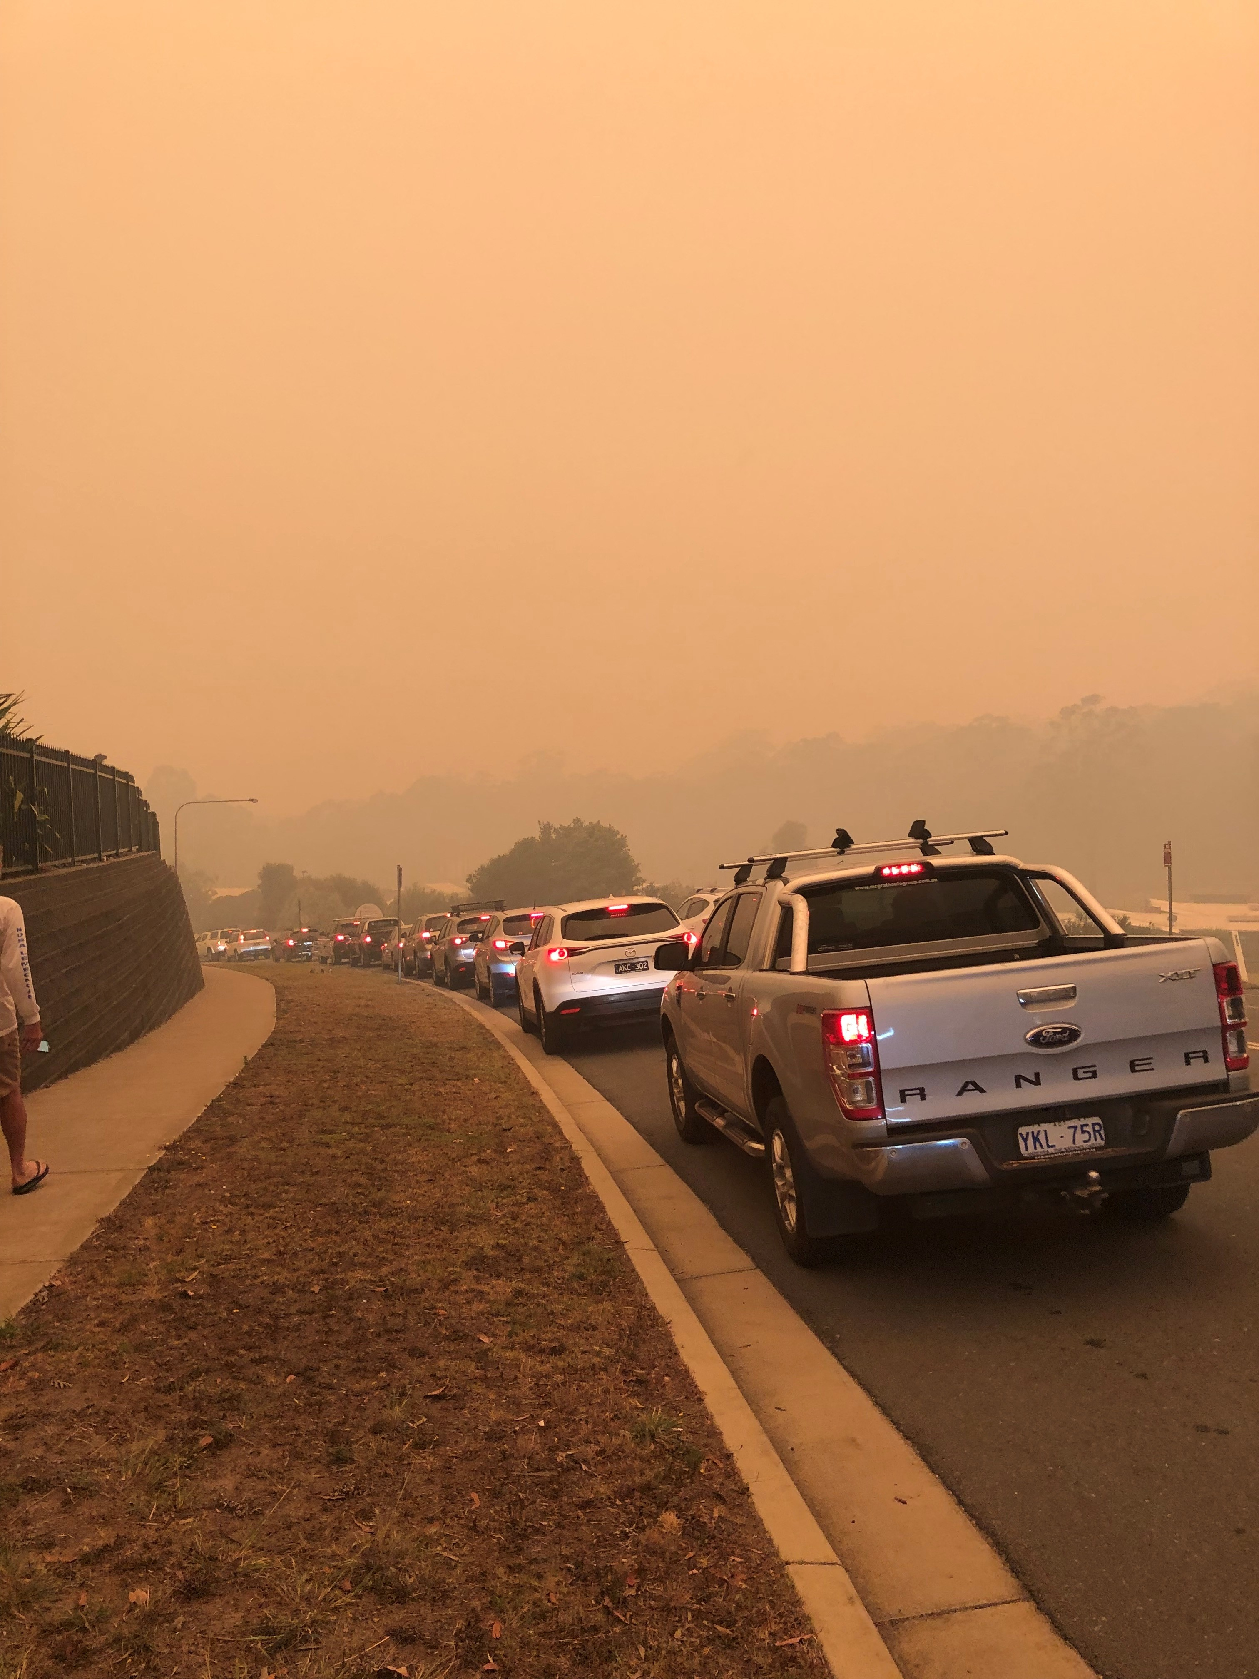
Encapsulating Polycrisis: A Regional Perspective
1: Lockhart River airfield Cape York, Queensland; 2: Queue for petrol, evacuating the 2019 bushfire, Merimbula, NSW (photos: Alexandra McEwan)

Slide 6
Understanding Polycrisis
Attempts to encapsulate polycrisis within a ‘big-picture’ frame mask the complexities of polycrisis; the dimensions and their connections can be challenging to perceive.
Attempts to isolate branches of polycrisis run counter to the interconnectedness of its dimensions, presenting challenges to overall understanding.

Slide 7
Perspective 1 (Animal Law Lecturer/Legal Practicum)
Disorienting Dilemma | Diversity of sustainability pressures in the context of education.
Self-Examination | Evaluating educational assumptions, questioning role of educator.
Critical Re-Assessment | Clarification of personal values and pedagogical intent.
Sharing Experiences | Peer review process was both affirming and challenging.
Exploring Options | Identifying sustainability-based education opportunities in the LLB.
Planning Action | Reorientating scope of interest in transformative learning.
Acquiring Knowledge | Sustainability education opportunity identified to strengthen link with TL
Trying New Roles | Transitioning from interest to expertise in transformative learning
Building Competence and Confidence | Facilitating sustainability-based dialogue with a diverse student cohort.
Reintegration | Developing a more nuanced framework for student engagement and research that is more clearly aligned with sustainability.

Slide 8
Perspective 2 (Clinical Legal Educator)
Disorienting Dilemma | Regional, rural and remote students’ access to opportunity and education
Self-Examination | Prior reliance on clinic student privilege as ‘haves’, assisting ‘have-nots’
Critical Re-Assessment | In RRR law schools, power, privilege (and free time) cannot be assumed
Sharing Experiences | Raising this at conferences through the research process
Exploring Options | Exploring what the social aims of clinics are in RRR law schools
Planning Action | Developing new opportunities in domestic clinic
Acquiring Knowledge | Iteration of opportunities, developing networks with other RRR clinics
Trying New Roles | Testing own concept of clinical legal education
Building Competence and Confidence | Upholding different routes to success and social justice in the curriculum
Reintegration | Understanding (more, not completely) the positionality of RRR law students

Slide 9
Structured Reflection as a Tool for Understanding Through Shared Experience
Structured reflective processes generate clearer, shareable understanding of narratives
These can be shared across perspectives, enabling the translation and potential amalgamation of understanding derived from experience
Climate Scientist
Legal Educator
Health Professional
Economist

Slide 10
Navigating Polycrisis through Transformative Learning Frameworks
Applying a transformative learning framework clarifies self-understanding of reflective practice that engages with the dimensions of polycrisis.
Adopting a transformative learning framework supports the sharing of this understanding across perspectives.
If that shared understanding can be integrated across perspectives, it may enable collective understanding and responses to polycrisis.

