Slide 1
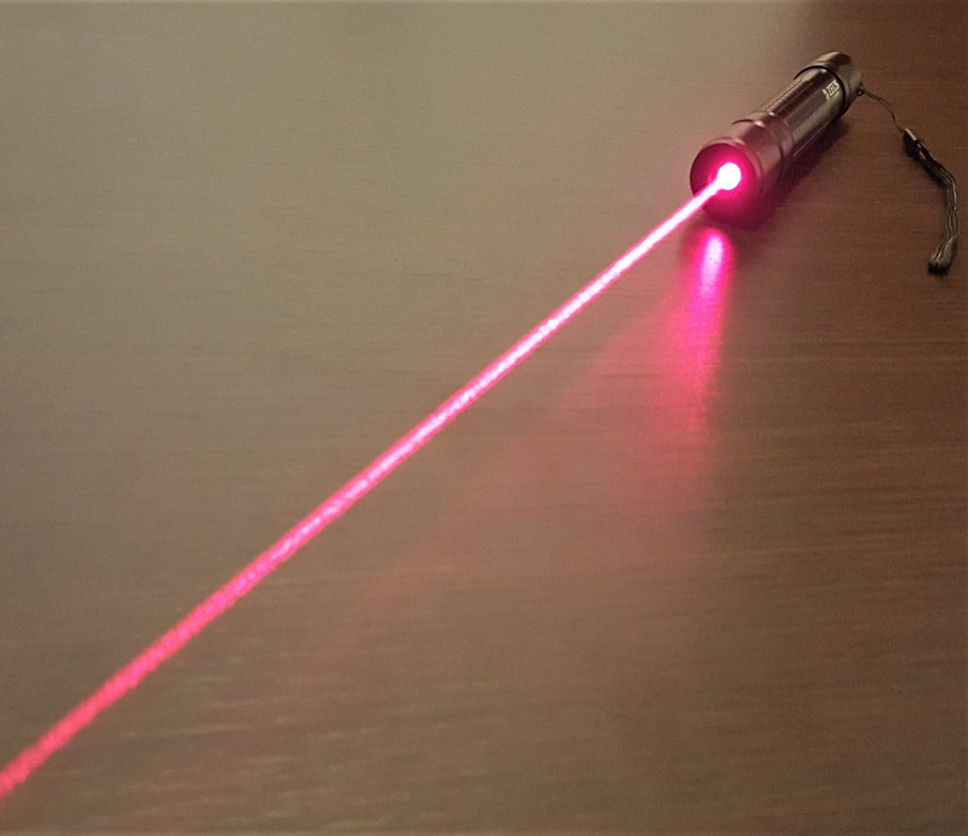

Laser Pointer
Safety Awareness
URSO
Queen’s University
Department of Environmental Health and Safety
This Photo by Unknown Author is licensed under CC BY-SA-NC
Notes:
Thank you for participating in the Laser Pointer Safety Awareness presentation, prepared by the Environmental Health and Safety Department as part of our Laser Radiation Safety Program. This presentation aims to raise awareness about laser pointer technology, highlight potential hazards, and emphasize safe usage practices in classroom settings. By following the recommended safety guidelines, we can ensure that laser pointers remain valuable tools while minimizing health risks and preventing accidents. Your understanding and adherence to these safety practices are essential in maintaining a secure and safe learning environment.

Slide 2
Laser use
Laser pointers have become common tools in the workplace.
Hand-held laser pointers are very popular in Canada. Unfortunately, users are not knowledgeable about the intensity of the light and the effect it may have on the eyes.
Notes:
Laser pointers have become common tools in the workplace. Most often laser pointers are used as a substitute for the retractable metal pointer used during lectures or presentations. Laser pointers can also be found in many power tools and levels.
Hand-held laser pointers are very popular in Canada. Unfortunately, users are not knowledgeable about the intensity of the light and the effect it may have on the eyes.

Slide 3
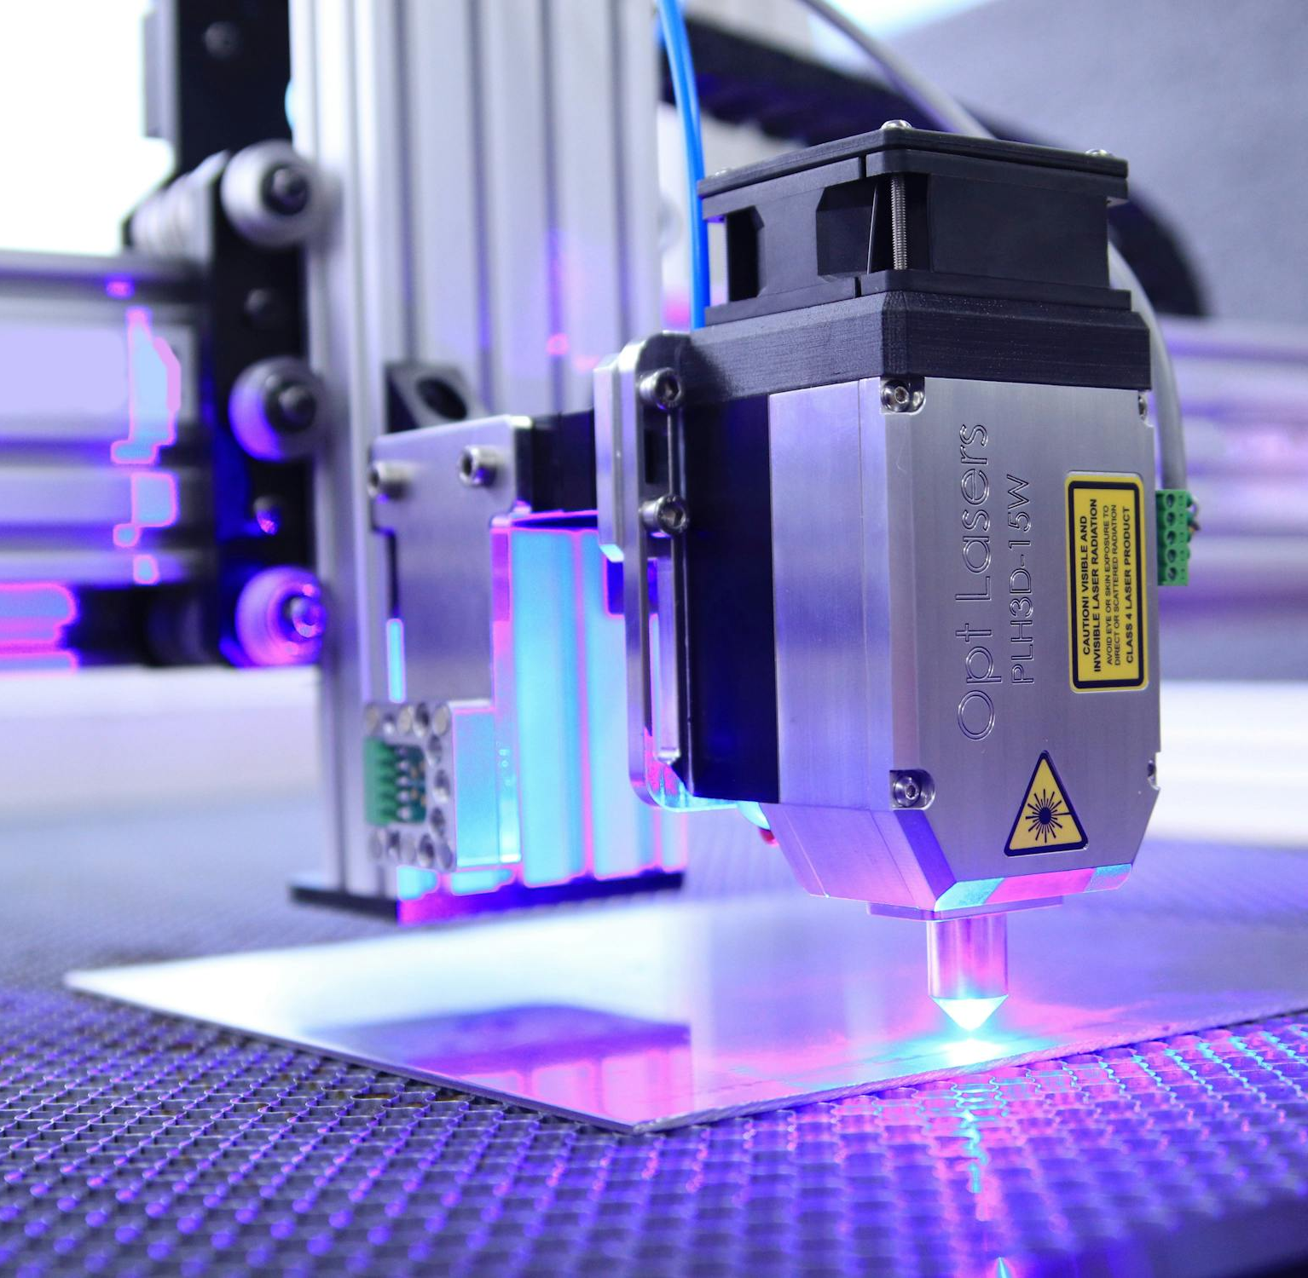
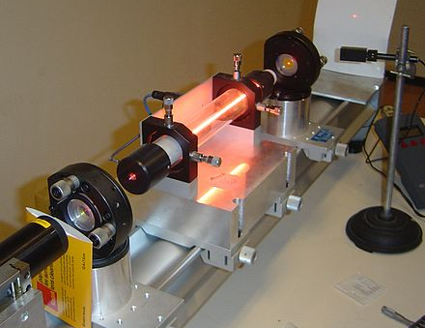
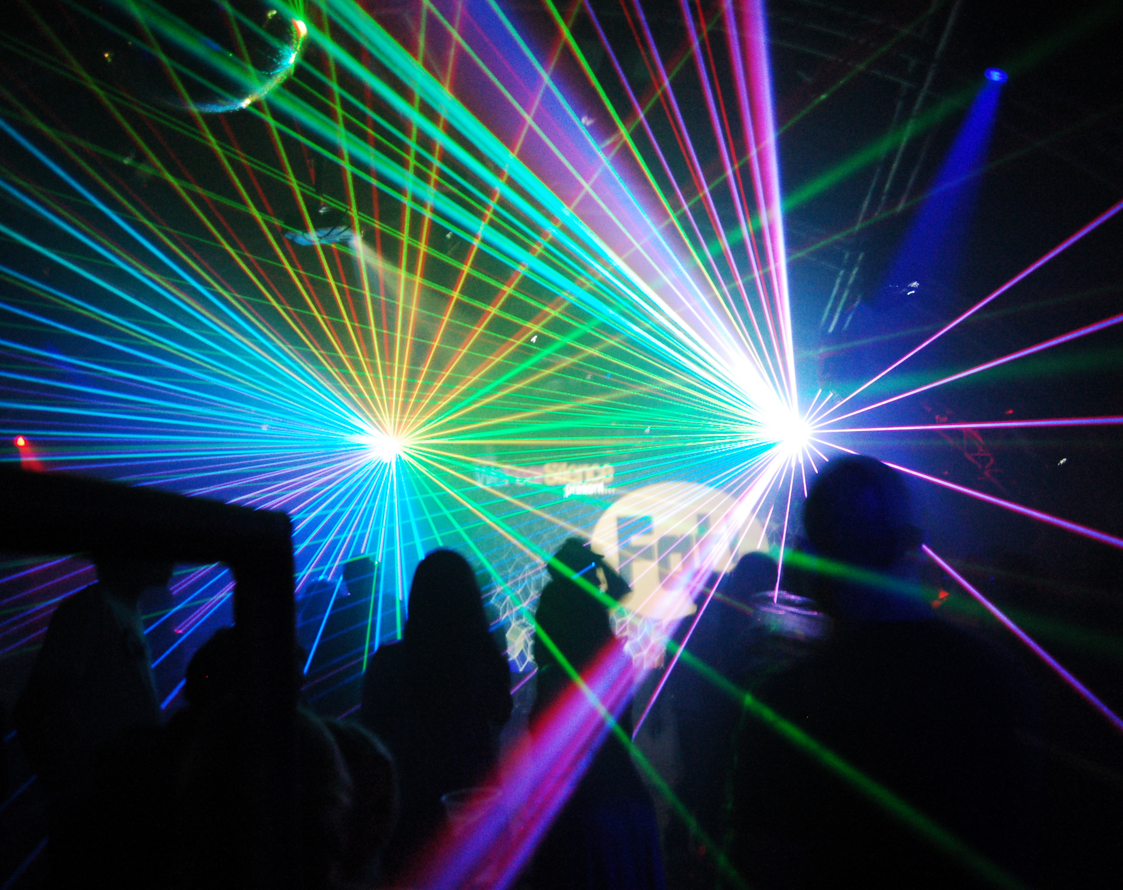

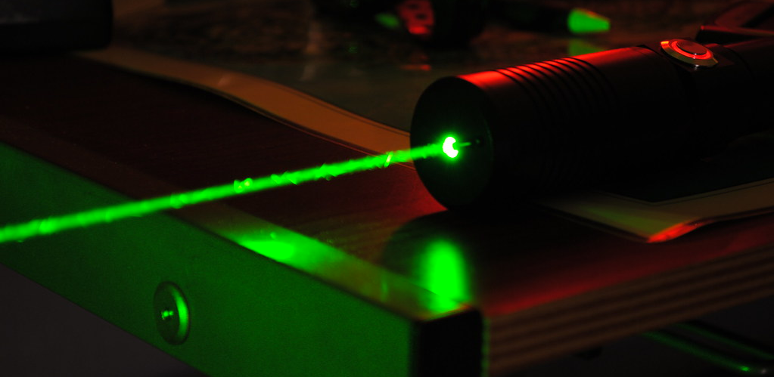
Light
Amplification
Stimulated
Emission
Radiation
This Photo by Unknown Author is licensed under CC BY-SA
This Photo by Unknown Author is licensed under CC BY-SA
This Photo by Unknown Author is licensed under CC BY-SA
Notes:
Laser technology was first developed in the 1960s and has grown to touch our lives in many ways. We use laser technology in space-age medical equipment, office printers and light shows at rock concerts.
A laser is the strongest source of light ever created by scientists. The beam that comes out of a simple hand-held laser pointer is at least a million times brighter than the average light bulb in your home.
The letters in "laser" stand for Light Amplification by Stimulated Emission of Radiation.

Slide 4
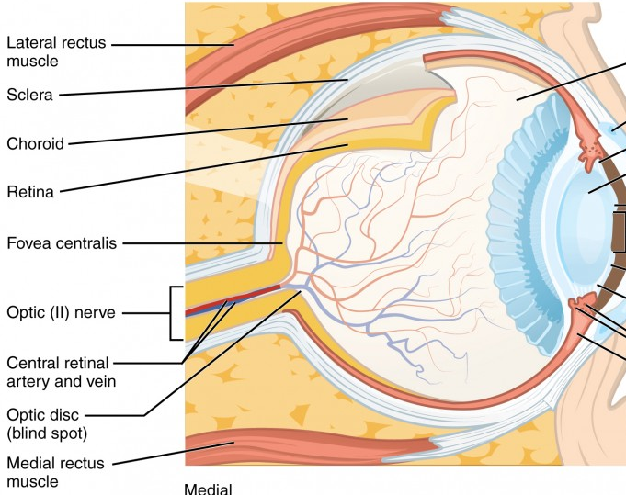
Laser Hazards
Laser pointers are not dangerous when used with care, but the brightness of laser light can damage the eyes of anyone who looks directly into the beam for more than a minute and a half.
This Photo by Unknown Author is licensed under CC BY

Slide 5
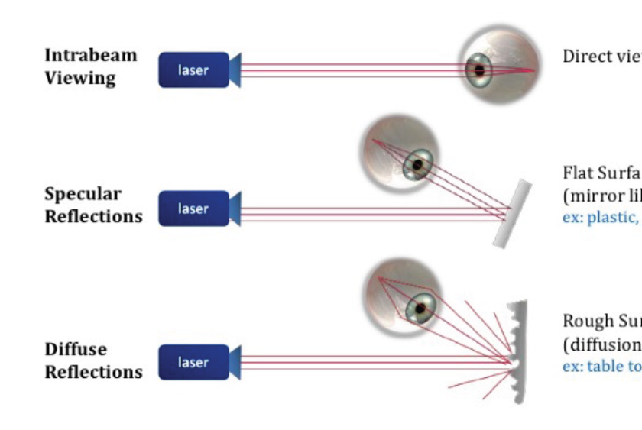
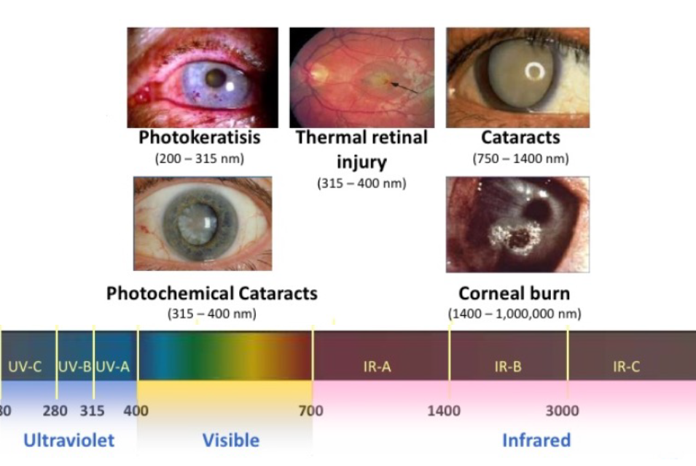
Type of exposure – Eye injuries
Notes:
Laser exposure can cause eye injuries through direct beams, specular reflections, or diffuse beams (tissue reflections). The severity of the damage depends on the intensity, wavelength, and duration of the exposure. High-intensity beams can focus on the retina, causing damage, as seen with dye lasers. Different wavelengths are absorbed by different parts of the eye—CO2 lasers, for instance, primarily affect the cornea and sclera. Even brief exposure, less than 0.25 seconds, can be harmful before the eye's natural aversion response occurs. A quick glance at a laser can result in flash blindness, similar to the temporary aftereffects of flash photography, where the image persists briefly and then fades away. While flash blindness is typically temporary and harmless, prolonged exposure can lead to serious damage. If the laser passes through optical devices like telescopes or binoculars, it can burn the retina, rupture blood vessels, or even cause permanent blindness in severe cases.

Slide 6
Laser Classification is mainly based on the level of hazard
Class I – 1M
Class 2 – 2M
Class 3R
Class 3B
Class 4
Notes:
Laser are separated in 4 main classes and subclasses. Classes are based on their emission power but also their ability to cause damage to the eye or skin.

Slide 7
Laser Pointers
Class 1 and 2 - Considered non-hazardous. Hazard increases if viewed with optical aids, including magnifiers, binoculars, or telescopes for an extended period of time (>0.25sec).
Class 3R - Depending on power and beam area, can be momentarily hazardous when directly viewed or when staring directly at the beam with an unaided eye. Risk of injury increases when viewed with optical aids.
Notes:
Class I and 2 are incapable of producing damaging radiation levels or causing eye and skin damage under normal operating conditions. (<0.4 mW) unless they are view directly for an extended period of time (>0.25 sec).

Slide 8
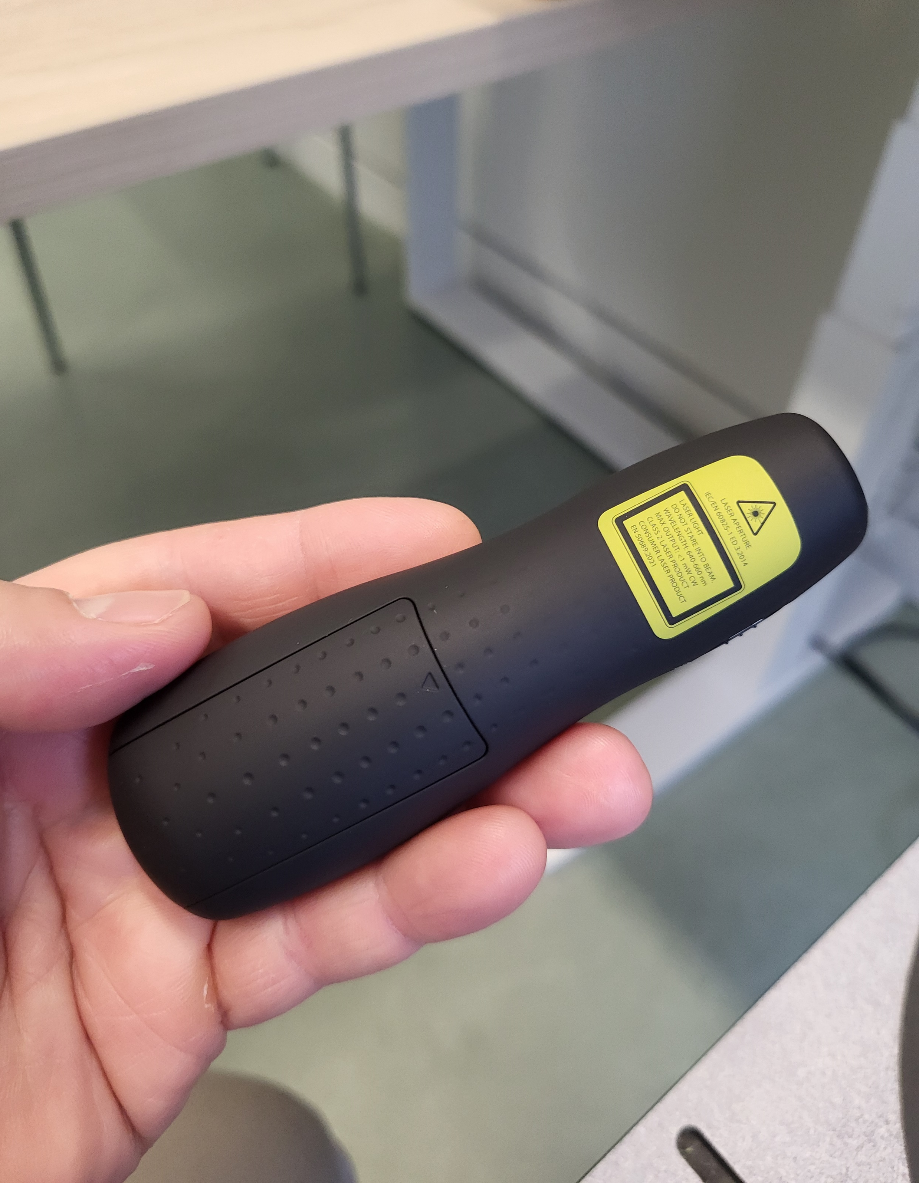
Proper use of laser pointers
When buying a laser pointer
  Choose one that is labeled Class II and operates with a wavelength between 630 nm and 680 nm. Maximum output should be less than 5m watts.
  Choose one that has a clear warning on the label about the potential to cause eye damage. Read the instructions carefully and follow them closely.
  Choose a laser pointer that stays on only when you apply pressure with your fingers. That way you can never leave the beam on by accident.
Before using your laser pointer
  Check the laser label is affixed to your device (do not remove) and clearly shows the laser hazard radiation symbol.
Using your laser pointer
  Never point a laser beam at anyone and never look directly into the beam yourself.
  Never aim a laser pointer at surfaces that would reflect the light back, such as mirrors or mirrored surfaces.
  Never leave a laser pointer where children might get their hands on it.
  Always turn off the laser when not in use to prevent unintended exposure
This Photo by Unknown Author is licensed under CC BY-SA-NC
This Photo by Unknown Author is licensed under CC BY-NC
Notes:
If you choose to use a laser pointer as part of your daily work routine, it's essential to follow key safety recommendations to ensure its proper use.

Slide 9
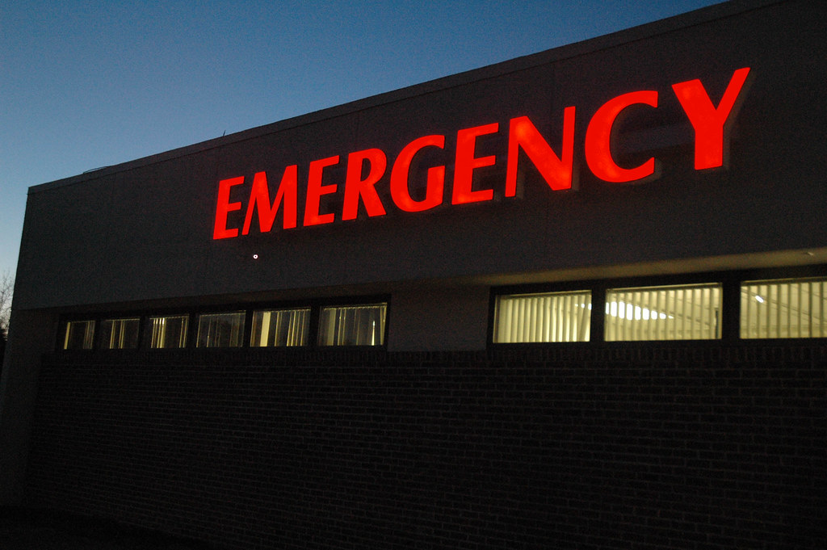
Emergency
In the event of an accidental exposure and you are feeling discomfort in your eyes after using a laser pointer, it is strongly recommended to be seeing by an expert to detect early signs of any ocular damage and to initiate prompt treatment if required.
You should contact Walsh and Associates during normal business hours, contact at their main office in Belleville at 613-966-4114, attend the Kingston General Hospital Emergency room, or your family health physician.
DON’T FORGET TO NOTIFY YOUR SUPERVISOR AND SUBMIT AND INCIDENT REPORT TO THE ENVIRONMENTAL HEALTH AND SAFETY DEPARTMENT.
Incident Report fillable V2024 .pdf
This Photo by Unknown Author is licensed under CC BY

Slide 10

Conclusion
In conclusion, while laser pointers are useful tools in various settings, their safe use is essential to prevent accidents and potential harm. By following the basic safety guidelines explained in this presentation you can ensure that laser pointers are used responsibly and safely. Ultimately, maintaining awareness and practicing caution will help prevent injuries and allow laser pointers to be effective tools without posing unnecessary risks.
This Photo by Unknown Author is licensed under CC BY

