Slide 1
Pulleys
Simple Machines

Slide 2
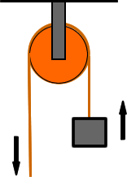
Pulleys are used to help lift heavy objects

Slide 3

What is a pulley?
Click here to load video
on YouTube
Click here to load video
on mocomi.com

Slide 4
What is a pulley?
Pulley: a simple machine that is used to change the direction you have to apply force to move an object
The more pulley’s you put together, the easier it becomes to move

Slide 5
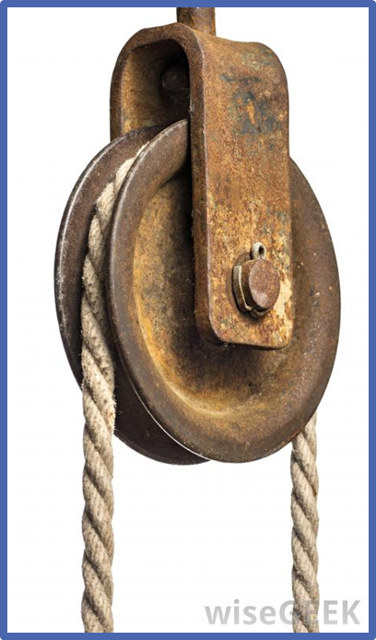
They work by using a wheel, an axle, and a rope
wheel
rope
axle

Slide 6
The axle holds the wheel in place
The wheel allows the rope to move around it smoothly
The rope is pulled across the wheel and axle, making it easy to lift objects attached to the other side
force
load

Slide 7
What are some examples of pulleys you might see in your daily lives?

Slide 8

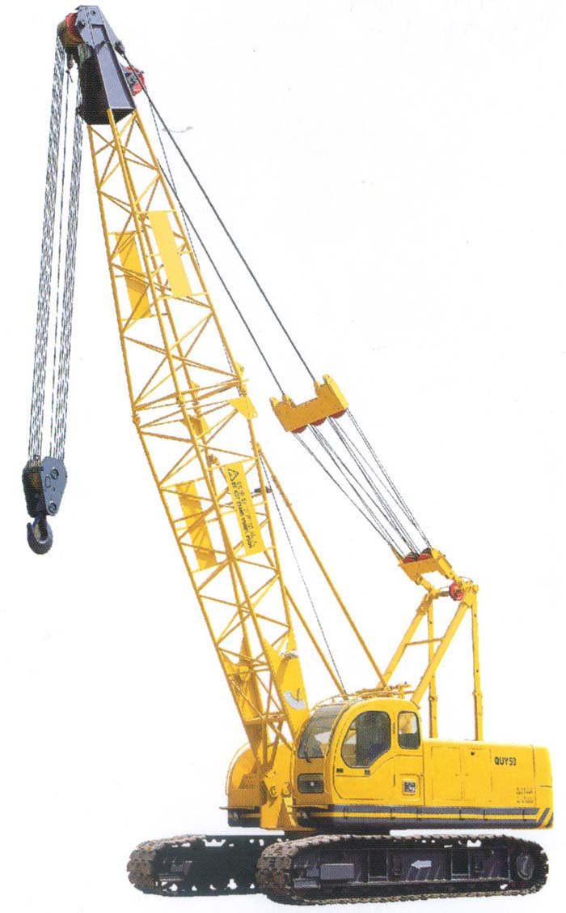
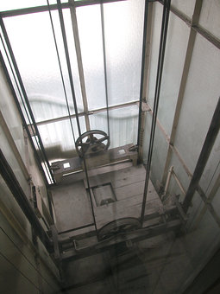
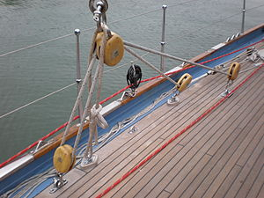
What are some examples of pulleys you might see in your daily lives?

Slide 9
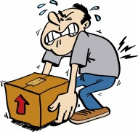
Pulleys are used when objects are too large or difficult to pick up by hand
Using a pulley allows you to change the direction you lift to move an object

Slide 10
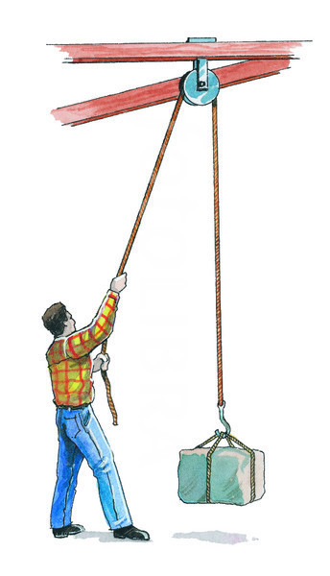
Instead of trying to lift an object from the side, a pulley will allow you to lift it from the top
This allows you to pull the object up with more strength because you can get all of your weight into it!

Slide 11
Types of Pulleys
Fixed Pulley: this type of pulley is attached to a supporting structure and stays in place
Movable Pulley: this type of pulley is able to move with the object being lifted
Compound Pulley: this is when 2 or more pulleys are put together

Slide 12
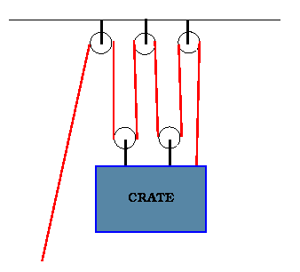
Types of Pulleys
fixed
compound
moveable

Slide 13
Compound Pulleys
The more pulleys you put together, the higher the mechanical advantage of the pulley system
Each extra pulley in a pulley system helps reduce effort needed by 1

Slide 14
Let’s try it!
Use different types of pulleys to lift different weights!
Write down your observations

