Slide 1
Wedge
Simple Machines

Slide 2
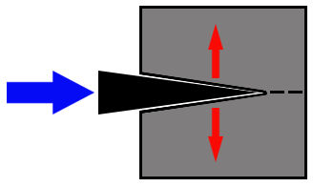
Wedges are used to split or separate objects

Slide 3

What is a wedge?
Click here to load video
on YouTube
Click here to load video
on mocomi.com

Slide 4
What is a wedge?
Wedge: a simple machine that is used to reduce the amount of force needed to split objects
By forcing an edge in between two things, it becomes easier to get them apart

Slide 5

They work by using the edge where two inclined planes meet to get into an object
This splits the object into two parts
split
edge

Slide 6
The wedge is placed in between objects that are to be separated
The force behind the wedge pushes the objects apart
force
load

Slide 7
What are some examples of wedges you might see in your daily lives?

Slide 8
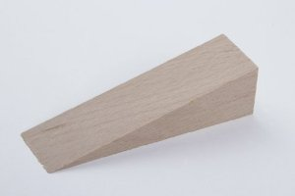
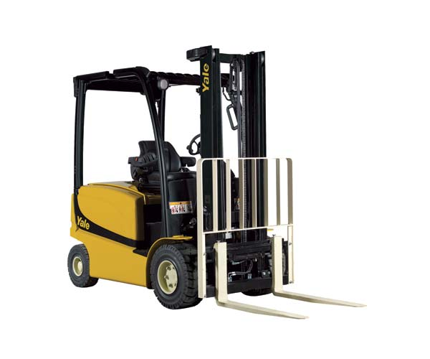
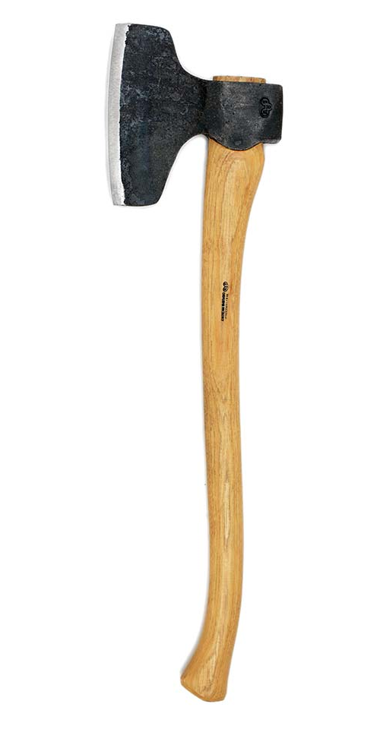
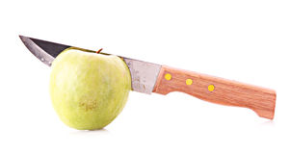
What are some examples of wedges you might see in your daily lives?

Slide 9
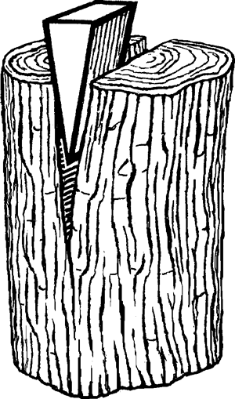
Wedges are used when something needs to be separated
Applying effort on a wedge allows you to create force outwards to the sides

Slide 10
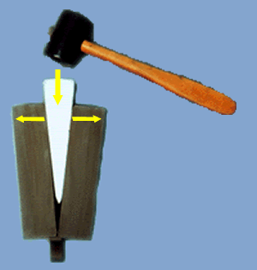
Instead of trying to pull an object apart from the sides, a wedge will allow you to split it from the middle
This makes it much easier to get two things apart!

Slide 11
Types of Wedges
Thin wedges are used to split objects that are very tightly held together
Wide wedges are useful to hold things that are already separated apart

Slide 12
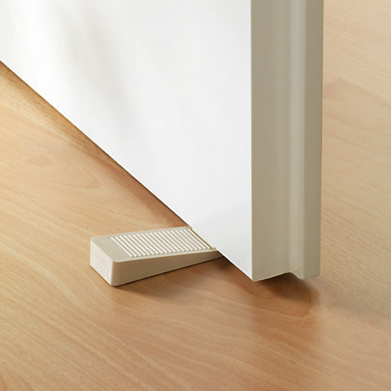
Types of Wedges
thin
wide

Slide 13
Let’s try it!
Use different types of wedges to separate different objects!
Write down your observations

