Slide 1
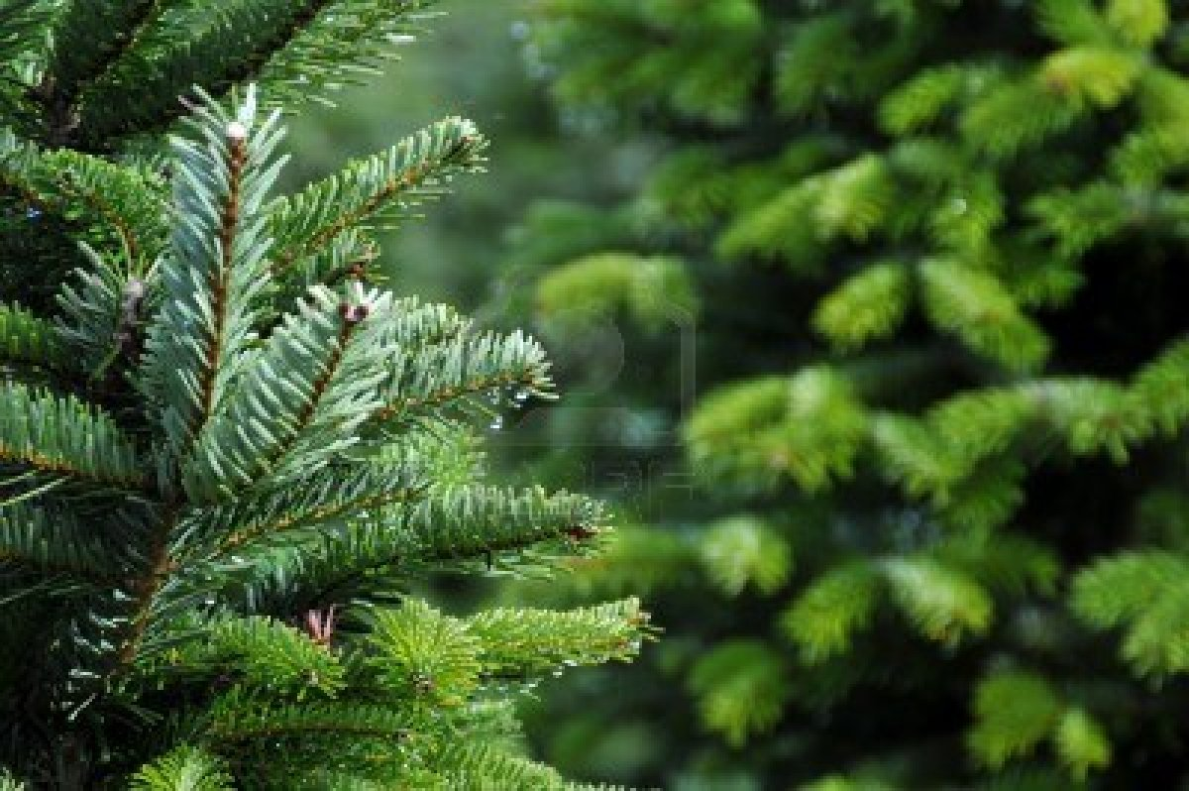
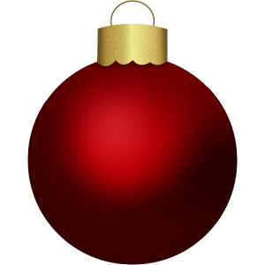
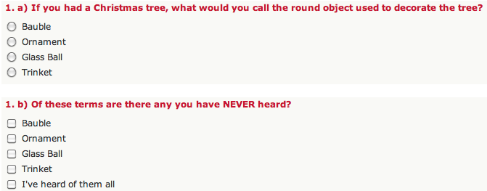
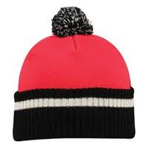
Baubles or Ornaments? An Investigation of Holiday Themed Lexical Differences
Between Canadians and Scots Lesley Henderson and Carling Wright, Queen’s University
Introduction
The aim was to explore lexical differences between native Scottish English speakers and native Canadian English speakers
Relevant topic since one of us is Canadian and one Scottish
Historical connections between Scotland and Canada due to immigration patterns
First teacher of English literature in Canada was Sir Daniel Wilson of Edinburgh
Below is a sample question (1.) from the survey, and to the right a graph analyzing the results from it.
We did this with each question.
Summary of Results
Overall results proved both hypotheses
Canadian and Scottish English speakers do use different lexical items
2. Both groups can still understand each other – even in the cases where there was not a full understanding, at least one group understood the other
It was a fun study which was both interesting and informative
Worthy of note than the survey was distributed over two Continents
A future study could investigate other areas of the lexicon aside from just Christmas/Winter holiday words.
Results from Part a), preferred terms:
What the large majority of each group said:
Findings:
5/8 or 63% of terms are different between Scottish and Canadian English speakers
Two terms, “Santa” and “Wrapping Paper” are shared terms
Question 5 produced complicated results because “Hat” is shared, but Canadians also use the term “Toque” just as often
The “Toque” Dilemma:
In part b) Question 5 also posed an issue
Because Canadians use both “Hat”
and “Toque” equally, Scottish speakers
only understand Canadians half the
time, complicating the results a bit
Results from Part b), each group’s understanding based off of their familiarity with their opposing group’s preferred term:
1. Scottish Understanding Only
45% of Canadians have never heard of the term “Bauble”
Only 1 Scottish person had never heard of “Ornament”
2. Scottish Understanding Only
51% of Canadians have never heard the term “Sledging”
2.5% of Scottish people had never heard of the term “tobogganing”
3. Full Understanding
100% of Canadians and Scots understood the term “Santa Claus”
4. Full Understanding
100% of Canadians and Scots understood the term “Wrapping paper”
5. Half Understanding/Canadian Understand Fully
100% of Canadians understood the term “hat”
86% of Scottish people have never heard of the term “toque”
6. Full understanding
5% of Canadians have never heard of the term “jumper”.
100% of Scottish people understood the term “Sweatshirt”
7. Full understanding
1 Canadian had not heard of the term “Sweeties”
100% of Scottish people understood the term “Candy”
8. Full understanding
100% of Canadians understood the term “biscuit”
100% of Scottish people understood the term “cookie”
Findings:
5/8 or 63% of the terms were understood by both sides very well
Objectives
Scots and Canadians prefer different lexical variants for describing the same item.
2. The lexical variants that exist between Scots and Canadian are still understood by each other, but are just not preferred in use.
In order to narrow down the lexical variants we studied, we chose to centralize our lexical choices around the theme of Christmas or winter holidays.
Complications
Ensuring we had enough responses from each group
Use of fillers affecting results, for example one Canadian respondent choosing “prezzy wrap” as their answer even though this was a term we invented
Our Study
We produced a survey and distributed it to family, friends and colleagues through social networking sites and email
We also sent the survey through various Queen’s pages
We collected 118 Scottish results and 101 Canadian
The survey was sent to Scottish people in Scotland to ensure the data truly represented Scottish English
Acknowledgements
Historical background information from Casteel, Sarah Phillips. ARIEL (A Review of International English Literature) Vol. 31:1, 2000. The Dream Empire: The Scottish Roots of English Studies in Canada.
Thank you to all who completed our survey
Thank you to Professor Anastasia Riehl for her assistance and Queen’s LING 202 classmates for their time

