Slide 1
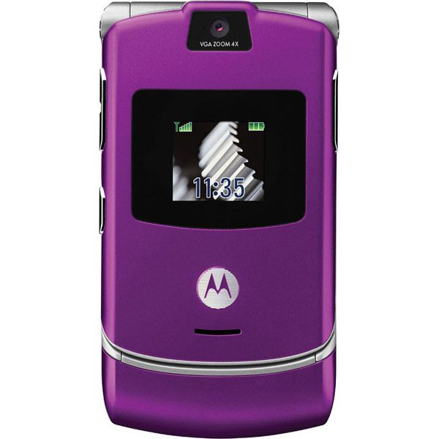
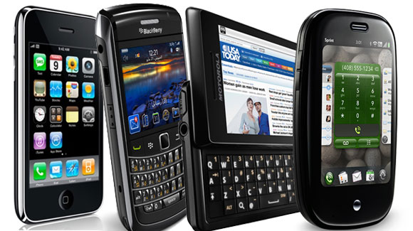
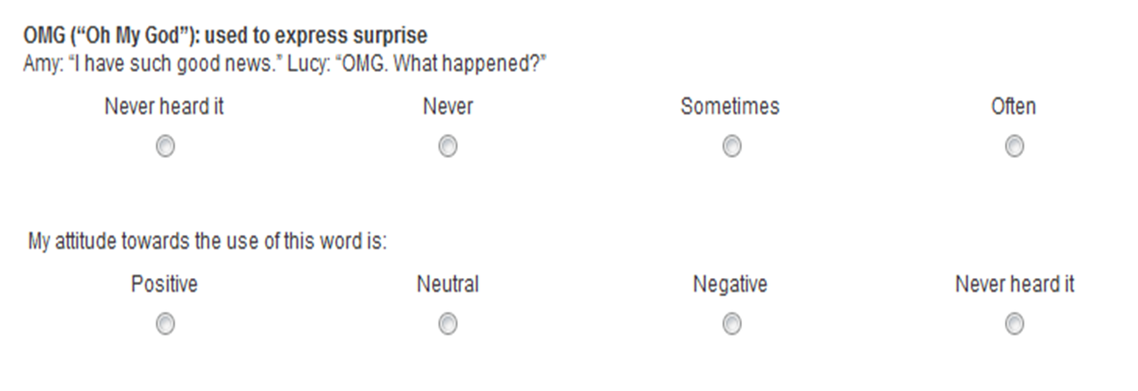
DYS: Do You Slang?
Isabelle Harris, Vanessa Khu, Rebecca Tumino
Queen’s University
Introduction/Background
- Canadian Texting Slang (CTS) = shortened terms & acronyms
- Canadian English (CE)
- 270 million texts = sent per day in Canada
- Quick relay of info
-Original text message = limited to 160 characters
-L2 learners may not use slang because feel like an outsider of group (Bradford, 2011)
- High value in spelling (Barkhuizen, 1999)→people may view CTS as typos leading to negative attitudes
Results Part 1: Usage
Discussion: H2
Part 1
H2 was not supported when looking at Survey Part 1:
When individual terms (LOL, OMG) are out of context, they appeared as appropriate for texting
Due to originally restricted Text Box sizes, ‘texters’ often used CTS to compensate
Part 2
- H2 was supported when looking at Survey Part 2:
When CTS was in texting dialogue, it became unappealing to receiver
There may be a balance between using CTS too much vs. too little
Use | Native Participants | Non-Native Participants
Often | LOL OMG BTW | LOL OMG BTW
Never | U2 Thx ATM | U2 LMAO Thx
Survey: Part 2
-Texting dialogue between 2 characters: Bob & Jane
-Consists of 10 text messages
-Bob frequently uses CTS, Jane does not
Example:
Bob: hey sup? Thx for lettin me use ur iPod 2day.
Jane: No problem! I hate running without music, so I’m glad I could help!
Asked Participants:
- How would you describe Bob/Jane? What is your attitude towards his/her text messages?
Top 3 answers for ‘Often’ and ‘Never’ used terms for both Native & Non-Native CE Speakers
Objectives
Examine use & attitudes of Native & Non-Native speakers of CE towards CTS
----------------------------------------------------------------------------------
H1. Non-Native speakers of CE that spend more time in Canada will use more CTS than those who have spent less time in Canada
H2. Participants will have a general negative attitude towards usage of CTS
---------------------------------------------------------------------------------Subjects
167 participants: 135 Natives, 32 Non-Natives
Conclusions
Depending on how CTS was presented to the participants → Attitudes differed!
Discovered that:
Non-Native CE speakers use CTS almost as frequently as Native CE speakers
There was a neutral attitude towards CTS when participants were asked about the terms individually
- There was an overall strongly-negative attitude towards frequently used CTS
Results: Part 2
- Participants had an overall negative attitude towards Bob
- Stated he was uneducated, immature and lazy
Example: ‘I would describe Bob as lazy. His inability to spell out words annoys and frustrates me.’
- Participants had an overall positive attitude towards Jane
- Stated she was educated, mature, and proper
Example: ‘I would describe Jane as professional and mature. Her text messages were more enjoyable to read because they were more grammatically correct.’
Term | Definition
LOL | ‘Laugh Out Loud’: used to express humour
OMG | ‘Oh My God’: used to express surprise
Probs | ‘Probably’: used to express certainty
ATM | ‘At The Moment’: used to express timing
BTW | ‘By The Way’ : used to express a side note
U2 | ‘You too’: used to express agreement
THX | ‘Thanks’: used to express gratitude
LMAO | ‘Laugh My Ass Off’: used to express humour
Participants who reported often using terms
Experiment
Online Survey:
24 multiple-choice questions about usage and attitudes
2 open-ended questions about attitudes towards a texting dialogue
4 filler & 8 background questions
8 CTS terms examined
Future Studies
Vary the amount of CTS in dialogue to gather more information about usage acceptability
Compare attitudes about abbreviations, acronyms, and misspelled words
Use a larger sample of Non-Native Canadians
Ask about slang usage before Non-Natives came to Canada
References
Barkhuizen, G. P. (1999). Teaching and learning good english spelling: What's the point? Tydskrif Vir Taalonderrig/Journal for Language Teaching, 33(4), 331-339. Retrieved from http://search.proquest.com.proxy.queensu.ca/docview/85519498?accountid=6180
Bradford, P. B.The acquisition of colloquial speech and slang in second language learners of english in el paso, texas. Masters Abstracts International, , 1493-1493. Retrieved from http://search.proquest.com/docview/1018381590?accountid=6180. (1018381590; 201205312).
Participants who reported never using terms
Discussion: H1
H1 was not supported because:
We had a wide range of data on time spent in Canada from Non-Native speakers (2 months vs. 21 years)
Unable to generalize their data
Participants who have resided in Canada longer → use CTS more often (more assimilated)
- Individuals from other countries may be using similar slang (before coming to Canada)
Survey: Part 1
Example Multiple Choice Question
Results Part 1: Overview of attitudes
Individual CTS terms
Overall general neutral attitude
More often used terms primarily neutral/positive attitude
Less often used terms primarily neutral/negative attitude

