Slide 1
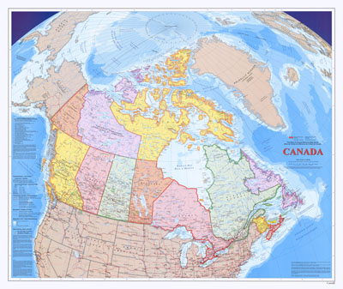
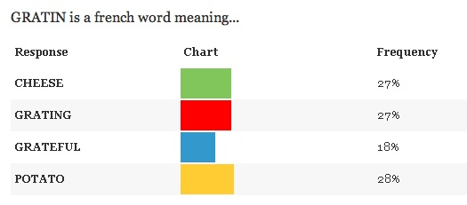
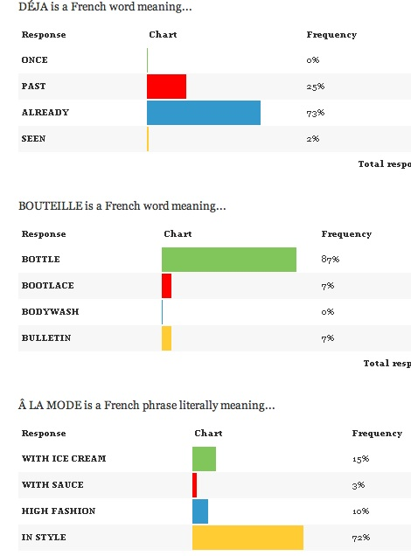
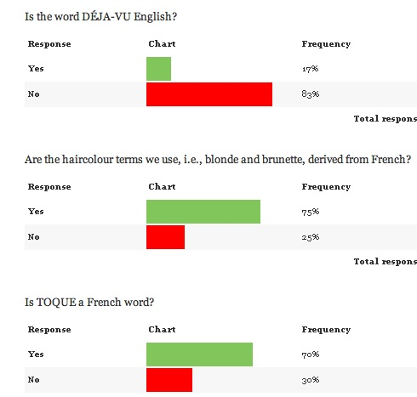
Is Canada really Bilingual?
French loanword recognition in Ontario
Madeline Best & Emily Obal
Queen’s University
Background
Canadian political institutions have long been concerned with bilingualism in Canada. The preservation of francophone communities outside of Quebec has been challenging. Even francophone's living in Quebec have had a long journey towards French language propagation and recognition. French has had a profound impact on all varieties of English thanks to the Norman conquest in 1066. Around this time thousands of lexical items made their way into Middle English from Old French. In this way we have gained many French terms. Other words have come from various fashion and culinary schools, and still others have come as names for phenomena such as déjà vu. Bilingualism is a pressing issue outside of Quebec. How can we claim to have a bilingual country when, in fact, it is only by virtue of our governmental institutions adherence to providing its services in both languages? Current rates of bilingual Canadians in English and French are around 17.6% of our population. 90% of those speakers live in Quebec. This lends credence to the notion that most Canadian citizens outside of Quebec are not bilingual. Given that, it makes sense that Canadian English speakers, though living in a bilingual country, may not be able to use or identify the French words that have been borrowed into their vocabulary.
Conclusions
Based on the fact that most of the questions had a similar frequency of correct responses we can make the conclusion that the general survey taker is more able to identify French terms in English than we initially thought. We found that, in general, participants did better at identifying the meaning of a word than we had anticipated. This included word for word translations as well as original meaning translations. Most of our survey takers had at least completed up to grade 9 French. This fact may provide some explanation for the frequency with which participants chose the correct answer—even though the vast majority of individuals did not identify as speaking French regularly/fluently. In fact, only 15 of our survey takers identified as being French-English bilingual. This accounts for about 20% of our participants, which is higher than the national percentage, about 17.6%. This could be related to the demographic from which we’ve pulled most of our respondents. Some other possible explanations for our results are explained in an article on this topic which indicated that the state of French language education in Canada is doing well. The problem is that, with disuse, people stop putting effort into maintaining their ability to speak French, thus losing understanding as they age. It’s like that old saying, use it or lose it. This means that the younger our demographic the more likely it is that they will be able to accurately identify French terminology. Another influence on our results which could have been related to the demographics of our survey is the ability of participants to recognize the word PORTAGE. In practice, a portage is a hiking trail that passes between two lakes or bypasses an impassable section of rapids in a river. The reason that it was very likely for participants to have recognized this is that most of our particular social groups involve some aspect of outdoor/adventure camping and recreation, and therefore are likely to have encountered portaging before. In summation, the relationship between the frequency of our respondents’ educations and general knowledge of French led us to disprove our initial hypothesis. Ontario Canadian English speakers are more often capable of understanding French words than anticipated.
Figure 1: Results for defining gratin
Hypothesis
Given that there is a relationship between familiarity with a language and being able to recognize the sounds and constructs of that language, we hypothesize that Ontario residents will have difficulty identifying the original meaning of borrowed French words. We chose this hypothesis because we believe that if people were unable to use French to communicate then they will likely have a harder time identifying the original meaning of borrowed words.
Study Details
We used an online survey to collect our data. This survey made use of four different types of questions. The first set of questions served to gather relevant information about the participants such as their level of French education and whether or not they identify themselves as bilingual. The second type of question was word origin identification (Figure 3), these were intended to show whether the participant would be able to identify the origin of the word. The third were single word translation questions (Figures 1&2). The goal of this type of question was to see if the participant could accurately identify the original meaning of the borrowed term rather than a meaning attributed to it by decades of integration into English vocabulary. The fourth set of questions took the form of translation questions. For example, we gave the participants one sentence in French and asked them to translate it into English and vice versa. These questions were used to test the participant’s level of French education as well as the participant’s ability to differentiate between recently associated meanings and original meanings
What is being done?
There is a project right now in Manitoba that is attempting to speed up the rate immigration among French first language speakers to Canada. The way this plan is being executed is by the increased advertisement, to prospective Canadians, of Winnipeg’s French quarter St. Boniface community in Manitoba. By keeping French alive outside of Quebec we can expect a continued effort to maintain our status as a Bilingual country.
Figure 2: Identification of French meanings
References
De Souza, Mike. "Bilingualism shrinking outside Quebec. Census finds.” Ottawa Citizen 25 Oct. 2012. Ottawa Citizen. Web. 20 Nov. 2012.
http://www.ottawacitizen.com/life/Bilingualism+shrinking+outside+Quebec+census+finds/7438529/story.html
Friesen, Joe. "French alive and well in Canada, official-languages watchdog." The Globe and Mail 30 Oct. 2012 [Canada] . Theglobeandmail.com. Web. 20 Nov. 2012. <http://www.theglobeandmail.com/news/politics/french-alive-and-well-in-canada-official-languages-watchdog-says/article4787027/>.
Keeping French alive outside of Quebec." Globe and Mail Oct. 2012 [Canada] . theglobeandmail.com. Web. 19 Nov. 2012. http://www.theglobeandmail.com/news/news-video/census-video-keeping-french-alive-outside-quebec/article4633835/?from=4633806
Result Summary & Data Analysis
We took our results and looked at the frequency with which Ontario speakers were able to: identify the correct origin of a French/English word, define a French word as used in English, and define a French word as used in French. For added context we used a translation test to see with what level of fluency participants could use French. The results show that Ontario speakers of Canadian English have a high frequency of correct answers in all types of questions. This does not support our initial hypothesis. With average correct responses ranging from 70-86% across the board (Figure 2&3), it is likely that Ontario French education is doing well to provide Ontario with a usable understanding of French words. One interesting result came in the form of the contextual translation for the French word AU GRATIN (Fig 1). In this question the answers were divided evenly among participants. AU GRATIN means with shavings, filings, or gratings. The spread of the responses could be attributed to the relationship between this term and a particular dish—potatoes au gratin. Because this name has been attributed to the popular and common cheesy potato dish, many people may believe that AU GRATIN could mean cheese, potato, or grating.
Figure 3: Results for word origin identification

