Slide 1


Student Wellness and Safety Resources 2023-24
Campus Services and Student Affairs – We’re here to help!
queensu.ca/studentaffairs
@queensustudentaffairs
Notes:
This deck outlines student wellness resources and supports available on and off campus.
These slides can be played on a loop by instructors and staff before the start of classes, workshops, lectures, info sessions.
Instructors are encouraged to also post this deck with their course materials.
Questions? Please email studentaffairs@queensu.ca.
Thank you!
This deck was last updated Aug 25, 2023

Slide 2
Take Care of Yourself!
Sleep!
Eat!
Goal: 7-9 hours of quality sleep a night.
Make an appointment at Student Wellness Services with a Peer Wellness Coach to get started.
Goal: Incorporate veggies, fruits, proteins,
and complex carbs in your meals.
Not sure where to start?
Bewellatqueens food recipes & articles
The Scoop nutrition & food blog
Healthy cooking sessions with Peer Health Educators
Food security and access resources
Move!
Connect!
Goal: Get involved and build your community.
Check out spaces, student clubs, and events including the Allyship & Belonging Student Calendar.
Get a Peer Mentor! For first-year and upper-years.
Scan the latest Pulse newsletter for key dates and info.
Goal: Move more, sit less.
Take a walk, run, or check out the ARC.
A Peer Wellness Coach can help!

Slide 3


Empower Yourself by Being Proactive
Academic Skills
Career Planning
Goal: Sharpen your academic skills.
Queen's Student Academic Success Services (SASS) provides one-to-one academic support, workshops and resources
queensusass
Goal: Get work experience and career guidance.
Visit Career Services for resume and cover letter advice, workshops, employer/recruiter sessions, and the job board.
queensucareers
Finances
Leadership & Development
Goal: Understand all your financial options.
Learn what financial aid options are available.
Book an in-person or online financial advising appointment.
queensu.ca/registrar/financial-aid
Goal: Build leadership skills.
Complete a leadership workshop series or other certificate program or become a peer mentor with the Student Experience Office (SEO).
queensuseo

Slide 4
Mental Health Supports
Student Wellness Services: 613-533-2506 or walk-in at Mitchell Hall, Floor 1
Health, Counselling and Accessibility Services available Mon–Fri
There are several crisis and mental health resources available Monday-Friday including
Empower Me Plus.
Good2Talk: 1-866-925-5454 (text: GOOD2TALKON to 686868)
24HR Supports

Slide 5
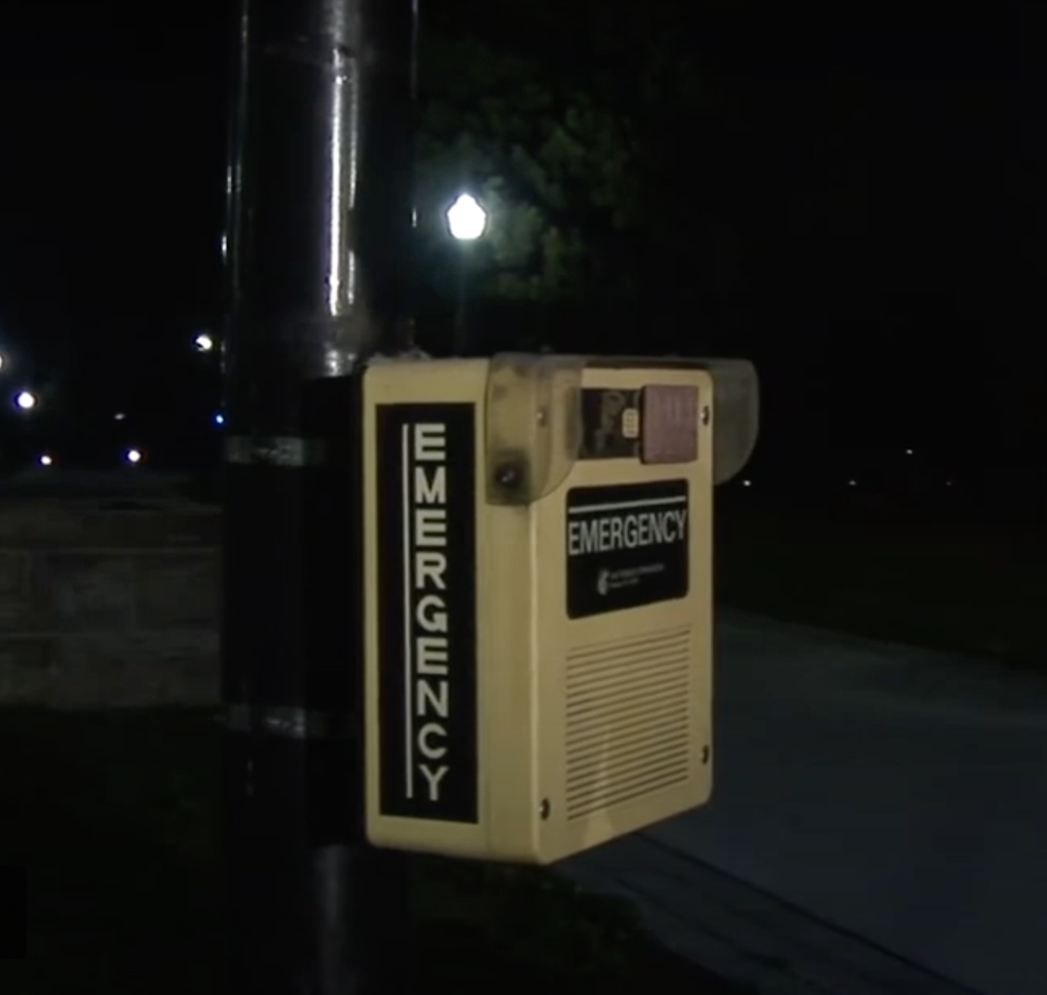
Emergency and Safety Services
Save these numbers in your phone contacts
Life threatening emergencies: 911
Queen’s Emergency Report Centre (24hr): 613-533-6111
Campus Security Non-Emergencies (24hr): 613-533-6080
AMS Walkhome: 613-533-9255
Campus Observation Room (COR): 613-533-6911
Outdoor Emergency Phones across campus are identified by their blue lights and yellow boxes.

Slide 6

Sexual Violence Prevention and Support Services
Non-judgmental support for all students impacted by sexual violence
Visit the SVPRS website for resources and information, including the VESTA online support hub that allows survivors to record experiences in a trauma-informed format with the options to remain anonymous and to notify SVPRS and/or police.
Get informed by participating in a workshop, or completing the It Takes All of Us online learning program or the Gender Based Violence, Awareness and Bystander Intervention certificate program.
Contact Sexual Violence Prevention & Response Coordinator Barb Lotan,
to learn about your options: bjl7@queensu.ca
24/7 Crisis and Support Line
Sexual Assault Centre Kingston: 613-544-6424 or 1-877-544-6424

Slide 7
Harassment and Discrimination Prevention and Support
Help Create a Harassment and Discrimination Free Campus
Learn more about the university’s harassment and discrimination policy and complaint and reporting procedures.
There are options to make a complaint or report being a witness to, or being aware of, discrimination, harassment, or reprisal.
  Consult with a human rights advisor on campus
  Fill out the In-Sight Harassment, Discrimination, and Bias/Hate Incident Anonymous Submission Form
Get informed with training modules and resources, including an online module for Identifying and Responding to Microaggressions.

Slide 8



Update Your Contact Info in SOLUS

