Slide 1
Student Services and Resources
Campus Services and Student Affairs – We’re Here to Help!
2026–2027

Slide 2
Careers, Leadership, Academics, and Accessibility
Careers
Visit Career Services for career advising, resume and cover letter advice, leadership workshops, employer/recruiter sessions, job fairs, internship support, and the MyCareer job board.
Leadership
Complete the Lead, Include, Transform (LIT) anti-oppression training to build the skills to lead with confidence and create positive change across campus.
Check out the Career Services Volunteer Opportunities Webpage and keep an eye on other Student Affairs units for more opportunities to gain experience and engage with the community.
Academics
Student Academic Success Services (SASS) provides free writing and learning support through workshops, resources, and one-on-one coaching.
Accessibility
Register with Queen’s Student Accessibility Services (QSAS) for academic accommodations.
Check out the Accessibility Hub to learn more about resources available for students with disabilities, including the Adaptive Technology Centre.
View the Queen's campus map for building accessibility features and information.

Slide 3
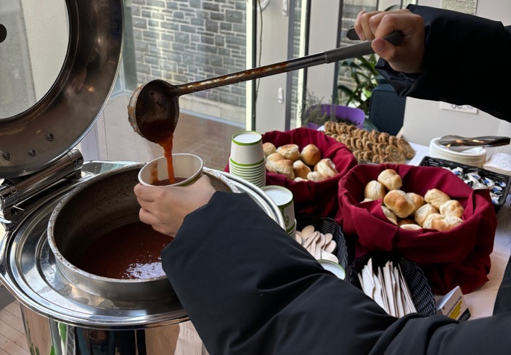
Food, Financial Aid, and Housing
Food & Food Access
Check what’s open now on campus.
Food access resources on campus include:
Campus markets and affordable produce
Prepared meals
Food banks
Meal prep take-home kits and cooking events
Grocery store and on-campus discounts
Financial Aid
Explore financial aid options designed to support your studies, including scholarships, bursaries, Work Study, government student aid, and more.
Housing
Off-Campus Living Advisors are here to help you navigate the Kingston rental market, understand your tenant rights and responsibilities, lease agreements, and more.

Slide 4

Health and Wellness
24/7 Mental Health Supports
There are several 24/7 crisis and mental health resources available including:
Empower Me
Good2Talk, Crisis Response: 1-866-925-5454
(text: GOOD2TALKON to 686868)
Suicide Crisis Helpline: Call or text 9-8-8
Student Wellness Services provides a welcoming, confidential, integrated service responsive to student needs.
Medical Services: appointments with healthcare providers, quick access for urgent needs, mental health intake
Mental Health Services: quick access for urgent needs, appointments with therapists, intake appointments, therapy groups
Wellness coaching: support for sleep, physical activity, nutrition, mindfulness, and substance use
Student-led and other wellness events
Create a TELUS Health Connect account to book medical and mental health appointments online, get text reminders and fill out required forms.
Stay active at the ARC! Athletics & Recreation offers intramurals, workouts, pickup sports, swimming, and free attendance to all Gaels regular home season games!

Slide 5
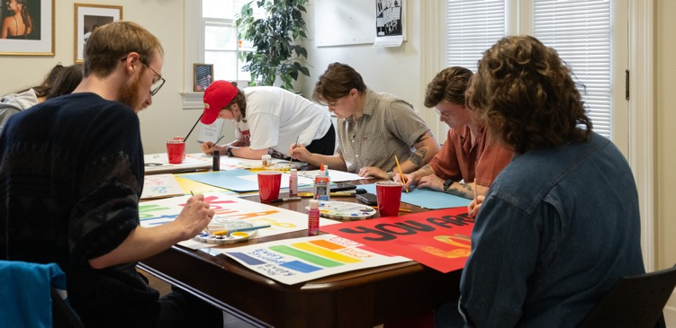
Community and Connection
Keep an eye on The Pulse newsletter and Student Affairs Instagram for event highlights.
Check out the Allyship & Belonging Student Calendar (ABC), the central events hub specifically for equity-deserving students and students wanting to become better allies.
Pick a Peer Mentor through the Student Experience Office (SEO) QSuccess First-Year & Upper Year peer mentorship programs.
First-Year? Living off-campus? Join the Off-Campus Community (OCC) to connect with other students living off-campus!
Find belonging and community with campus units including:
Faith and Spiritual Life
Four Directions Indigenous Student Centre
Queen’s University International Centre
Ban Righ Centre for mature women students
Yellow House Student Centre for Equity & Inclusion

Slide 6
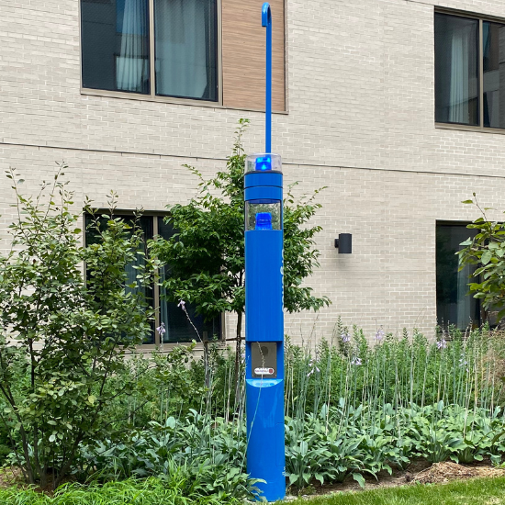
Emergency and Safety Services
Life threatening emergencies: 911
Save these numbers in your phone contacts:
Queen’s Emergency Report Centre (24hr): 613-533-6111
Campus Security Non-Emergencies (24hr): 613-533-6080
AMS Walkhome: 613-533-9255
Campus Observation Room (COR): 613-533-6911 for students who have had too much to drink (Fall term only)
National Overdose Response Service (NORS): 1-888-688-NORS(6677)
Campus Safety App & Alerts
Download the SeQure App for quick access to all the Campus Security and Emergency Services resources.
Sign up for QUAlerts to allow Queen’s to quickly send important messages via email, SMS text and text-to-voice, and the SeQure app.
Outdoor Emergency Phones across campus are identified by their blue lights or yellow boxes.

Slide 7

Sexual Violence Prevention and Response Services (SVPRS)
Non-judgmental support for all students impacted by sexual violence and intimate partner violence.
Contact SVPRS for information about supports/services and other options: SVPRServices@queensu.ca.
Visit the SVPRS website for resources and information.
Get informed by participating in a workshop offered through the Gender Based Violence, Awareness and Bystander Intervention program and by completing the It Takes All of Us online learning program.
24/7 Crisis and Support Line
Sexual Assault Centre Kingston: 613-544-6424 or 1-877-544-6424

Slide 8
Harassment and Discrimination Prevention and Support
As a student at Queen’s, you have the right to study in an environment that does not discriminate or harass based on the protected grounds outlined in Ontario’s Human Rights Code. These grounds include race, disability, sex, gender identity/expression, creed/religion, family status.
If you believe you have faced harassment or discrimination, you are encouraged to make an appointment with a Human Rights Advisor.
During a meeting, we will:
Work together to explore options to respond to what has happened.
Share with you whether the incident is likely to be considered discrimination or harassment.
Guide you through the official Complaint process.
Explain how to make an anonymous submission through the IN-SIGHT platform.
Connect you with other relevant resources on campus.
Central to our work is:
Confidentiality
Impartiality
Consent
Take the H&D Self-Guided Module for Students

Slide 9
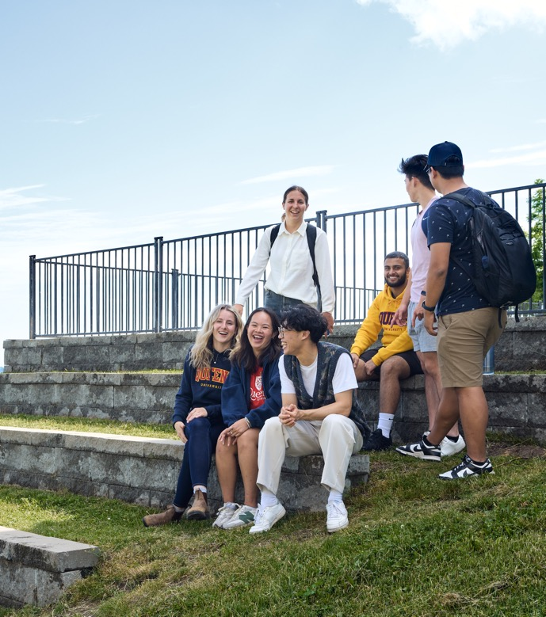
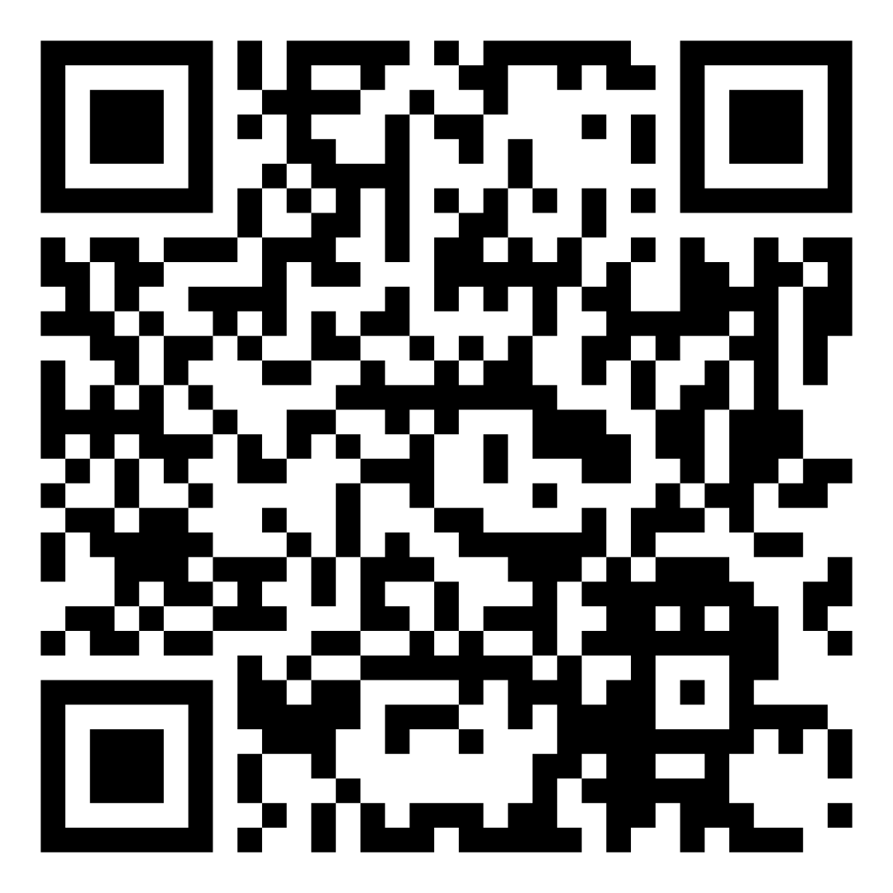
Student Resources
We're here to help!
Student Affairs is your first point of contact to get you to the information, resources, programs, and services you need to thrive at Queen's.
Scan for student resources!
Contact Us
613-533-6944
studentaffairs@queensu.ca
Instagram: @queensustudentaffairs

