Slide 1
You Got Googled: How (& Why) to Tell a Compelling Research Story “The data may hold the answers, but stories tell us which questions to ask, and why the answers matter.” Roni Zeiger, Data Are Shadows of Stories
Adrian Kelly, PhD
Research Projects Advisor
Social Sciences, Humanities, Creative Arts
Queen’s University
adrian.kelly@queensu.ca

Slide 2
Why storytelling? What’s in it for me?
“But I’m not a storyteller.”
You’re telling a story all the time, whether you think so or not.
You are being Googled.
What kind of story are you telling?
Become conscious as to your story.
“Figure out the story you want to tell. Otherwise, it becomes a self-fulfilling prophecy.”

Slide 3
Benefits of developing a clear research story
Short autobiography or story-based CV
Research- or project-based website with an effective “About Me.”
CER, reaching non-academic stakeholders
Better grant applications
Research rut, writer’s block

Slide 4
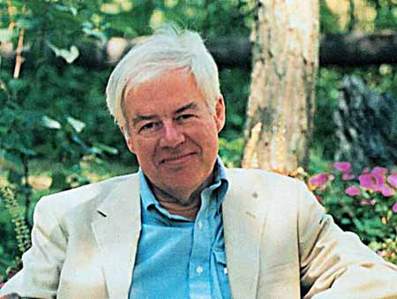
Toward a new ‘About You’: what’s your “Final Narrative?”
“All human beings carry about a set of words which they employ to justify their actions, their beliefs, and their lives. These are the words in which we formulate. . .our long-term projects, our deepest self doubts and our highest hopes. They are the words in which we tell, sometimes prospectively and sometimes retrospectively, the stories of our lives.”
__________
“Rorty’s word “final” is ironic. . . . His sense is that a “final” language ought to be anything but final. He believes that we ought to be constantly challenging, testing, refining, and if need be overthrowing our ultimate terms and stories, replacing them with others that serve us better.”

Slide 5
Your Final Narrative: questions to get you going
What truly motivates you?
Core values?
Whom/what do you serve?
What are your origins, what’s your backstory?
Do you have a dramatic before and after?
At what point did you decide to pursue an academic career, and why?
Which ideas and people had the biggest influence?
Did any personal (non-academic) events influence your decision?

Slide 6
Adding details to your new About You: Position/Prestige
Do you hold or have you held a unique prestige position inside academe, a company, a NGO etc?
Canada Research Chair
Killam Fellow
SSRHC Gold Medal
Teaching Awards

Slide 7
Publications
Don’t merely list
Brief, engaging summaries
Understandable by non-academics
Good press

Slide 8
Popularity / Praise
Number of citations
Number of followers (blog, Twitter, newsletter etc)
Who’s said great things about you and your work?
Recognized/reputable media sources
Reputable professionals/peers/public figures

Slide 9
Performances
At what prestigious or reputable non-academic venues have you spoken?
Keynotes, plenary etc.
Radio and TV appearances

Slide 10
Paying clients/Products
Who has hired you for your expertise?
Have you designed or invented products, systems, or some form of intellectual property?

Slide 11
Professional affiliations
What key networks, communities, circles are you part of?
(Are there some you should be part of but aren’t?)

Slide 12
Philanthropy
Where do you donate, or volunteer your time?
In what ways are you committed to giving back to issues you care about?

Slide 13
Pulling it all together: a new “About Me.”
Focus of what you do, and the audience you serve (one sentence)
Relevance. Why can you help me? What’s your particular skill, your point of view, your curiosity?
Relevant backstory (including key or pivotal moments).
External validators
Personal/humanizing details (e.g. surprising facts, labours of love, interesting quirks).
Call to action. What do you want people to do? Contact you for media appearances? Follow your blog? FB? Twitter?

Slide 14
Concluding exercise: your story lead
One-sentence summary at beginning of About Me.
“I’m an academic support specialist at Queen’s University who helps leading scholars describe and fund their major research projects.”

Slide 15
Your one-sentence story lead: the three components
Position: who you are in the professional world (job title, status or credential, role description.)
Audience: who you help and serve.
Value: what you provide
“I'm an Assistant Professor of Sociology and Bisell-Heyd Fellow in the Munk School of Global Affairs at the University of Toronto, and a member of the Homicide Research Consortium, a multidisciplinary group of scholars studying the causes and consequences of homicide.”

Slide 16
Concluding thoughts
Think of your story as a work in constant progress.
Bogging down? Research rut? Feeling blocked?
Go back to basic questions, and re-explore, re-write your story.
getstoried.com

