Slide 1

Expanding Networks and Building Partnerships with Industry

Slide 2
Introduction
Queen’s Partnerships and Innovation (QPI)
QPI supports the VP Research Portfolio’s mission to be an essential catalyst for advancing research and knowledge mobilization, strengthening Queen’s local, national and global impact.
The QPI team develops and facilitates partnerships with industry, governments, not-for-profit organizations, and other academic institutions to (i) advance the research enterprise at Queen’s and the commercialization of intellectual property and (ii) strengthen the regional innovation ecosystem in Kingston and Eastern Ontario. QPI offers many services to Queen’s faculty members, post-docs, students, research centres, departments and faculties.
Expanding Networks and Building Partnerships with Industry
Notes:
Introduction to QPI and hosts (including background/experience)

Slide 3
Identifying Industry Partners
Expanding Networks and Building Partnerships with Industry

Slide 4




Industry Publications
Industry-specific publications are good resources for identifying companies active in your field of research
Notes:
So, how do you conduct a technology assessment?
Talk about how these magazines are always looking for content and how we used it to write an article about our research/technology to get industry partners.

Slide 5
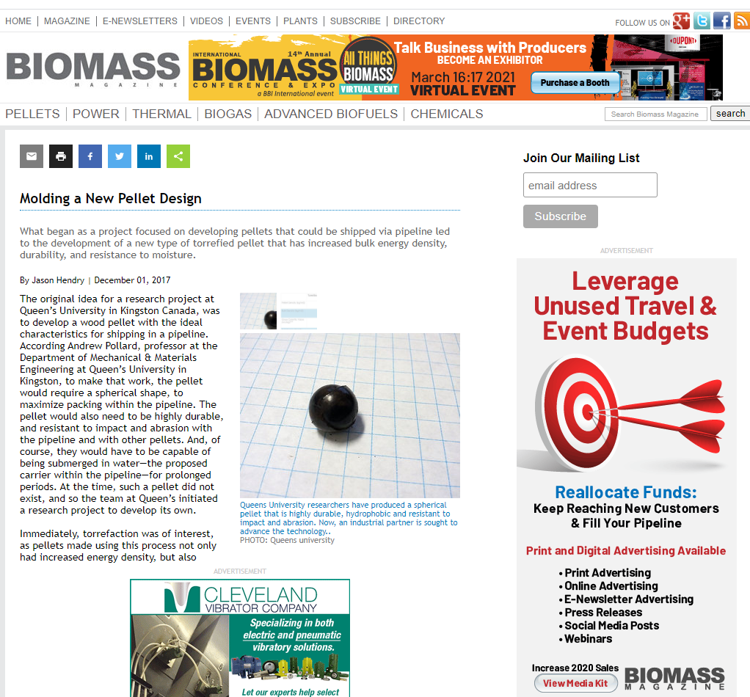

Slide 6
Market Reports
Market report summaries give high level information about the market and often include a list of companies profiled in the report
Expanding Networks and Building Partnerships with Industry
Notes:
So, how do you conduct a technology assessment?
Talk about how these magazines are always looking for content and how we used it to write an article about our research/technology to get industry partners.

Slide 7
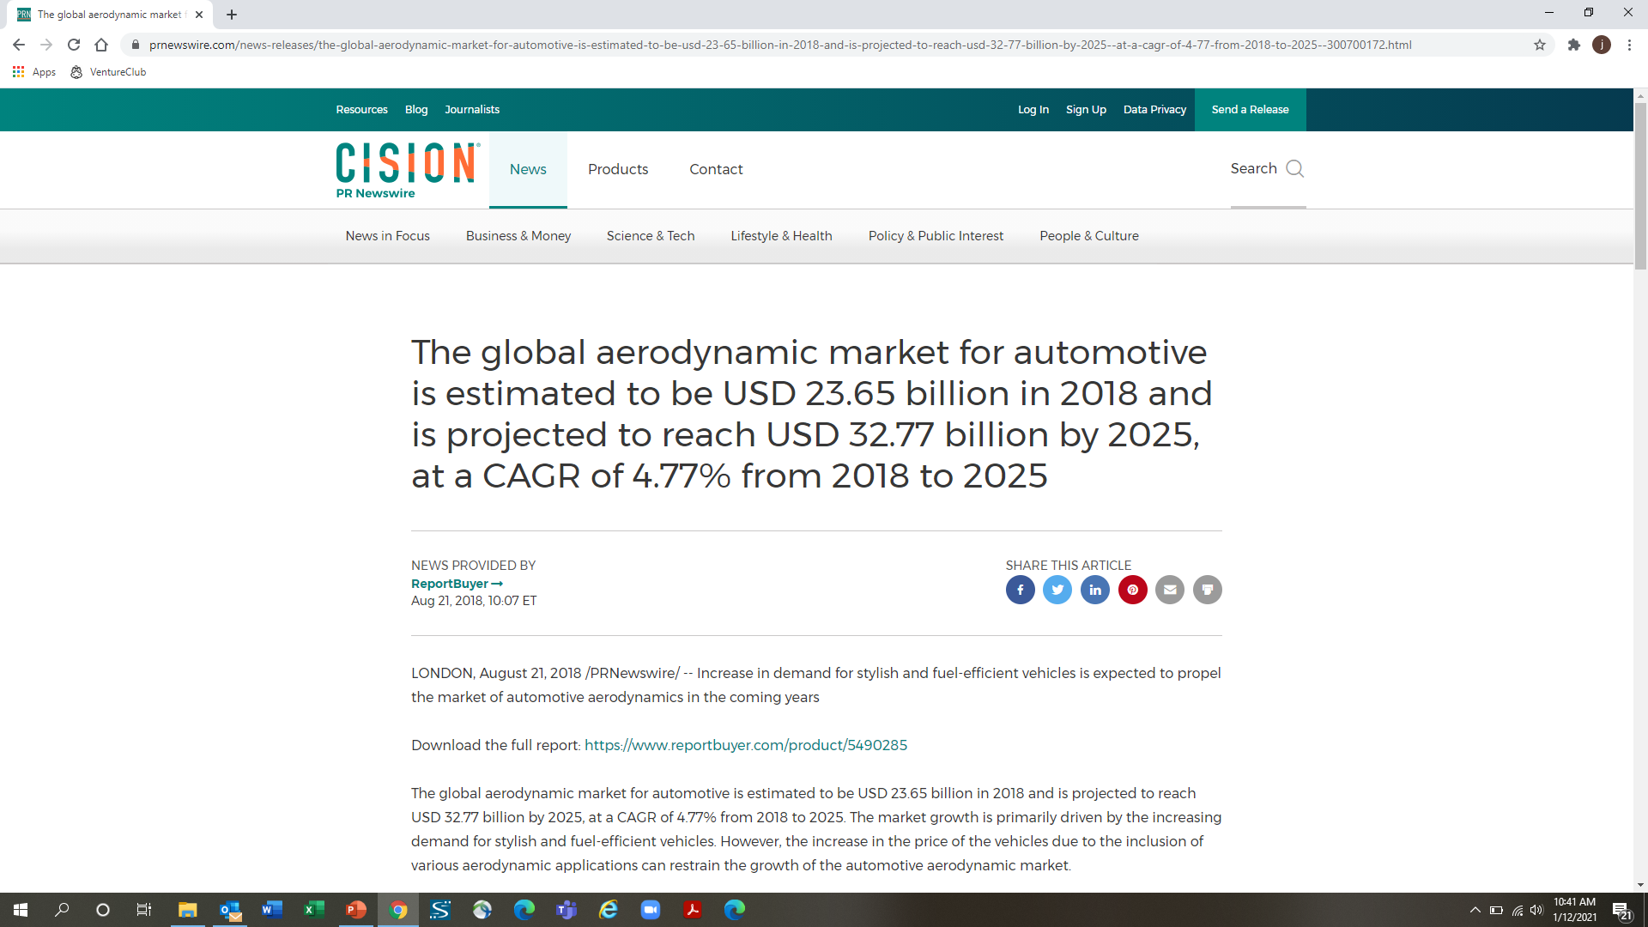

Slide 8
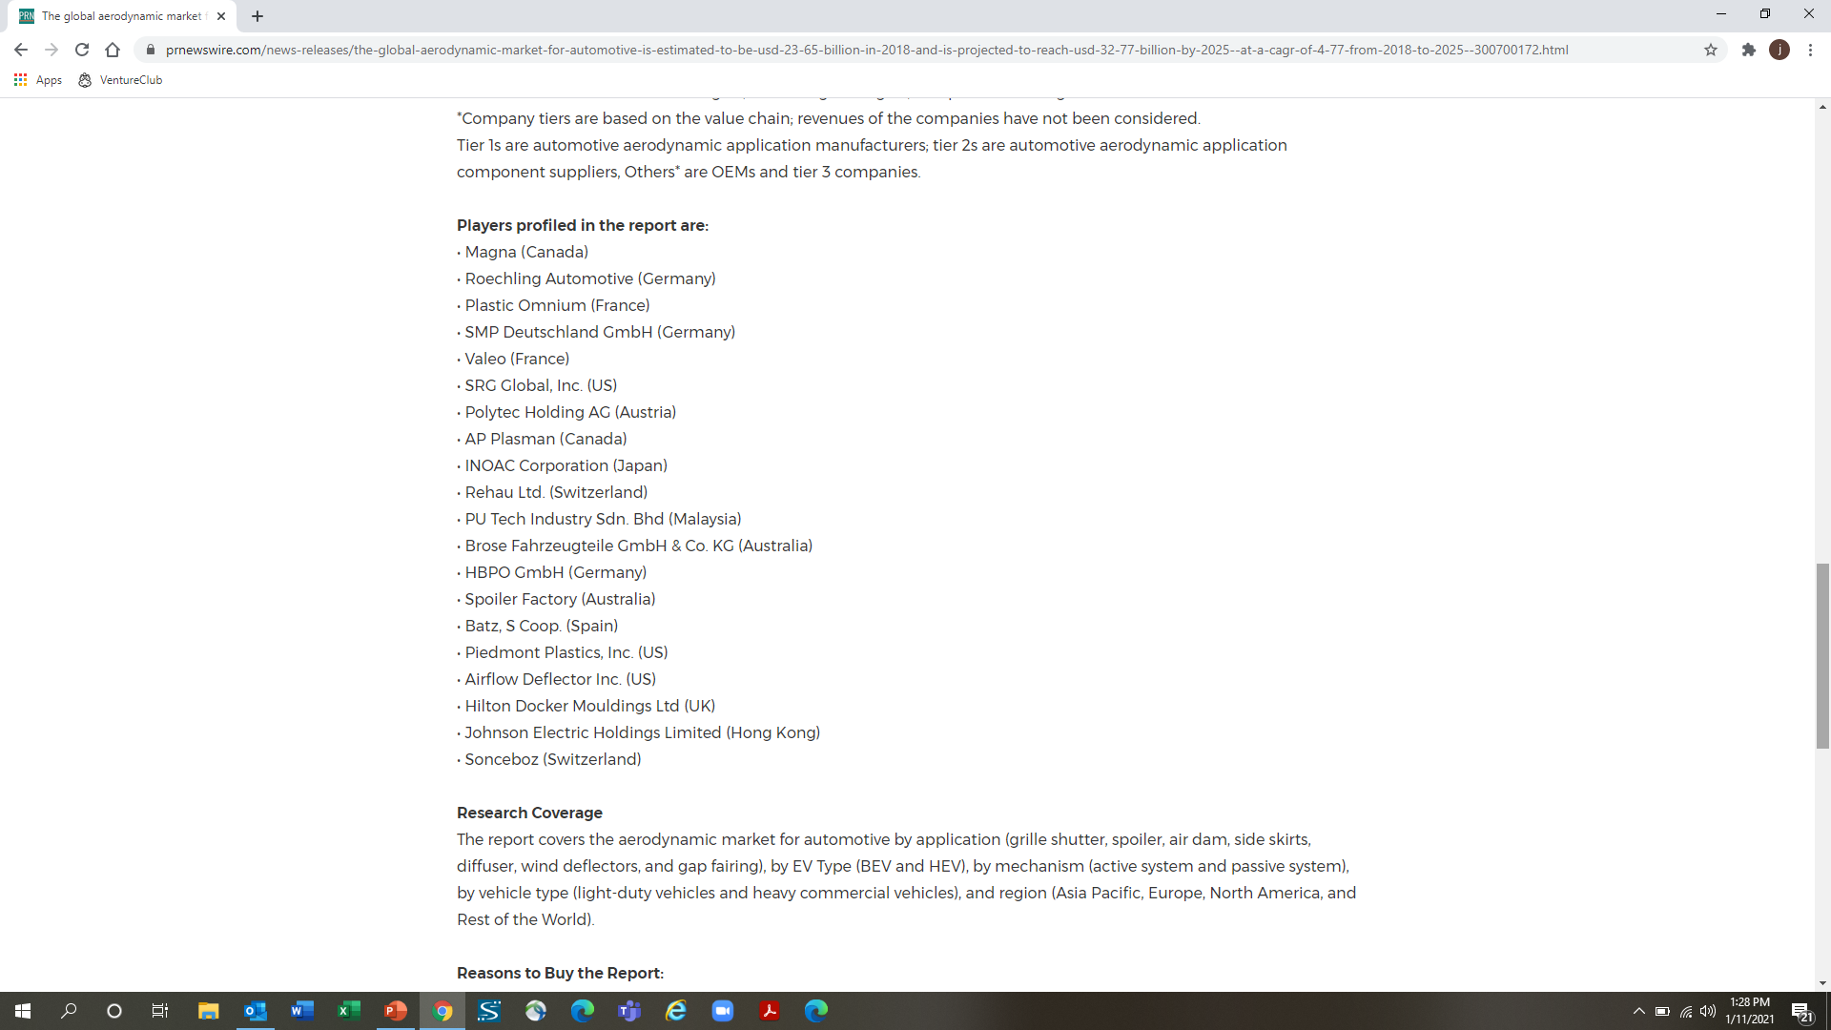


Slide 9
Conferences
Conference websites often list companies that will be attending as exhibitors and may provide summaries/contact info
Expanding Networks and Building Partnerships with Industry
Notes:
So, how do you conduct a technology assessment?
Talk about how these magazines are always looking for content and how we used it to write an article about our research/technology to get industry partners.

Slide 10
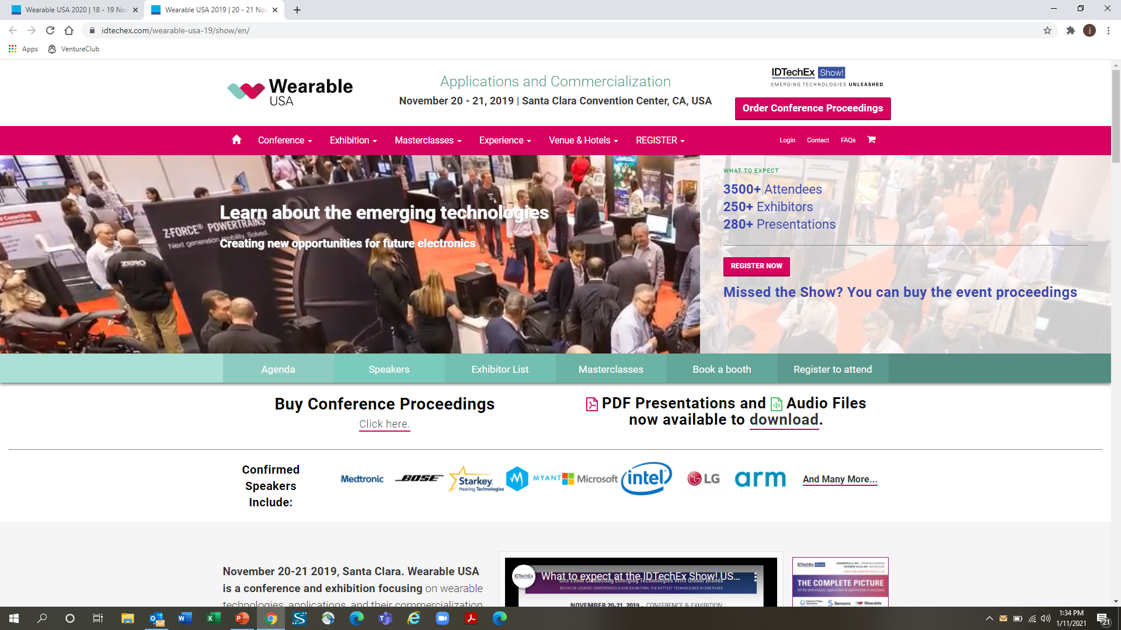

Slide 11
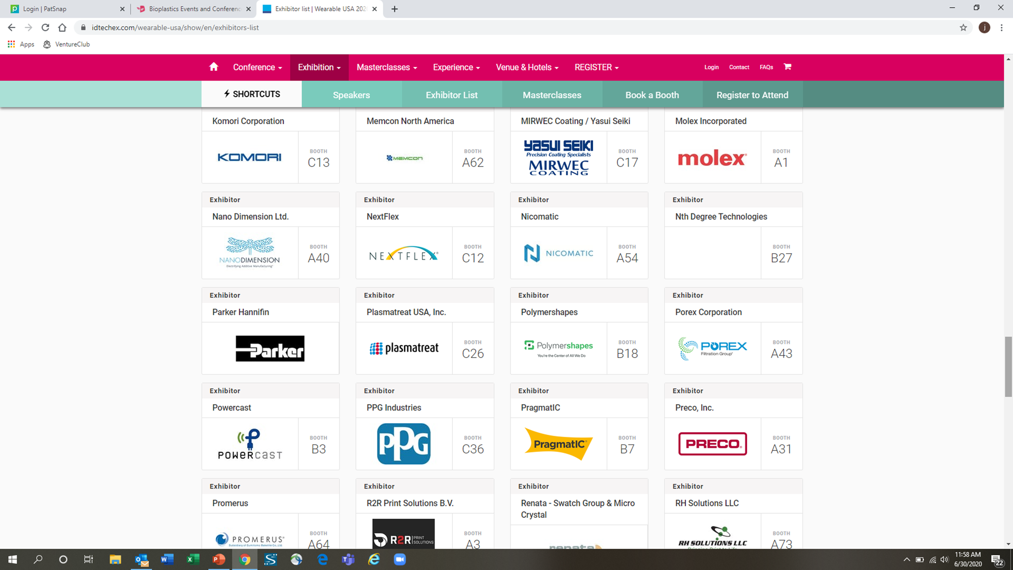

Slide 12
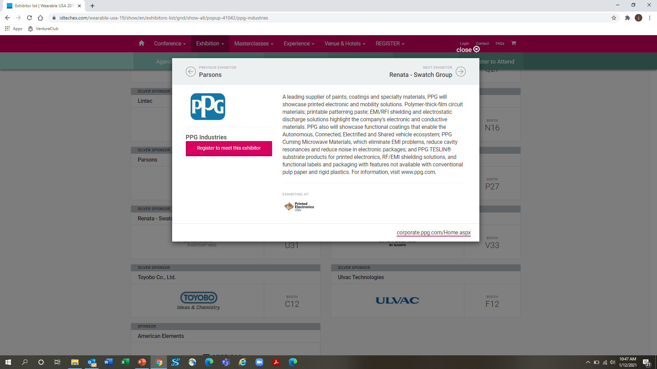

Slide 13
Patent Literature
Patent literature is where industry “publishes” its research
This research is usually not published in the scientific literature
A patent search can identify companies actively conducting research in your field of study
Expanding Networks and Building Partnerships with Industry
Notes:
… We have an invention disclosure form that we use that are filled out by researchers and in it there are two checkboxes – one that asks if a literature review has been conducted – this is checked more than 95% of the time – and one that asks if a patent review has been conducted – this is not checked about 99% of the time.
By not conducting a patent review you’re missing out on tons of research that has been conducted by industry, and it’s significant – check this out….

Slide 14
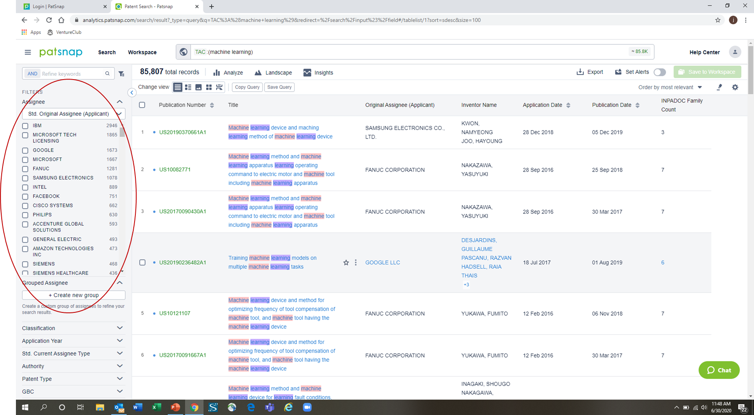

Slide 15
Patent Searching
Most countries have a patent office and any patent application filed in that office is kept in a database. Note that a patent application filed only in the US will not be found in the Canadian patent database
Fortunately, there are several free patent searching websites that can access many of the different patent databases
  FreePatentsOnline - http://www.freepatentsonline.com/
  Google Patents - https://www.google.com/?tbm=pts
  Patentscope - https://www.wipo.int/patentscope/en/
  Espacenet - https://worldwide.espacenet.com/patent/
Expanding Networks and Building Partnerships with Industry

Slide 16
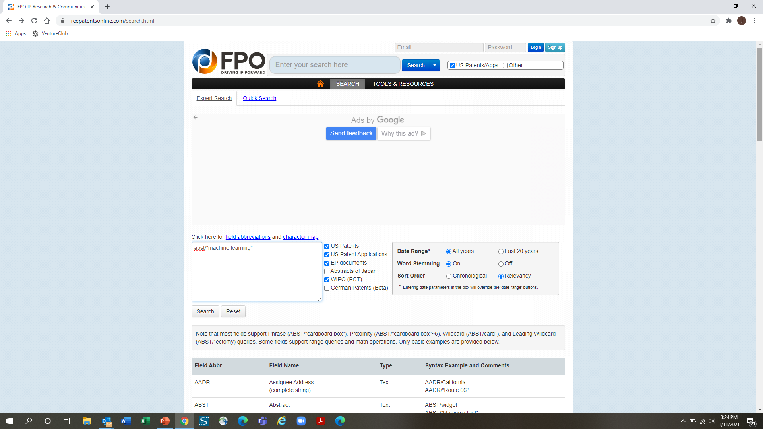

Slide 17
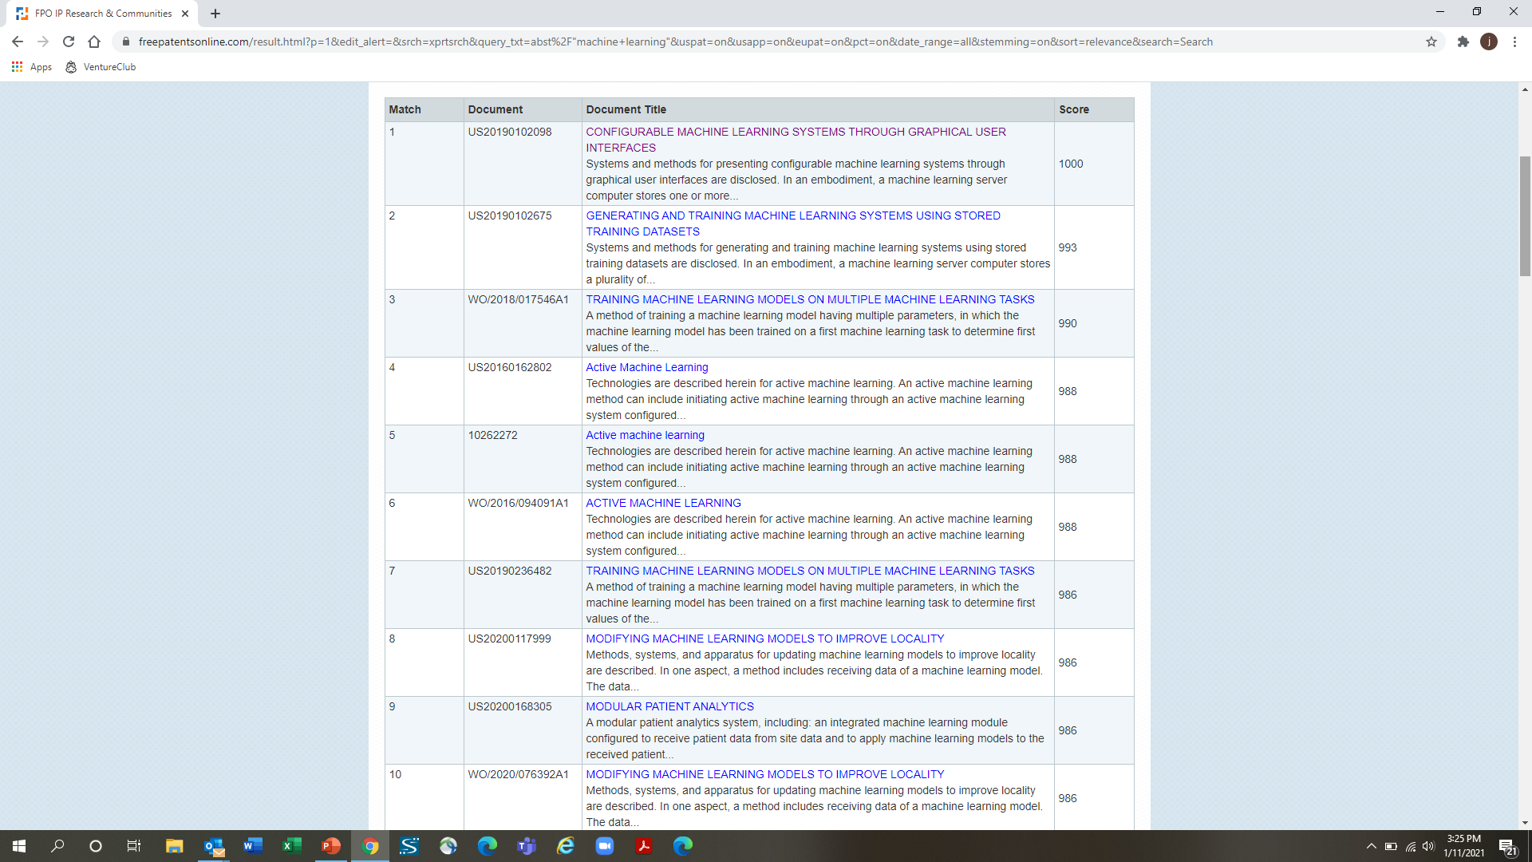

Slide 18
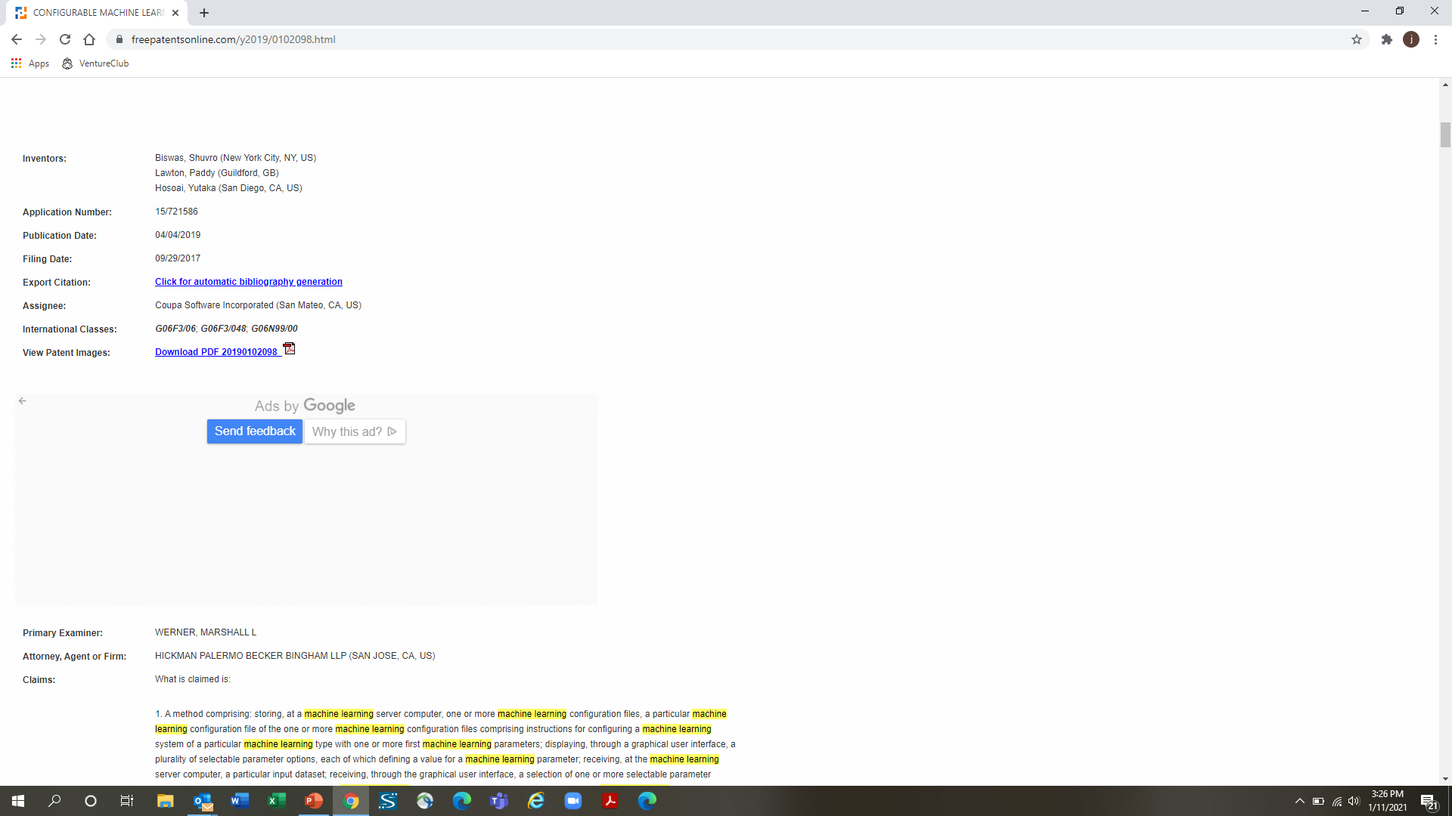

Slide 19
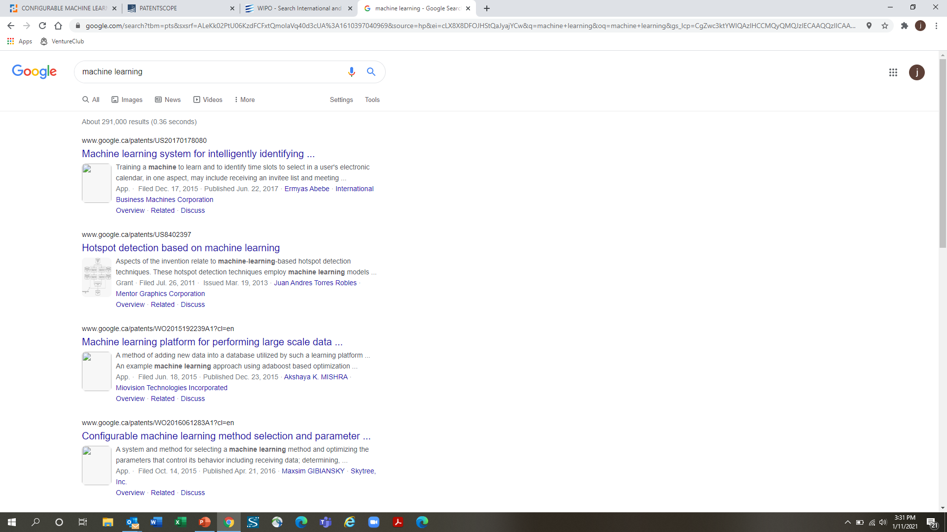

Slide 20
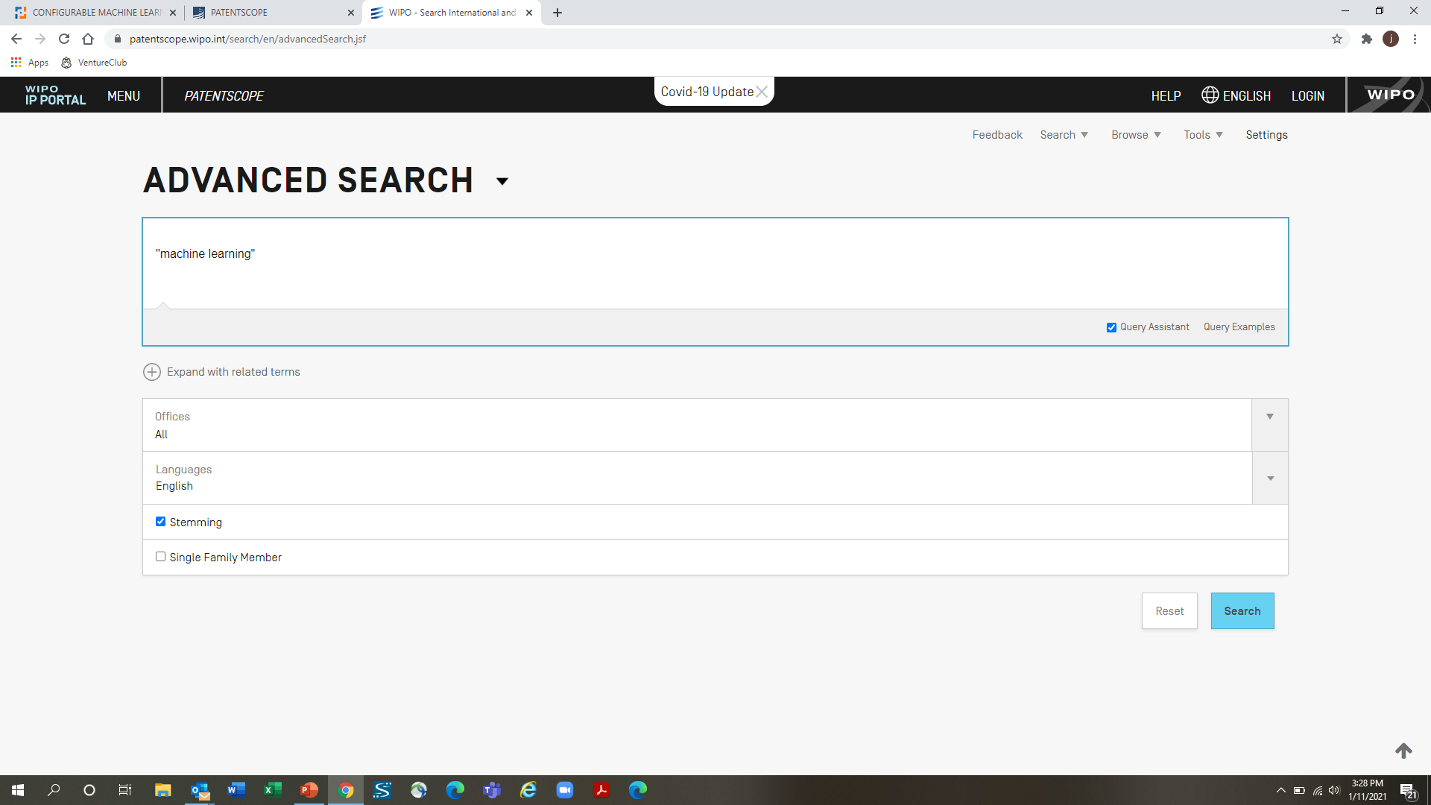

Slide 21
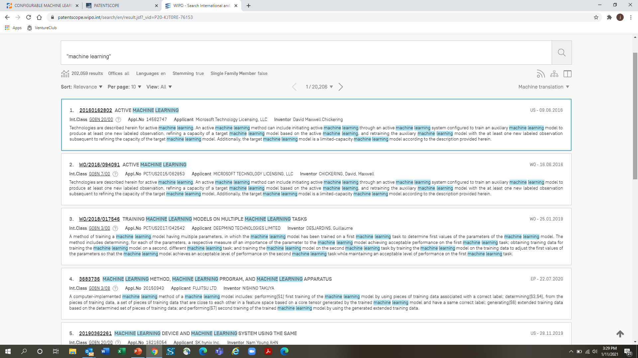

Slide 22
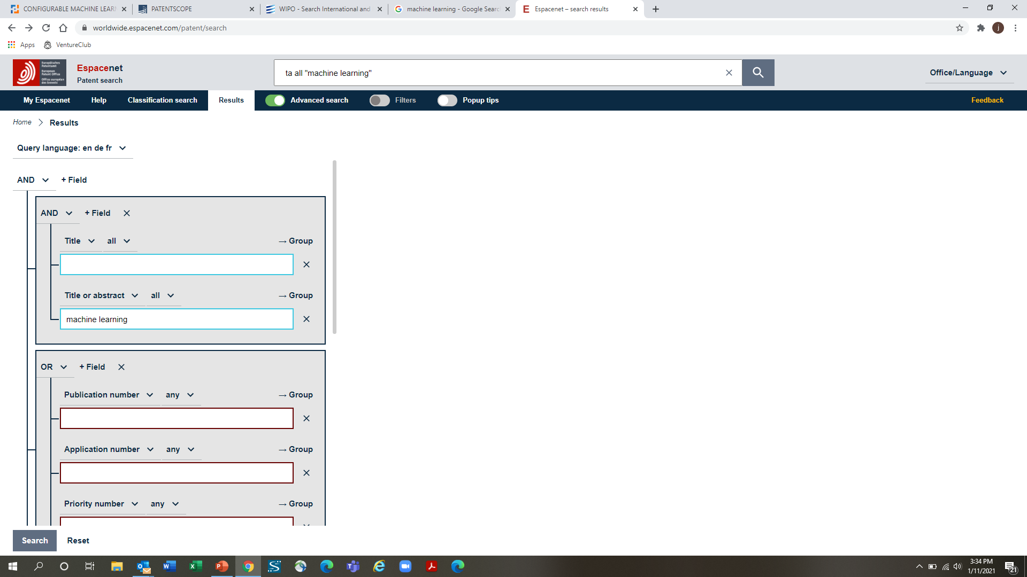

Slide 23
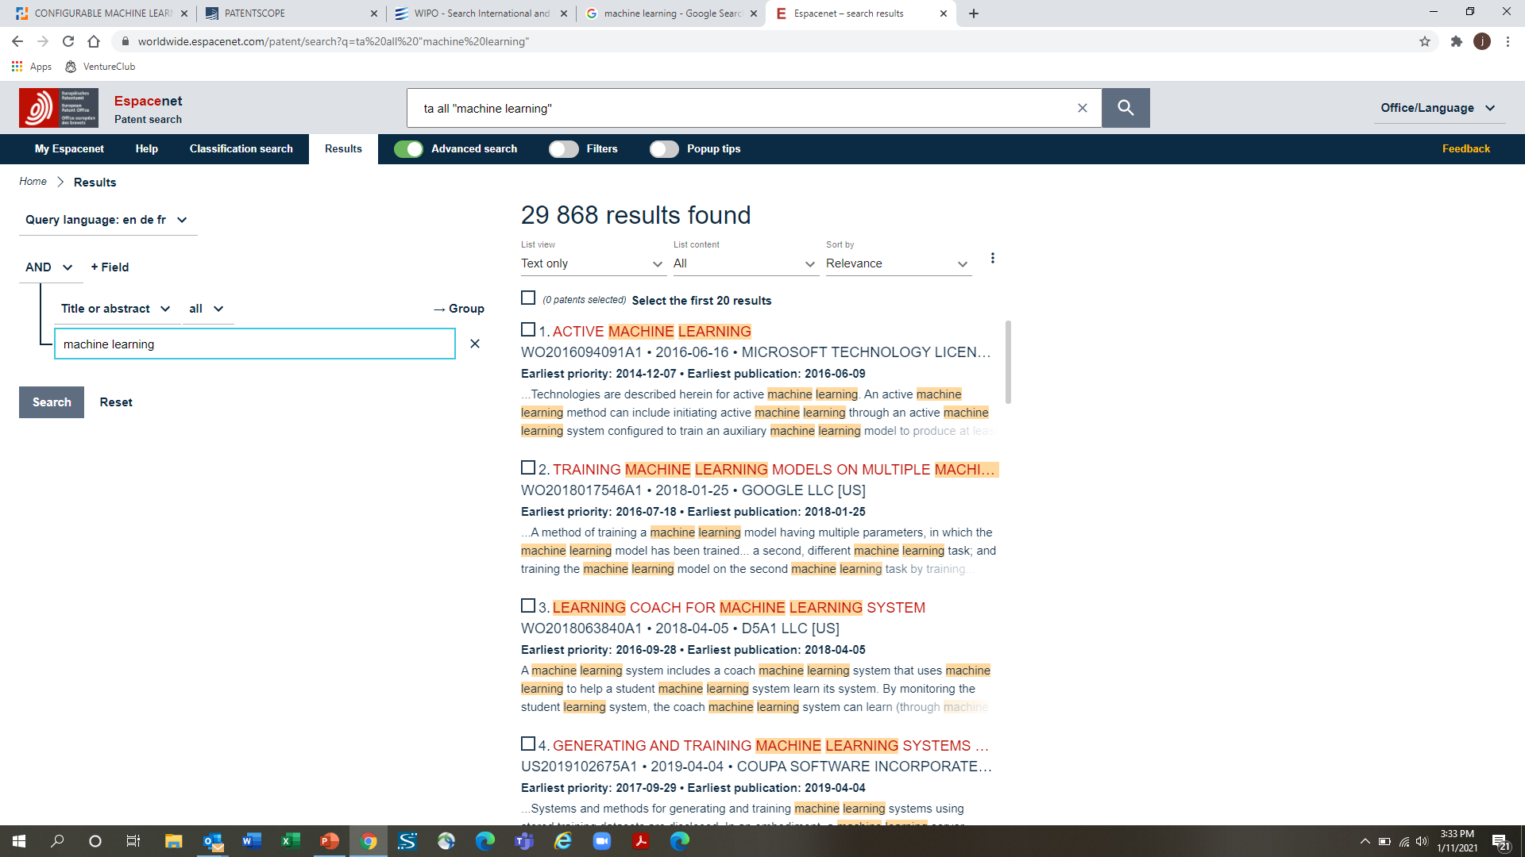

Slide 24
Industry Outreach
Expanding Networks and Building Partnerships with Industry
Notes:
Background behind the workshop.
Commercializing academic research is hard and, frankly, the track records of universities, even the top ones, are pretty poor. There are lots of reasons why and no single fix but one of the issues that we’ve seen (and one that is often overlooked by traditional ‘commercialization programs’) is that most researchers don’t start thinking about commercializing their research until after a technology has been developed or a discovery made. And so what you end up with is a solution looking for a problem – as opposed to a solution to a known problem. And if you’re lucky enough to even find the problem – chances are that the solution doesn’t align with the needs/wants of the target market, which is not surprising considering that the solution was developed in the absence of any market input. And usually it is difficult at this stage to make any changes to the solution because the research project is over and the student is finishing up or has already left, or there is no funding and even if there was the activities needed aren’t really considered ‘research’ and so the funds cannot be used or a publication will not result from the work, etc. And so the technology sits on a shelf… which is a shame
We hope that this workshop will help you see the value of thinking about commercialization (or just the real-world use of your research) earlier in the process so that the chances of your technology/research being utilized in the real-world are improved.
And an important part of this is performing a market/technology assessment early in your research project because conducting…

Slide 25

Making Contact
Who you ‘target’ will depend on the size of the company
  Start-ups & SMEs – founders/senior management team
  Multinationals – R&D managers or business development
Identify contact person via company website
  Management team
  Press releases
  Investor presentations
Expanding Networks and Building Partnerships with Industry

Slide 26
Making Contact
Getting the individual’s contact info is usually very difficult
  Use your network to get an introduction
  Try to make a connection on LinkedIn
  Use company documents or publications to figure out email format
Expanding Networks and Building Partnerships with Industry

Slide 27
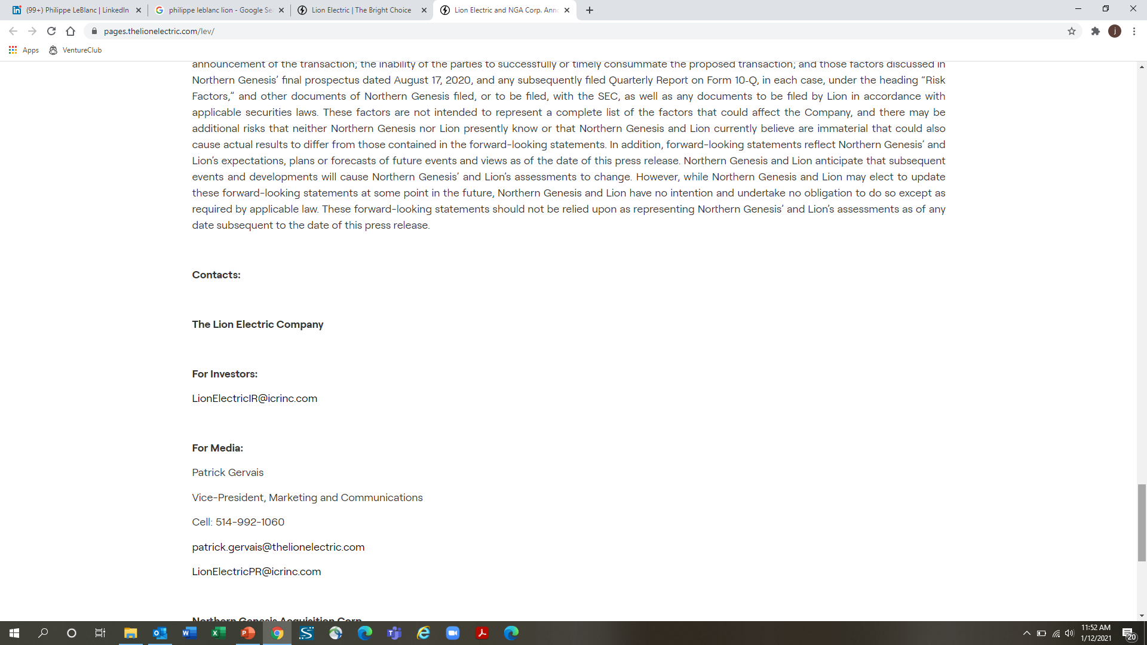

Slide 28
Cold Email
An email sent to someone that you’ve never met or have an existing connection with
It is not SPAM, it is an attempt to start a one-on-one personal conversation
There are laws regarding SPAM (unsolicited commercial email (UCE)) and so your ‘cold’ email should…
  have an appropriate header
  be personalized
  offer value
https://www.criminallyprolific.com/cold-email-example/
Expanding Networks and Building Partnerships with Industry

Slide 29
SPAM Email
jhonlongpeter@gmail.com

Slide 30
Cold Email Best Practices
Use correct email headers (i.e. where the email is coming from)
Use the recipient’s name
Make the email relevant to the recipient using customized content
Match the subject line with the body of the email
Keep it short and don’t spend too much time talking about yourself
Include a specific request (e.g. short call)
Position it as a conversation rather than a request for action
Don’t use obviously copy-pasted text
Include your contact info
https://www.criminallyprolific.com/cold-email-example/

Slide 31
Cold Email
jason.hendry@queensu.ca
New drug delivery technology
Dear Mr. <Last Name>,
I’m with the technology transfer office of Queen’s University in Kingston, Canada and I am trying to get some feedback on a new drug delivery system that has recently been developed here. I understand that <Company Name> has its own drug delivery technologies but I was wondering whether you might be so kind as to offer your expert opinion as to whether the technology described below addresses any known limitations of existing drug delivery technologies and/or could prove to be useful in certain applications. Essentially, I am trying to determine whether this technology could have value in a drug delivery application. Thanks in advance for your help, I very much appreciate it.
Kind regards,
Jason
Queen’s University has developed a novel, injectable, liquid polymer drug delivery system intended for the localized delivery of low molecular weight chemotherapeutics, cytokines, growth factors, and other drugs/biologics that are susceptible to degradation in acidic environments. Based on biocompatible poly(aliphatic carbonates), the degradation products of this drug delivery system do not result in a significant reduction of the local pH, thereby, avoiding the issues associated with aliphatic polyester-based drug delivery systems. This drug delivery system is a viscous liquid depot at body temperature (and below) but is easily injected through standard gauge needles. The degradation and release profiles can be tailored to meet specific applications and can range between a few days to several months. Further, the drug can be added through a simple mixing procedure and local tissue irritation issues associated with solid depot and microsphere drug delivery technologies are avoided.
Expanding Networks and Building Partnerships with Industry

Slide 32
Cold Email
Even with well-crafted emails the response rate is low – 30% is considered good
A follow-up email is acceptable and often gets a response, but you shouldn’t send more than one
LinkedIN ‘InMails’ have lower response rates than emails
If you get a response make the most of it because you will likely only get one opportunity – the goal is to build a relationship, get to next meeting

Slide 33
Talking to Industry
Consider your audience – avoid using technical jargon when speaking with non-technical people
The goal is to build a relationship – this takes time – asking for something (support letter, samples, funding, etc.) too early in the relationship may damage it
Clear and concise communication is the most effective
You need to demonstrate the value of your research/technology

Slide 34
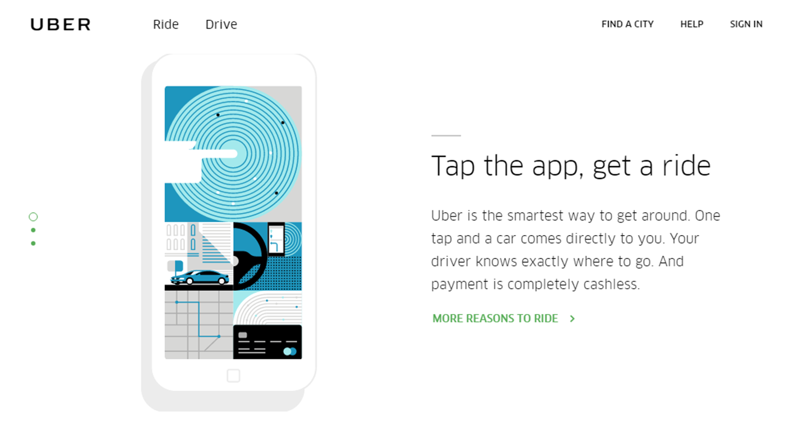
Value Proposition
Expanding Networks and Building Partnerships with Industry
Notes:
… Four short sentences and I get it. Notice that they’re not telling me how it works… Frankly, I don’t care how it works… all I care about is how it’s going to benefit me, make my life easier.
So how do we apply this to a research project that is more complex and difficult to summarize. Here’s an example of a summary that I recently received from a researcher – and to be fair, I asked for a summary not a value proposition statement.

Slide 35
Value Proposition
We have been exploring the use of sparse and distributed pressure sensing on delta-wing airframes for use in gust prediction and alleviation. Based on this work we believe that we can apply this pressure-sensing technology in the context of real-time mapping of truck aerodynamic drag where the sensor system can inform optimal driving conditions based on its immediate surroundings, e.g. wake of upstream vehicles, cross-winds, environmental conditions, etc.
Expanding Networks and Building Partnerships with Industry
Notes:
… A bit wordy. Uses scientific words that not everyone will readily understand. Kind of tells a story as opposed to telling the reader why they should care or how it is going to benefit them. So we revised it and came up with this…

Slide 36
Value Proposition
Our research on measuring the aerodynamic state of trucks in real-time will enable the development of control systems that will reduce fuel consumption and GHG emissions
Expanding Networks and Building Partnerships with Industry
Notes:
… Short and concise. To the point. Clearly identifies the value of the research project. Doesn’t say how – most audiences won’t understand anyways and don’t care.

Slide 37
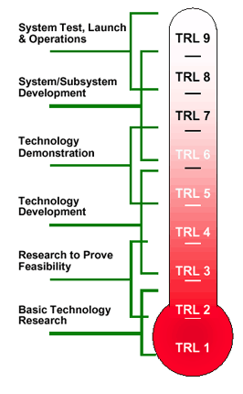
Technology Readiness Level
  Developed by NASA back in 1970’s to enable estimation of maturity of technologies during the acquisition phase of a program
  Enables easier understanding of place in development process for many types of technologies
  Utilized by many organizations
  Provides guidelines for researchers to understand place in commercialization process
Expanding Networks and Building Partnerships with Industry

Slide 38
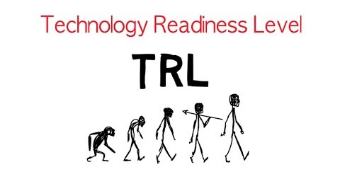

Slide 39
Working with Industry
Expanding Networks and Building Partnerships with Industry
Notes:
Background behind the workshop.
Commercializing academic research is hard and, frankly, the track records of universities, even the top ones, are pretty poor. There are lots of reasons why and no single fix but one of the issues that we’ve seen (and one that is often overlooked by traditional ‘commercialization programs’) is that most researchers don’t start thinking about commercializing their research until after a technology has been developed or a discovery made. And so what you end up with is a solution looking for a problem – as opposed to a solution to a known problem. And if you’re lucky enough to even find the problem – chances are that the solution doesn’t align with the needs/wants of the target market, which is not surprising considering that the solution was developed in the absence of any market input. And usually it is difficult at this stage to make any changes to the solution because the research project is over and the student is finishing up or has already left, or there is no funding and even if there was the activities needed aren’t really considered ‘research’ and so the funds cannot be used or a publication will not result from the work, etc. And so the technology sits on a shelf… which is a shame
We hope that this workshop will help you see the value of thinking about commercialization (or just the real-world use of your research) earlier in the process so that the chances of your technology/research being utilized in the real-world are improved.
And an important part of this is performing a market/technology assessment early in your research project because conducting…

Slide 40
Best Practices
  Familiarize yourself with the industry, company, competitors, etc. and use the same language that they use
  Position your research/technology as something that could add value and try to create a win-win scenario
  Be willing to ‘pivot’ your research if it doesn’t directly align with their interests
  Identify path forward (i.e. grant) and gaps that need to be addressed

Slide 41
Best Practices cont’d
  Only disclose what you need to, especially early in the relationship. Don’t be afraid to say ‘I can’t tell you’
  Use non-disclosure agreements (NDA) and/or material transfer agreements (MTA) to govern early discussions. Use research agreement to govern collaborations.
  Discuss how IP, publications, etc. will be handled early on
  Ensure expectations are clear/aligned before beginning any collaboration

Slide 42
Managing your IP
  Your research may generate IP that could be protected and commercialized
  Disclosing the IP publicly (i.e. paper, poster, oral presentation, discussion with collaborators/partners, etc.) could decrease its value by limiting the scope of protection – North America & Japan only
  This can be managed by limiting what you disclose (i.e. keep the secret sauce a secret) and/or using non-disclosure agreements (NDAs)
Expanding Networks and Building Partnerships with Industry

Slide 43
NDAs
  Some companies don’t like to use NDAs because of “IP contamination” concerns, particularly if they’re working in a similar field
  It is best practice to only disclose what is necessary – in many cases you can discuss what your technology can do without describing the technology itself
  Ensure that the scope of what is considered confidential information is not too broad and that the term of the confidentiality obligation is not too onerous
Expanding Networks and Building Partnerships with Industry

Slide 44
NDAs
  If receiving confidential information from a company care must be taken to ensure it isn’t disseminated amongst your lab/colleagues or in publications/presentations without the prior approval of the company
  This also applies to proprietary materials received from a company – do not use left over material in another research project or provide to another lab without first getting approval from the company
  Recommended that you contact Queen’s Partnerships and Innovation when interacting with industry
Expanding Networks and Building Partnerships with Industry

Slide 45
MTA – Material Transfer Agreements
  Legal contract between research institutions and companies setting terms under which their materials and associated data may be obtained and used by others
  MTAs protect interests of the owners of discoveries and inventions while promoting data and material sharing in the research community.
  Typically used for biological materials such as reagents, cell lines, plasmids, and vectors but also for other types of materials, such as chemical compounds, mouse models, and even some types of software

Slide 46
Funding Programs
Expanding Networks and Building Partnerships with Industry
Notes:
Background behind the workshop.
Commercializing academic research is hard and, frankly, the track records of universities, even the top ones, are pretty poor. There are lots of reasons why and no single fix but one of the issues that we’ve seen (and one that is often overlooked by traditional ‘commercialization programs’) is that most researchers don’t start thinking about commercializing their research until after a technology has been developed or a discovery made. And so what you end up with is a solution looking for a problem – as opposed to a solution to a known problem. And if you’re lucky enough to even find the problem – chances are that the solution doesn’t align with the needs/wants of the target market, which is not surprising considering that the solution was developed in the absence of any market input. And usually it is difficult at this stage to make any changes to the solution because the research project is over and the student is finishing up or has already left, or there is no funding and even if there was the activities needed aren’t really considered ‘research’ and so the funds cannot be used or a publication will not result from the work, etc. And so the technology sits on a shelf… which is a shame
We hope that this workshop will help you see the value of thinking about commercialization (or just the real-world use of your research) earlier in the process so that the chances of your technology/research being utilized in the real-world are improved.
And an important part of this is performing a market/technology assessment early in your research project because conducting…

Slide 47
Sources of Funding for Research
Tri-Agencies/Councils:
  The Canadian Institutes of Health Research (CIHR) – https://cihr-irsc.gc.ca/e/193.html
  The Natural Sciences and Engineering Research Council (NSERC) – https://www.nserc-crsng.gc.ca/index_eng.asp
  The Social Sciences and Humanities Research Council (SSHRC) – https://www.sshrc-crsh.gc.ca/home-accueil-eng.aspx
Ontario Centre of Innovation (OCI; formerly OCE) – https://www.oc-innovation.ca/
Ontario Brain Institute (OBI) – https://braininstitute.ca/
Canada Foundation for Innovation (CFI) – https://www.innovation.ca/
Provincial and Federal Departments (MTO, DFO, DND, ECCC, etc.)
Mitacs – https://www.mitacs.ca/en
Foundations (Heart and Stroke, Diabetes, etc.)
Industry Sponsors
National Institutes of Health (NIH) (US) – https://www.nih.gov/

Slide 48
Sources of Funding for Research
Innovation, Science, Economic Development Canada (ISED) – http://www.ic.gc.ca/eic/site/icgc.nsf/eng/home
  The National Research Council (NRC) – https://nrc.canada.ca/en
  The National Research Council of Canada Industrial Research Assistance Program (NRC IRAP) – https://nrc.canada.ca/en/support-technology-innovation
  Canadian Space Agency (CSA) – https://www.asc-csa.gc.ca/eng/default.asp
  Genome Canada – https://www.genomecanada.ca/en/
  Sustainable Development Technology Canada (SDTC) – https://www.sdtc.ca/en/
    Innovative Solutions Canada – https://www.ic.gc.ca/eic/site/101.nsf/eng/00001.html
      fund R&D and test prototypes in real-life settings
      two streams with funding dedicated to Canadian innovators who want to start, grow and get to market
  Accessible Technology Program – https://www.ic.gc.ca/eic/site/118.nsf/eng/home
  co-funds innovative projects led by research institutes, private sector companies and not-for-profit organizations to develop innovative assistive and adaptive digital devices and technologies for persons with disabilities
Expanding Networks and Building Partnerships with Industry
Notes:
Seventeen federal departments and agencies make up the Innovation, Science and Economic Development Portfolio. Together, these organizations are uniquely positioned to further the government's goal of building a knowledge-based economy in all regions of Canada and to advance the government's jobs and growth agenda.
Innovation, Science and Economic Development Canada works in partnership with the members of the Innovation, Science and Economic Development Portfolio to leverage resources and exploit synergies in a number of specific areas:
innovation through science and technology—helping firms and not-for-profit institutions more rapidly turn ideas into new products and services
trade and investment—encouraging more firms in more sectors to export to more markets, and helping Canadian firms attract a larger share of foreign direct investment
growth of small and medium-sized enterprises—providing access to capital, information and services
economic growth of Canadian communities—fostering new approaches to community economic development, based on community strengths and information infrastructures
The Innovation, Science and Economic Development Portfolio includes:
Atlantic Canada Opportunities Agency (ACOA)
Business Development Bank of Canada (BDC)
Canada Economic Development for Quebec Regions (CED)
Canadian Northern Economic Development Agency (CanNor)
Canadian Space Agency (CSA)
Competition Tribunal (CT)
Copyright Board Canada (CB)
Destination Canada (DC) (formerly known as the Canadian Tourism Commission)
Federal Economic Development Agency for Southern Ontario (FedDev Ontario)
Federal Economic Development Initiative for Northern Ontario (FedNor)
Innovation, Science and Economic Development Canada (ISED)
National Research Council Canada (NRC)
Natural Sciences and Engineering Research Council Canada (NSERC)
Social Sciences and Humanities Research Council of Canada (SSHRC)
Standards Council of Canada (SCC)
Statistics Canada (StatCan)
Western Economic Diversification Canada (WD)
The following organizations are also associated with the Innovation, Science and Economic Development Portfolio:
Genome Canada
Canada Foundation for Innovation (CFI)
Council of Canadian Academies
Pierre Elliott Trudeau Foundation
Sustainable Development Technology Canada (SDTC)

Slide 49
Sources of Funding for Research
Invest In Canada – https://www.investcanada.ca/
  Innovation Superclusters Initiative – https://www.ic.gc.ca/eic/site/093.nsf/eng/home
      Next Generation Manufacturing Canada Supercluster (NGen) – https://www.ngen.ca/
      Scale AI Supercluster – https://www.scaleai.ca/
      Canada’s Ocean Supercluster (OSC) – https://oceansupercluster.ca/
      Canada’s Digital Technology Supercluster – https://www.digitalsupercluster.ca/
      Protein Industries Canada Supercluster – https://www.proteinindustriescanada.ca/
  Strategic Innovation Fund (SIF) – https://www.investcanada.ca/programs-incentives/strategic-innovation-fund?gclid=EAIaIQobChMIk_vL3PSg7gIVwtXACh1B-AAHEAAYASAAEgL44PD_BwE
      Various industry consortia
    National Defence
      Innovation for Defence Excellence and Security (IDEaS) – https://www.canada.ca/en/department-national-defence/programs/defence-ideas.html
Expanding Networks and Building Partnerships with Industry

Slide 50
Sources of Funding for Research
Other Industry Consortia
  The Canadian Urban Transit Research & Innovation Consortium (CUTRIC) – https://cutric-crituc.org/
  The Consortium for Research and Innovation in Aerospace in Quebec (CRIAQ) – https://www.criaq.aero/en/
  The Ontario Aerospace Council (OAC) – https://theoac.ca/
  The Centre for Excellence in Mining Innovation (CEMI) – https://www.cemi.ca/
  MICA National Mining Innovation Network – https://www.cemi.ca/mica-national-innovation-ecosystem/
  Clean Resource Innovation Network (CRIN) – https://cleanresourceinnovation.com/
  The Canadian Nuclear Association (CNA) – https://cna.ca/about-cna/members/
  The Autonomous Vehicle Innovation Network (AVIN) – https://www.avinhub.ca/
  The Centre of Excellence in Next Generation Networks (CENGN) – https://www.avinhub.ca/
  ENCQOR 5G – https://www.encqor.ca/
  Life Science Network – https://www.lifescience.net/#
  adMare Bioinnovations - https://www.admarebio.com/
  CQDM (a biopharmaceutical research consortium) – https://cqdm.org/en/mission-et-vision/
Expanding Networks and Building Partnerships with Industry

Slide 51
Sources of Funding for Research
Other Industry Consortia (Queen’s not currently involved)
  Canadian Food Innovators – https://canadianfoodinnovators.ca/
  Satellite Canada Innovation Network (SatCan) – https://www.satellitecanada.org/
  The Optical SatCom Consortium (OSC) – https://www.opticalsatcom.com/
  etc. etc.
Expanding Networks and Building Partnerships with Industry

Slide 52
How to Stay Informed with QPI
QPI Website: https://www.queensu.ca/partnershipsandinnovation/
QPI News: https://www.queensu.ca/partnershipsandinnovation/news
QPI Workshops and Events: https://www.queensu.ca/partnershipsandinnovation/workshops-and-events
QPI YouTube Channel: https://www.youtube.com/channel/UCKGqfyz8KQNLyKMTtE5HjCA (Recorded Workshops)
QPI Social Media Accounts:
https://twitter.com/QueensInnovates
https://www.facebook.com/QueensInnovates/
https://www.instagram.com/queensinnovates/
https://www.linkedin.com/company/queensinnovates/
https://twitter.com/WeCanQueensU
https://www.facebook.com/WECANQueensU/
https://www.instagram.com/wecanqueensu/
https://www.linkedin.com/company/we-can-project-at-queen-s-university/
Weekly WE-CAN Digest
Bi-weekly SciTech Digest

Slide 53
Questions?
Expanding Networks and Building Partnerships with Industry
Notes:
Background behind the workshop.
Commercializing academic research is hard and, frankly, the track records of universities, even the top ones, are pretty poor. There are lots of reasons why and no single fix but one of the issues that we’ve seen (and one that is often overlooked by traditional ‘commercialization programs’) is that most researchers don’t start thinking about commercializing their research until after a technology has been developed or a discovery made. And so what you end up with is a solution looking for a problem – as opposed to a solution to a known problem. And if you’re lucky enough to even find the problem – chances are that the solution doesn’t align with the needs/wants of the target market, which is not surprising considering that the solution was developed in the absence of any market input. And usually it is difficult at this stage to make any changes to the solution because the research project is over and the student is finishing up or has already left, or there is no funding and even if there was the activities needed aren’t really considered ‘research’ and so the funds cannot be used or a publication will not result from the work, etc. And so the technology sits on a shelf… which is a shame
We hope that this workshop will help you see the value of thinking about commercialization (or just the real-world use of your research) earlier in the process so that the chances of your technology/research being utilized in the real-world are improved.
And an important part of this is performing a market/technology assessment early in your research project because conducting…

