Slide 1
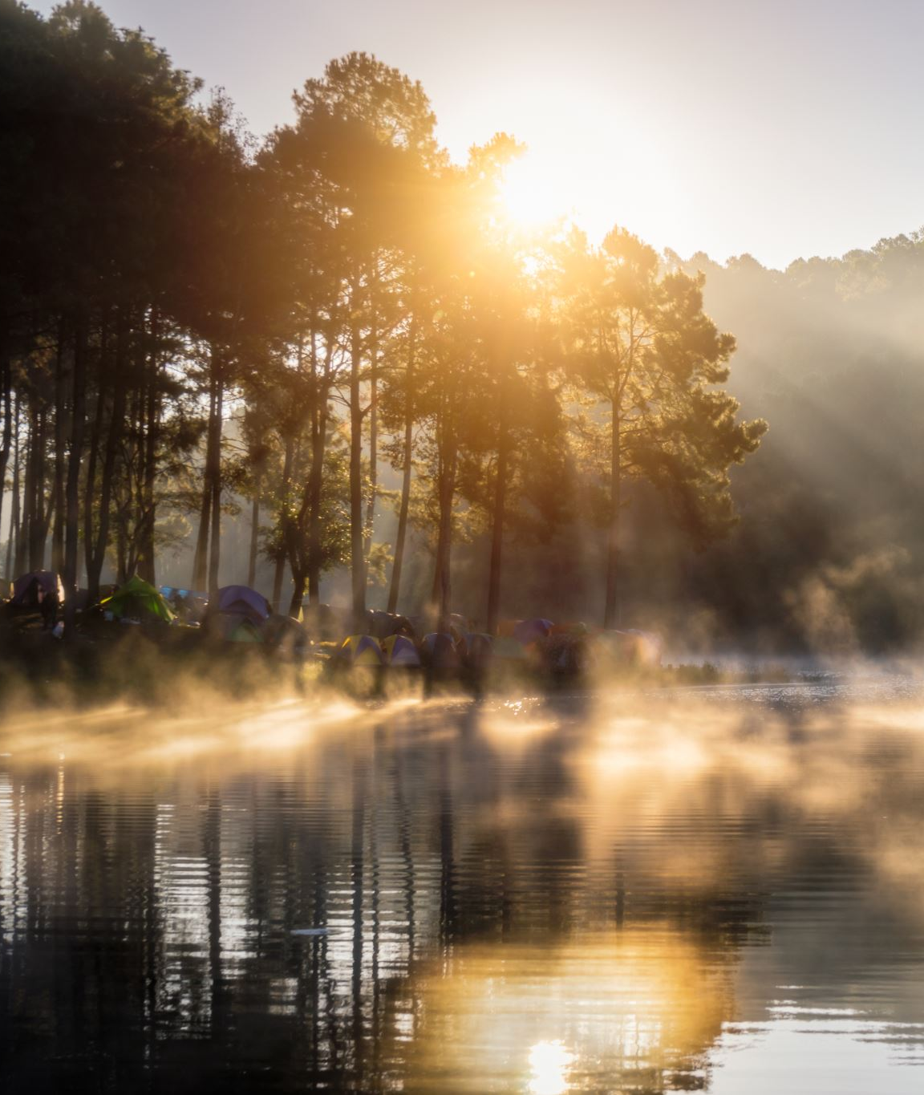
Decolonizing STEM Instruction Through Land-Based Teaching and Research
Alice Johnston
-July 6th, 2021

Slide 2
Positioning Myself
Alice Johnston
From Ottawa. Unceded Algonquin Territory
Pronouns she/her
Settler Canadian
Experience working as a classroom teacher
Question of allyship

Slide 3
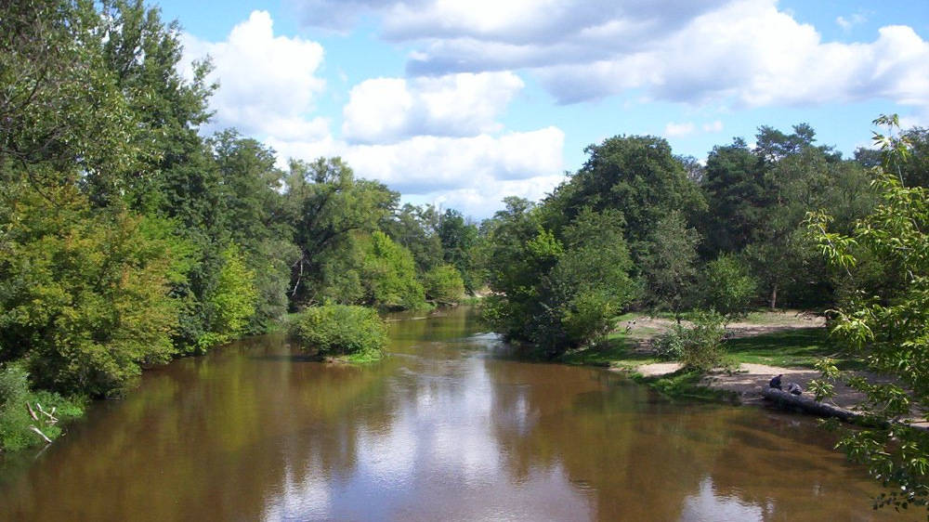
Problem
Underrepresentation of Indigenous people and perspectives in science related subjects and careers
This Photo by Unknown author is licensed under CC BY-SA.

Slide 4
Purpose
Decolonize science learning materials
-Understand the validity of multiple perspectives and ways of knowing, understanding, doing, and honoring.
-Envision new ways living and connecting to land.
This Photo by Unknown author is licensed under CC BY-SA.

Slide 5
Context
Natural Sciences and Engineering Research Council's (NSERC) PromoScience Program
Helping Teachers Integrate Traditional Indigenous Knowledge and Environmental Science in a Rapidly Changing World
This Photo by Unknown author is licensed under CC BY-SA.

Slide 6
Project Goals
Research Focus
Create and Reflect on Learning Bundles.
Create online, multimedia resources for each learning bundle.
Work with Pinegrove Productions to create video footage related to focus themes.
Hold hands-on, land-based professional development sessions with teachers.

Slide 7
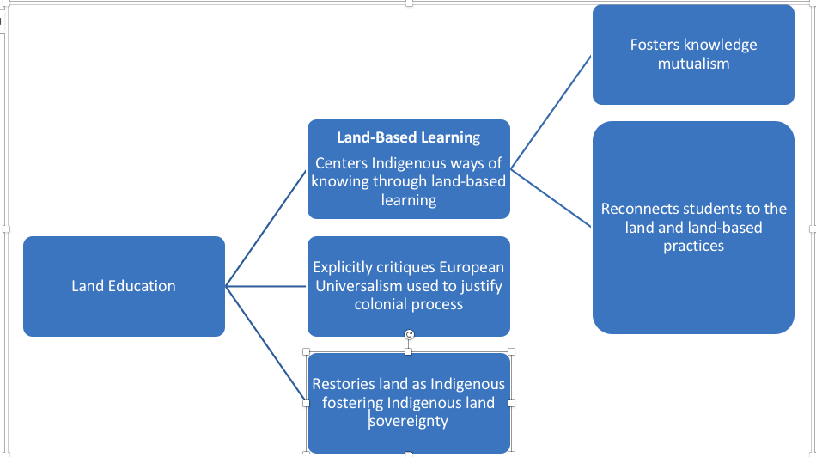
Land Education

Slide 8
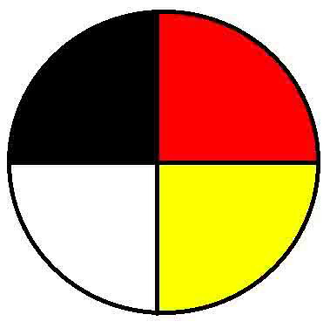
Indigenous Knowledge
Epistemological beliefs common to Indigenous groups include:
Reciprocity,
Relationality,
Harmony,
Holism
*Indigenous knowledge is place-based and not generalizable.
This Photo by Unknown author is licensed under CC BY.

Slide 9
What Does it Look Like?
Centering Indigenous land-based practices (not integration).
Folding in curricular outcomes and STEM studies after.
Food Bundle: Maple sap production; wild ricing; moose hunting; gardening; fishing.
Examination of how impacted by climate change from both an Indigenous perspective and Western scientific perspective.

Slide 10
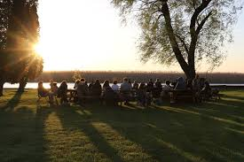
Indigenous Research Methodology
Researcher and research methods are required to maintain good relations with:
People,
The land,
The cosmos, and
Ideas.
Notes:
Ontology: The nature of existence or nature of reality. The understanding that there is one "real world" that can be observed through the senses and the notion that there are various worlds that exists depending on the point of view of the observer are examples of two competing ontological beliefs. Essentially, ontology asks the question, “what is real?” (Wilson, 2008, p. 33).
Ontology: The spiritual and physical realms are not separate. Instead, reality is created by a rich web of relationships tying everyone and everything in the physical and spiritual realms together.
Epistemology: Is the study of knowing that strives to account for how we come to have knowledge about the world. Epistemology asks, “how do I know what is real?” (Wilson, 2008, p.33).
Connected to ontology. Ie: What one understands to be real will impact how one things about that reality. The ontological assumption that relationships tie living and non-living things together on both physical and spiritual planes, for instance, impacts beliefs regarding where valid sources of knowledge come from.
Epistemology: Diverse sources of holistic community and land-based knowledge from the physical and spiritual realms are embraced.
Axiology: Refers to ethics that researchers employ to determine what knowledge is worth searching for (Wilson, 2008).
A researcher’s ontology will impact what information a researcher considers important when pursing a more complete understanding of reality.
Axiology also encompasses the ethics of how knowledge is acquired (Wilson, 2008). A researcher must consider, for instance, whether pursuit of knowledge for knowledge sake is an acceptable goal or whether knowledge should have a positive impact on the world.
Axiology asks “what part of this reality is worth finding out more about” in addition to “what is ethical to do in order to gain this knowledge, and what will this knowledge be used for?” (p. 34)
Axiology: Researchers are understood to be accountable to all their relations.
Methodology: Refers to the theory of how knowledge is gained and the strategies employed to generate new knowledge.
Methodology asks, “how do I find out more about this reality?” (Wilson, 2008, p. 34).
Methodology is also intimately intertwined with a researcher’s ontology, epistemology, and axiology. For instance, a researcher’s understanding of what constitutes reality, what part of reality is worth finding out about, and what is ethical to do to find out knowledge, will implicate how a researcher generates knowledge (Wilson, 2008).
Methodology: Researcher and research methods are required to maintain good relations with people, the land, the cosmos, and ideas.

Slide 11
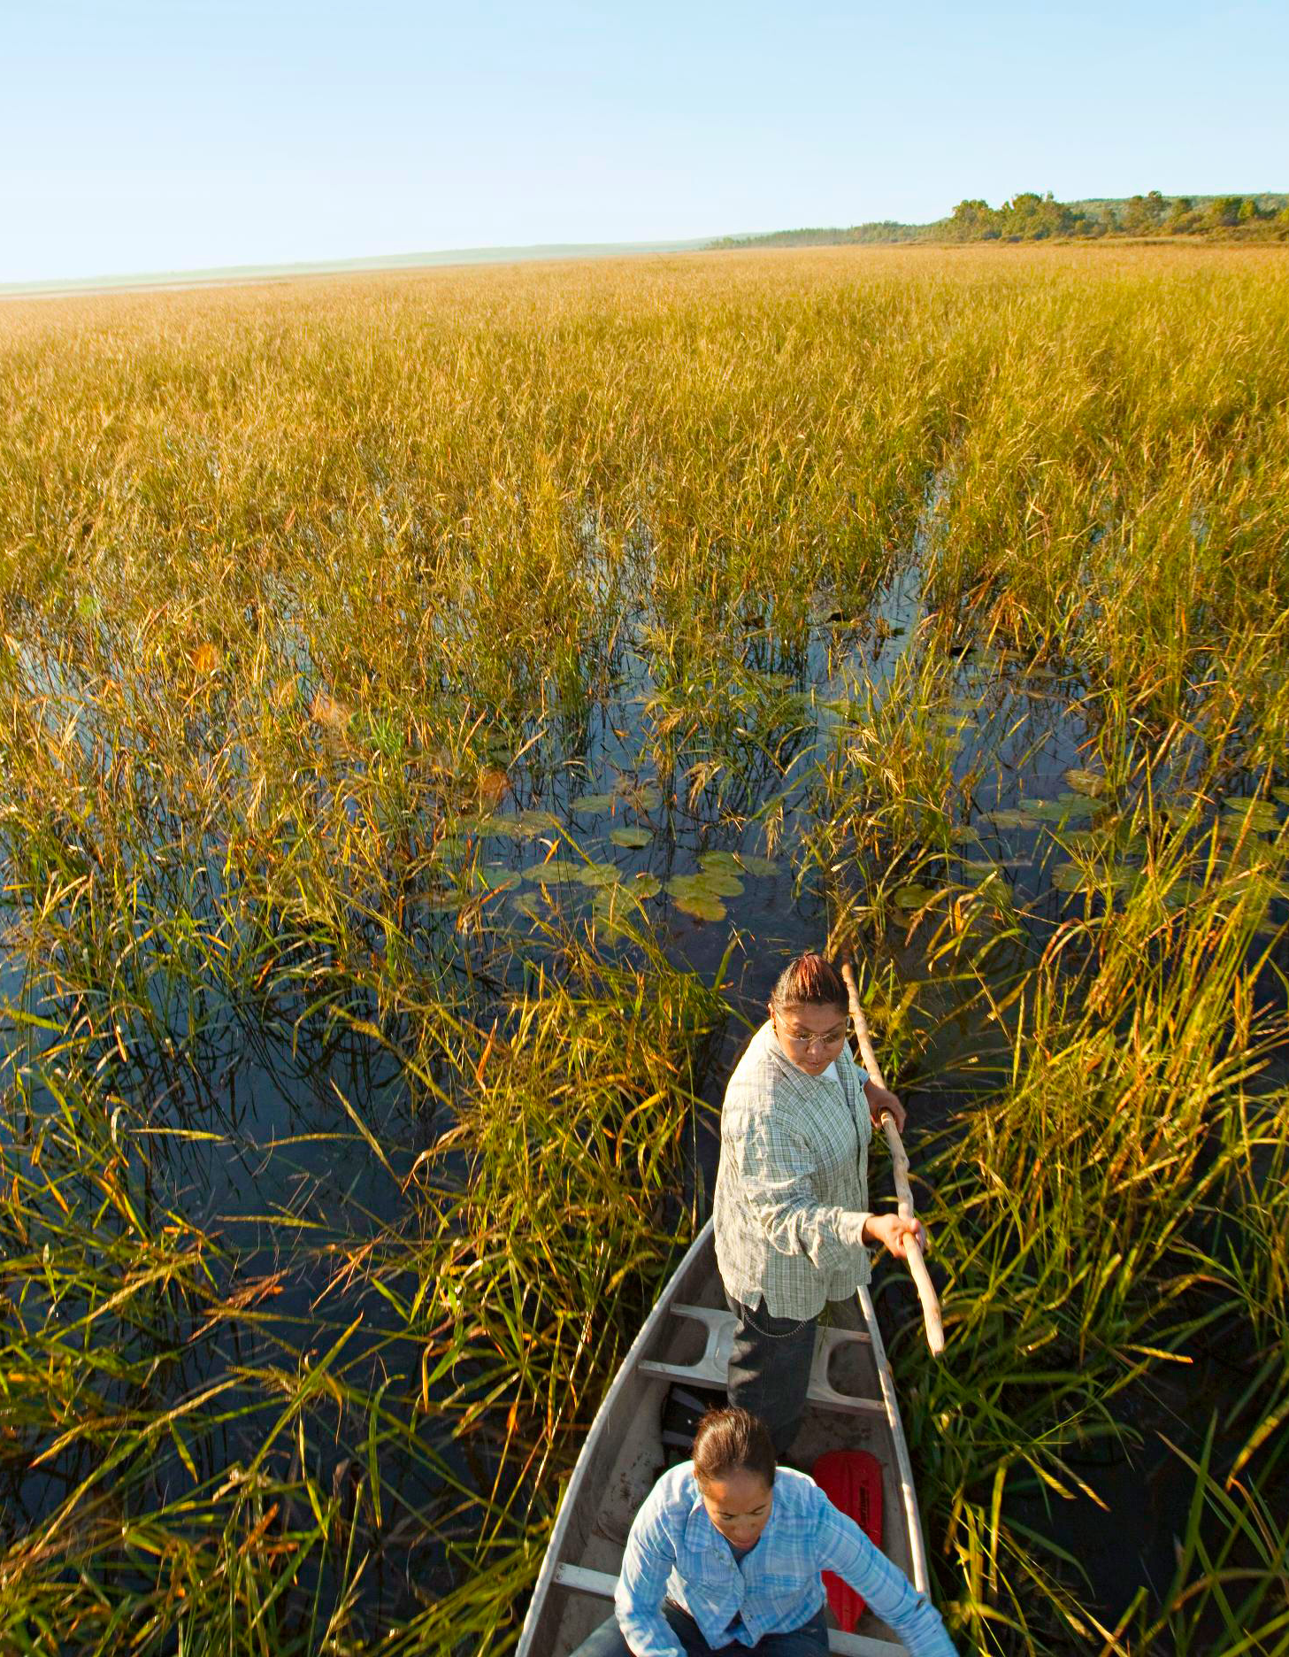
Relationality with the Land
“If we think about research, the world land should come first as the world land can tell us who we are and where we should go. Land is our identity and our culture. Without land we do not exist. Land can tell all our stories.” (Datta et al. 2014, p. 20).

Slide 12
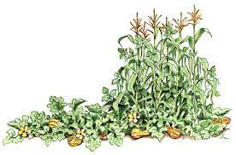
What Does The Mean in Terms of Research?
Knowledge is in the relationships and connections formed with the environment that surrounds us.
The purpose of research is to close the space between participants and the land. Ie: research as ceremony.
Relationships made between people and people and the land are equally sacred (Wilson, 2018).

Slide 13
Land-Based Methodology
Impacts choice of topic
Relationship formed with participants
Role of the researcher
Research methods employed
Data analysis and dissemination
Impact of research
Notes:
Choice of Topic: Topic chosen for me however should come from community.
Relationship formed with participants- Reciprocal and ongoing ie: community active in choosing direction of each bundle, writing each lesson, member checking etc.
Role of researcher- As facilitator not leader of the process.
Research methods employed- Those that promote relationality ie: talking circles/ symbol-based reflection.
Data analysis/dissemination and Impact of Research- Closing the space between people and the land as opposed to simply satisfying the curiosity of the researcher/institution.

Slide 14
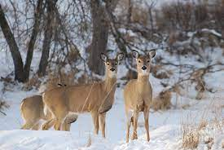
Benefits of Land-Based Research
-Step towards reclaiming and implementing Indigenous traditional practices.
-Decolonizing- Centering Indigenous ontology/epistemology and promoting Indigenous land sovereignty.
-Empowering for knowledge keepers and community members
-Inclusive: Provides space for all ages and genders. Land does not discriminate against anyone.

Slide 15
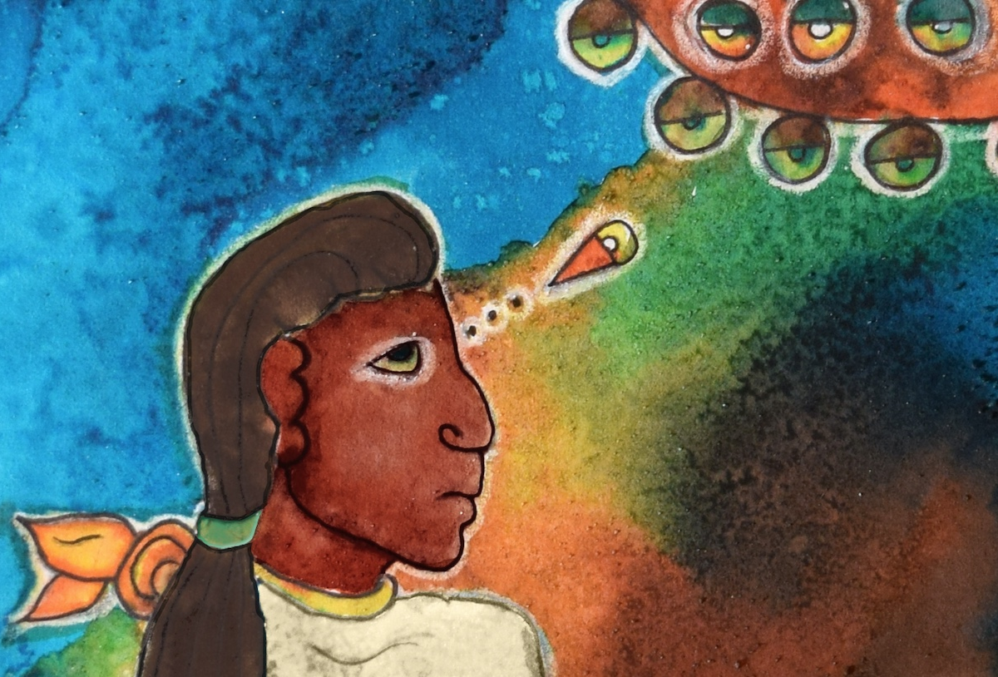
Knowledge Mutualism Framework
Knowledge Mutualism Framework:
Three Sisters Garden (Kimmerer, 2020)
Two-Eyed Seeing
“Two-eyed seeing” refers to the process of seeing the world with one eye that draws on the strengths of Indigenous knowledge and the other eye on the strengths of Western knowledge systems (Hatcher, Bartlett, Marshall, & Marshall, 2009).
Notes:
Ethical space for engagement: Meetings
-The process of doing decolonizing work is as important as the product.

Slide 16
Miigwech, Nia:wen, Thank You
Questions

